Slide 1
Metamodeling of behavior-driven development support for software development
Aaqib saeed (1651854)
Muhammad arif Wicaksana (1507850)

Slide 2
contents
Introduction
Metamodel of BDD and Simplified Programming Language
Alternatives
Examples
Conclusion

Slide 3
Introduction
Behavior driven development (BDD)
BDD is software development process which uses stories from users as the base of the development
A story is a descriptive narration explaining about the desired behavior of the software being developed for certain scenarios
Advantage: to minimize communication barrier between technical people and users through the use of natural language for gathering requirements
From user’s stories, the tools will generate relevant source code in a certain programming language
Java is preferred as the target programming language

Slide 4
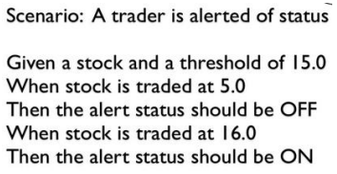
Introduction
Bdd example

Slide 5
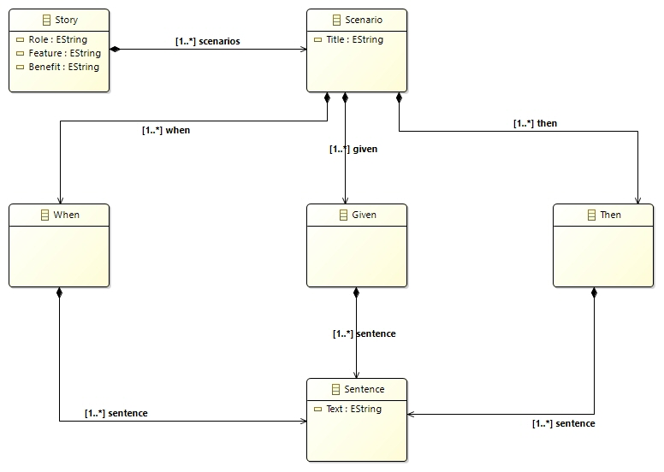
metamodel
Metamodel of bdd

Slide 6
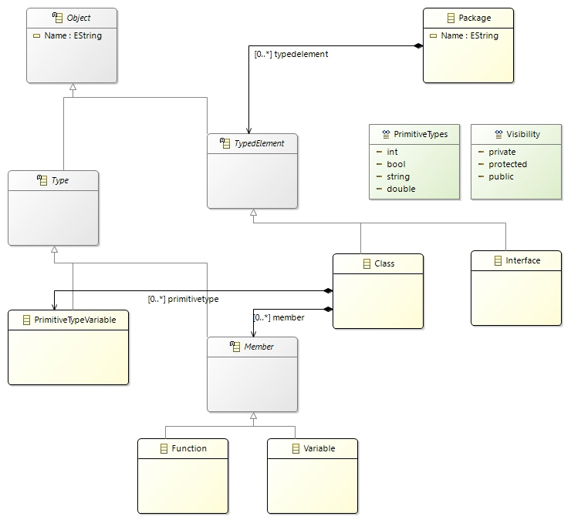
Metamodel
Metamodel of simplified programming language

Slide 7
alternatives
Alternative 1: putting sentence as an attribute of directive classes
To model the sentence as attribute of ‘When’, ‘Given’, and ‘Then’ classes
Problem:
each sentence itself contains structure, which would be easier to describe as a dedicated classes
because When, Given, and Then classes may have many sentences in it. Therefore, it is more appropriate to define sentence as a dedicated class, as our metamodel suggests
It is easier to translate the structure of the story into source code

Slide 8
alternatives
Alternative 2: defining ‘and’ operator as child class of ‘sentence’
to make operator ‘and’ as child of the sentence class
we found out later that in the generated plugin, the placement of child nodes are arranged alphabetically by Eclipse. This nature makes ‘and’ operator to not be put between sentences, hence making it difficult to parse each sentence later
Therefore, the separation of sentences in each directive through the use of operator ‘and’ is better to be implemented in application logic during translation into source code

Slide 9
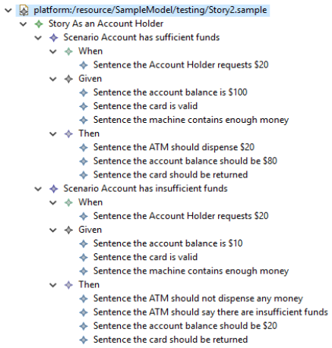
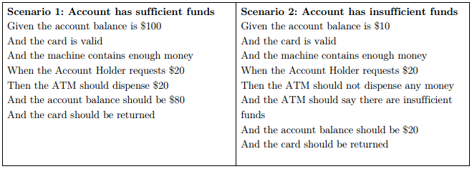
examples
Story: account holder withdraws cash

Slide 10
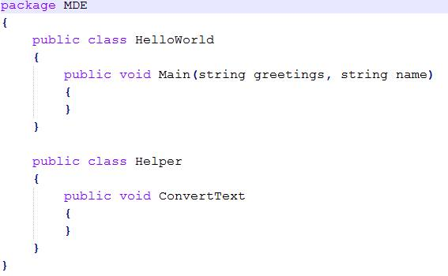
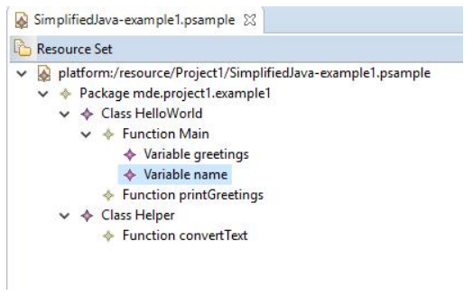
examples
Simplified programming language: simple program

Slide 11
examples
Simplified programming language: simple program

Slide 12
conclusion
From the example, it can be seen that our metamodel is sufficient at this point to represent the essence of BDD and the simplified programming language

