Slide 1
Ecore
instanceOf
instanceOf
Bdd.ecore
(source metamodel)
ATL
Java.ecore
(target metamodel)
instanceOf
uses
uses
instanceOf
BddToJava.atl
instanceOf
input
ATL
transformation
engine
Bdd.sample.xmi
(source model)
input
output
Java.sample.xmi
(target model)

Slide 2
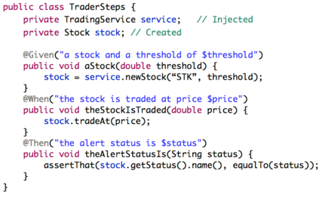
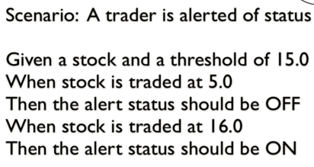
User story
Java code used by jBehave

