Slide 1
Software development: behavior-driven development support task 2: transformation
Muhammad arif Wicaksana (1507850)
Aaqib saeed (1651854)

Slide 2
introduction
Metamodeling
of BDD
and simplified Java
Transformation
from story to
simplified Java model
Source code
generation

Slide 3
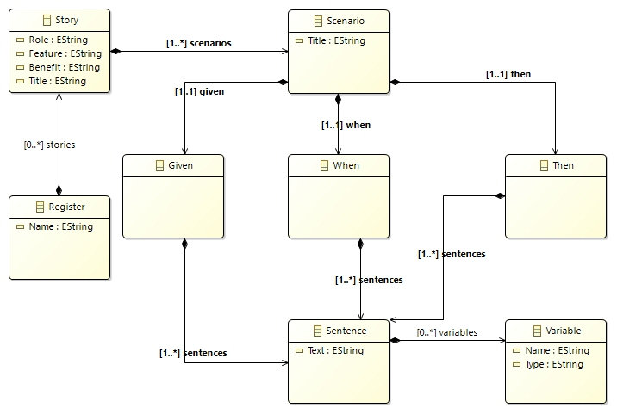
Metamodel of bdd

Slide 4
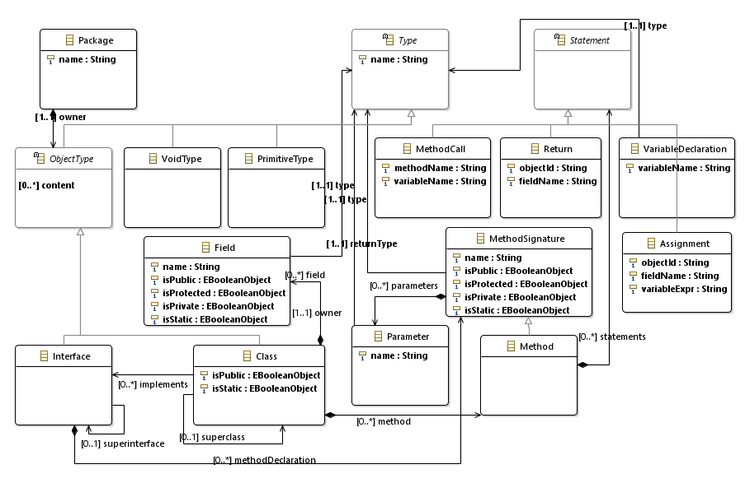
Metamodel of simplified java

Slide 5
transformation
to Java class
to Java package
to Java method
to Java parameter

Slide 6
transformation

Slide 7
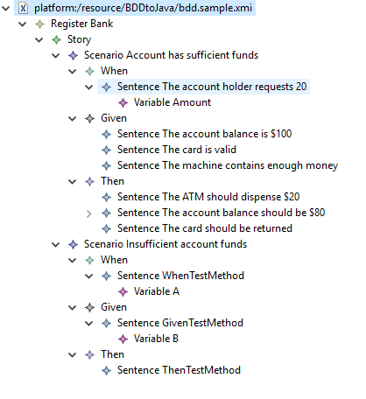
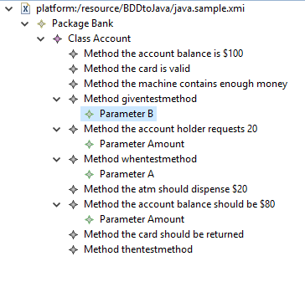
Source model
Target model
Example

Slide 8
Source model
Target model
Example

Slide 9
Conclusion
User story and its elements are successfully transformed into its respective Java model

Slide 10
Questions?

Slide 11
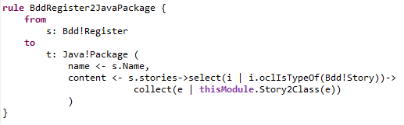
Register to package

Slide 12
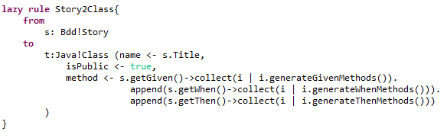
Story to class

Slide 13
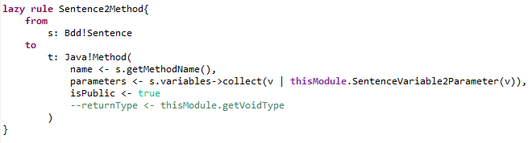
Sentence to method

Slide 14
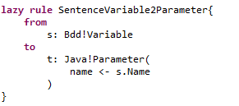
Variable to parameter

Slide 15
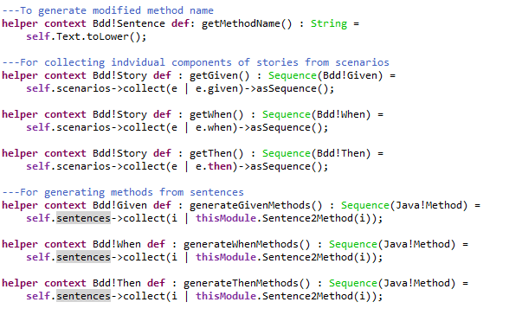
helpers

