Slide 1
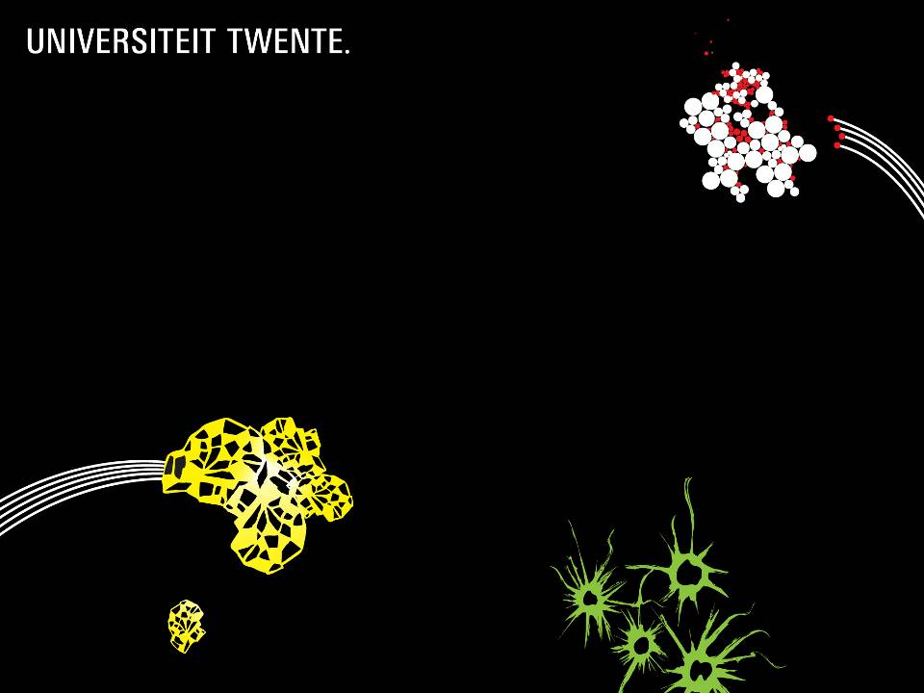
ENRICHING WOLFF CINEMA USING LINKED DATA
WITH DBPEDIA
GROUP 4
MUHAMMAD ARIF WICAKSANA, IWAN TIMMER, KHRISHNA
25-01-16

Slide 2
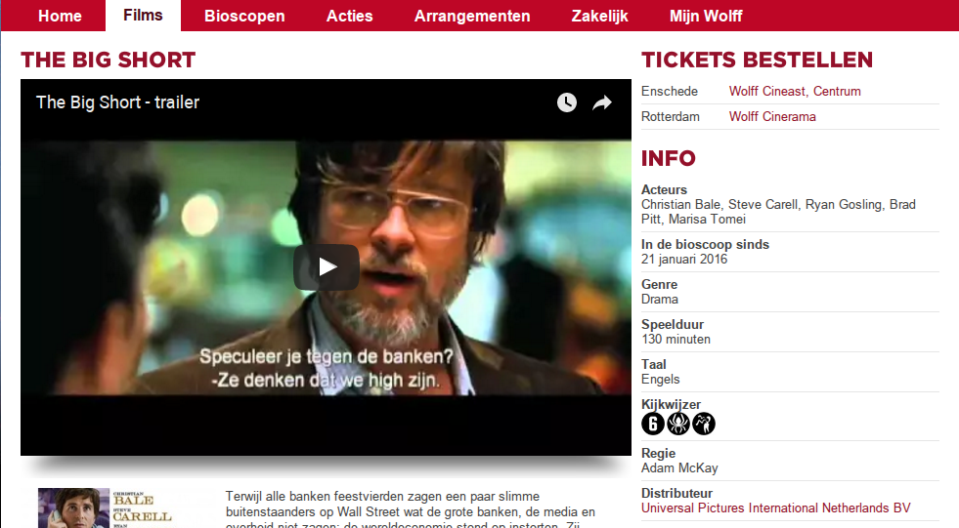
INTRODUCTION
Limited information

Slide 3

GOAL
To enrich movie data from Wolff Cinema with linked data from Dbpedia

Slide 4
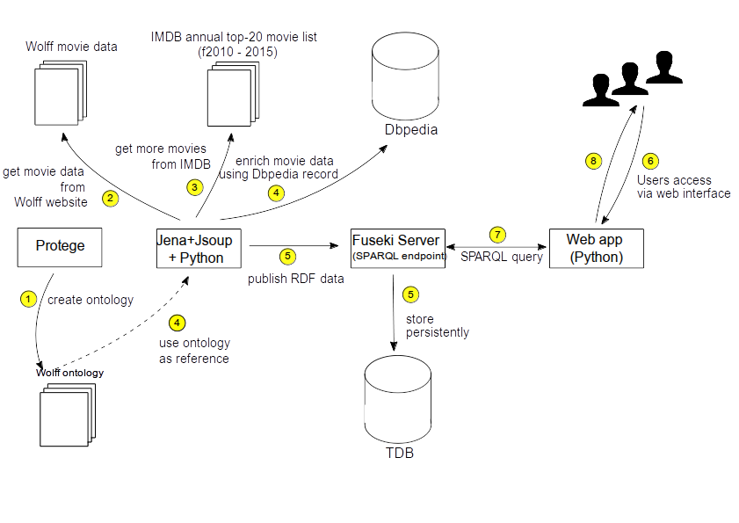
SYSTEM DESCRIPTION

Slide 5
ONTOLOGY
Describes classes and properties related to film
5 main classes (Company, Genre, Movie, Person, Presentation)
20 sub-classes in total

Slide 6
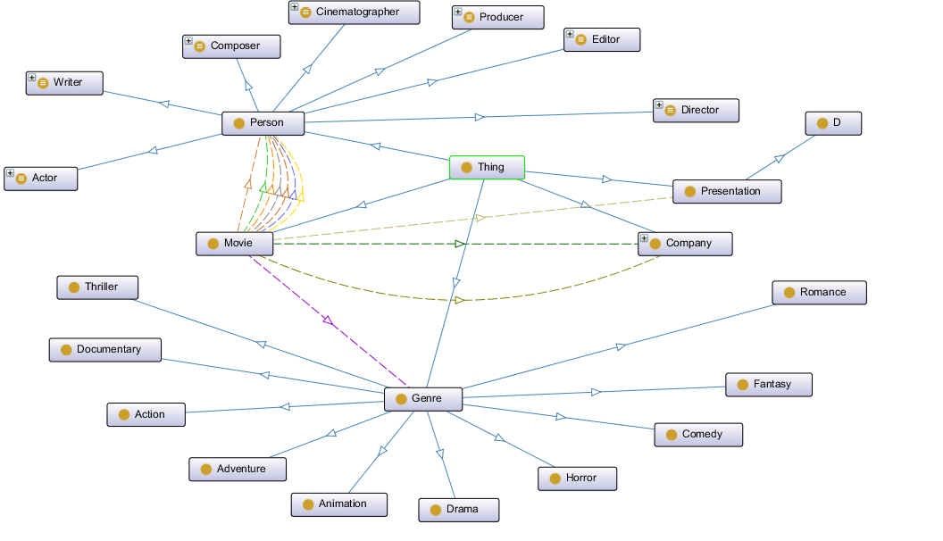
ONTOLOGY

Slide 7
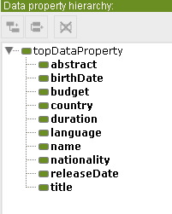
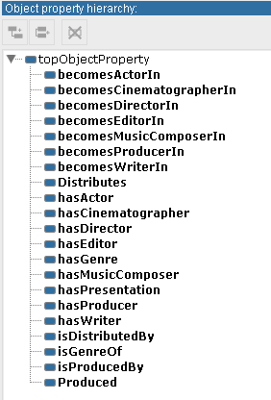
ONTOLOGY: PROPERTIES

Slide 8
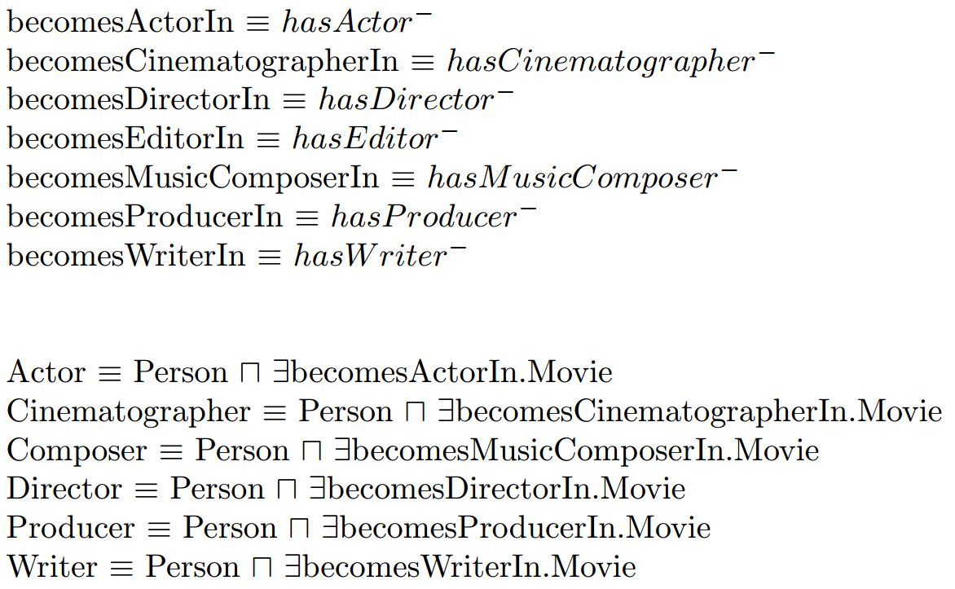
ONTOLOGY

Slide 9

ENRICHING ORIGINAL DATASET
Original data: movie title, actors, directors, release date, duration
Use only additional data from Dbpedia
  Linked movie database (linkedmdb) has outdated database
  Connection to linkedmdb server is unreliable
Additional data from Dbpedia:
  Movie-related: producers, composers, editors, budget, abstract
  Person-related: birth-date
RDF individuals are given owl:sameAs towards its corresponding Dbpedia resources, if available

Slide 10
EXAMPLE QUERIES:
People with whom the subject frequently works with
SELECT DISTINCT ?name (GROUP_CONCAT(DISTINCT ?movietitle; SEPARATOR = "; ") AS ?movielist) (COUNT(DISTINCT ?movietitle) AS ?movietotal) WHERE {
wolff-p:Quentin_Tarantino owl:sameAs ?dbplink .
SERVICE <http://dbpedia.org/sparql> {
?movie a dbo:Film .
?movie ?p ?dbplink .
?movie rdfs:label ?movietitle .
?movie ?p2 ?actor .
?actor a dbo:Person .
?actor rdfs:label ?name .
FILTER (langMatches(lang(?movietitle),"en"))
FILTER (langMatches(lang(?name),"en"))
FILTER (?actor != ?dbplink)
}
} GROUP BY ?name ORDER BY DESC(?movietotal) LIMIT 15

Slide 11
EXAMPLE QUERIES:
Oscar Winners with whom the subject frequently works with
SELECT DISTINCT ?strippedname ?strippedtitle WHERE {
wolff-p:Quentin_Tarantino owl:sameAs ?p_link .
SERVICE <http://dbpedia.org/sparql> {
?movie a dbo:Film . ?movie ?pre ?p_link . ?movie dbo:starring ?actor .
{ ?actor dct:subject <http://dbpedia.org/resource/Category:Best_Actor_Academy_Award_winners> .}
UNION { ?actor dct:subject <http://dbpedia.org/resource/Category:Best_Actress_Academy_Award_winners> . }
UNION { ?actor dct:subject <http://dbpedia.org/resource/Category:Best_Supporting_Actor_Academy_Award_winners> }
UNION { ?actor dct:subject <http://dbpedia.org/resource/Category:Best_Supporting_Actress_Academy_Award_winners> }
?actor rdfs:label ?name .
?movie rdfs:label ?title .
FILTER(?p_link != ?actor) FILTER (langMatches(lang(?name),"en"))
FILTER (langMatches(lang(?title),"en"))
BIND(str(?name) AS ?strippedname) BIND(str(?title) AS ?strippedtitle)
}
}

Slide 12
EXAMPLE QUERIES:
<tba>
Fsfsfddsfdsf
sdfsdf

Slide 13

REMARKS
Linked data allows us to reuse information provided by others automatically
Self-developed ontology vs reuse existing ontology
  Dbpedia per country (nl, de, etc) have their own ontologies to describe the same object
Linkedmdb problems: outdated datasets, server reliability, more often does not provide more complete information than Dbpedia
Despite its status as the largest linked datasets, Dbpedia does not provide complete information for movies. But at least, it is the most up-to-date

