Slide 1
Introduction to Flink with its Practices
Speaker: Chun-Yu Wang wicanr2@gmail.com

Slide 2
Stuff Download
Week1 Slide
https://goo.gl/EGWo99
Week 1 Example Code
https://goo.gl/as4g2m
Week2 Slide
https://goo.gl/42tiAt
Week2 Example Code
https://goo.gl/0v66Mc

Slide 3
Outline
Hadoop
HDFS
YARN
Flink
Lambda Architecture
Flink Practice
設定執行環境, 執行範例
Flink 範例教學, 實際編譯程式執行

Slide 4
Hadoop and its sub-systems

Slide 5
Introduction to Hadoop
Data grows day-by-day, its volume had outgrown, and is impossible to store and process in a single host.
Big Data 5V
Volume、Velocity、Variety、Veracity、Value
Hadoop
Distributed System
Distributed Filesystem
Date Processing-MapReduce
Master-slaves architecture

Slide 6
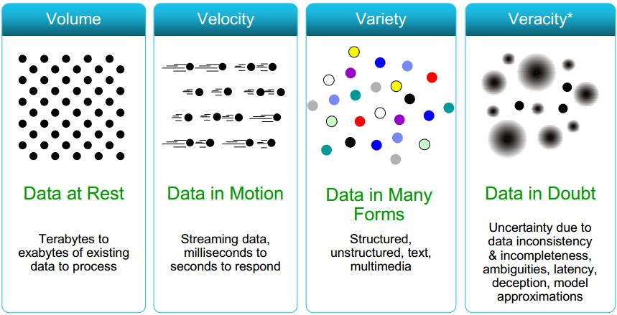

Big Data 5V Concept
Value

Slide 7
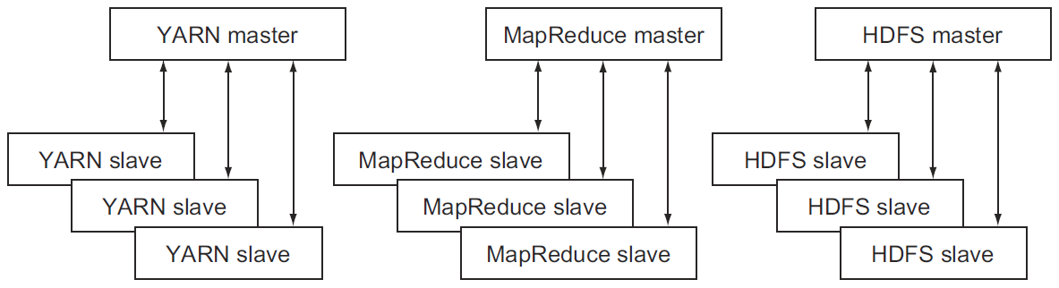
Introduction to Hadoop
Hadoop
Fix Nutch Scalability issue
Idea come from Google’s Paper MapReduce
MapReduce: Simplified Data Processing on Large Clusters 2004
Master-Slaves Architecture

Slide 8
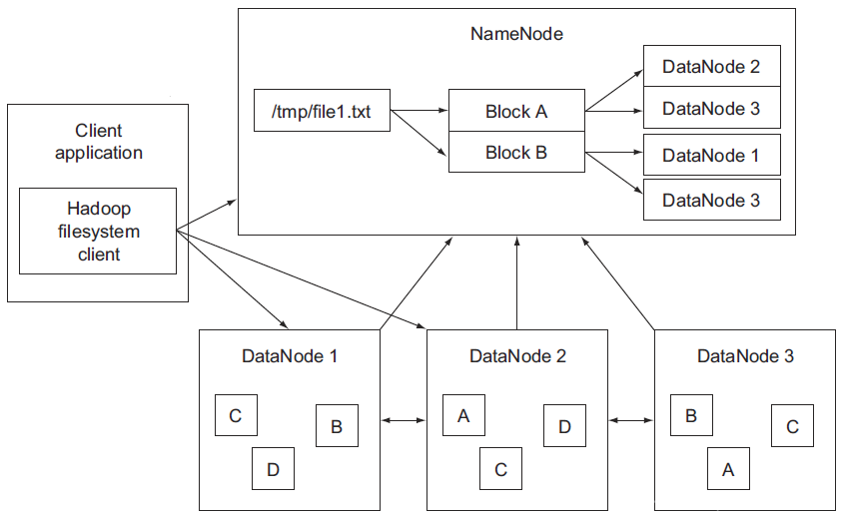
HDFS – Hadoop Distributed File System
HDFS
Storage Component in Hadoop
Come from Google File System (GFS)
Data replication
Fault Toleraance
NameNode ( Metadata )
DataNode ( Block/ Split )

Slide 9
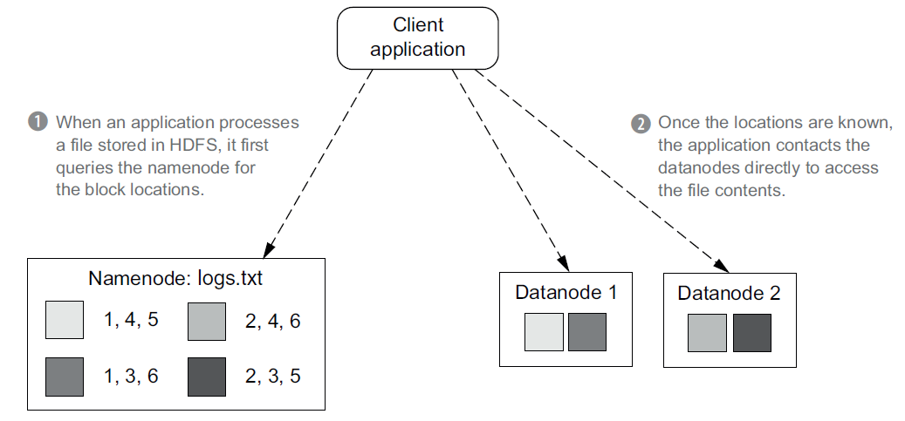
HDFS Client communication

Slide 10
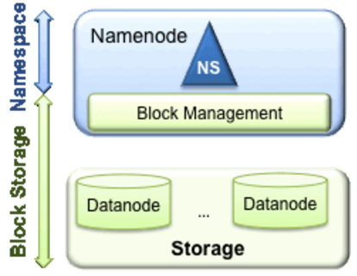
HDFS – Hadoop Distributed File System
HDFS
NameNode
Namespace and Block Management
Location of the directories, files and blocks
DataNode registration and heart-beats (ping-pong)
Replication
DataNode (Block Storage)
Store block on local file system
Read-write block

Slide 11
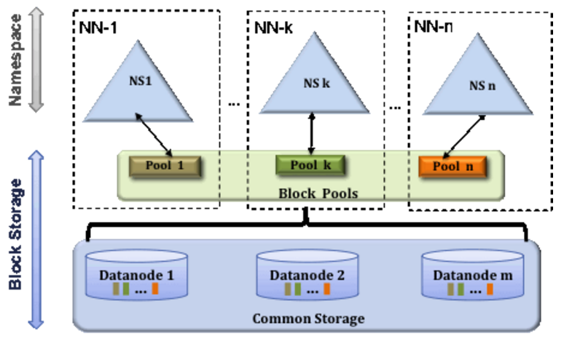
HDFS - Federation
Datanodes are shared among multiple Namenodes

Slide 12
HDFS- High Availability
Standby Namenode can take over work from a Failed Namenode automatically.

Slide 13
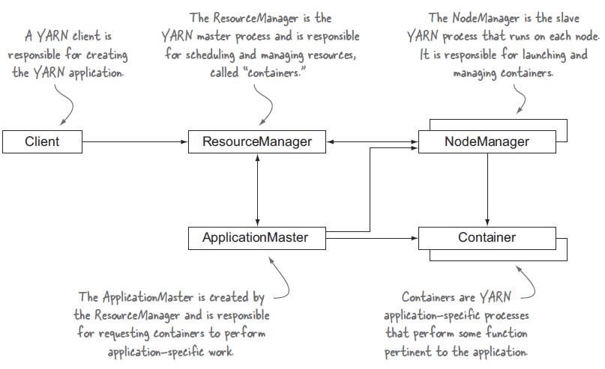
Hadoop - YARN

Slide 14
Hadoop - YARN
Conquer the challenge in Hadoop 1
Nonlinear scalability improvement in more than 4000 nodes.
Only support Hadoop MapReduce
YARN
A generic application scheduler
Separate Hadoop 1 into Computation Layer (MapReduce, Spark, Storm ..) and Storage Layer ( HDFS )

Slide 15
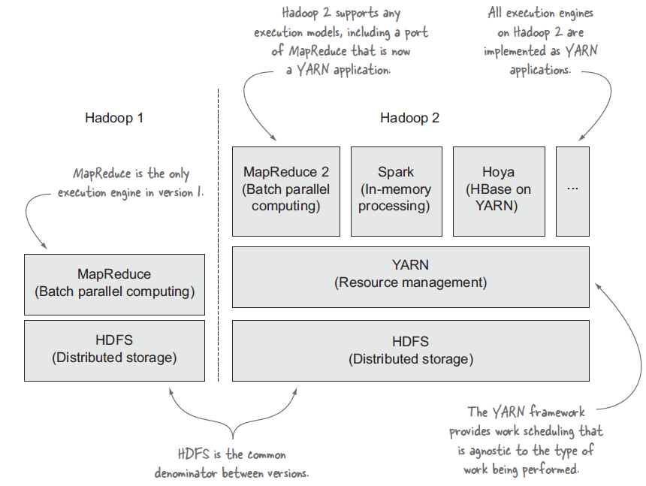
Hadoop 1 vs Hadoop 2

Slide 16
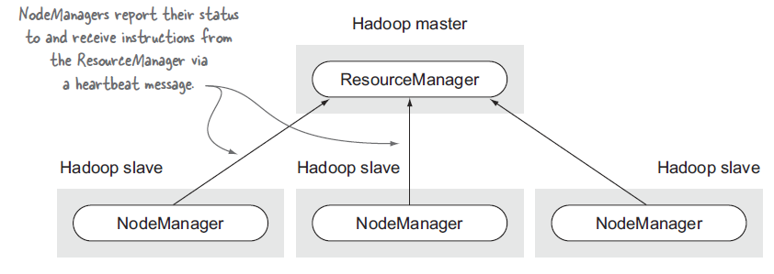
YARN Framework
ResourceManager
the YARN master process
Application scheduler and Resource allocation
Pluggable Schedular
NodeManager
Container Maintaince
Application Master ( JobManager )
Worker ( TaskManager )

Slide 17
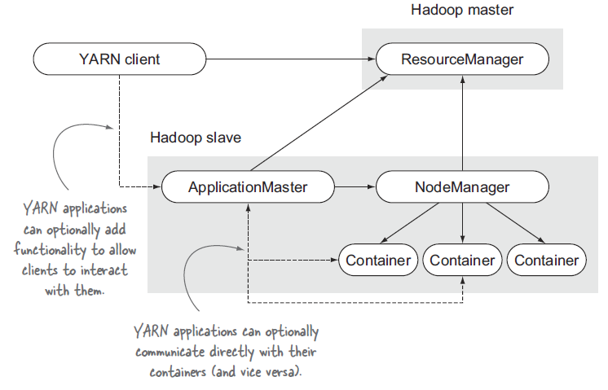
YARN – Application interactive

Slide 18
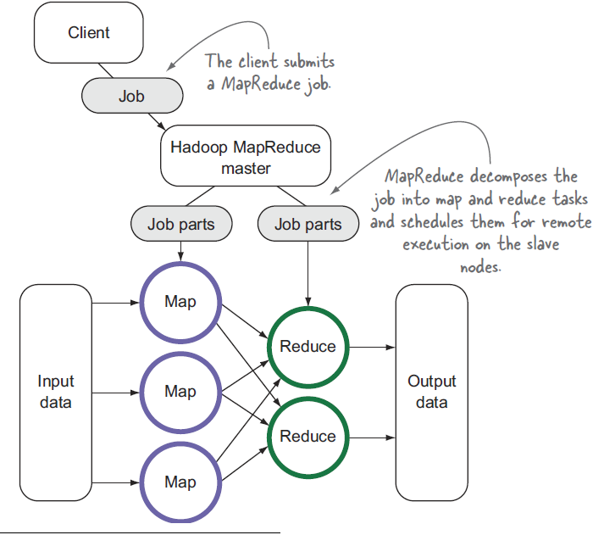
Hadoop MapReduce

Slide 19
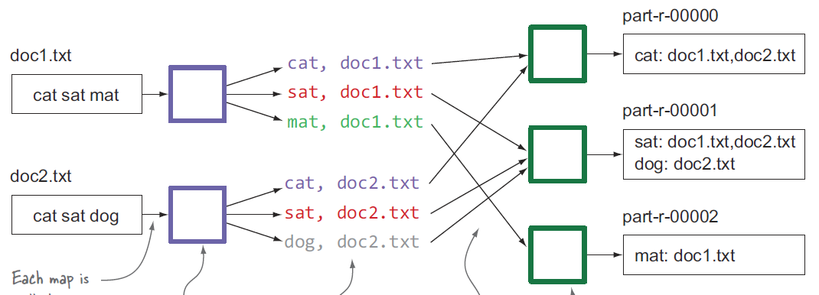
Hadoop MapReduce Inverted Index

Slide 20
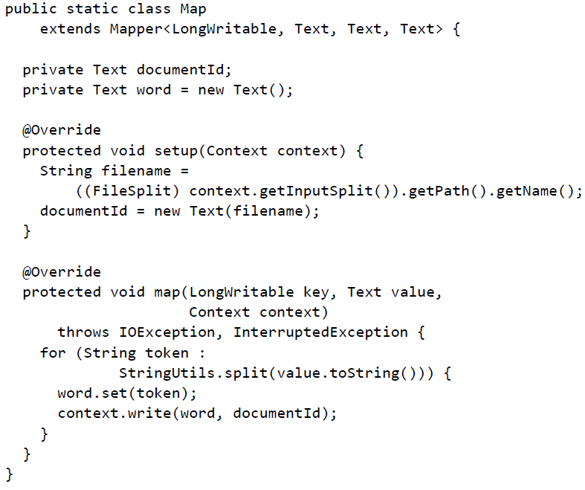
Inverted Index Map Part

Slide 21
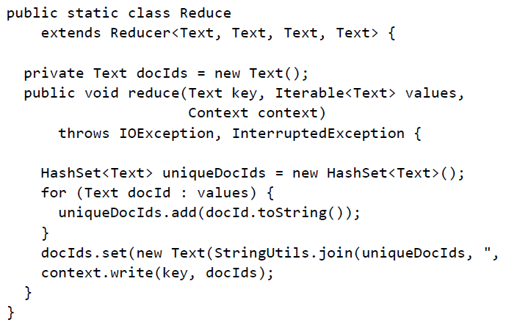
Inverted Reduce Part

Slide 22
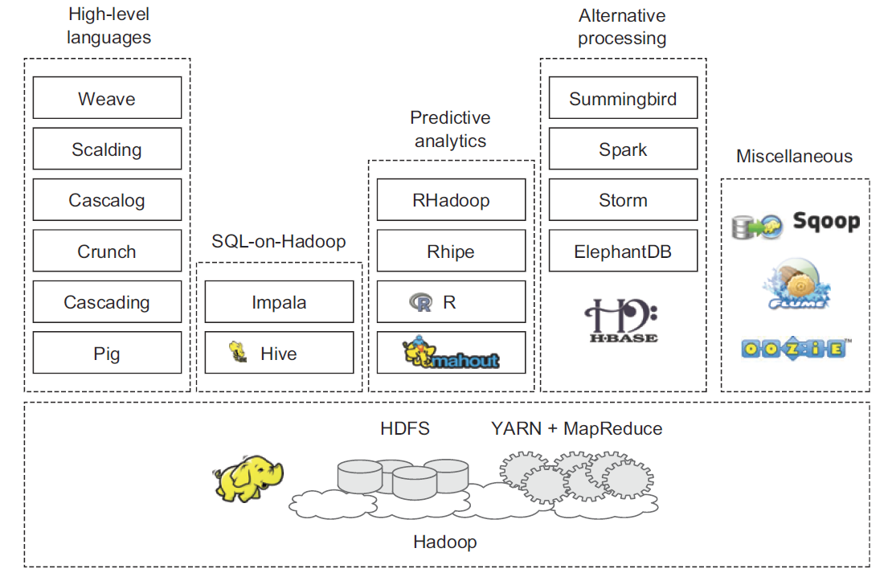
Hadoop Ecosystem

Slide 23
Apache Flink

Slide 24
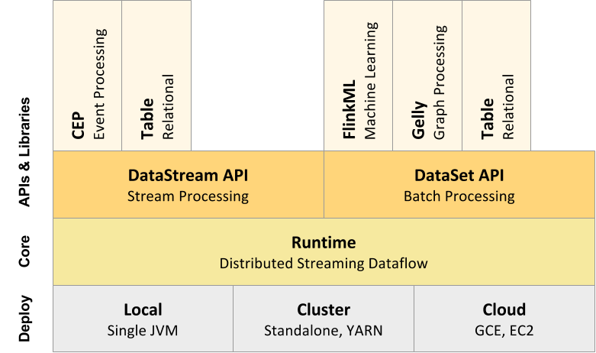
Flink
A Stream and Batch data processing platform
Flink Stack

Slide 25
Flink
Flink’s core
Streaming dataflow engine
distribution ( move streams between two operators )
Communication ( Client-Master-Worker )
fault tolerance
batch processing
Based on top of the streaming engine, overlaying native iteration support, managed memory, and program optimization.

Slide 26
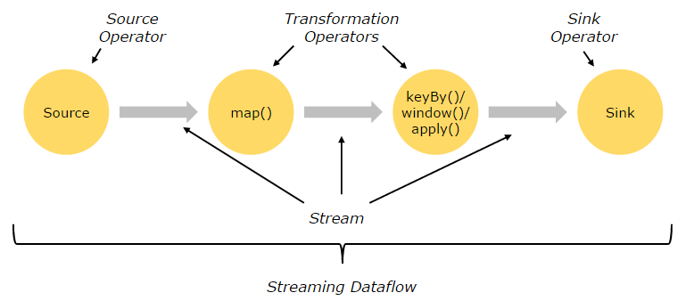
Flink programs
Programs
a streaming dataflow consists of streams and transformation operators.
streams - an intermediate result
transformations - an operation on one or multiple streams
inherently parallel and distributed.
Dataflow
Start with one or more sources
Ends in one or more sinks

Slide 27
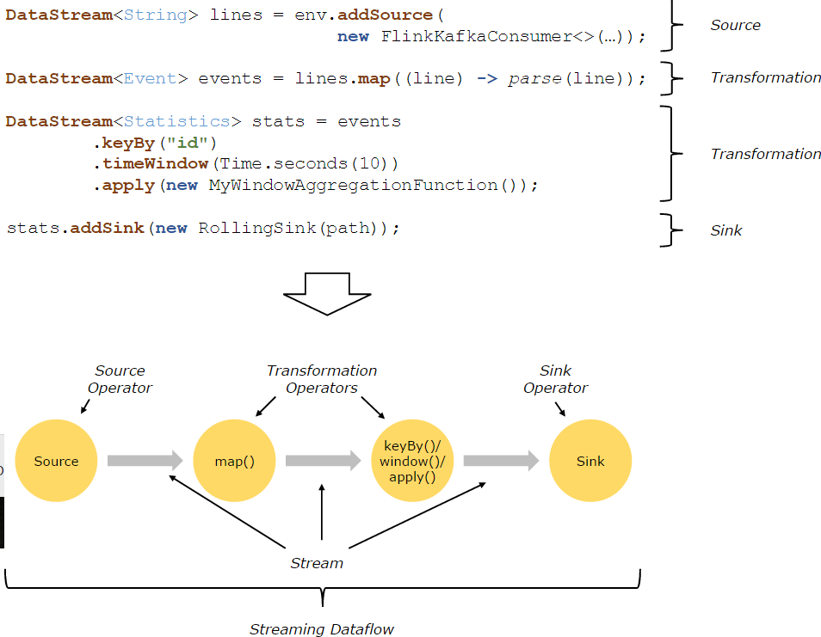
Flink Program

Slide 28
Flink – partition and operator
Streams
split into stream partitions
Transformation
split into operator subtasks to process stream partitions.
execute independently, in different threads and on different machine and containers
Operator parallelism is different.

Slide 29
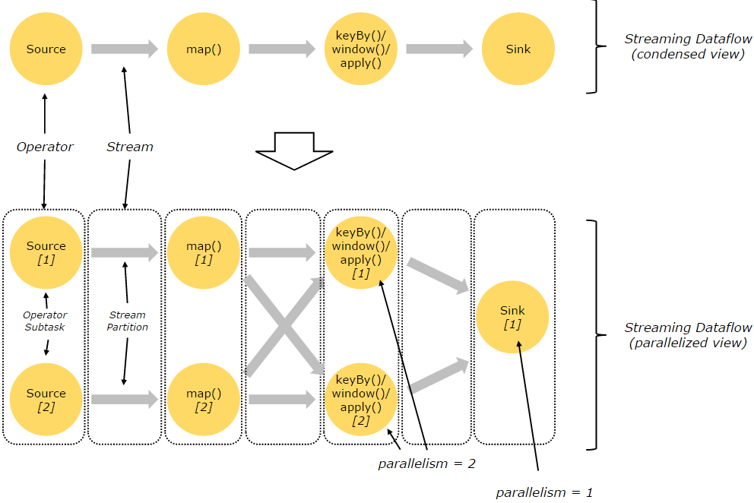
Flink – partition and operator

Slide 30
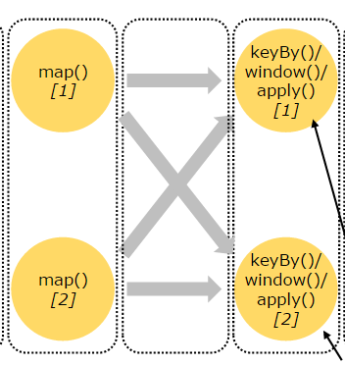
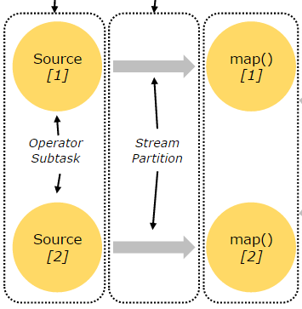
Flink- Data Distribution
Streams can transport data between two operators
one-to-one or forwarding
redistributing
One-to-one
Total ordered
Redistributing
partial ordered

Slide 31
Flink - Tasks & Operator Chains
Flink chains operator subtasks together into tasks in distribution execution.
Task
One thread per task
Operator subtasks chain
Reduce overhead in context switching
Chaining can be configured through APIs

Slide 32
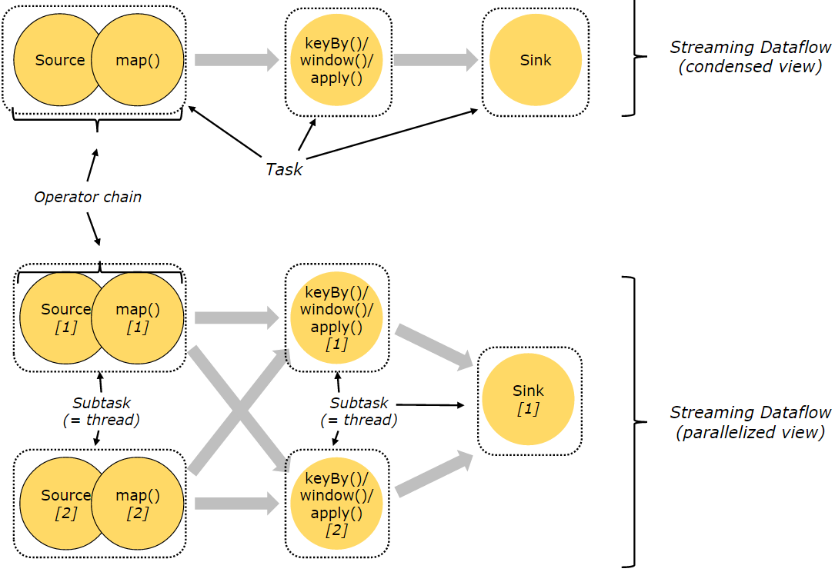
Flink - Tasks & Operator Chains
Total 5 tasks in this program

Slide 33
Flink - Distributed Execution
Master-Worker-Client
Client
Submit program ( dataflow ) to the master.
Master processes ( JobManagers )
Schedule tasks, checkpoints, recovery failure ( failover )
At least one Leader Master
Multiple Standby Masters (options)
Worker processes ( TaskManagers )
Execute tasks
Buffer and Exchange data stream
At least one worker
Workers connect to masters, announcing themselves as available, and get work assigned.

Slide 34
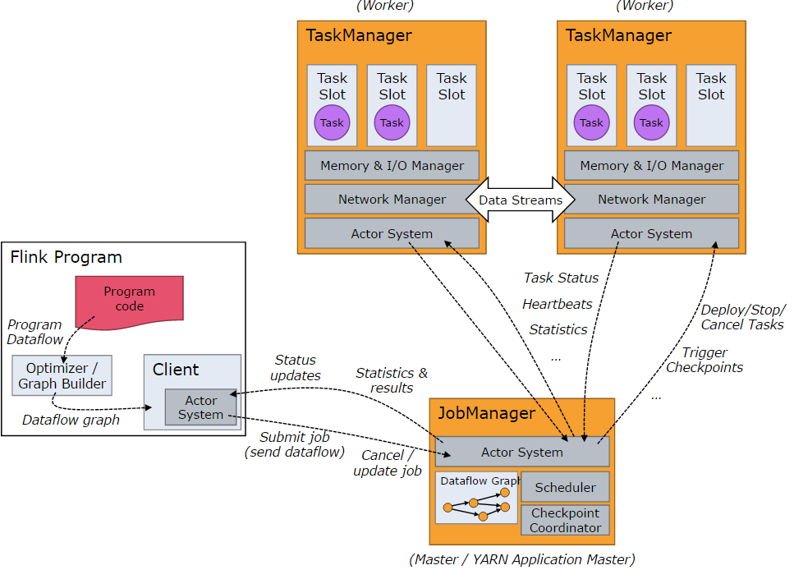
Flink - Distributed Execution

Slide 35
Apache Flink Fault-Tolerance

Slide 36
Apache Flink Fault-Tolerance
Fault Tolerance in Flink
Recover the state of application in failure
Ensure record will be guaranteed processed exactly once or at least once
Store data flow snapshot and Operator state in HDFS or configurable place (snapshot store)
When program failure
Stop distributed streaming flow
Restart the operators from the latest state, reset the input streams to the latest snapshot.
Only records after checkpoints(snapshot) will be restarted

Slide 37
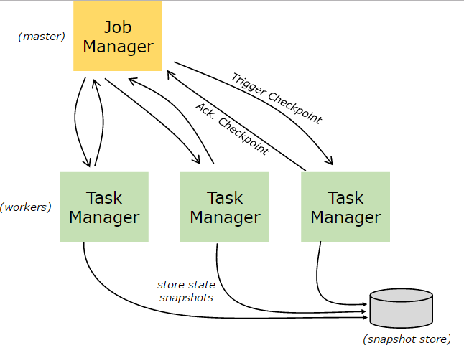
Apache Flink Fault-Tolerance

Slide 38
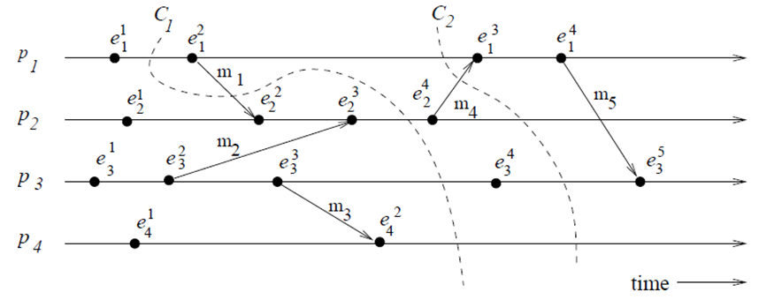
Snapshot Cuts
C1+
Cuts as Snapshot
Inconsistent cuts C1
m1 send from future. C1+ is consistent
Consistent cuts C2
Every message received in the PAST of the cut, was sent in the PAST of the cut

Slide 39
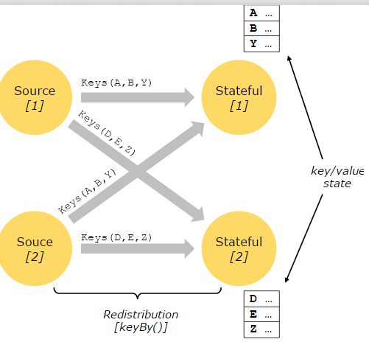
Flink - Checkpoints
Checkpoints consist of
Distributed Snapshot for Data Stream
Operator State
Chandy-Lamport algorithm ( 1985 )
Asynchronous barrier snapshot
Operators
Stateful Operations
Record processed events key/value pairs

Slide 40
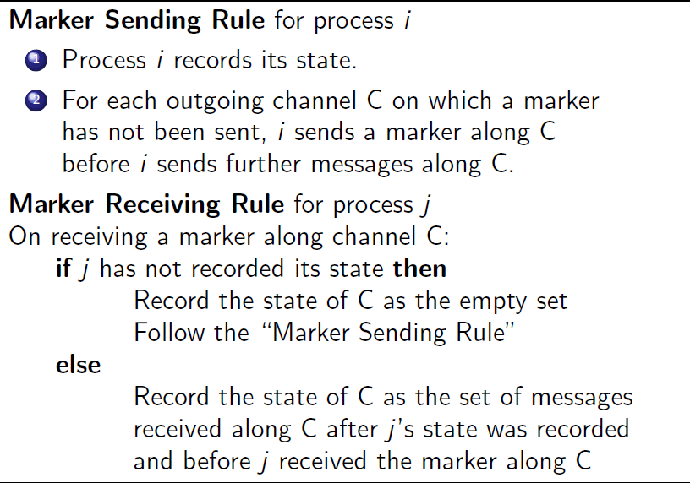
Chandy-Lamport algorithm
Marker 2
M
C
M
Marker 1
Snapshot 1 : Start from Marker1, End before Marker 2

Slide 41
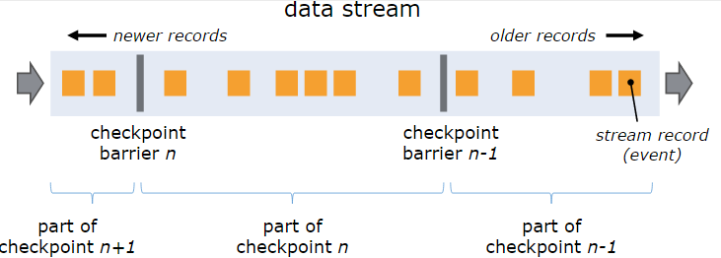
Flink Barrier

Slide 42
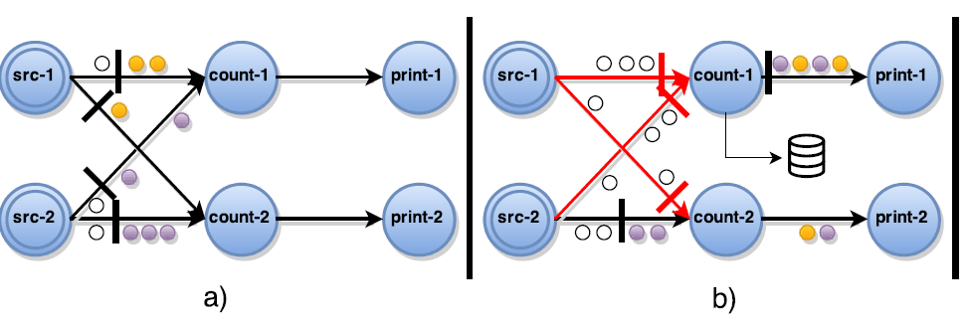
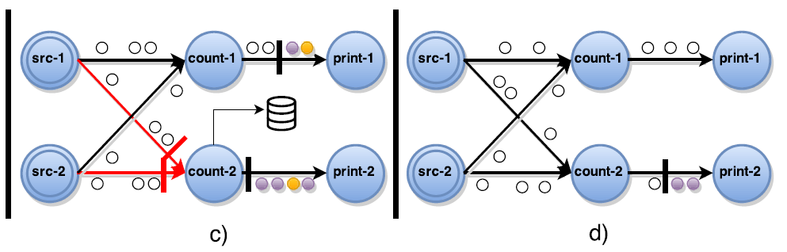
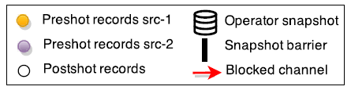
Asynchronous barrier snapshot

Slide 43
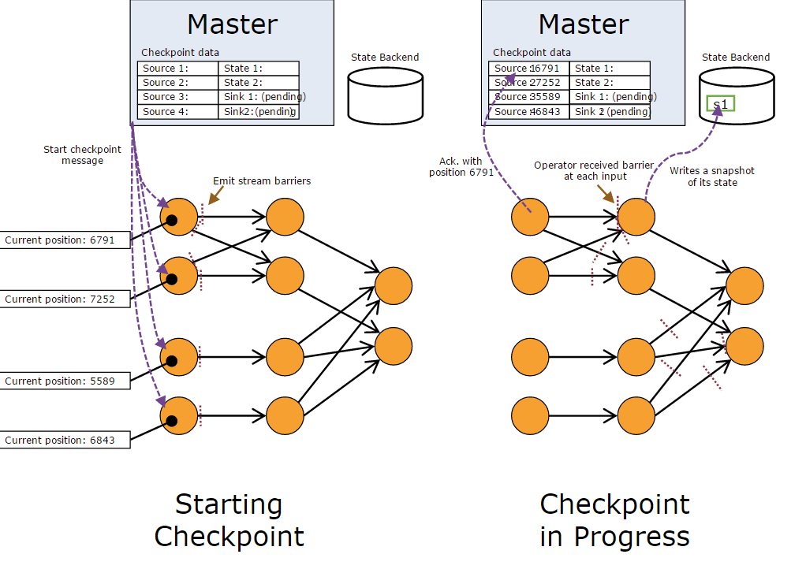
Flink Checkpoint Example

Slide 44
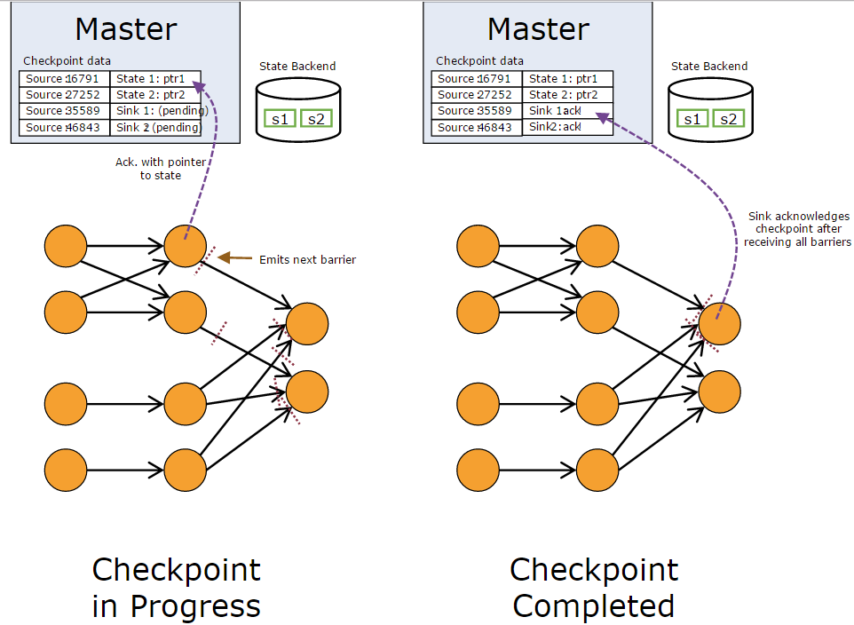
Flink Checkpoint Example

Slide 45
Lambda Architecture

Slide 46
Lambda Architecture
How to acquire data, in petabytes, in the past up to the present?
query = function(all data)
Lambda Architecture
A general-purpose approach to implementing an arbitrary function on an arbitrary dataset and having the function return its results with low latency.
There’s no single tool that provides a complete solution. Instead, you have to use a variety of tools and techniques to build a complete Big Data system.
Batch view
precomputed query function, ex: sum, total count
Realtime view
Partial result come from new data, instead of recomputation all dataset.

Slide 47
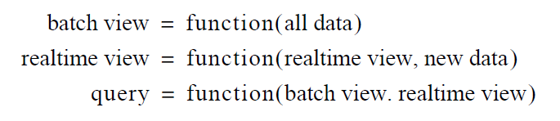
Lambda Architecture as equation

Slide 48
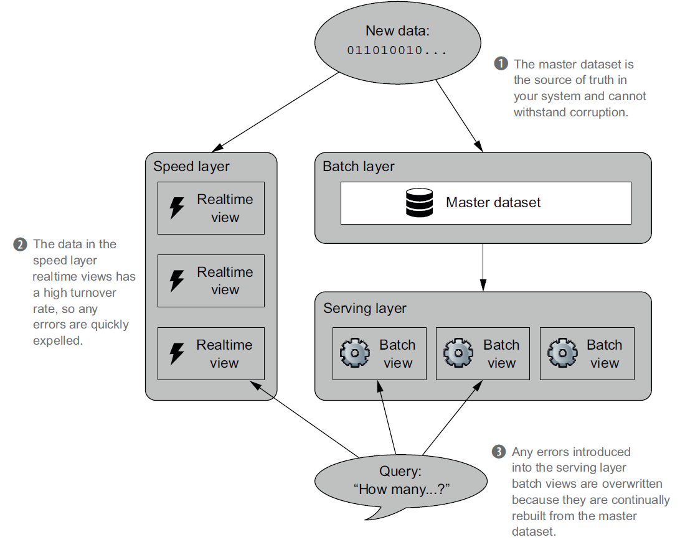
Lambda Architecture

Slide 49
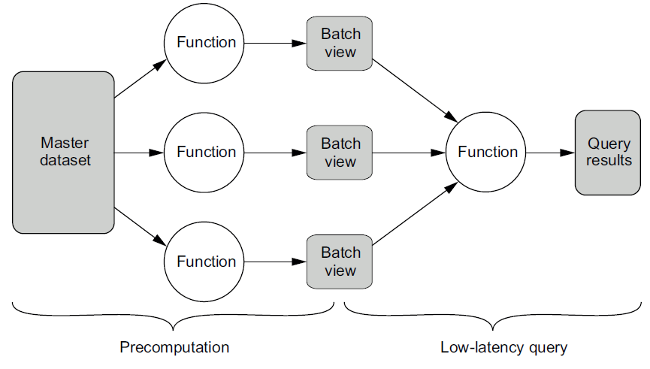
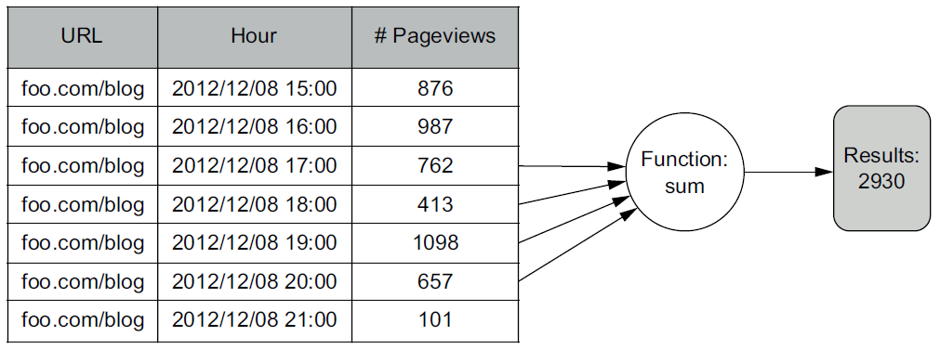
Lambda – Batch View

Slide 50
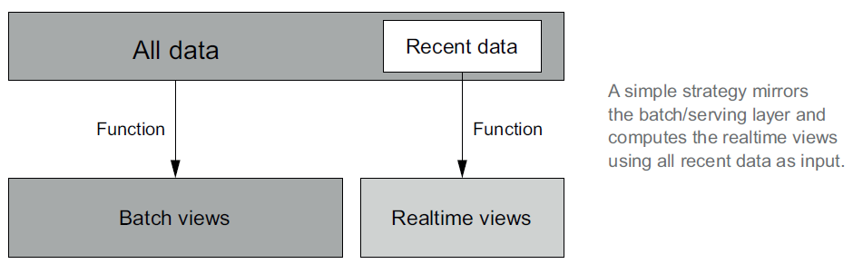
Realtime View

Slide 51
Flink Practices
Prerequisities
Java 1.8 or Higher
Flink 1.2
Flink on Windows
WordCount
LineCount
PageRank
Maven on Windows

Slide 52
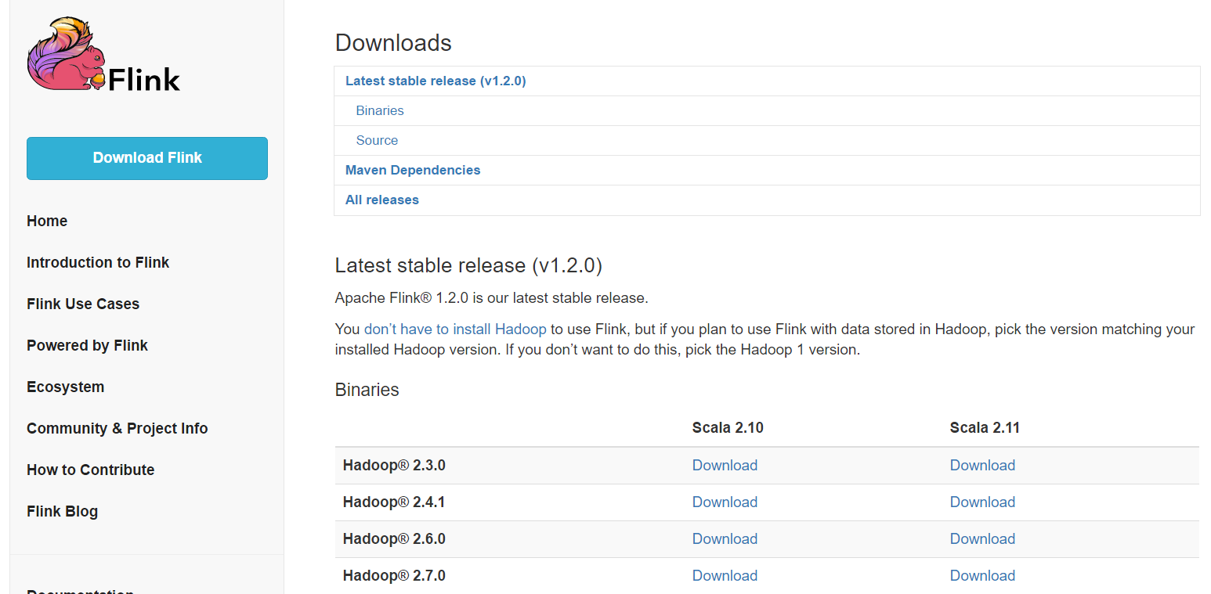
Flink Practices Prequisities
Install Java 1.8 or Higher
Install Flink 1.2
Go to https://flink.apache.org/downloads.html#binaries
Download Flink 1.2

Slide 53
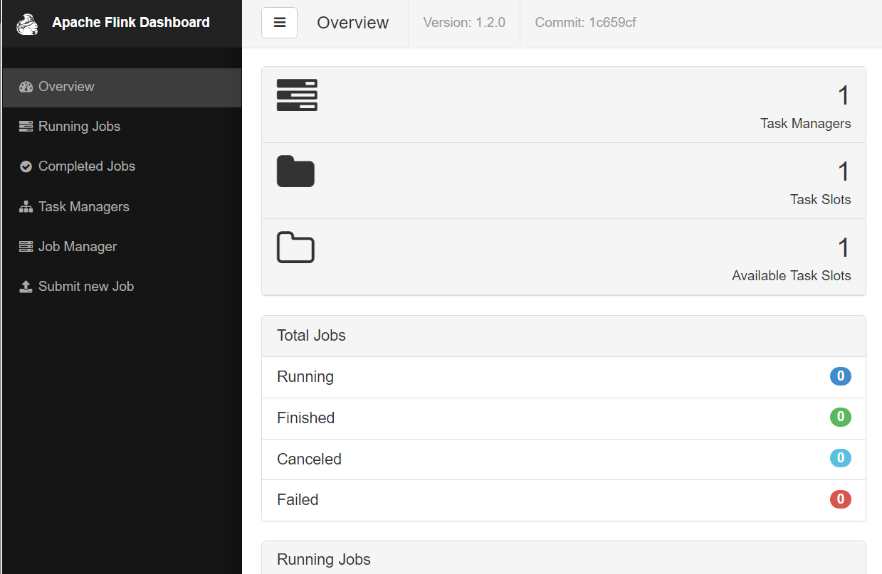
Flink Startup
bin\start-local.bat
http://localhost:8081

Slide 54
Flink Wordcount
Run default WordCount Example
bin\flink.bat run examples\WordCount.jar
WordCount with specifiy input
bin\flink.bat run examples\WordCount.jar --input d:\wc-test.txt

Slide 55
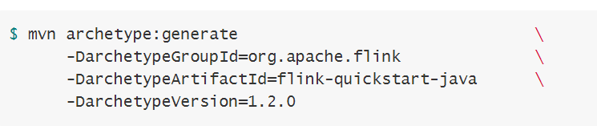
Using Maven to initiate Flink Project
mvn.cmd package (compile empty project)

Slide 56
Flink Main
Import
org.apache.flink.api.java.ExecutionEnvironment;
org.apache.flink.api.java.DataSet;
Construct Flink Execution Env
final ExecutionEnvironment env = ExecutionEnvironment.getExecutionEnvironment();
Input
readTextFile
generateSequence
readCsvFile
Output
writeAsText
DataSet
An abstract class to hold batch data in flink cluster

Slide 57
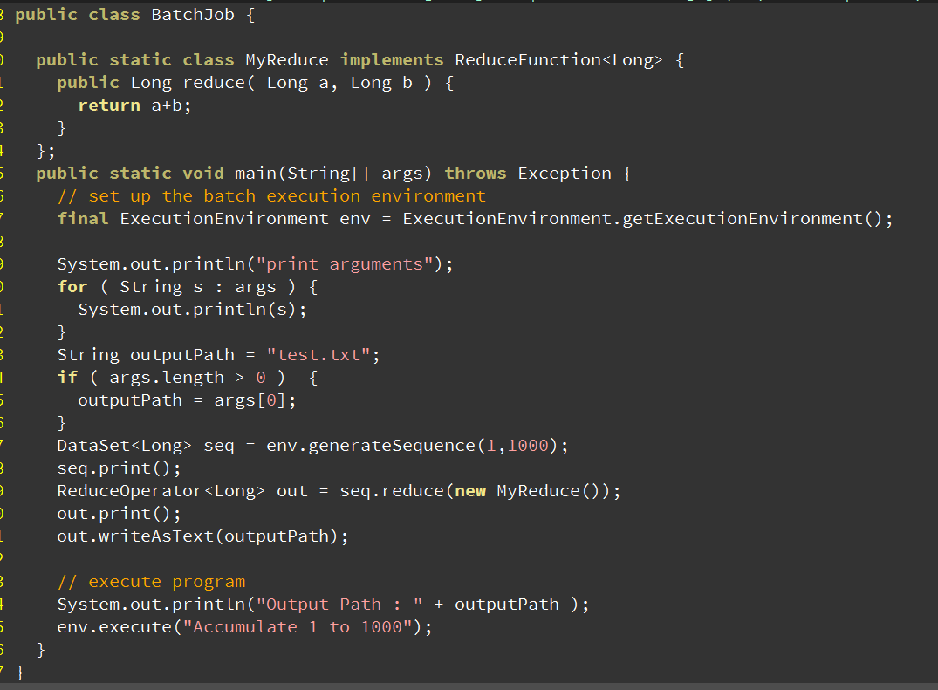
Flink Example 1 to 1000 sum

Slide 58
Line Count in Flink
Main()
getExecutionEnvironment()
readTextFile
map
Line → 1
reduce
1 + 1 + ….
Collect / print
Final Line

Slide 59
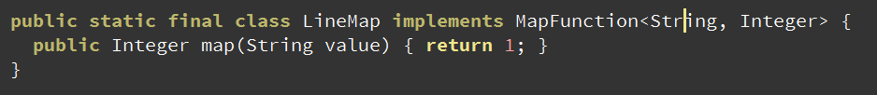

Flink MapFunction and ReduceFunction Classes
MapFunction is a flink defined interface for map transformation
implementation
Interface
Generic Types

Slide 60
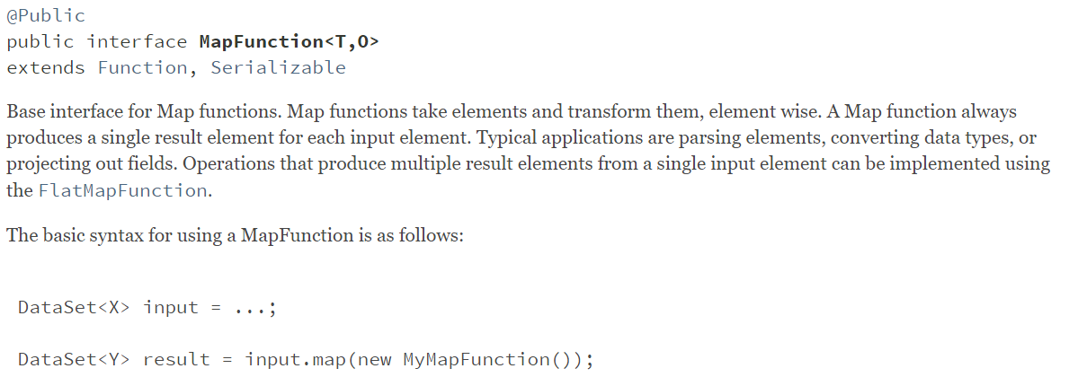
Class Definition In Document
https://ci.apache.org/projects/flink/flink-docs-master/api/java/org/apache/flink/api/common/functions/MapFunction.html

Slide 61
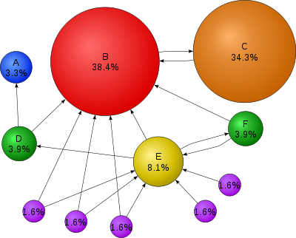
PageRank
Measure the importance of a Web Page

Slide 62
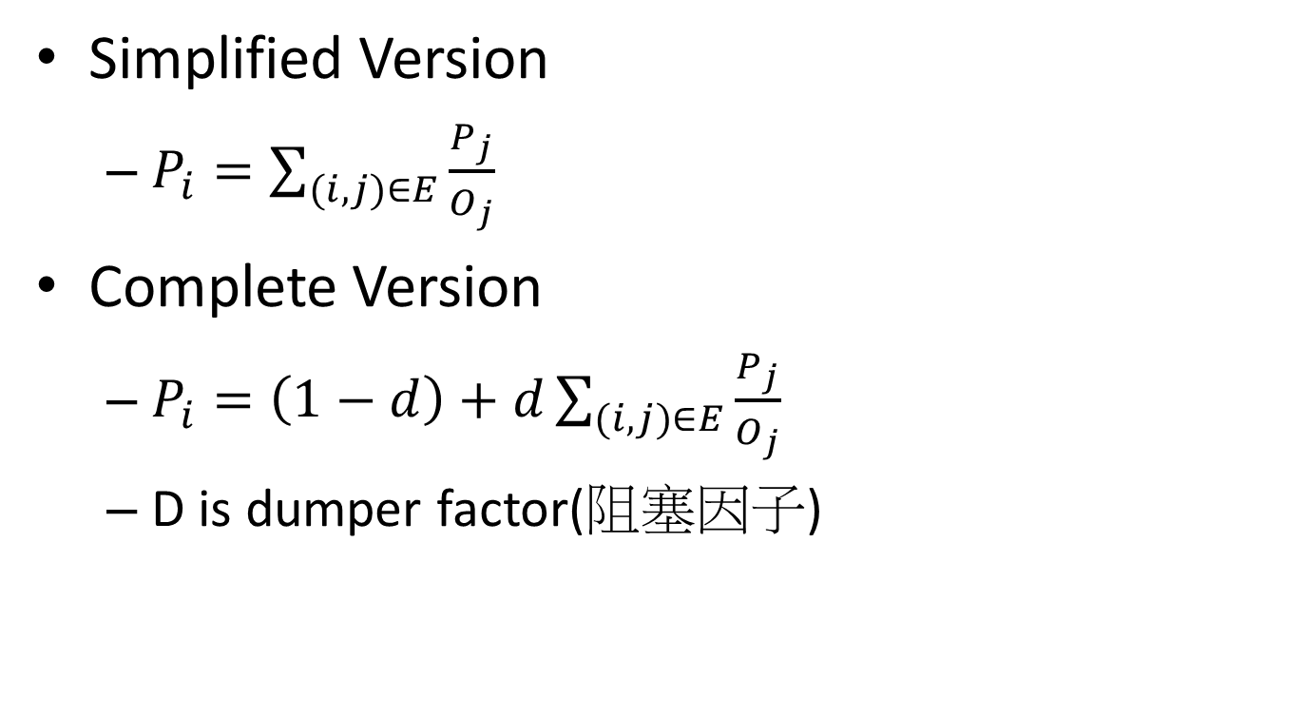
PageRank
Graph G = { N, E }
N is Node Set
E is Edge Set
Simplified Version
$P_{i}=\sum_{(i,j)∈E}{\frac{P_{j}}{O_{j}}}$
Complete Version
$P_{i}=\left(1−d\right)+d\sum_{(i,j)∈E}{\frac{P_{j}}{O_{j}}}$
D is dumper factor(阻塞因子)
A
B
C

Slide 63
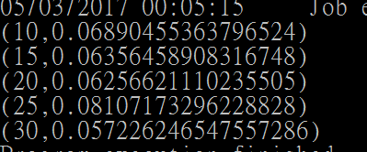
PageRank on Flink
bin\flink run examples\batch\PageRank.jar
--pages ( Page IDs, the nodes of a Graph )
--links ( Links, the edges of a Graph )

Slide 64
Build PageRank By Yourself

