Slide 1
Momentum
short term trading stratEgies in R

Slide 2
Client Problem (Hypothetical)
Would I benefit from applying absolute momentum to my current strategy?
Details: Invest in five diversified ETFs Rebalance monthly
Goal: Increase risk adjusted return

Slide 3
Technical Approach
Using the client’s current portfolio as a benchmark,
historically back test absolute momentum strategy
with identical assets and the rebalancing period
Demonstrate how the client’s portfolio would have performed if they used absolute momentum
Provide the client with the return and risk adjusted return for the absolute momentum portfolio

Slide 4
Technical Approach
Apply absolute momentum to the client’s current strategy:
Using ETFs VOO, VEA, VWO, GLD, VGLT
Reallocating monthly based on momentum signal

Slide 5
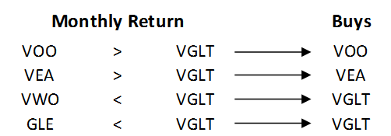
Momentum Signal
Individually compare monthly returns of VOO, VEA, VWO and GLD to VGLT and buy the one that has the greatest return
Hold for one month and repeat
Example: Signal to hold 50% VGLT, 25% VEA, and 25% VOO

Slide 6
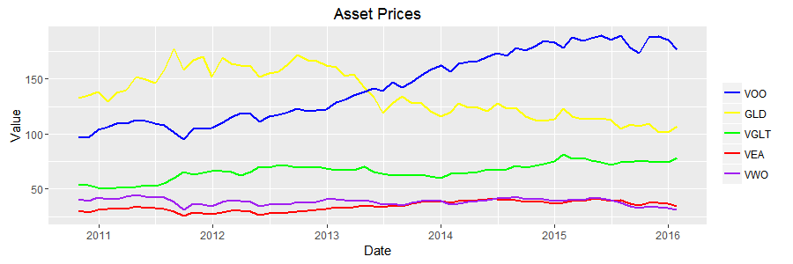
Data Visualization Asset prices all adjusted for splits

Slide 7
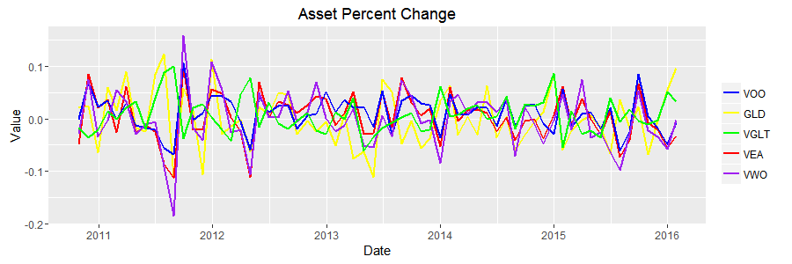
Data Visualization No performance outliers

Slide 8
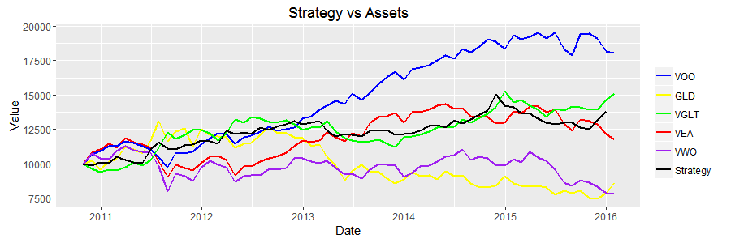
Results & Recommendations Strategy performs better than 3 of the 5 assets

Slide 9
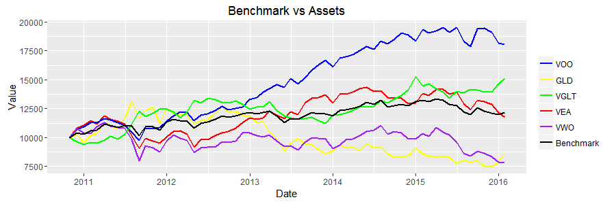
Results & Recommendations Benchmark tracks average performance of assets

Slide 10
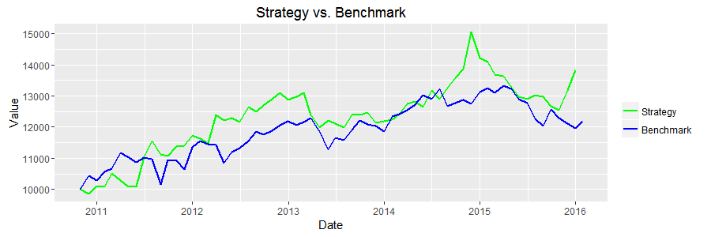
Results & Recommendations Strategy outperforms benchmark

Slide 11
Results & Recommendations
Absolute momentum increases compound annual growth rate
Unexpectedly, absolute momentum slightly increased volatility
The return/volatility ratio increased using absolute momentum
 | Benchmark | Strategy
CAGR | 3.49% | 6.37%
Standard dev | .028 | .030
Return/SD | .12 | .19

Slide 12
I would recommend this strategy to the client because, when using it, returns increased more than risk
Conclusion

