Slide 1
Date-Time Validation System
Reads large input file, validates records, removes duplicates, writes unique valid records.

Slide 2
Problem Statement
Read large input file
Validate ISO 8601 values
Remove duplicates
Write unique valid output
No STL containers

Slide 3
Functional Requirements
Read date-time records from the input file.
Process very large input files efficiently.
Parse individual records from the input stream.
Validate each record according to the supported ISO 8601 format.
Ignore invalid records.
Detect and remove duplicate date-time values.
Store only unique valid records.
Write all unique valid records to the output file.

Slide 4
Non-Functional Requirements
Handle very large input files (100K+ records).
Process data efficiently using multiple threads.
Allow configurable DataBlock size.
Thread-safe communication using synchronized queues.

Slide 5
Key Classes
ValidationManager
InputFileReader
WorkerPool
DataBlockProcessor
DateTimeParser
DateTimeValidator
DataBlock

Slide 6
Validation Manager
Responsibility
Acts as the central coordinator of the application.
Responsibilities
Initialize all components
Create shared resources
Start reader thread
Start worker threads
Wait for all threads to finish
Invoke output writer

Slide 7
InputFileReader
Responsibility
Acts as the Producer.
Reads the input file and creates DataBlock objects.
Responsibilities
Open file
Read data
Create DataBlock
Push DataBlock into queue
Mark last block

Slide 8
WorkerPool
Responsibility
Manages all worker threads.
Responsibilities
Create worker threads
Start threads
Join threads
Destroy threads

Slide 9
DataBlockProcessor
Responsibility
Contains the business logic.
Each worker executes one DataBlockProcessor.
Responsibilities
Dequeue DataBlock
Parse records
Validate records
Remove duplicates
Process until last block

Slide 10
DateTimeParser
Responsibility
Extract one record at a time from a DataBlock.
Responsibilities
Read next line
Trim spaces
Skip empty lines
Return one record

Slide 11
DateTimeValidator
Responsibility
Validate ISO 8601 date-time.
Validation Steps
Length
Numeric format
Date
Leap year
Time
Timezone

Slide 12
DataBlock
Responsibility
Represents one batch of data.
Contains
Buffer
Capacity
Size
Last block flag

Slide 13
OutputFileWriter
Responsibility
Generate the final output file.
Responsibilities
Read unique records
Write output
Close file

Slide 14
Execution Flow
1. main()
2. ValidationManager
3. Reader
4. Queue
5. Workers
6. Parser
7. Validator
8. HashSet
9. Writer

Slide 15
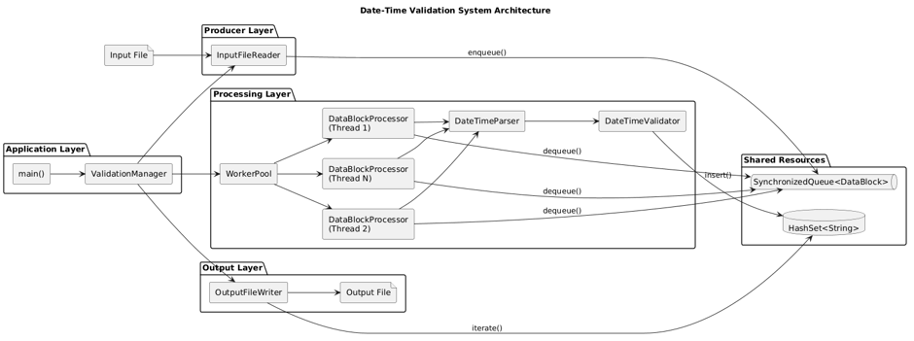
Architecture Diagram

Slide 16
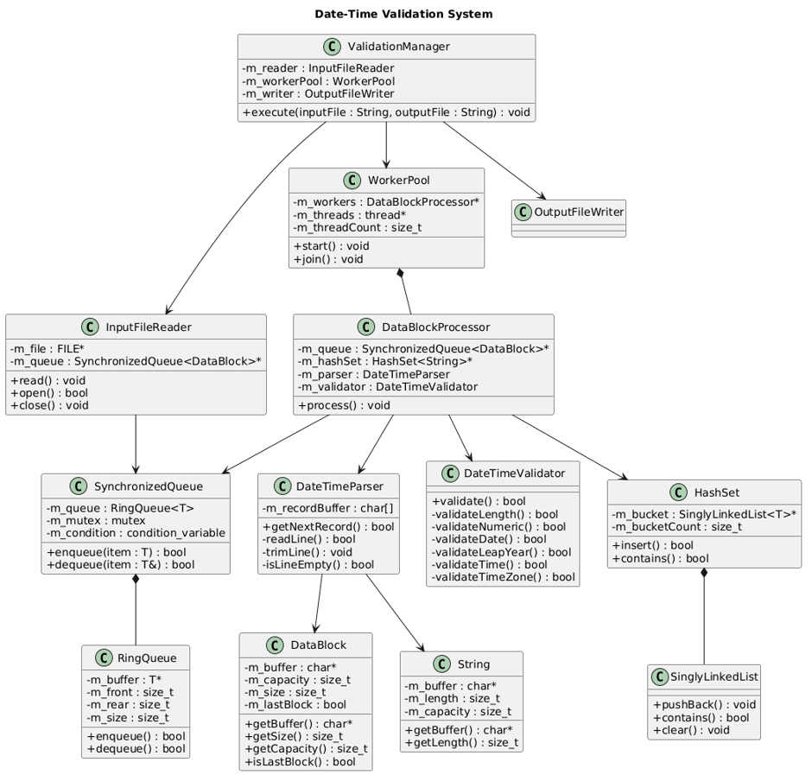
Class Diagram

Slide 17
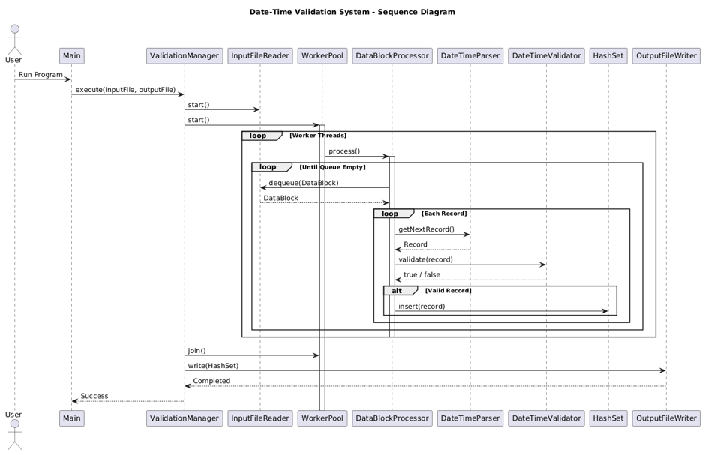
Sequence Diagram

Slide 18
Challenges
Reading Large Files Efficiently
Producer–Consumer Design
ISO 8601 Validation
Designing Custom Data Structures
HashSet Thread Safety
Thread Synchronization
Memory Management
Compilation Issues
Debugging Segmentation Fault

Slide 19
Testing
Invalid Input Testing
Duplicate Record Testing
Parser Testing
Multithreading Testing
Large File Testing (100K)
Boundary Value Testing
Data Structure Testing
Stress Testing

Slide 20
Future Scope
Configurable Parameters
Support Additional ISO 8601 Formats
Dynamic Thread Pool
Logging Framework
Performance Metrics
Unit Test Framework

