Slide 1

COMPILER AIDED USER DEFINED CALLING CONVENTIONS FOR REVERSE ENGINEERING
Presentation By: Jared Widberg
Mentor: Sashank Narain
Committee member: Yimin (Ian) Chen

Slide 2
Roadmap
Introduction
What is a Calling Convention?
The Problem
IDA Pro
The Solutions
Publication
Live Demo
Conclusion

Slide 3
What is a Calling Convention?
“Calling conventions specify how arguments are passed to a function, how return values are passed back out of a function, how the function is called, and how the function manages the stack and its stack frame. In short, the calling convention specifies how a function call in C or C++ is converted into assembly language.”
https://en.wikibooks.org/wiki/X86_Disassembly/Calling_Conventions

Slide 4
The Problem
“If these standard conventions did not exist, it would be nearly impossible for programs created using different compilers to communicate and interact with one another.”
https://en.wikibooks.org/wiki/X86_Disassembly/Calling_Conventions

Slide 5
The Problem
Whole program optimization
Compilers can optimize the use of registers across function boundaries
Use of assembly language
Use of another high-level language with different conventions (e.g. Go)
Use of non-standard-compliant compiler (e.g. Watcom)

Slide 6
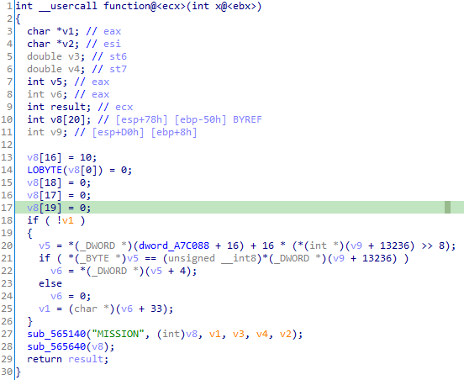
IDA Pro
// body
Body of the function is unimportant
ecx – return value of type int passed via ecx register
ebx – x argument value of type int passed via ebx register
Can be much more complicated

Slide 7
The Solutions
Out of Line Assembly
Inline Assembly
usercall-hook
usercall.hpp
Clang __usercall

Slide 8
Out of Line Assembly
# function.S
section .text
global _function
extern _functionInternal
_function:
push ebx
call _functionInternal
add esp, 4
mov ecx, eax
ret
// functionInternal.c
__attribute__((__cdecl__))
int functionInternal(int x) {
// body
return result;
}

Slide 9
Inline Assembly
__attribute__((__cdecl__))
int functionInternal(int x);
__attribute__((naked))
void function(void) {
asm volatile (
".intel_syntax noprefix\n"
"push ebx\n"
"call %P0\n"
"add esp, 4\n"
"mov ecx, eax\n"
"ret\n"
".att_syntax prefix\n"
:
: "i"(functionInternal)
: "ecx"
);
}
__attribute__((__cdecl__))
int functionInternal(int x) {
// body
return result;
}

Slide 10
usercall-hook
# script.sh
$ usercall-hook \
> "int __usercall function@<ecx>(int x@<ebx>)" \
> > function.c
// function.c
static void __declspec(naked) function()
{
__asm
{
push ebx // x
// Call your __cdecl function here:
call func
pop ebx // x
retn
}
}
// functionInternal.c
__attribute__((__cdecl__))
int functionInternal(int x) {
// body
return result;
}

Slide 11
usercall.hpp
#include <usercall_hpp/usercall.hpp>
FF(int __usercall function AT ecx)(int x AT ebx)(
// body
RETURN(result);
)

Slide 12
Clang __usercall
int __usercall function@<ecx>(int x@<ebx>) {
// body
return result;
}

Slide 13
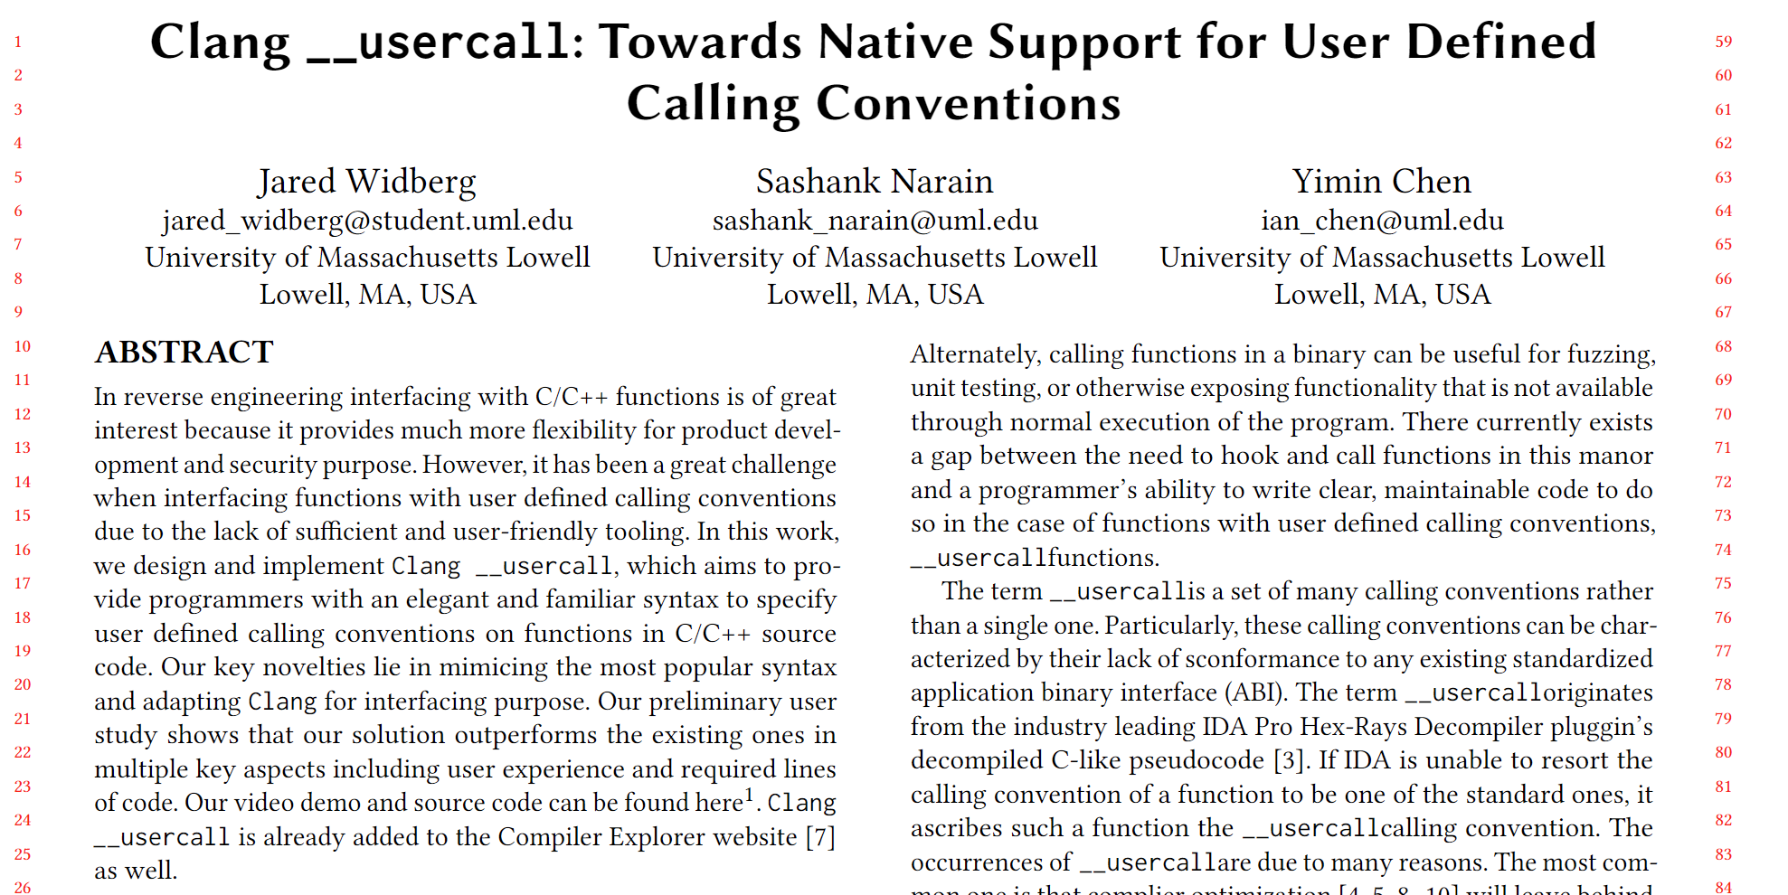
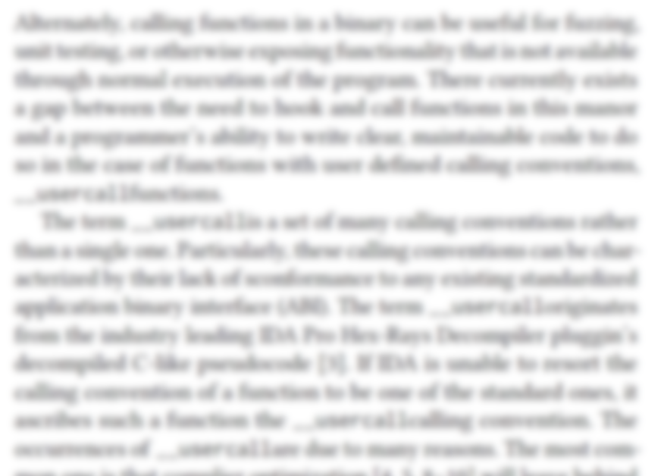
ESEC/FSE 2022 - Demonstration

Slide 14
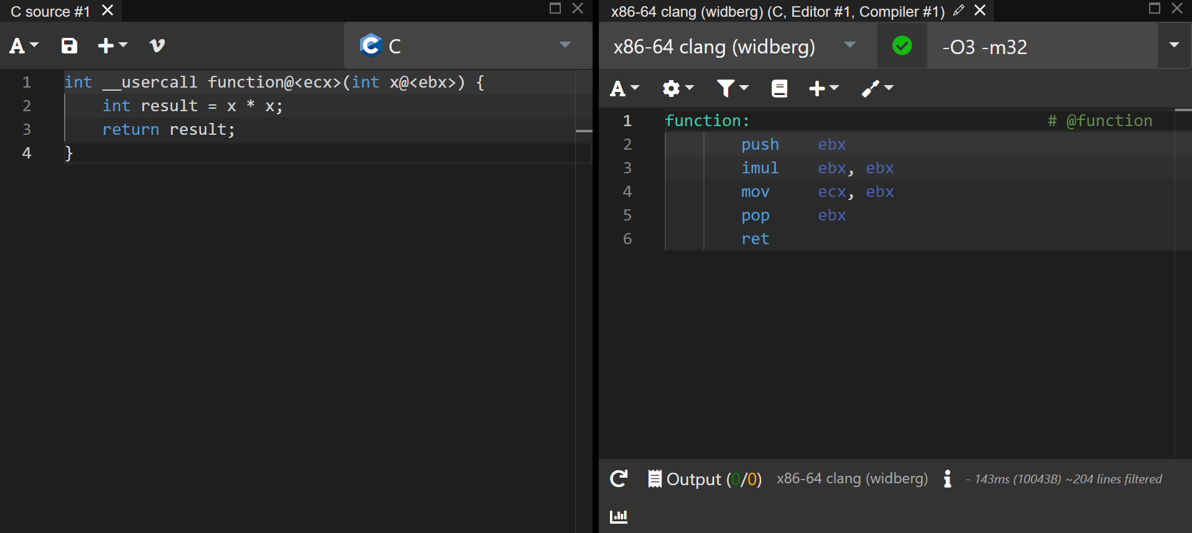
Live Demo
Live demo: https://godbolt.org/z/Konrx48x3

Slide 15
Conclusion
Great experience
Compiler development
Reverse engineering
Publishing
What’s next?
Further research
BAE
Open source

