Slide 1
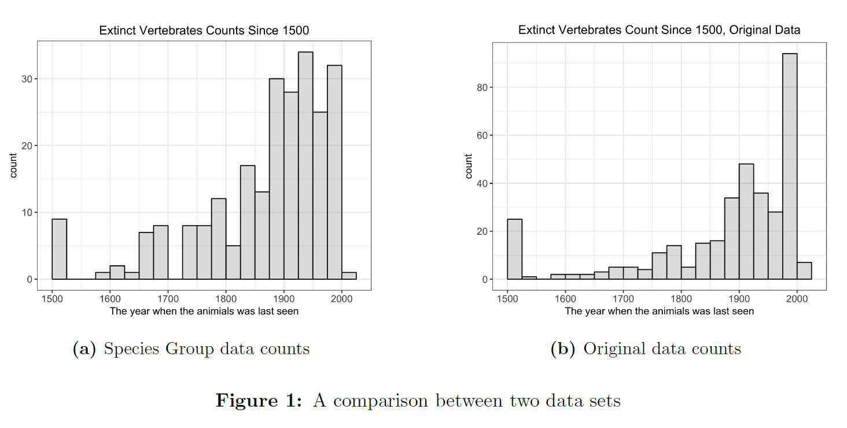
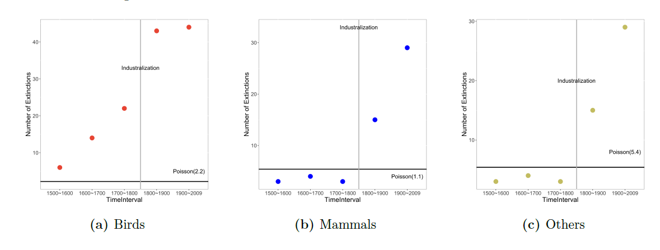
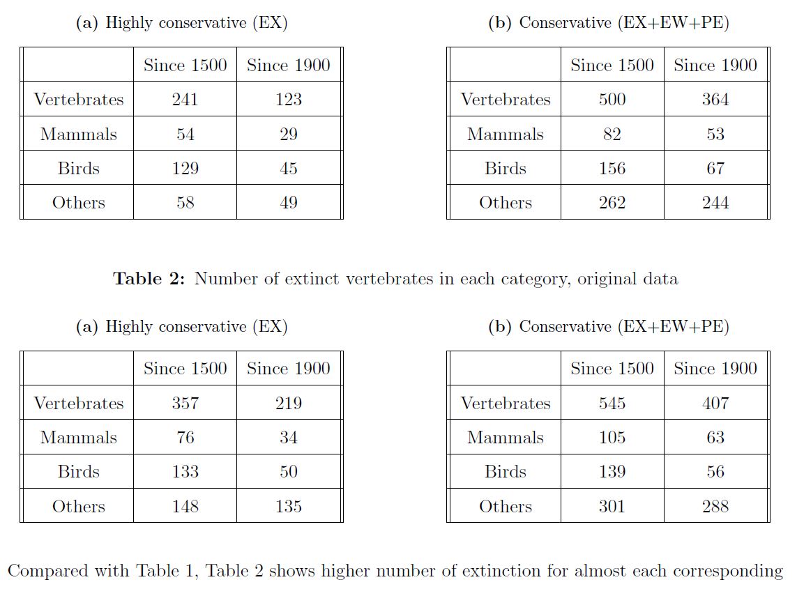
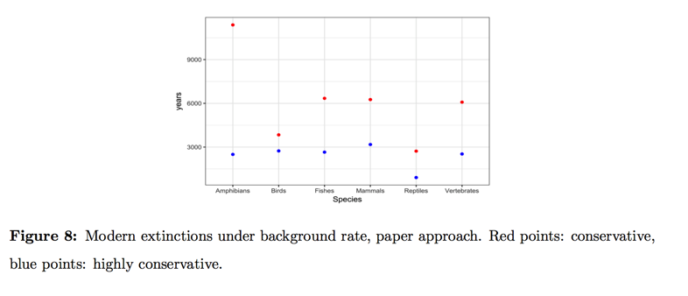
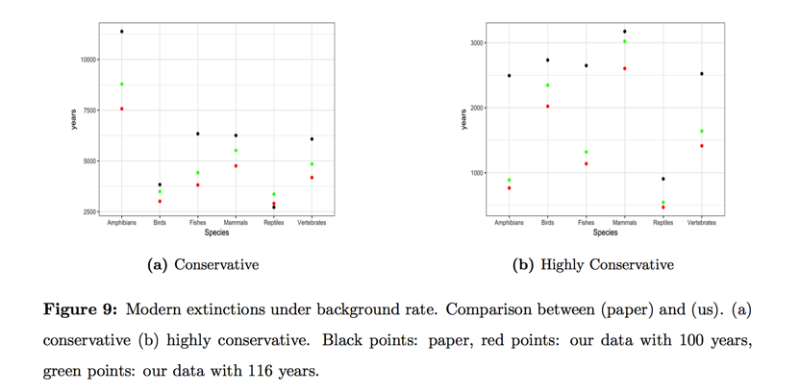
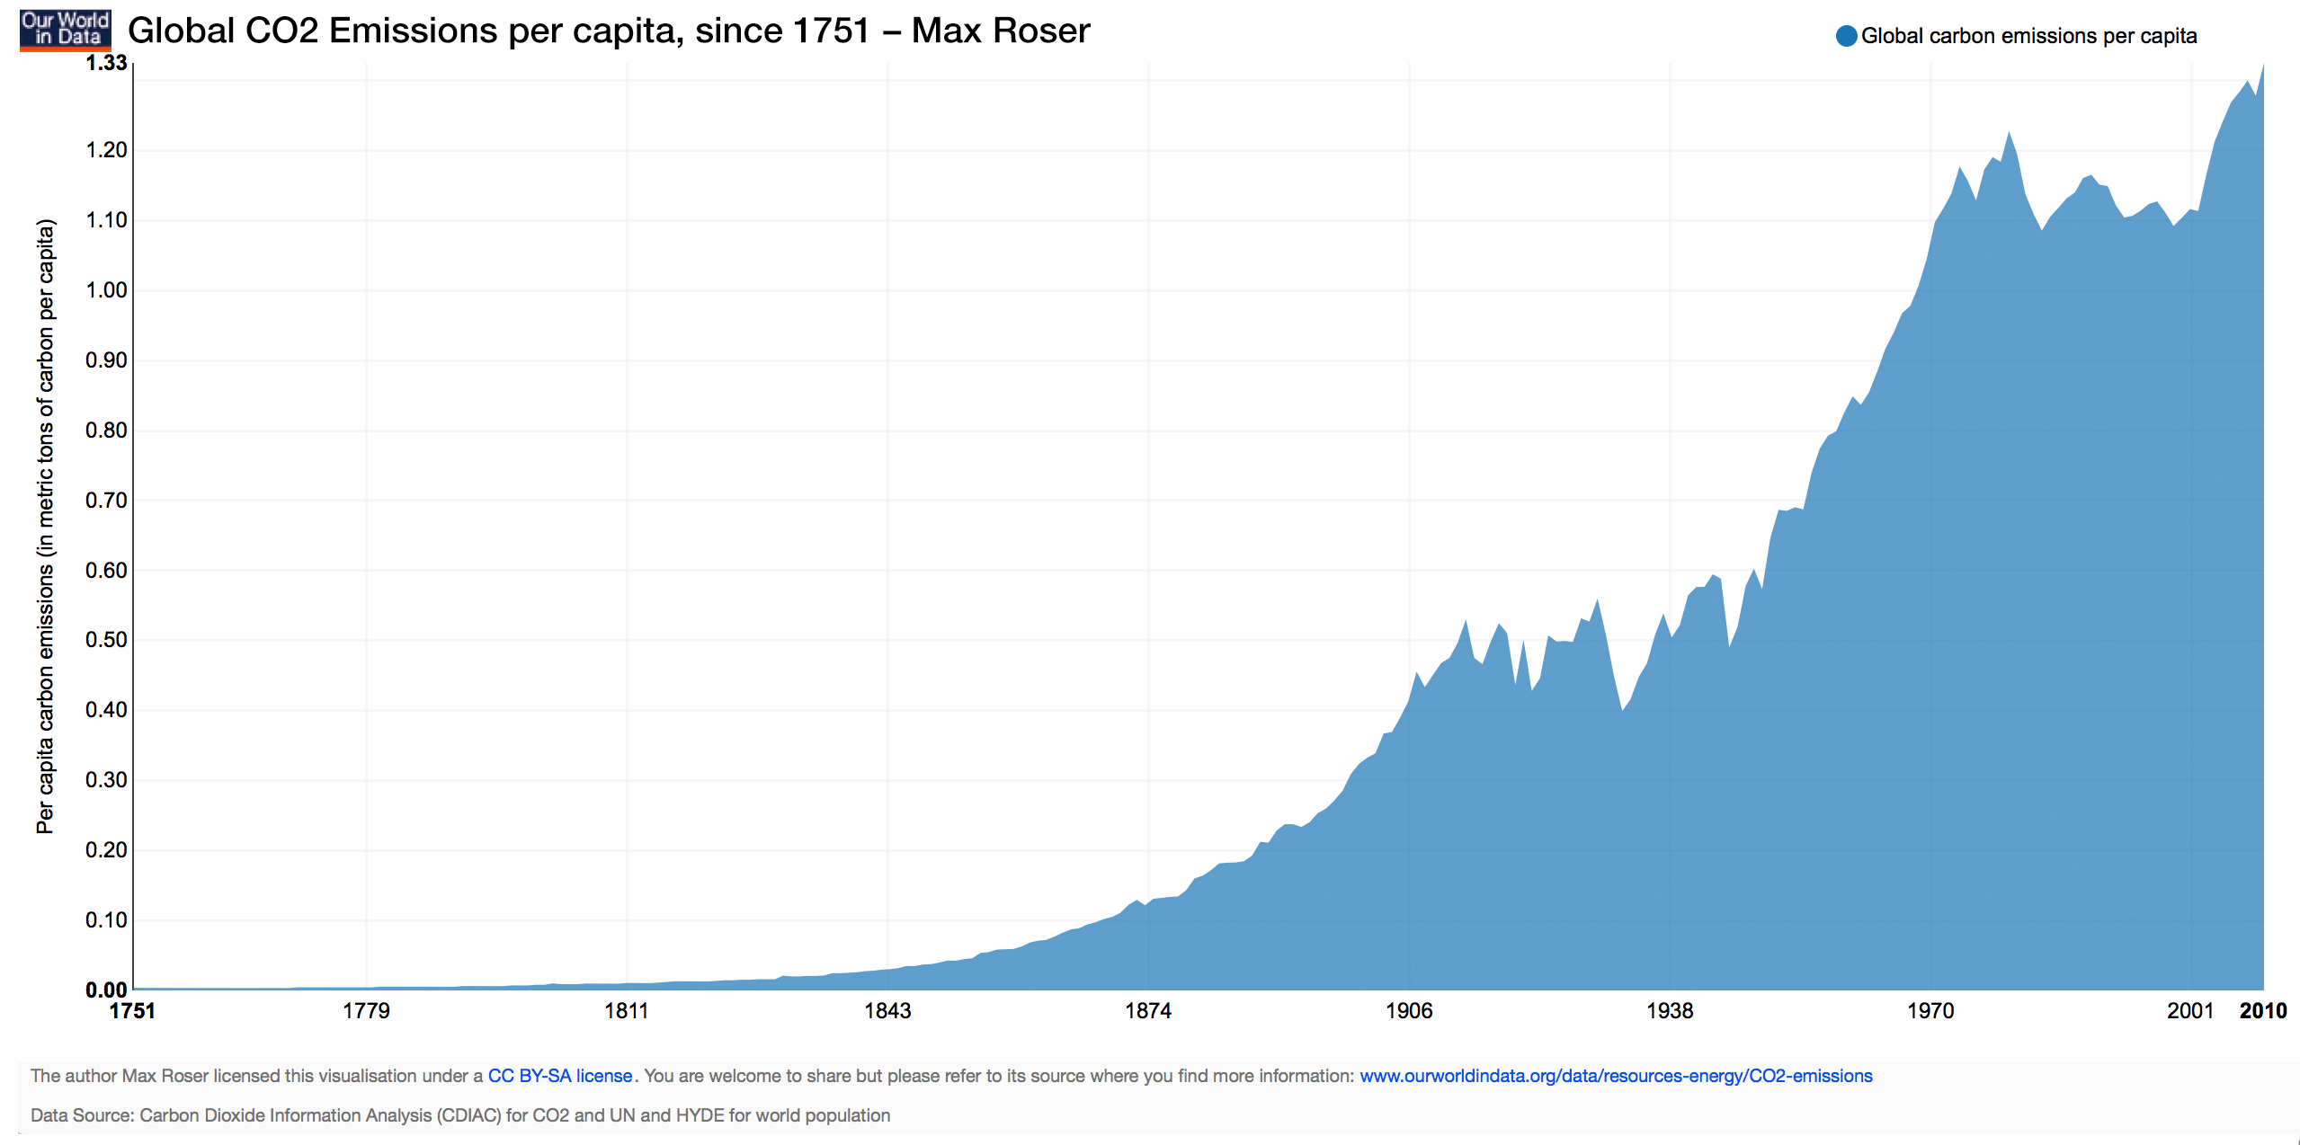
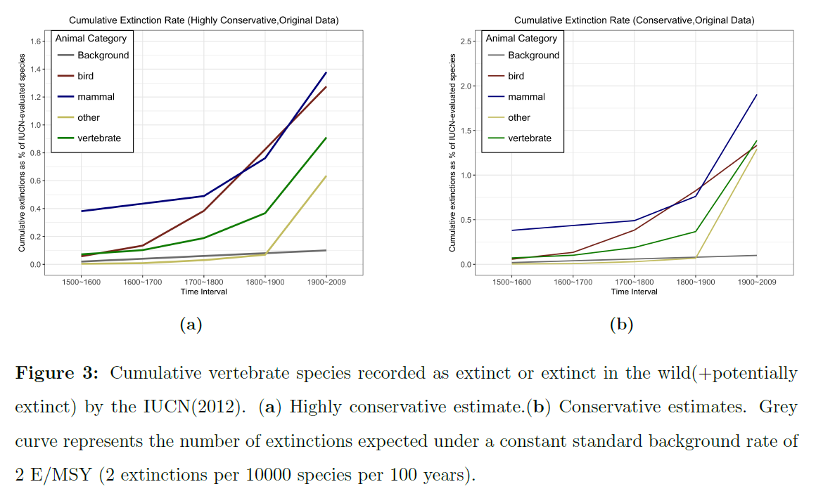
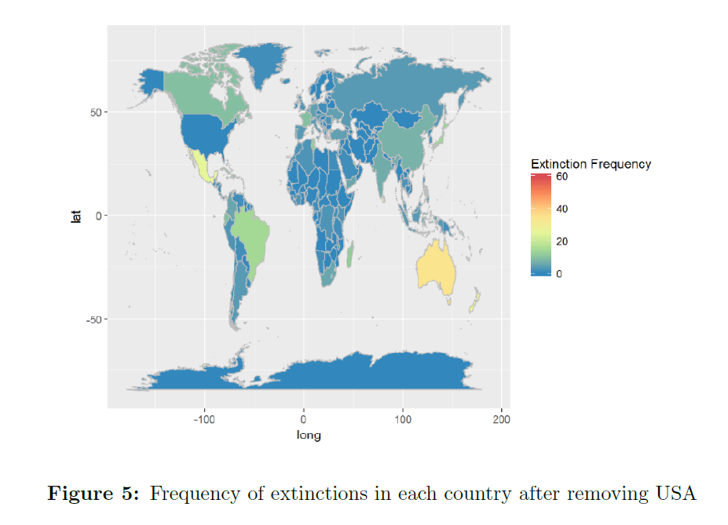
Species Extinction Research
Wenxi Xu Wideet Shende Ziyang Zhou
Introduction
Results
Results
Conclusion
In recent years, there has been much concern over how human activity is affecting the global environment. One aspect of the environment that humans may be affecting is the species extinction rate. The goal of this project is to analyze how the global extinction rate has been changing between 1500 and 2016. Through analysis of species extinction dates, we were able to conclude that the global extinction rate has been increasing since 1500. By also looking at extinction locations, were able to show a correlation between industrialized countries and increased species extinctions. This points toward some interaction between humans and the increased extinction rate.
From the findings of our report, we can corroborate with the original authors in saying that the extinction rate is increasing over time. We can also hypothesize that modernization and industrialization are having an effect on this increase in extinction rate. The increase in the extinction rate following the year 1850 is distinct. Furthermore, most of the countries that have recorded a significant number of extinctions are developed countries. The destruction of animal habitats for the sake of modernization could cause several species to go extinct.
Further research with data on climate change and deforestation would be potentially helpful in learning more about the cause of the growing extinction rate.
Fig. 4 shows the trend in extinction rate before and after 1850, comparing to a Poisson distribution.
Background
Fig. 8 shows the extinction rate under the background rate, as calculated in the original paper.
This project was influenced by the findings and research in [1] Ceballos.
Fig. 1 and Fig. 2 show the differences in the data sets between our project and the original article. Our methods of data collections were potentially different, leading to slightly different results, but showing the same trends of increased species extinction in recent years.
Data Collection
Extinction Years
Gathered list of extinct species from IUCN Red List, a database that tracks species that have gone extinct since 1500
Extinction years gathered through web-scraping the IUCN website
Additional data provided by Professor Ceballos
Data showed heavy skew towards the 20th century and beyond
Extinction Locations
Location data gathered through web-scraping the IUCN website
Data showed an outlier in the United States, with over 200 listed extinctions in the United States and the next highest country having 67
A different type of outlier was in the Saint Helena Islands, where numerous extinctions have been reported in a very small area
Fig. 9 compares how the paper’s extinction rate predictions differed from our project findings.
Acknowledgements
We would like to thank Professor Nolan, Professor Boettiger, and Professor Ceballos for their help with this project.
References
[1] G. Ceballos, P. R. Ehrlich, A. D. Barnosky, A. Garcia, R. M. Pringle, T. M. Palmer, Accelerated
modern humaninduced species losses: Entering the sixth mass extinction. Sci. Adv. 1, e1400253
(2015).
[2] IUCN 2016. The IUCN Red List of Threatened Species. Version 2016-3.
http://www.iucnredlist.org. Downloaded on March 2017.
[3] ESPM-88B course webpage.
http://berkeley.carlboettiger.info/espm-88b/extinction/extinction.
Fig. 3 looks at the trend of extinctions in different classes of vertebrates using (a) highly conservative and (b) conservative estimates. Both estimates show a distinct increase in the extinction rate around the mid-1800’s.
Figure 5 shows the frequency of extinctions per country. USA removed because it was a high outlier.

