Slide 1
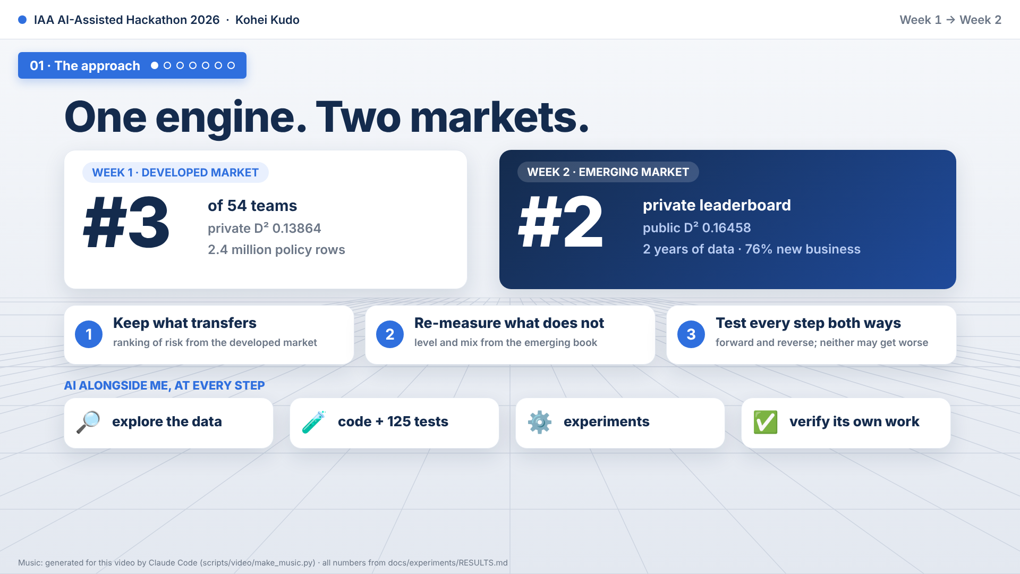
Notes:
I'm Kohei, and this is one pricing engine applied to two markets. Week one: a developed market with two point four million policy rows. Rank three of fifty-four. Week two: an emerging market with only two years of data, and a test book that is seventy-six percent new business. We finished second. The approach: keep what transfers from the developed market, re-measure what does not, and test every step in both directions. And AI works alongside me through all of it: exploring the data, writing and testing the code, running experiments, and checking its own work.

Slide 2
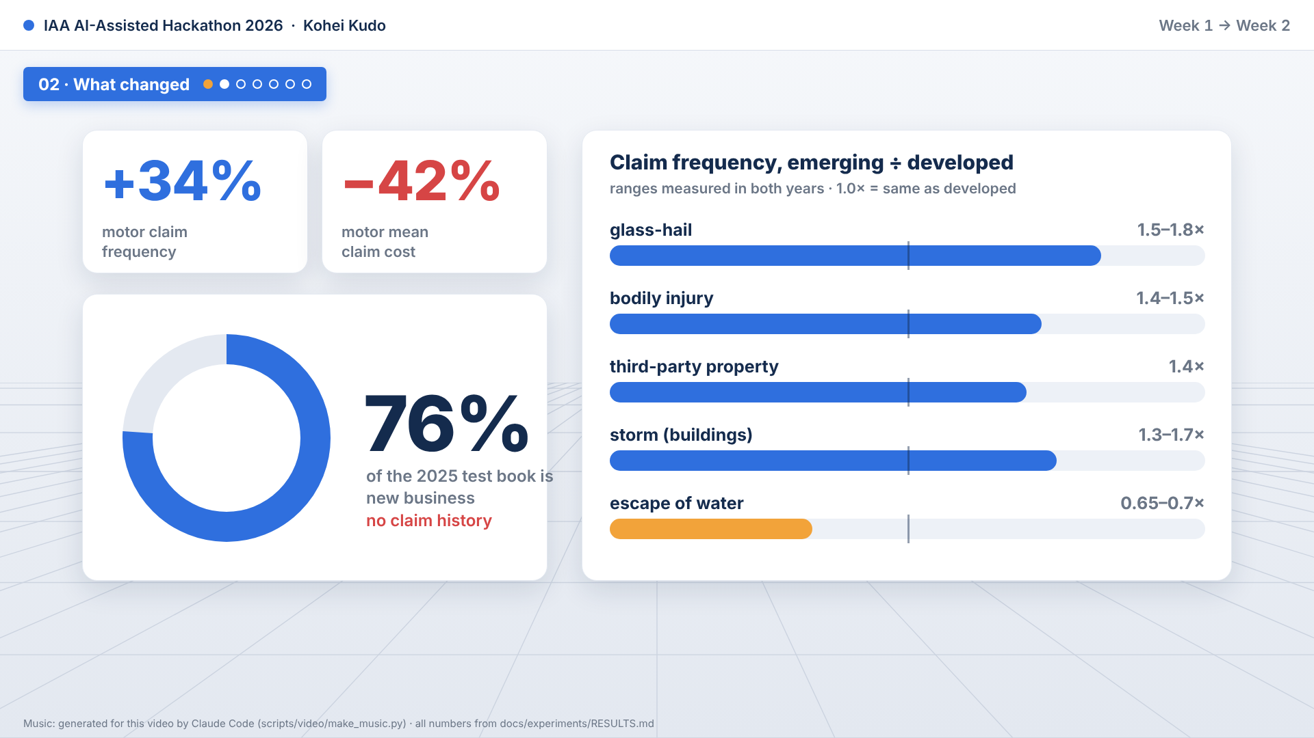
Notes:
So what changed in the new market? Motor claims are thirty-four percent more frequent, but forty-two percent cheaper. Glass, third-party and injury claims are far more frequent. Escape of water is far less. And three out of four test policies are brand-new customers with no history. We measured that these differences are stable across both years, instead of assuming it.

Slide 3
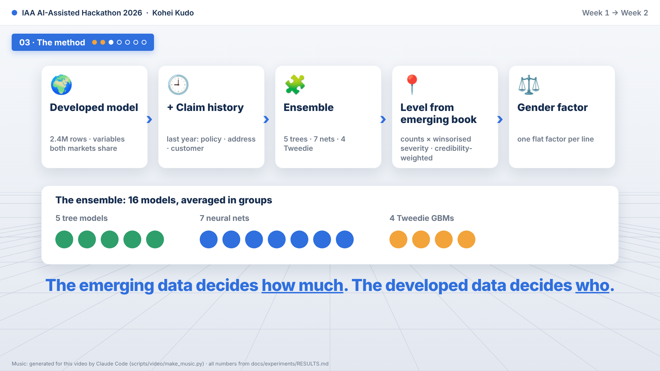
Notes:
The method keeps what transfers, and re-measures what does not. A developed-market model, trained on the variables both markets share, ranks who is risky. I add last year's claim history. An ensemble of five tree models, seven neural nets and four Tweedie models averages out the noise. Then the emerging book sets the level: claim counts and winsorised severities for each peril, credibility-weighted, plus one gender factor. The emerging data decides how much. The developed data decides who.

Slide 4
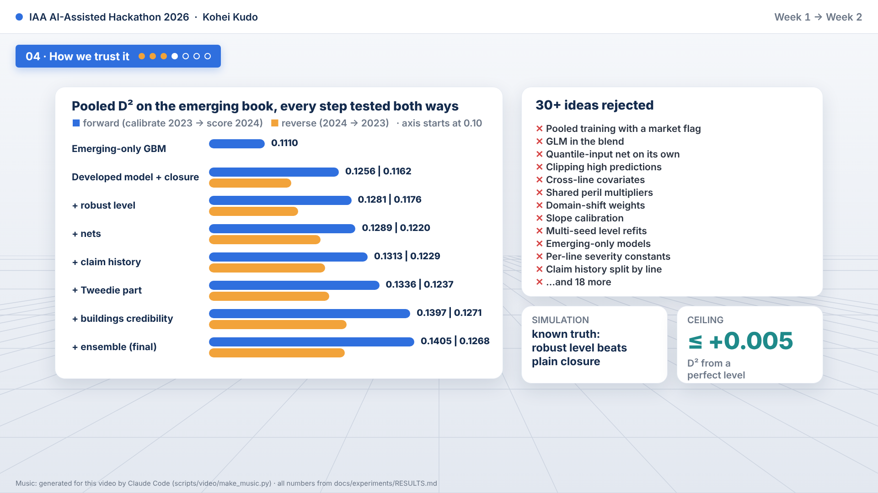
Notes:
With two years of data, a single split can mistake noise for signal. So every change is tested in both directions: calibrate on 2023 and score 2024, then the reverse. We keep it only if neither direction gets worse. That took the score from point one one one oh, for an emerging-only model, to point one four oh five. More than thirty ideas were rejected this way, including pooled training, a GLM blend and clipping of high predictions. A simulation with a known truth confirmed the level method, and a ceiling analysis showed that a perfect level is worth at most half of one hundredth.

Slide 5
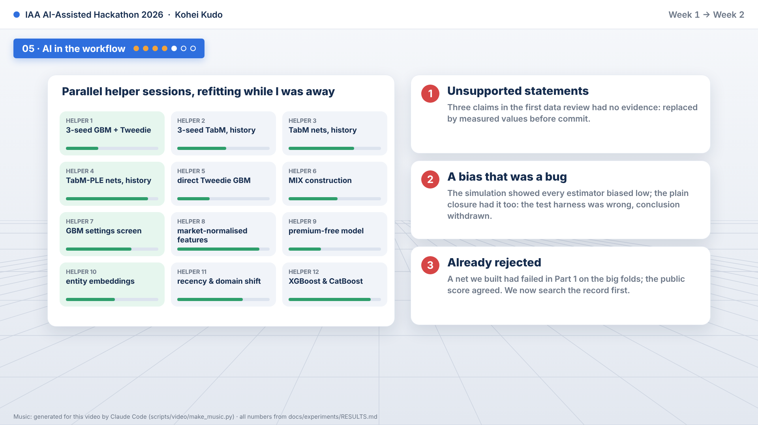
Notes:
Here is how that looked in practice. Claude Code explored both markets, wrote the code with one hundred and twenty-five tests, and ran the experiments, while more than ten helper sessions refit models in parallel. A blind second agent compared the markets from the raw tables alone. And verification caught real errors: unsupported statements in a first draft, a simulator bug that looked like a model bias, and a net that Part one had already rejected. Every number traces to a command.

Slide 6
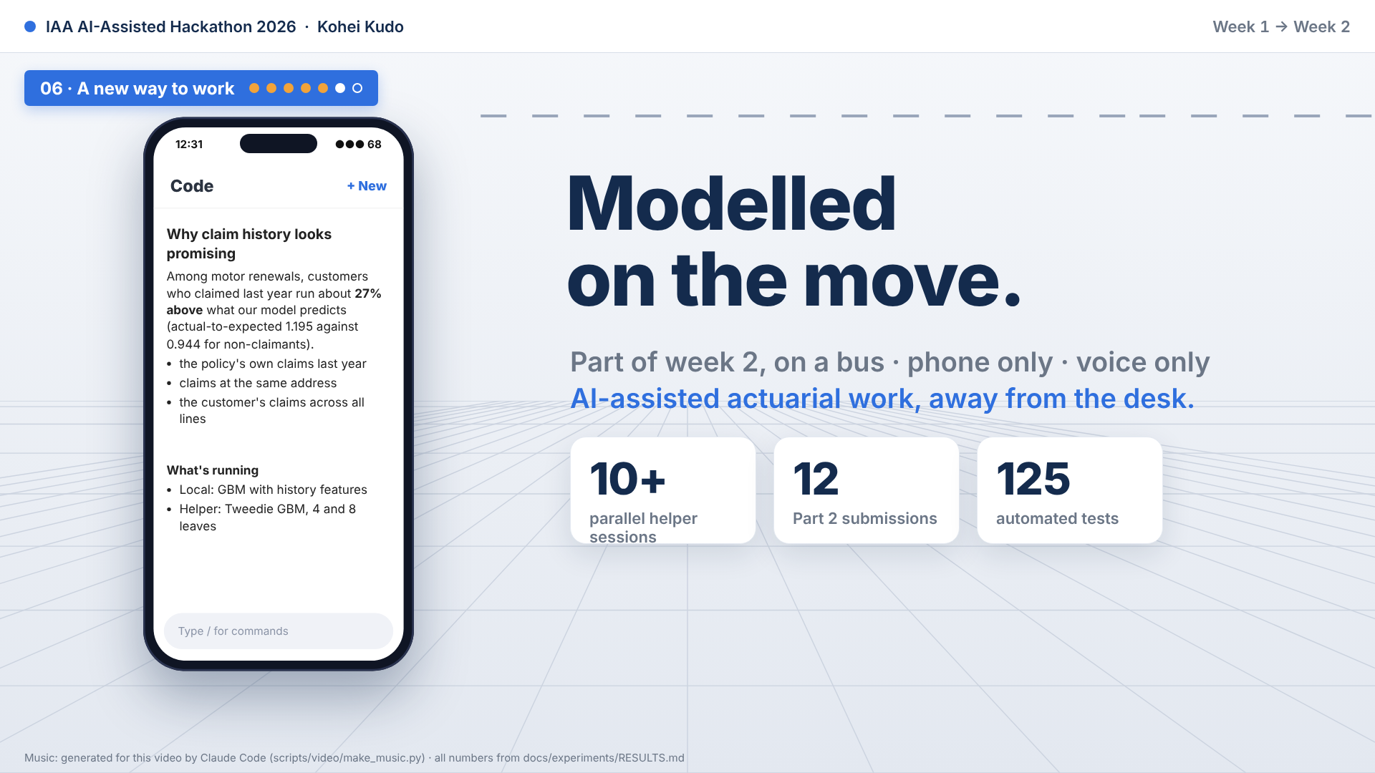
Notes:
One example of how this changes the way I work. Part of week two was modelled from my phone, on a bus, with no laptop. I spoke my instructions, Claude Code transcribed them, ran the experiments in the cloud, and sent back results I could read between stops. That is AI-assisted actuarial work, away from the desk.

Slide 7
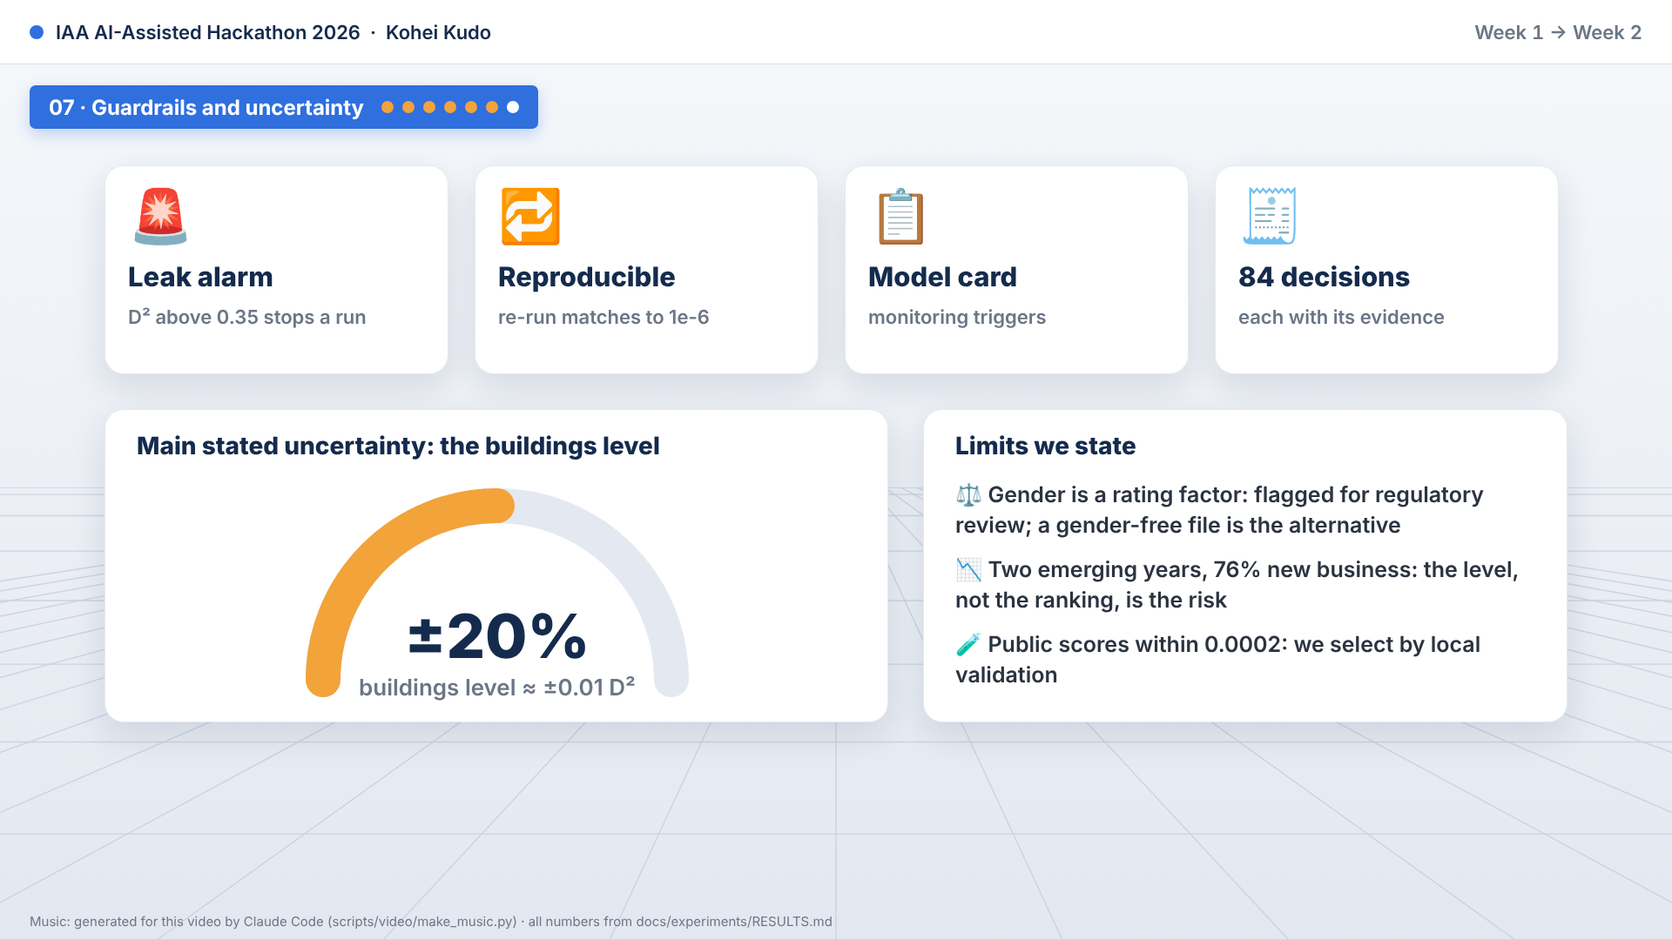
Notes:
Guardrails: a leak alarm, reproducibility checks, a model card, and eighty-four recorded decisions. The biggest uncertainty is the buildings level. Plus or minus twenty percent is about one hundredth of a point. And gender rating is flagged for regulatory review.

Slide 8

Notes:
Built with an AI teammate, from a bus seat. Thank you.

