Slide 1

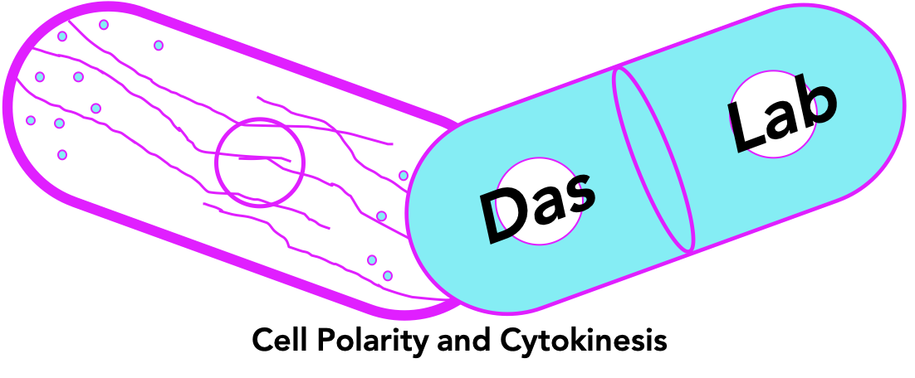

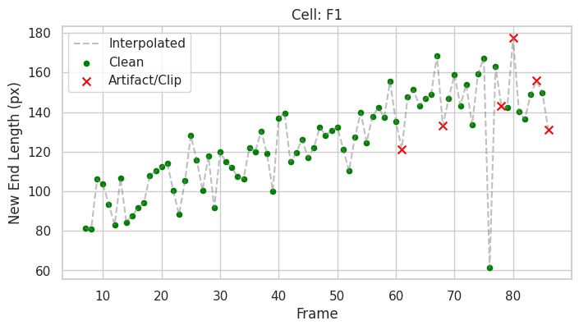
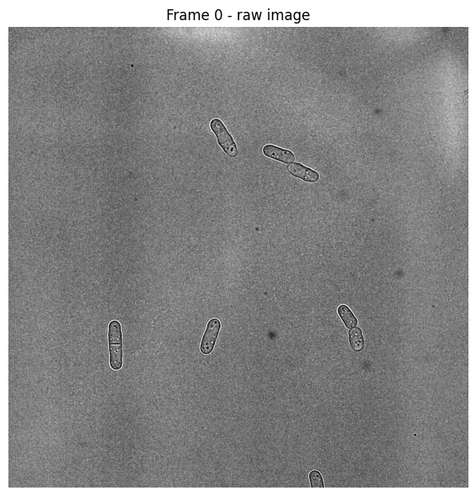
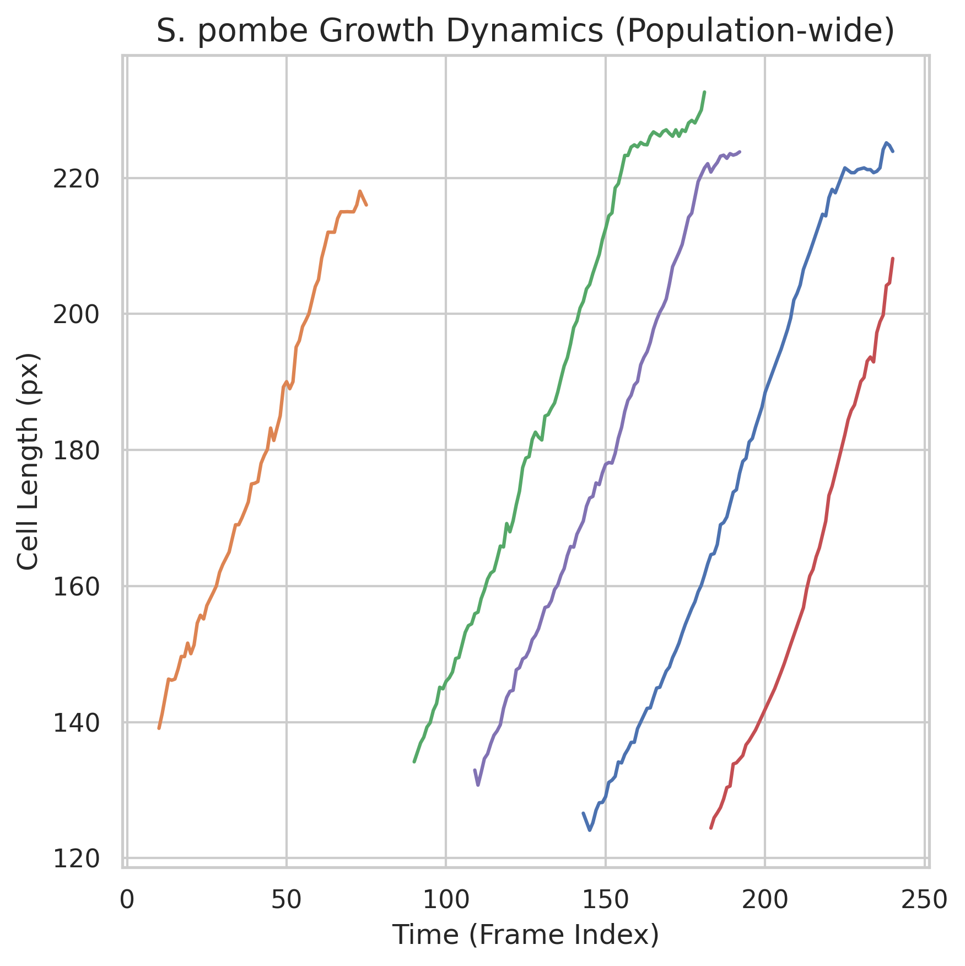
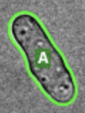
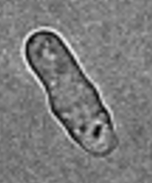
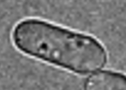
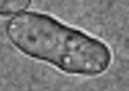
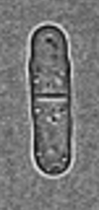
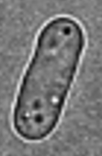
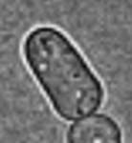
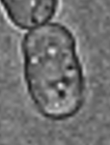
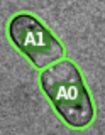
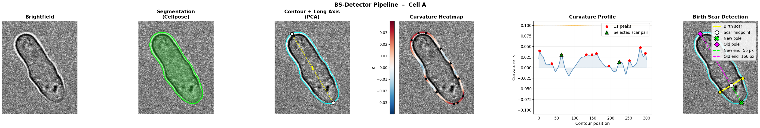
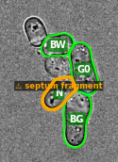
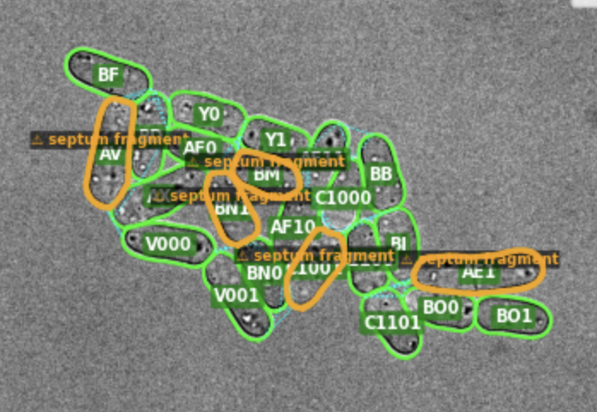
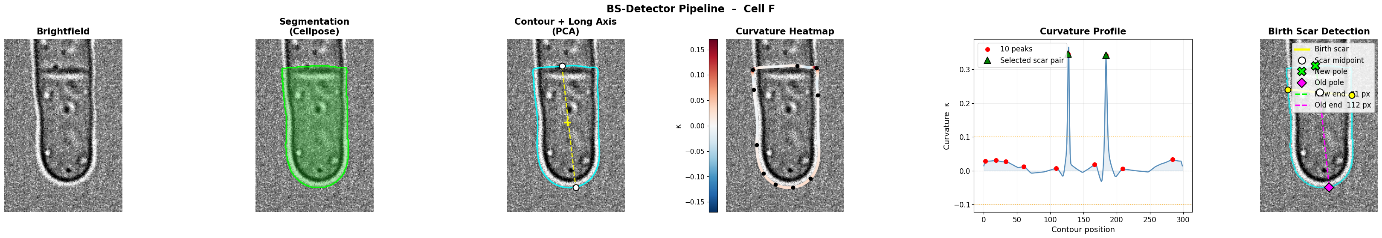
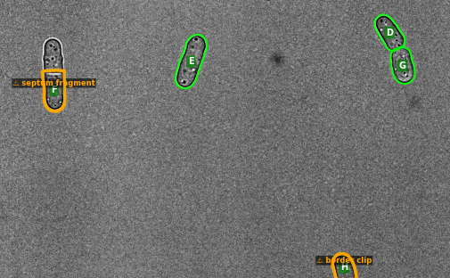
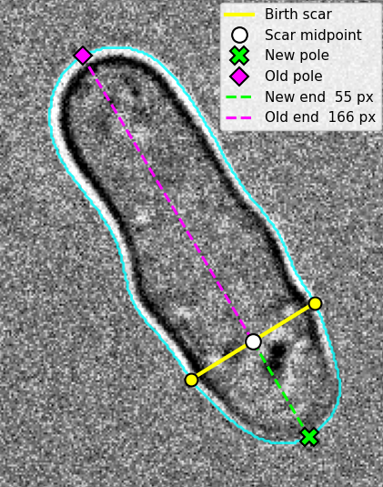
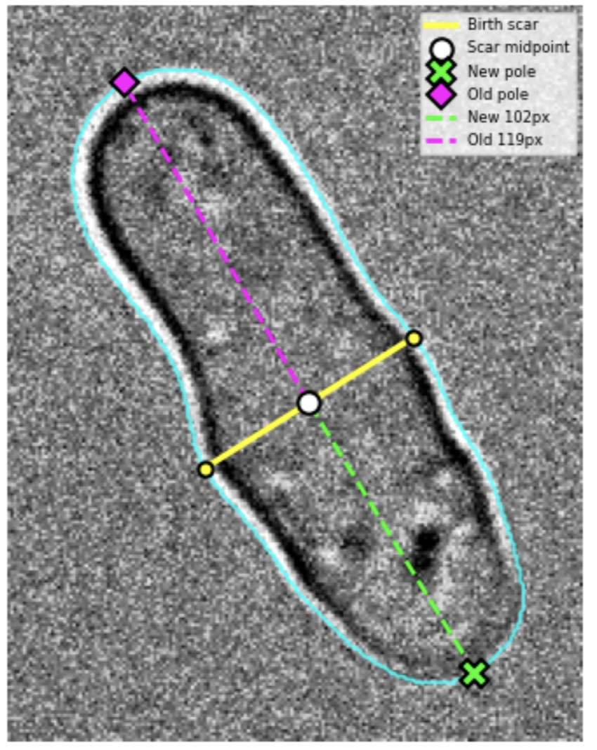
Automated Analysis of Polar Growth Dynamics in Fission Yeast:
A Hybrid Deep Learning and Geometric Modeling Approach
Michael “Xander” Widener¹, Carmen Rivera², Maitreyi Das², Donglai Wei¹
¹Computer Science Department, Boston College
²Biology Department, Boston College
Context & Challenges
The BS-Detector Pipeline
Limitations & Future Work
Cell shape is critical for function. In fission yeast Schizosaccharomyces pombe, this rod-like shape is maintained by polarized growth, which is regulated by conserved Rho GTPases, specifically Cdc42 and Rho1.¹ These proteins oscillate between the cell poles to establish bipolar growth. After successful division, cells grow first from the "Old End" (inherited from the previous generation) before activating the "New End" in a process called New End Take Off (NETO).²
Our lab is investigating how Cdc42 and Rho1 regulate these distinct growth phases to maintain polarity. Recently, we observed that in rgf1Δ mutants with low rho1 activity, the fluorescence intensity of active Cdc42 decreases significantly.³
Testing this hypothesis requires correlating growth rates at the Old versus New ends with localized protein activity, allowing us to better link cell shape and polarity to the complex of mechanisms that set and maintain growth rate. However, distinguishing these ends requires identifying the "birth scar," a subtle ridge on the cell wall marking the previous division site. Manual annotation of birth scars is subjective and inefficient for the high-throughput analysis required to study subtle mutant phenotypes. To solve this, we developed a computational pipeline that automates this analysis by combining deep learning for segmentation with geometry for feature extraction.
n frame brightfield video
k cells per frame
lineage tracking
.csv & growth curves
…
Green indicates clean BS detections and red marks frames where the cell was flagged as a border clip or segmentation artifact.
For each cell, for each frame, the following steps are performed
Birth scar localization remains the primary source of measurement noise, compounded by occasional Cellpose segmentation failures, quality control failures and sensitivity to parameter choice. Future development will target more robust candidate scoring, automated parameter tuning, and tools that allow researchers to inspect and correct flagged detections without re-running the pipeline.
Steps of the algorithm visualized at the cell level
For each cell, a B-spline is fit to the Cellpose segmentation contour and signed curvature is computed at every point.⁴ The long axis is identified via PCA, and birth scar candidates are flagged as pairs of curvature peaks on opposite sides of the cell whose connecting vector is perpendicular to the long axis and spans the full cell width. The highest-scoring candidate pair defines the scar midpoint, from which new-end and old-end compartment lengths are measured to each pole.
Quality Control: Mitigating Segmentation & Tracking Noise
References, Demo, Connect
Colab Demo
Github Repo
LinkedIn
Spatial and curvature-based filters flag border clips and septated cells. To eliminate birth scar oscillation, a temporal stability algorithm preserves high-confidence candidates across frames, filtering out transient curvature noise.
For direct inquiries, email: widenerm@bc.edu
[1] Mosaddeghzadeh & Ahmadian. Cells 10(7):1831 (2021).
[2] Mitchison & Nurse. J Cell Sci 75:357–376 (1985).
[3] Rivera et al. Unpublished manuscript (2025).
[4] Stringer et al. Nat Methods 18:100–106 (2021).
Funding: NIH/NIGMS R01GM136847

