Slide 1

CTS deepin
Mar 11, 2011
Jingtao
Notes:
1
1
1
主标题 字号：37 （加粗）字体：Arial颜色：RGB：51 51 153
日期 字号：30 字体：Arial颜色：RGB：51 51 153

Slide 2
Agenda
CTS workflow
manage test plan
structure of CTS
design test case
tools in CTS
test automation on Android
Notes:
1
1
1

Slide 3
CTS workflow
cmd parser
test executer
report generator
log generator
Notes:
1

Slide 4
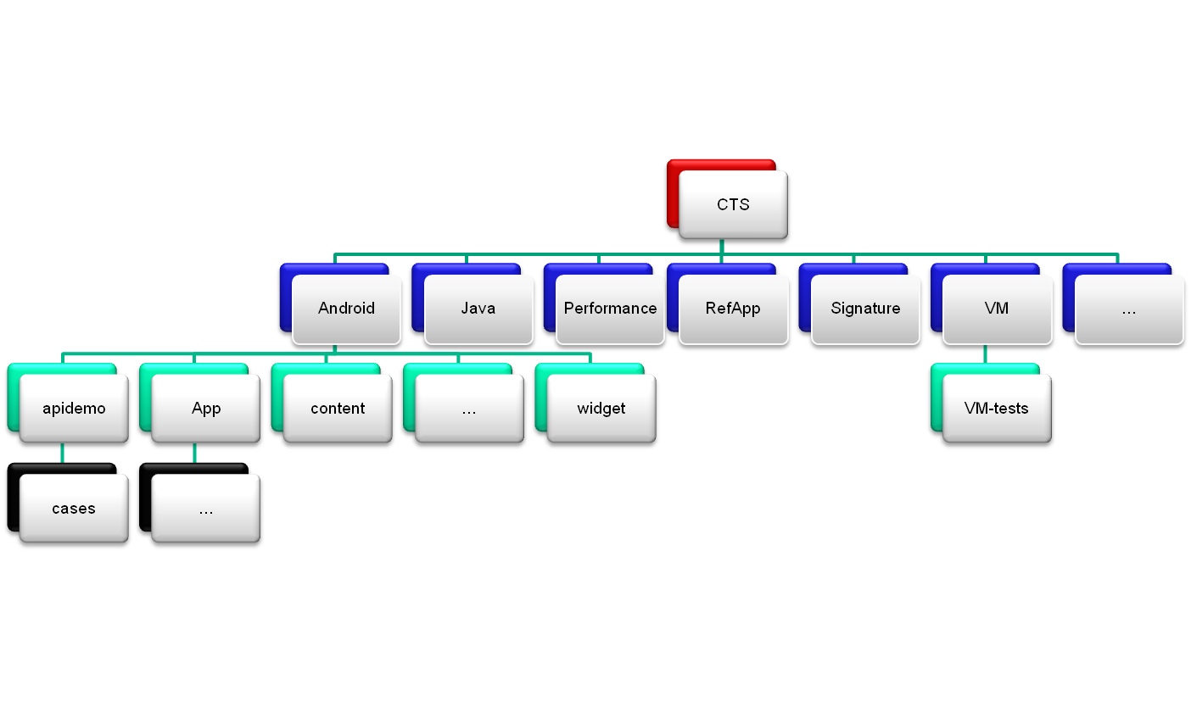
Plan hierarchy
Notes:
1
1

Slide 5
CTS folder structure
|-- repository
| |-- ...
| |-- plans
| | |-- Android.xml
| | |-- ...
| | `-- CTS.xml
| |-- results
| | |-- 2009.12.29_14.48.20
| | | |-- ...
| | | `-- testResult.xml
| | |-- 2009.12.29_14.48.20.zip
| `-- testcases
| |-- CtsAppTestCases.apk
| |-- CtsAppTestCases.xml
| |-- ...
| |-- android.core.vm-tests.jar
| `-- android.core.vm-tests.xml
`-- tools
|-- cts.jar
`-- startcts
Notes:
1
1
1

Slide 6
“Android” plan
<?xml version="1.0" encoding="UTF-8" ?>
<TestPlan version="1.0">
<Entry uri="android.tests.sigtest"/>
<Entry uri="android.app"/>
<Entry uri="android.content"/>
<Entry uri="android.database"/>
<Entry uri="android.graphics"/>
<Entry uri="android.hardware"/>
<Entry uri="android.location"/>
<Entry uri="android.net"/>
<Entry uri="android.os"/>
<Entry uri="android.permission"/>
<Entry uri="android.provider"/>
<Entry uri="android.text"/>
<Entry uri="android.util"/>
<Entry uri="android.view"/>
<Entry uri="android.widget"/>
</TestPlan>
Notes:
1
1
1

Slide 7
CTS source structure
|-- Android.mk
|-- CleanSpec.mk
|-- CtsTestCaseList.mk
|-- tests
| |-- Android.mk
| |-- AndroidManifest.xml
| |-- core
| |-- jni
| |-- res
| |-- src
| |-- tests
| `-- vm-tests
`-- tools
Notes:
1
1
1

Slide 8
generate test description
buildCts.py <testRoot> <ctsOutputDir> <tempDir> <androidRootDir> <docletPath>
e.g.
cts/tools/utils/buildCts.py cts/tests/tests out/host/linux-x86/cts/android-cts /tmp . out/host/linux-x86/framework/descGen.jar
Notes:
1
1
1

Slide 9
targetSdkVersion
each release of CTS require specific platform to run, e.g.,
CTS2.2 can only run on froyo device.
but if you want to run it on other platform for some special reason,
you can rebuild cts by:
make cts DEFAULT_APP_TARGET=1
you can also change it in build/core/version_defaults.mk
Notes:
1
1
1

Slide 10
Tools in CTS
Annotation helper
Device info collector
Process controller
Test plan generator
Signature generator
Host configer
Script starter
…
Notes:
1
1
1

Slide 11
further study
java com.android.cts.TestHost in startcts
cts/tools/host
cts/tools/host/src/com/android/cts/TestHost.java
...
Notes:
1
1
1

Slide 12
work flow of TestHost
Notes:
1
1
1

Slide 13
categary of cases and execute strategy
CTS cases
hardware/opl
related cases
general cases
run on each product
by build check
run full cycle on
emulator each week
Notes:
1
1
1

Slide 14

Notes:
1
1
1

