Slide 1

CDD digest
Nov 5, 2010
Jingtao
Notes:
主标题 字号：37 （加粗）字体：Arial颜色：RGB：51 51 153
日期 字号：30 字体：Arial颜色：RGB：51 51 153

Slide 2
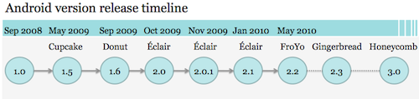
Android versions
http://www.ifanr.com/23934

Slide 3
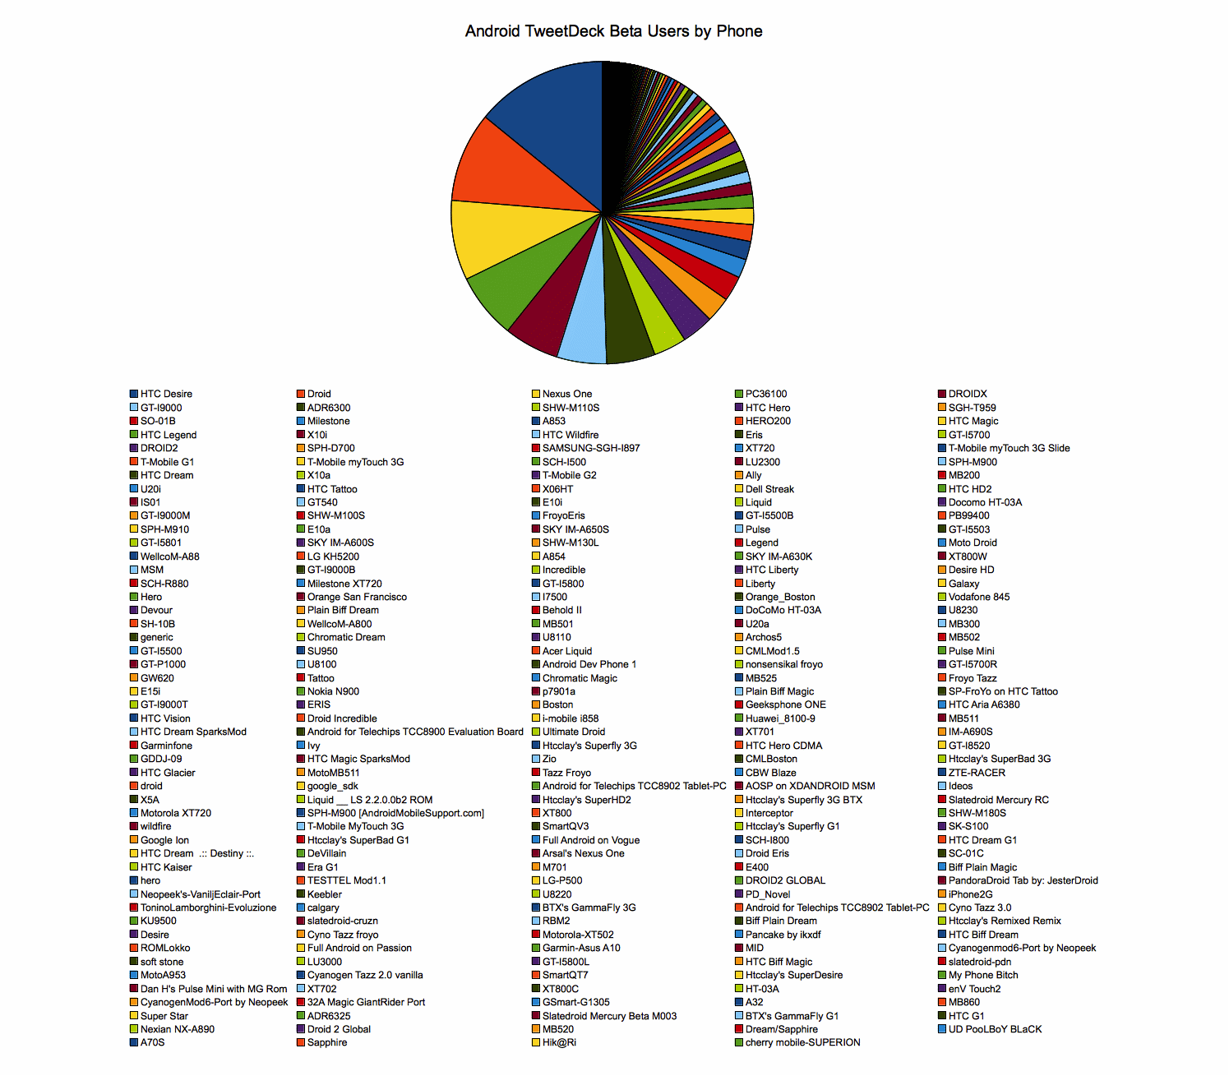
Android fragmentation

Slide 4
Google's solution to anti fragmentation
  Google define an “Android compatibility” device as one that can run any application written by third-party developers using the Android SDK and NDK.
  Device that are properly compatible can seek approval to use Android trademark and Android Market client software.
Notes:
标题 字号28 字体：Arial （加粗）颜色：RGB：51 51 153
内容：
一级标题 字号18 字体：Arial （加粗）
二三级标题 字号18 字体：Arial

Slide 5
how to verify compatibility
  the Android Compatibility Definition Document(CDD) spells out the specific device configuration that will be considered compatible.
  CTS(an automatically compatibility test tool) test
  Third party application test
Notes:
标题 字号28 字体：Arial （加粗）颜色：RGB：51 51 153
内容：
一级标题 字号18 字体：Arial （加粗）
二三级标题 字号18 字体：Arial

Slide 6
where is CDD
http://source.android.com/compatibility/downloads.html
Notes:
to build CTS from froyo source code, no need to download all the source.
you can follow below steps
1, repo sync bionic build cts dalvik development frameworks Makefile ndk prebuilt sdk system
2, repo sync external/apache-http external/clearsilver external/elfcopy external/elfutils external/expat external/fdlibm external/icu4c external/junit external/libpng external/opencore external/openssl external/proguard external/sqlite external/svox external/tagsoup external/xmlwriter external/zlib
3, make cts

Slide 7
requirement in CDD
3. software API compatibility
4. reference app test
5. application packaging compatibility
6. multimedia compatibility
7. developer tool compatibility
8. hardware compatibility
9. performance compatibility
10. security model compatibility
11. CTS
12. system update

Slide 8
3. software requirement
Managed Java API
Permissions
android.os.Build.*
Intent
Native API
Web compatibility
API behavior and name space
Virtual Machine compatibility
UI

Slide 9
3.1 managed API
The managed (Dalvik-based) execution environment is the primary vehicle for Android applications. The Android application programming interface(API) is the set of Android platform interfaces exposed to applications running in the managed VM environment. Device implementations MUST provide complete implementations, including all documented behaviors, of any documented API exposed by the Android 2.2 SDK [Resources, 4].
Device implementations MUST NOT omit any managed APIs, alter API interfaces or signatures, deviate from the documented behavior, or include no-ops, except where specifically allowed by this Compatibility Definition.

Slide 10
3.2 software API
permission
build paras(android.os.Build)‏
intent

Slide 11
3.2.3.1 core application intent
Desk Clock
Browser
Calendar
Calculator
Camera
Contacts
Email
Gallery
GlobalSearch
Launcher
LivePicker (the Live Wallpaper picker application; MAY be omitted if the device does not support Live Wallpapers)‏
Messaging (AKA "Mms")‏
Music
Phone
Settings
SoundRecorder

Slide 12
3.3 native API requirement
libc (C library)‏
libm (math library)‏
JNI interface
libz (Zlib compression)‏
liblog (Android logging)‏
Minimal support for C++
Support for OpenGL, as described in CDD

Slide 13
3.4 web compatibility
Browser app must be standalone, may not based on webkit
android.webkit.WebView must based on webkit.
user agent of WebView must in the format of
Mozilla/5.0 (Linux; U; Android $(VERSION); $(LOCALE); $(MODEL) Build/$(BUILD)) AppleWebKit/533.1 (KHTML, like Gecko) Version/4.0 Mobile Safari/533.1

Slide 14
3.5 API behaviour
Devices MUST NOT change the behavior or meaning of a standard Intent.
Devices MUST NOT alter the lifecycle or lifecycle semantics of a particular type of system component (such as Service, Activity, ContentProvider, etc.)‏
Devices MUST NOT change the semantics of a particular permission.

Slide 15
3.6 API namespaces
1, java.*
2, javax.*
3, sun.*
4, android.*
5, com.android.*
Device implementations MUST NOT modify the publicly exposed APIs on the Android platform by changing any method or class signatures, or by removing classes or class fields.
Device implementers MAY modify the underlying implementation of the APIs, but such modifications MUST NOT impact the stated behavior and Java-language signature of any publicly exposed APIs.
Device implementers MUST NOT add any publicly exposed elements (such as classes or interfaces, or fields or methods to existing classes or interfaces) to the APIs above.

Slide 16
3.7 virtual machine compatibility
Device implementations MUST support the full Dalvik Executable (DEX) bytecode specification and Dalvik Virtual Machine semantics [Resources, 10].
Device implementations with screens classified as medium- or low-density MUST configure Dalvik to allocate at least 16MB of memory to each application.
Device implementations with screens classified as high-density MUST configure Dalvik to allocate at least 24MB of memory to each application. Note that device implementations MAY allocate more memory than these figures.

Slide 17
3.8 UI requirement
AppWidget
Notification
Search
Toast
Live Wallpaper

Slide 18
4. reference apps
Calculator(in SDK)‏
Lunar Lander(in SDK)‏
http://code.google.com/p/apps-for-android/
Replica Island(on Android Market, for OpenGL ES2.0)‏
Api Demos(in SDK)‏

Slide 19
5. application packaging
Device implementations MUST install and run Android ".apk" files as generated by the "aapt" tool included in the official Android SDK [Resources, 19].
Devices implementations MUST NOT extend either the .apk [Resources, 20], Android Manifest [Resources, 21], or Dalvik bytecode [Resources, 10] formats in such a way that would prevent those files from installing and running correctly on other compatible devices.

Slide 20
6. multimedia
Media Codec
Audio Record
Audio Latency

Slide 21
7. development tool
adb
ddms
monkey

Slide 22
8. hardware compatibility
display
keyboard
Non-touch navigation
screen orientation
touch-screen input: must have a touch screen
USB
navigation keys
wireless data networking
camera
accelerometer
compass
GPS
telephony
memory and storage:
application shared storage
Bluetooth

Slide 23
8.1 display
Android 2.2 includes facilities that perform certain automatic scaling and transformation operations under some circumstances, to ensure that third-party applications run reasonably well on a variety of hardware configurations [Resources, 24]. Devices MUST properly implement these behaviors, as detailed in this section.
common display configure: QVGA, WQVGA, FWQVGA, HVGA, WVGA, FWVGA

Slide 24
8.2 keyboard
must support Input Management Framework.
must support at least one soft keyboard implementation.
must not include a hardware keyboard that does not match one of the formats specified in android.content.res.Configuration.keyboard.

Slide 25
8.3 none-touch navigation
MAY omit a non-touch navigation options (that is, may omit a trackball, d-pad, or wheel).
MUST report the correct value for android.content.res.Configuration.navigation.

Slide 26
8.4 screen orientation
Compatible devices MUST support dynamic orientation by applications to either portrait or landscape screen orientation. That is, the device must respect the application's request for a specific screen orientation. Device implementations MAY select either portrait or landscape orientation as the default.

Slide 27
8.5 touchscreen
must have a touchscreen.
MUST report the value of android.content.res.Configuration [Resources, 25] reflecting corresponding to the type of the specific touchscreen on the device.

Slide 28
8.6 usb
MUST implement a USB client, connectable to a USB host with a standard USB-A port.
MUST implement the Android Debug Bridge over USB (as described in Section 7)‏.
MUST implement the USB mass storage specification, to allow a host connected to the device to access the contents of the /sdcard volume.

Slide 29
8.7 navigation keys
The Home, Menu and Back functions are essential to the Android navigation paradigm. Device implementations MUST make these functions available to the user at all times, regardless of application state. These functions SHOULD be implemented via dedicated buttons. They MAY be implemented using software, gestures, touch panel, etc., but if so they MUST be always accessible and not obscure or interfere with the available application display area.

Slide 30
8.8 wireless connection
Device implementations MUST include support for wireless high-speed data networking. Specifically, device implementations MUST include support for at least one wireless data standard capable of 200Kbit/sec or greater. Examples of technologies that satisfy this requirement include EDGE, HSPA, EV-DO, 802.11g, etc.
If a device implementation includes a particular modality for which the Android SDK includes an API (that is, WiFi, GSM, or CDMA), the implementation MUST support the API.
Devices MAY implement more than one form of wireless data connectivity. Devices MAY implement wired data connectivity (such as Ethernet), but MUST nonetheless include at least one form of wireless connectivity, as above.

Slide 31
8.9 camera
MUST include a rear-facing camera.
which MUST have a resolution of at least 2 megapixels.

Slide 32
8.10 accelerometer
Device implementations MUST include a 3-axis accelerometer and MUST be able to deliver events at 50 Hz or greater.
The coordinate system used by the accelerometer MUST comply with the Android sensor coordinate system as detailed in the Android APIs.

Slide 33
8.11 compass
Device implementations MUST include a 3-axis compass and MUST be able to deliver events 10 Hz or greater.
The coordinate system used by the compass MUST comply with the Android sensor coordinate system as defined in the Android API.

Slide 34
8.12 GPS
Device implementations MUST include a GPS receiver, and SHOULD include some form of "assisted GPS" technique to minimize GPS lock-on time.

Slide 35
8.13 telephony
Android 2.2 MAY be used on devices that do not include telephony hardware. That is, Android 2.2 is compatible with devices that are not phones.
However, if a device implementation does include GSM or CDMA telephony, it MUST implement the full support for the API for that technology.
Device implementations that do not include telephony hardware MUST implement the full APIs as no-ops.

Slide 36
8.14 memory & storage
Device implementations MUST have at least 92MB of memory available to the kernel and userspace. The 92MB MUST be in addition to any memory dedicated to hardware components such as radio, memory, and so on that is not under the kernel's control.
Device implementations MUST have at least 150MB of non-volatile storage available for user data. That is, the /data partition MUST be at least 150MB.

Slide 37
8.15 app shared storage
Device implementations MUST offer shared storage for applications. The shared storage provided MUST be at least 2GB in size.
Device implementations MUST be configured with shared storage mounted by default, "out of the box". If the shared storage is not mounted on the Linux path /sdcard, then the device MUST include a Linux symbolic link from /sdcard to the actual mount point.
Device implementations MUST enforce as documented the android.permission.WRITE_EXTERNAL_STORAGE permission on this shared storage. Shared storage MUST otherwise be writable by any application that obtains that permission.
Regardless of the form of shared storage used, the shared storage MUST implement USB mass storage, as described in Section 8.6. As shipped out of the box, the shared storage MUST be mounted with the FAT filesystem.
It is illustrative to consider two common examples. If a device implementation includes an SD card slot to satisfy the shared storage requirement, a FAT-formatted SD card 2GB in size or larger MUST be included with the device as sold to users, and MUST be mounted by default. Alternatively, if a device implementation uses internal fixed storage to satisfy this requirement, that storage MUST be 2GB in size or larger, formatted as FAT, and mounted on /sdcard (or /sdcard MUST be a symbolic link to the physical location if it is mounted elsewhere.)‏

Slide 38
8.16 Blue tooth
Device implementations MUST include a Bluetooth transceiver. Device implementations MUST enable the RFCOMM-based Bluetooth API as described in the SDK documentation.
The Compatibility Test Suite includes cases that cover basic operation of the Android RFCOMM Bluetooth API. However, since Bluetooth is a communications protocol between devices, it cannot be fully tested by unit tests running on a single device. Consequently, device implementations MUST also pass the human-driven Bluetooth test procedure described in Appendix A.

Slide 39
9. performance
browser launch time< 1300ms
MMS/SMS launch time < 700ms
AlarmClock launch time < 650ms
re-launch time < first launch time

Slide 40
10. security model
permissions
UID and process isolation
File system permissions
Alternative execution environment

Slide 41
11. CTS
MUST pass the latest CTS version available at the time the device software is completed.

Slide 42
12. system update
Must support to replace the entirely of system software without wiping user data.
eg, OTA, USB, SDcard

Slide 43


