Slide 1

CDD2.3 digest
Jan 4, 2011
Jingtao
Notes:
主标题 字号：37 （加粗）字体：Arial颜色：RGB：51 51 153
日期 字号：30 字体：Arial颜色：RGB：51 51 153

Slide 2
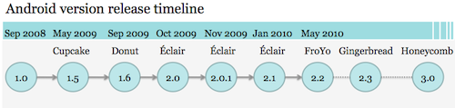
Android versions
http://www.ifanr.com/23934

Slide 3
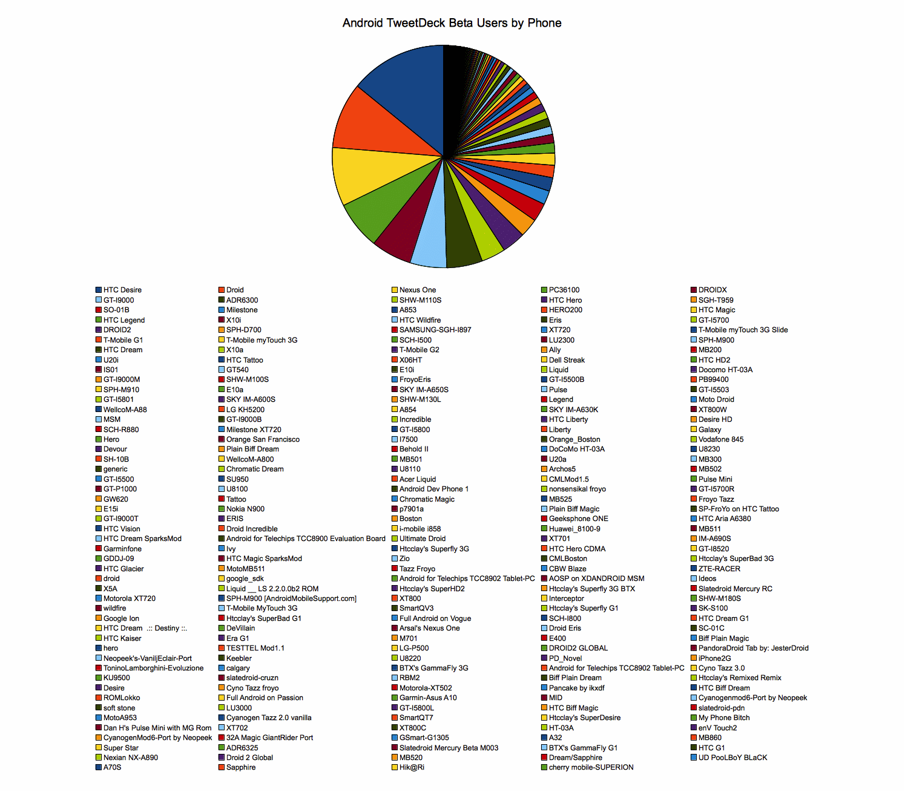
Android fragmentation
http://www.ifanr.com/23318

Slide 4
Google's solution to anti fragmentation
  Google define an “Android compatibility” device as one that can run any application written by third-party developers using the Android SDK and NDK.
  Device that are properly compatible can seek approval to use Android trademark and Android Market client software.
Notes:
标题 字号28 字体：Arial （加粗）颜色：RGB：51 51 153
内容：
一级标题 字号18 字体：Arial （加粗）
二三级标题 字号18 字体：Arial

Slide 5
how to verify compatibility
  the Android Compatibility Definition Document(CDD) spells out the specific device configuration that will be considered compatible.
  CTS(an automatically compatibility test tool) test
  Third party application test
Notes:
标题 字号28 字体：Arial （加粗）颜色：RGB：51 51 153
内容：
一级标题 字号18 字体：Arial （加粗）
二三级标题 字号18 字体：Arial

Slide 6
where is CDD
http://source.android.com/compatibility/downloads.html
Notes:
to build CTS from froyo source code, no need to download all the source.
you can follow below steps
1, repo sync bionic build cts dalvik development frameworks Makefile ndk prebuilt sdk system
2, repo sync external/apache-http external/clearsilver external/elfcopy external/elfutils external/expat external/fdlibm external/icu4c external/junit external/libpng external/opencore external/openssl external/proguard external/sqlite external/svox external/tagsoup external/xmlwriter external/zlib
3, make cts

Slide 7
requirement in CDD
3. software API compatibility
4. application packaging compatibility
5. multimedia compatibility
6. developer tool compatibility
7. hardware compatibility
8. performance compatibility
9. security model compatibility
10. Software Compatibility Testing
11. Updatable system

Slide 8
3. software requirement
Managed API
Soft API
Native API
Web compatibility
API behavior and name space
Virtual Machine compatibility
UI

Slide 9
3.1 managed API
The managed (Dalvik-based) execution environment is the primary vehicle for Android applications. The Android application programming interface(API) is the set of Android platform interfaces exposed to applications running in the managed VM environment. Device implementations MUST provide complete implementations, including all documented behaviors, of any documented API exposed by the Android 2.3 SDK [Resources, 4].
Device implementations MUST NOT omit any managed APIs, alter API interfaces or signatures, deviate from the documented behavior, or include no-ops, except where specifically allowed by this Compatibility Definition.
This Compatibility Definition permits some types of hardware for which Android includes APIs to be omitted by device implementations. In such cases, the APIs MUST still be present and behave in a reasonable way. See Section 7 for specific requirements for this scenario.

Slide 10
3.2 soft API
permission
build paras(android.os.Build)‏, can verify manually
intent

Slide 11
3.2.3.1 core application intent
Desk Clock, does all product have Desk Clock?
Browser
Calendar
Calculator
Camera
Contacts
Email
Gallery
GlobalSearch, do we have GlobalSearch?
Launcher
LivePicker (the Live Wallpaper picker application; MAY be omitted if the device does not support Live Wallpapers)‏
Messaging (AKA "Mms")‏
Music
Phone
Settings
SoundRecorder
Notes:
some 2.2 core apps removed for the list.

Slide 12
3.3 native API requirement
libc (C library)‏
libm (math library)‏
JNI interface
libz (Zlib compression)‏
liblog (Android logging)‏
Minimal support for C++
Support for OpenGL, as described in CDD
add below by CDD2.3:
libdl(dynamic link)‏
libGLESv1_CM.so (OpenGL ES 1.0)‏
libGLESv2.so (OpenGL ES 2.0)‏
libEGL.so (native OpenGL surface management)‏
libjnigraphics.so
libOpenSLES.so (Open Sound Library audio support)‏
libandroid.so (native Android activity support)‏

Slide 13
ABI(Application Binary Interface)‏
If a device implementation includes support for an Android ABI, it:
MUST include support for code running in the managed environment to call into native code, using the standard Java Native Interface (JNI) semantics.
MUST be source-compatible (i.e. header compatible) and binary-compatible (for the ABI) with each required library in the list below
MUST accurately report the native Application Binary Interface (ABI) supported by the device, via the android.os.Build.CPU_ABI API
MUST report only those ABIs documented in the latest version of the Android NDK, in the file docs/CPU-ARCH-ABIS.txt
Note that future releases of the Android NDK may introduce support for additional ABIs. If a device implementation is not compatible with an existing predefined ABI, it MUST NOT report support for any ABI at all.

Slide 14
3.4 web compatibility
Browser app must be standalone, may not based on webkit
android.webkit.WebView must based on webkit.
user agent of WebView must in the format of
Mozilla/5.0 (Linux; U; Android $(VERSION); $(LOCALE); $(MODEL) Build/$(BUILD)) AppleWebKit/533.1 (KHTML, like Gecko) Version/4.0 Mobile Safari/533.1

Slide 15
HTML5
MUST support each of these APIs associated with HTML5 in the WebView:
application cache/offline operation
the <video> tag
geolocation
Additionally, device implementations MUST support the HTML5/W3C webstorage API
HTML5 APIs, like all JavaScript APIs, MUST be disabled by default in a WebView, unless the developer explicitly enables them via the usual Android APIs.

Slide 16
3.5 API behaviour
Devices MUST NOT change the behavior or meaning of a standard Intent.
Devices MUST NOT alter the lifecycle or lifecycle semantics of a particular type of system component (such as Service, Activity, ContentProvider, etc.)‏
Devices MUST NOT change the semantics of a particular permission.

Slide 17
3.6 API namespaces
1, java.*
2, javax.*
3, sun.*
4, android.*
5, com.android.*
Device implementations MUST NOT modify the publicly exposed APIs on the Android platform by changing any method or class signatures, or by removing classes or class fields.
Device implementers MAY modify the underlying implementation of the APIs, but such modifications MUST NOT impact the stated behavior and Java-language signature of any publicly exposed APIs.
Device implementers MUST NOT add any publicly exposed elements (such as classes or interfaces, or fields or methods to existing classes or interfaces) to the APIs above.

Slide 18
3.7 virtual machine compatibility
Device implementations MUST support the full Dalvik Executable (DEX) bytecode specification and Dalvik Virtual Machine semantics [Resources, 10].
Device implementations with screens classified as medium- or low-density MUST configure Dalvik to allocate at least 16MB of memory to each application.
Device implementations with screens classified as high-density MUST configure Dalvik to allocate at least 24MB of memory to each application. Note that device implementations MAY allocate more memory than these figures.

Slide 19
3.8 UI compatibility
AppWidget
Notification
Search
Toast
Live Wallpaper

Slide 20
4. application packaging
Device implementations MUST install and run Android ".apk" files as generated by the "aapt" tool included in the official Android SDK.
Devices implementations MUST NOT extend either the .apk, Android Manifest , or Dalvik bytecode formats in such a way that would prevent those files from installing and running correctly on other compatible devices.

Slide 21
5. multimedia compatibility
Device implementations MUST fully implement all multimedia APIs. Device implementations MUST include support for all multimedia codecs described below, and SHOULD meet the sound processing guidelines described below. Device implementations MUST include at least one form of audio output, such as speakers, headphone jack, external speaker connection, etc. Could we test below manually?
Media Codec
Audio Recording
Audio Latency

Slide 22
5.1 media codecs
Media Decoders
Audio: AAC LC/LTP, HE-AACv1, HE-AACv2, AMR-NB, AMR-WB, MP3, MIDI, Ogg Vorbis, PCM
Image: JPEG, PNG, GIF, BMP
Video: H.263, H.264, MPEG4 simple profile
Media Encoders
Audio: AMR-NB(4.75 to 12.2 kbps, sampled @ 8kHz)‏
Image: JPEG, PNG
Video: H.263

Slide 23
5.2. Audio Recording
When an application has used the android.media.AudioRecord API to start recording an audio stream, device implementations SHOULD sample and record audio with each of these behaviors:
Noise reduction processing, if present, SHOULD be disabled.
Automatic gain control, if present, SHOULD be disabled.
The device SHOULD exhibit approximately flat amplitude versus frequency characteristics; specifically, ±3 dB, from 100 Hz to 4000 Hz
Audio input sensitivity SHOULD be set such that a 90 dB sound power level (SPL) source at 1000 Hz yields RMS of 5000 for 16-bit samples.
PCM amplitude levels SHOULD linearly track input SPL changes over at least a 30 dB range from -18 dB to +12 dB re 90 dB SPL at the microphone.
Total harmonic distortion SHOULD be less than 1% from 100 Hz to 4000 Hz at 90 dB SPL input level.

Slide 24
5.3 Audio Latency
cold output latency of 100 milliseconds or less
warm output latency of 10 milliseconds or less
continuous output latency of 45 milliseconds or less
cold input latency of 100 milliseconds or less
continuous input latency of 50 milliseconds or less

Slide 25
6. development tool
Below can be verified manually
adb
ddms
monkey
If a device implementation is unrecognized by the adb tool as provided in the standard Android SDK, device implementers MUST provide Windows drivers allowing developers to connect to the device using the adb protocol. These drivers MUST be provided for Windows XP, Windows Vista, and Windows 7, in both 32-bit and 64-bit versions.

Slide 26
7. hardware compatibility
If a device includes a particular hardware component that has a corresponding API for third-party developers, the device implementation MUST implement that API as described in the Android SDK documentation. If an API in the SDK interacts with a hardware component that is stated to be optional and the device implementation does not possess that component:
complete class definitions (as documented by the SDK) for the component's APIs MUST still be present
the API's behaviors MUST be implemented as no-ops in some reasonable fashion
API methods MUST return null values where permitted by the SDK documentation
API methods MUST return no-op implementations of classes where null values are not permitted by the SDK documentation
API methods MUST NOT throw exceptions not documented by the SDK documentation

Slide 27
7.1 display & graphics
Device implementations MAY use screens of any pixel dimensions, provided that they meet the following requirements:
screens MUST be at least 2.5 inches in physical diagonal size
density MUST be at least 100 dpi
the aspect ratio MUST be between 1.333 (4:3) and 1.779 (16:9)‏
the display technology used consists of square pixels
The units used by the requirements above are defined as follows:
"Physical diagonal size" is the distance in inches between two opposing corners of the illuminated portion of the display.
"dpi" (meaning "dots per inch") is the number of pixels encompassed by a linear horizontal or vertical span of 1". Where dpi values are listed, both horizontal and vertical dpi must fall within the range.
"Aspect ratio" is the ratio of the longer dimension of the screen to the shorter dimension. For example, a display of 480x854 pixels would be 854 / 480 = 1.779, or roughly "16:9".

Slide 28
7.1.4 screen orientation
Compatible devices MUST support dynamic orientation by applications to either portrait or landscape screen orientation. That is, the device must respect the application's request for a specific screen orientation. Device implementations MAY select either portrait or landscape orientation as the default. Devices that cannot be physically rotated MAY meet this requirement by "letterboxing" applications that request portrait mode, using only a portion of the available display.
Devices MUST report the correct value for the device's current orientation, whenever queried via the android.content.res.Configuration.orientation, android.view.Display.getOrientation(), or other APIs.

Slide 29
7.1.5 3D
Device implementations MUST support OpenGL ES 1.0, as required by the Android 2.3 APIs. For devices that lack 3D acceleration hardware, a software implementation of OpenGL ES 1.0 is provided by the upstream Android Open-Source Project. Device implementations SHOULD support OpenGL ES 2.0.
Implementations MAY omit Open GL ES 2.0 support; however if support is ommitted, device implementations MUST NOT report as supporting OpenGL ES 2.0. Specifically, if a device implementations lacks OpenGL ES 2.0 support:
the managed APIs (such as via the GLES10.getString() method) MUST NOT report support for OpenGL ES 2.0
the native C/C++ OpenGL APIs (that is, those available to apps via libGLES_v1CM.so, libGLES_v2.so, or libEGL.so) MUST NOT report support for
OpenGL ES 2.0.
Conversely, if a device implementation does support OpenGL ES 2.0, it MUST accurately report that support via the routes just listed.

Slide 30
7.2.1 keyboard
MUST include support for the Input Management Framework (which allows third party developers to create Input Management Engines -- i.e. soft keyboard) as detailed at developer.android.com
MUST provide at least one soft keyboard implementation (regardless of whether a hard keyboard is present)‏
MAY include additional soft keyboard implementations
MAY include a hardware keyboard
MUST NOT include a hardware keyboard that does not match one of the formats specified in android.content.res.Configuration.keyboard (that is, QWERTY, or 12-key)‏

Slide 31
7.2.2 none-touch navigation
MAY omit a non-touch navigation options (that is, may omit a trackball, d-pad, or wheel).
MUST report the correct value for android.content.res.Configuration.navigation.
MUST provide a reasonable alternative user interface mechanism for the selection and editing of text, compatible with Input Management Engines.

Slide 32
7.2.3 navigation keys
The Home, Menu and Back functions are essential to the Android navigation paradigm. Device implementations MUST make these functions available to the user at all times, regardless of application state. These functions SHOULD be implemented via dedicated buttons. They MAY be implemented using software, gestures, touch panel, etc., but if so they MUST be always accessible and not obscure or interfere with the available application display area.
Device implementers SHOULD also provide a dedicated search key. Device implementers MAY also provide send and end keys for phone calls.

Slide 33
7.2.4 touchscreen
MUST have a touchscreen
MAY have either capacitive or resistive touchscreen
MUST report the value of android.content.res.Configuration [Resources, 30] reflecting corresponding to the type of the specific touchscreen on the device
SHOULD support fully independently tracked pointers, if the touchscreen supports multiple pointers

Slide 34
7.3 sensors
MUST accurately report the presence or absence of sensors per the android.content.pm.PackageManager class. [Resources, 27]
MUST return an accurate list of supported sensors via the SensorManager.getSensorList() and similar methods
MUST behave reasonably for all other sensor APIs (for example, by returning true or false as appropriate when applications attempt to register listeners, not calling sensor listeners when the corresponding sensors are not present; etc.)‏

Slide 35
7.3.1 accelerometer
Device implementations SHOULD include a 3-axis accelerometer. If a device implementation does include a 3-axis accelerometer, it:
MUST be able to deliver events at 50 Hz or greater
MUST comply with the Android sensor coordinate system as detailed in the Android APIs (see [Resources, 31])‏
MUST be capable of measuring from freefall up to twice gravity (2g) or more on any three-dimensional vector
MUST have 8-bits of accuracy or more
MUST have a standard deviation no greater than 0.05 m/s^2

Slide 36
7.3.2 Magnetometer
Device implementations SHOULD include a 3-axis magnetometer (i.e. compass.) If a device does include a 3-axis magnetometer, it:
MUST be able to deliver events at 10 Hz or greater
MUST comply with the Android sensor coordinate system as detailed in the Android APIs (see [Resources, 31]).
MUST be capable of sampling a range of field strengths adequate to cover the geomagnetic field
MUST have 8-bits of accuracy or more
MUST have a standard deviation no greater than 0.5 μT

Slide 37
7.3.4 Gyroscope
Device implementations SHOULD include a gyroscope (i.e. angular change sensor.) Devices SHOULD NOT include a gyroscope sensor unless a 3-axis accelerometer is also included. If a device implementation includes a gyroscope, it:
MUST be capable of measuring orientation changes up to 5.5*Pi radians/second (that is, approximately 1,000 degrees per second)‏
MUST be able to deliver events at 100 Hz or greater
MUST have 8-bits of accuracy or more

Slide 38
7.3.5 Barometer
Device implementations MAY include a barometer (i.e. ambient air pressure sensor.) If a device implementation includes a barometer, it:
MUST be able to deliver events at 5 Hz or greater
MUST have adequate precision to enable estimating altitude

Slide 39
7.3.6 Thermometer
Device implementations MAY but SHOULD NOT include a thermometer (i.e. temperature sensor.) If a device implementation does include a thermometer, it MUST measure the temperature of the device CPU. It MUST NOT measure any other temperature. (Note that this sensor type is deprecated in the Android 2.3 APIs.)‏

Slide 40
7.3.3. GPS
Device implementations SHOULD include a GPS receiver. If a device implementation does include a GPS receiver, it SHOULD include some form of "assisted GPS" technique to minimize GPS lock-on time.
7.3.7. Photometer
Device implementations MAY include a photometer (i.e. ambient light sensor.)‏
7.3.8. Proximity Sensor
Device implementations MAY include a proximity sensor. If a device implementation does include a proximity sensor, it MUST measure the proximity of an object in the same direction as the screen. That is, the proximity sensor MUST be oriented to detect objects close to the screen, as the primary intent of this sensor type is to detect a phone in use by the user. If a device implementation includes a proximity sensor with any other orientation, it MUST NOT be accessible through this API. If a device implementation has a proximity sensor, it MUST be have 1-bit of accuracy or more.

Slide 41
7.4 Data connectivity
Network connectivity
access to the Internet
device-to-device interaction

Slide 42
7.4.1 telephony
"Telephony" as used by the Android 2.3 APIs and this document refers specifically to hardware related to placing voice calls and sending SMS messages via a GSM or CDMA network. While these voice calls may or may not be packet-switched, they are for the purposes of Android 2.3 considered independent of any data connectivity that may be implemented using the same network. In other words, the Android "telephony" functionality and APIs refer specifically to voice calls and SMS; for instance, device implementations that cannot place calls or send/receive SMS messages MUST NOT report the "android.hardware.telephony" feature or any sub-features, regardless of whether they use a cellular network for data connectivity.

Slide 43
7.4.2 802.11
Android 2.3 device implementations SHOULD include support for one or more forms of 802.11 (b/g/a/n, etc.) If a device implementation does include support for 802.11, it MUST implement the corresponding Android API.

Slide 44
7.4.3 Bluetooth
Device implementations SHOULD include a Bluetooth transceiver. Device implementations that do include a Bluetooth transceiver MUST enable the RFCOMM-based Bluetooth API as described in the SDK documentation [Resources, 32]. Device implementations SHOULD implement relevant Bluetooth profiles, such as A2DP, AVRCP, OBEX, etc. as appropriate for the device.
The Compatibility Test Suite includes cases that cover basic operation of the Android RFCOMM Bluetooth API. However, since Bluetooth is a communications protocol between devices, it cannot be fully tested by unit tests running on a single device. Consequently, device implementations MUST also pass the human-driven Bluetooth test procedure described in Appendix A.

Slide 45
7.4.4 NFC
Device implementations of a handheld mobile type SHOULD include a transceiver and related hardware for Near-Field Communications (NFC). If a device implementation does include NFC hardware, then it:
MUST report the android.hardware.nfc feature from the android.content.pm.PackageManager.hasSystemFeature() method.
[Resources, 27]
MUST be capable of receiving NDEF messages from Type 1, Type 2, Type 3, and Type 4 tags, as defined by the NFC Forum.
If a device implementation does not include NFC hardware, it MUST NOT declare the android.hardware.nfc feature from the android.content.pm.PackageManager.hasSystemFeature() method [Resources, 27], and MUST implement the Android 2.3 NFC API as a no-op. Note that the upstream Android 2.3 source code implements this behavior.

Slide 46
7.4.5 minimum network capability
Device implementations MUST include support for one or more forms of data networking. Specifically, device implementations MUST include support for at least one data standard capable of 200Kbit/sec or greater. Examples of technologies that satisfy this requirement include EDGE, HSPA, EV-DO, 802.11g, Ethernet, etc.
Device implementations where a physical networking standard (such as Ethernet) is the primary data connection SHOULD also include support for at least one common wireless data standard, such as 802.11 (WiFi).
Devices MAY implement more than one form of data connectivity.

Slide 47
7.5 cameras
Device implementations SHOULD include a rear-facing camera, and MAY include a front-facing camera. A rear-facing camera is a camera located on the side of the device opposite the display; that is, it images scenes on the far side of the device, like a traditional camera. A front-facing camera is a camera located on the same side of the device as the display; that is, a camera typically used to image the user, such as for video conferencing and similar applications.

Slide 48
7.5.1 rear-facing camera
Device implementations SHOULD include a rear-facing camera. If a device implementation includes a rear-facing camera, it:
MUST have a resolution of at least 2 megapixels
SHOULD have either hardware auto-focus, or software auto-focus implemented in the camera driver (transparent to application software)‏
MAY have fixed-focus or EDOF (extended depth of field) hardware
MAY include a flash. If the Camera includes a flash, the flash lamp MUST NOT be lit while an android.hardware.Camera.PreviewCallback instance has been registered on a Camera preview surface, unless the application has explicitly enabled the flash by enabling the FLASH_MODE_AUTO or FLASH_MODE_ON attributes of a Camera.Parameters object. Note that this constraint does not apply to the device's built-in system camera application, but only to third-party applications using Camera.PreviewCallback.

Slide 49
7.5.2 front-facing camera
Device implementations MAY include a front-facing camera. If a device implementation includes a front-facing camera, it:
MUST have a resolution of at least VGA (that is, 640x480 pixels)‏
MUST NOT use a front-facing camera as the default for the Camera API.
MAY include features (such as auto-focus, flash, etc.) available to rear-facing cameras as described in Section 7.5.1.
MUST horizontally reflect (i.e. mirror) the stream displayed by an app in a CameraPreview, as follows:
• If the device implementation is capable of being rotated by user (such as automatically via an accelerometer or manually via user input), the
camera preview MUST be mirrored horizontally relative to the device's current orientation.
• If the current application has explicitly requested that the Camera display be rotated via a call to the
android.hardware.Camera.setDisplayOrientation() [Resources, 33] method, the camera preview MUST be mirrored horizontally
relative to the orientation specified by the application.
• Otherwise, the preview MUST be mirrored along the device's default horizontal axis.
MUST mirror the image data returned to any "postview" camera callback handlers, in the same manner as the camera preview image stream. (If the device implementation does not support postview callbacks, this requirement obviously does not apply.)‏
MUST NOT mirror the final captured still image or video streams returned to application callbacks or committed to media storage

Slide 50
7.5.3 camera API behavior
Device implementations MUST implement the following behaviors for the camera-related APIs, for both front- and rear-facing cameras:
If an application has never called android.hardware.Camera.Parameters.setPreviewFormat(int), then the device MUST use android.hardware.PixelFormat.YCbCr_420_SP for preview data provided to application callbacks.
If an application registers an android.hardware.Camera.PreviewCallback instance and the system calls the onPreviewFrame() method when the preview format is YCbCr_420_SP, the data in the byte[] passed into onPreviewFrame() must further be in the NV21 encoding format. (This is the format used natively by the 7k hardware family.) That is, NV21 MUST be the default.

Slide 51
7.5.4 camera orientation
Both front- and rear-facing cameras, if present, MUST be oriented so that the long dimension of the camera aligns with the screen's long dimention. That is, when the device is held in the landscape orientation, a cameras MUST capture images in the landscape orientation. This applies regardless of the device's natural orientation; that is, it applies to landscape-primary devices as well as portrait-primary devices.

Slide 52
7.6.1 minimum memory & storage
Device implementations MUST have at least 128MB of memory available to the kernel and userspace. The 128MB MUST be in addition to any memory dedicated to hardware components such as radio, memory, and so on that is not under the kernel's control.
Device implementations MUST have at least 150MB of non-volatile storage available for user data. That is, the /data partition MUST be at least 150MB.
The Android APIs include a Download Manager that applications may use to download data files. The Download Manager implementation MUST be capable of downloading individual files 55MB in size, or larger. The Download Manager implementation SHOULD be capable of downloading files 100MB in size, or larger.

Slide 53
7.6.2 app shared storage
Device implementations MUST offer shared storage for applications. The shared storage provided MUST be at least 1GB in size.
Device implementations MUST be configured with shared storage mounted by default, "out of the box". If the shared storage is not mounted on the Linux path /sdcard, then the device MUST include a Linux symbolic link from /sdcard to the actual mount point.
Device implementations MUST enforce as documented the android.permission.WRITE_EXTERNAL_STORAGE permission on this shared storage. Shared storage MUST otherwise be writable by any application that obtains that permission.
Regardless of the form of shared storage used, the shared storage MUST implement USB mass storage, as described in Section 8.6. As shipped out of the box, the shared storage MUST be mounted with the FAT filesystem.
It is illustrative to consider two common examples. If a device implementation includes an SD card slot to satisfy the shared storage requirement, a FAT-formatted SD card 1GB in size or larger MUST be included with the device as sold to users, and MUST be mounted by default. Alternatively, if a device implementation uses internal fixed storage to satisfy this requirement, that storage MUST be 1GB in size or larger, formatted as FAT, and mounted on /sdcard (or /sdcard MUST be a symbolic link to the physical location if it is mounted elsewhere.)‏

Slide 54
7.7 usb
MUST implement a USB client, connectable to a USB host with a standard USB-A port
MUST implement the Android Debug Bridge over USB (as described in Section 7)‏
MUST implement the USB mass storage specification, to allow a host connected to the device to access the contents of the /sdcard volume
SHOULD use the micro USB form factor on the device side
MAY include a non-standard port on the device side, but if so MUST ship with a cable capable of connecting the custom pinout to standard USB-A port
SHOULD implement support for the USB Mass Storage specification (so that either removable or fixed storage on the device can be accessed from a host PC)‏

Slide 55
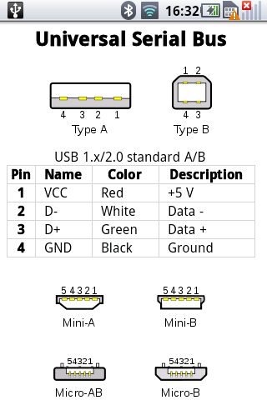
usb type
from ElectroDroid

Slide 56
8. key performance
browser launch time< 1300ms
MMS/SMS launch time < 700ms
AlarmClock launch time < 650ms
re-launch time < first launch time

Slide 57
9. security model
permissions
UID and process isolation
File system permissions
Alternative execution environment

Slide 58
10. software compatibility testing
CTS
CTS verifier
ref apps

Slide 59
10.1 compatibility test suite
Device implementations MUST pass the Android Compatibility Test Suite (CTS) [Resources, 2] available from the Android Open Source Project, using the final shipping software on the device. Additionally, device implementers SHOULD use the reference implementation in the Android Open Source tree as much as possible, and MUST ensure compatibility in cases of ambiguity in CTS and for any reimplementations of parts of the reference source code.
The CTS is designed to be run on an actual device. Like any software, the CTS may itself contain bugs. The CTS will be versioned independently of this Compatibility Definition, and multiple revisions of the CTS may be released for Android 2.3. Device implementations MUST pass the latest CTS version available at the time the device software is completed.
MUST pass the most recent version of the Android Compatibility Test Suite (CTS) available at the time of the device implementation's software is completed. (The CTS is available as part of the Android Open Source Project [Resources, 2].) The CTS tests many, but not all, of the components outlined in this document.

Slide 60
10.2 CTS verifier
Device implementations MUST correctly execute all applicable cases in the CTS Verifier. The CTS Verifier is included with the Compatibility Test Suite, and is intended to be run by a human operator to test functionality that cannot be tested by an automated system, such as correct functioning of a camera and sensors.
The CTS Verifier has tests for many kinds of hardware, including some hardware that is optional. Device implementations MUST pass all tests for hardware which they possess; for instance, if a device possesses an accelerometer, it MUST correctly execute the Accelerometer test case in the CTS Verifier. Test cases for features noted as optional by this Compatibility Definition Document MAY be skipped or omitted.
Every device and every build MUST correctly run the CTS Verifier, as noted above. However, since many builds are very similar, device implementers are not expected to explicitly run the CTS Verifier on builds that differ only in trivial ways. Specifically, device implementations that differ from an implementation that has passed the CTS Verfier only by the set of included locales, branding, etc. MAY omit the CTS Verifier test.

Slide 61
10.3 reference apps
All below can be verified manually.
Calculator(in SDK)‏
Lunar Lander(in SDK)‏
http://code.google.com/p/apps-for-android/
Replica Island(on Android Market, for OpenGL ES2.0)‏
Api Demos(in SDK)‏

Slide 62
11. system update
Device implementations MUST include a mechanism to replace the entirety of the system software. The mechanism need not perform "live" upgrades -- that is, a device restart MAY be required.
Any method can be used, provided that it can replace the entirety of the software preinstalled on the device. For instance, any of the following approaches will satisfy this requirement:
• Over-the-air (OTA) downloads with offline update via reboot
• "Tethered" updates over USB from a host PC
• "Offline" updates via a reboot and update from a file on removable storage
The update mechanism used MUST support updates without wiping user data. Note that the upstream Android software includes an update mechanism that satisfies this requirement.
If an error is found in a device implementation after it has been released but within its reasonable product lifetime that is determined in consultation with the Android Compatibility Team to affect the compatibility of third-party applications, the device implementer MUST correct the error via a software update available that can be applied per the mechanism just described.

Slide 63


