Slide 1

CTS introduction
Jan 18, 2011
Jingtao
Notes:
主标题 字号：37 （加粗）字体：Arial颜色：RGB：51 51 153
日期 字号：30 字体：Arial颜色：RGB：51 51 153

Slide 2
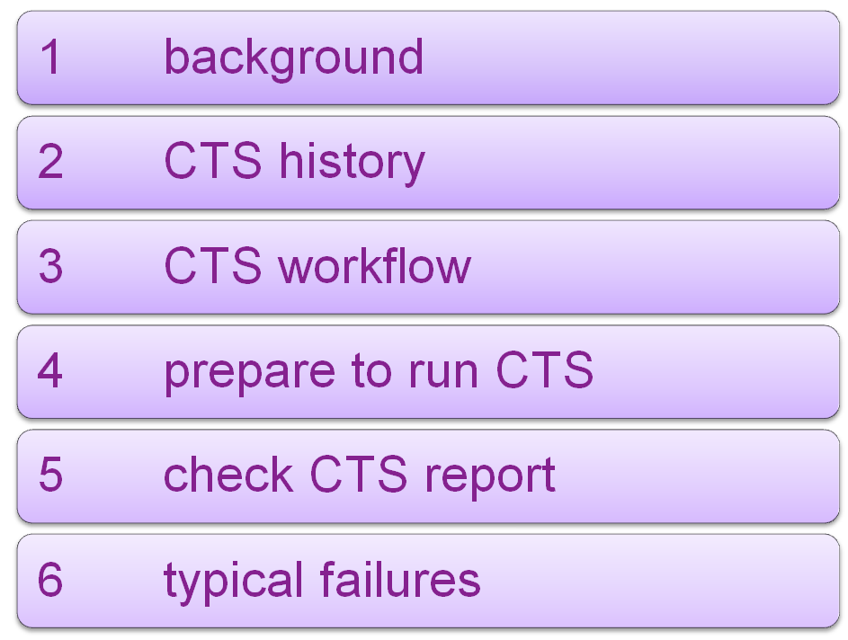
Agenda
Notes:
1

Slide 3
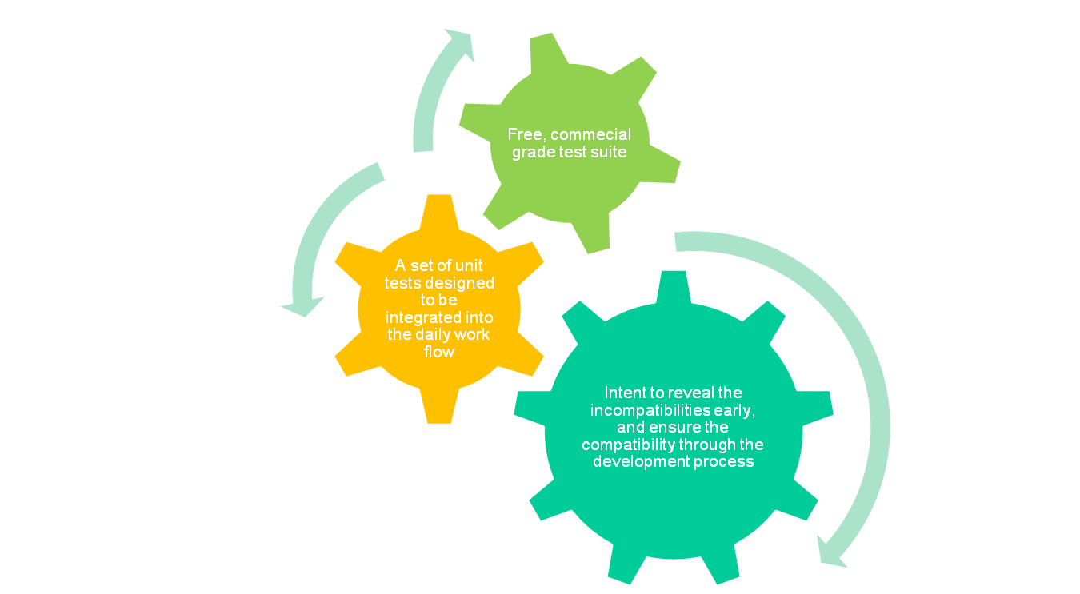
Compatibility Test Suite(CTS)‏

Slide 4
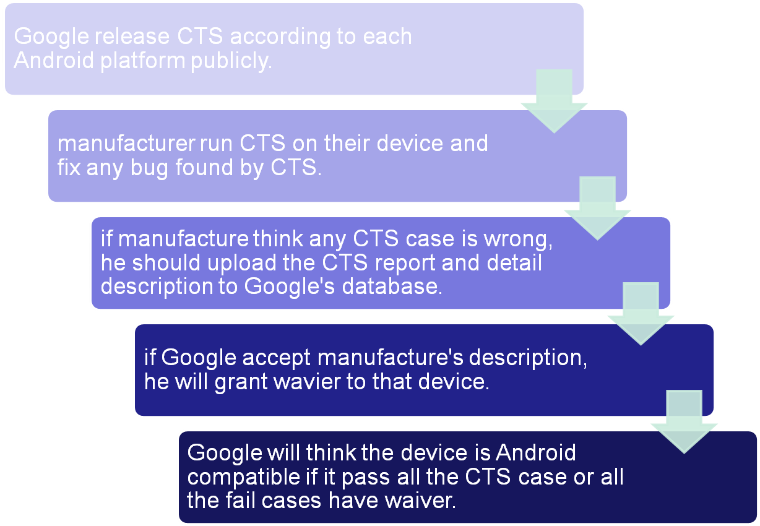
Process to get Google’s certification

Slide 5
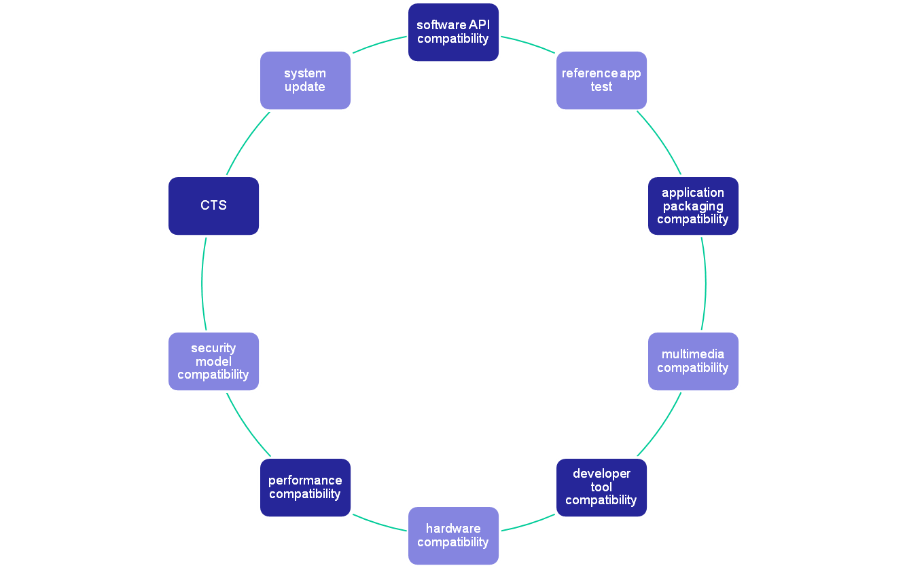
requirement in CDD

Slide 6
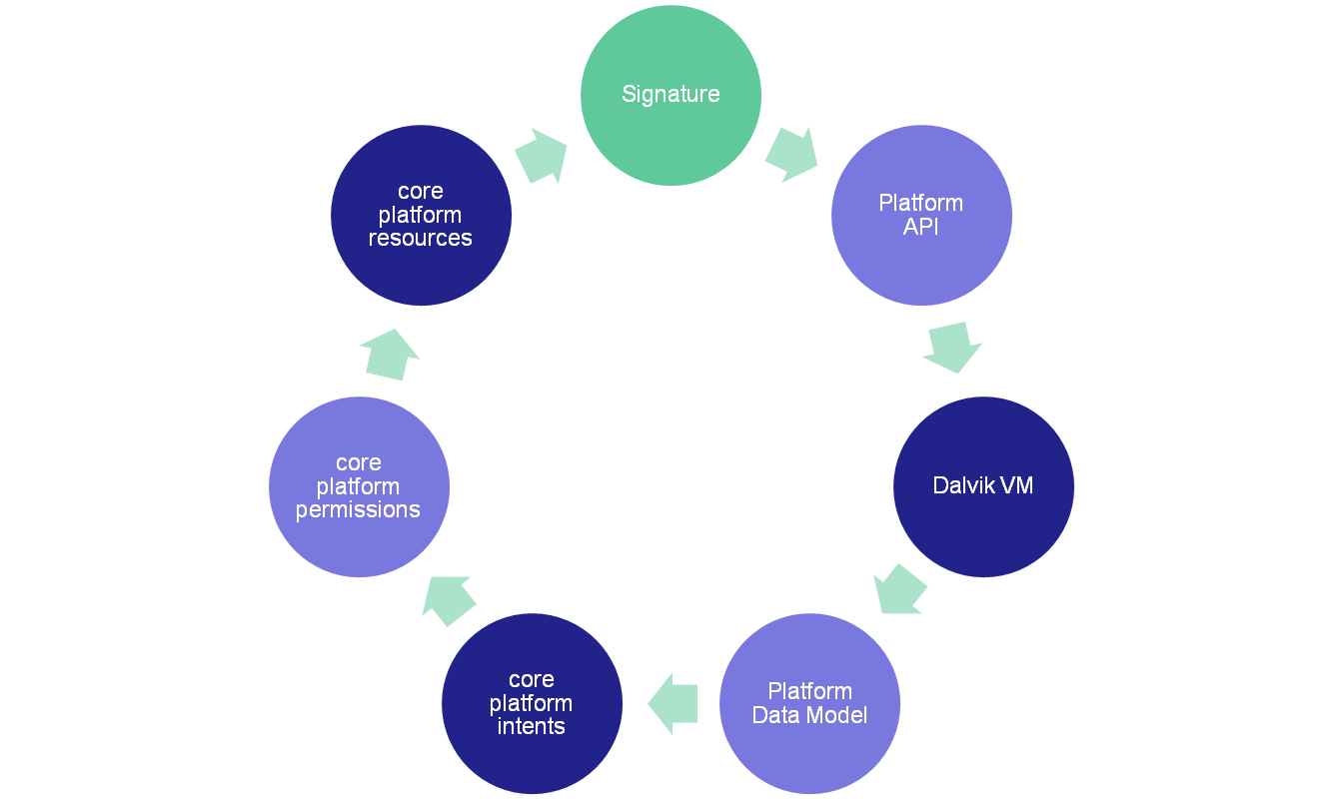
what does CTS test
Notes:
1
unit test, function test, performance test, robust test

Slide 7
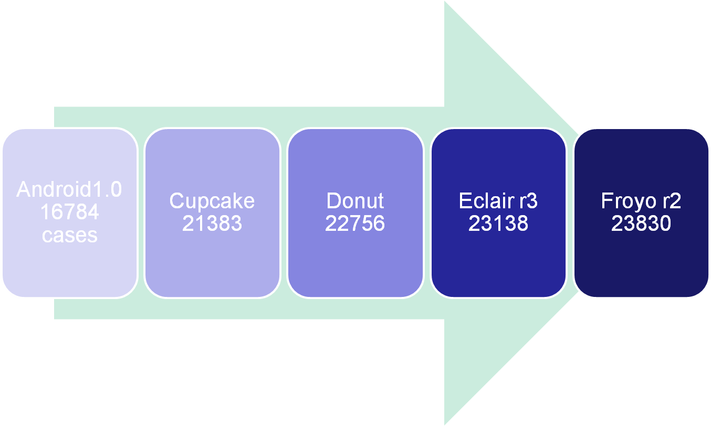
CTS History
Notes:
1
2.1-r4 just released

Slide 8
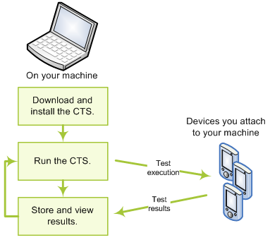
CTS work flow
Notes:
1

Slide 9
download CTS
binary: http://source.android.com/compatibility/downloads.html
source:
1, git ls-remote --heads git://192.168.1.250/android-mirror/platform/manifest.git
...
refs/heads/android-cts-2.1_r4
refs/heads/android-cts-2.2_r1
refs/heads/android-cts-2.2_r2
...
2, repo init -u git://192.168.1.250/android-mirror/platform/manifest.git -b android-cts-2.2_r2
3, repo sync cts
Notes:
1

Slide 10
build CTS
if from svn://192.168.1.250/oms/branches/horse
make BUILD_CTS=true cts
if from git://android.git.kernel.org/platform/manifest.git
make cts
Notes:
1
the command to generate test plan
cts/tools/utils/buildCts.py cts/tests/tests/ out/host/linux-x86/cts/android-cts out/host/linux-x86/cts/temp . out/host/linux-x86/framework/descGen.jar
Generating test description for package android.tests.sigtest
Generating test description for package android.apidemos.cts
Generating test description for package android.tests.appsecurity
...
Generating test description for package android.os
Generating test plan CTS
Generating test plan Android
Generating test plan Java
Generating test plan VM
Generating test plan Signature
Generating test plan RefApp
Generating test plan Performance
Generating test plan AppSecurity

Slide 11
install CTS
1. install Android SDK tool(http://androidappdocs.appspot.com/sdk/index.html)‏
2. unzip CTS package(e.g, android-cts-2.1_r3-x86.zip)‏
android-cts
|-- docs
|-- repository
| |-- host_config.xml
`-- tools
|-- cts.jar
`-- startcts
3. edit android-cts/tools/startcts, set
SDK_ROOT=<absolute fold of Android SDK>
Notes:
1

Slide 12
run CTS
1. connect phone/emulator to PC.
2. close eclipse otherwise CTS will report can't bind port 8700
3. android-cts/tools/startcts to enter CTS shell.
three modes to run case:
plan mode
package mode
case mode
Notes:
1

Slide 13
Sample of CTS commands
start --plan CTS
start --plan Android -p android.app.cts.ActivityManagerTest
start --plan Android -t android.app.cts.ActivityManagerTest#testGetRunningServices
Notes:
1

Slide 14
tricky in host_config.xml
in plan mode, set “maxTestCount” to 0 will avoid restart phone from time to time.
in case mode, must set “maxTestCount” to none zero.
Notes:
1

Slide 15
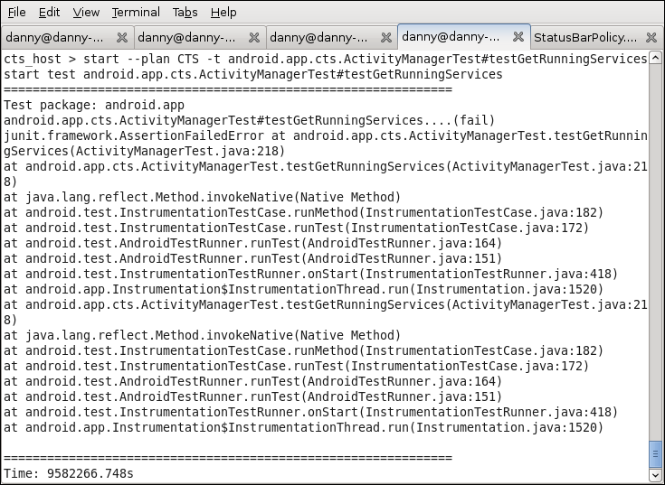
screen shot of CTS
Notes:
1

Slide 16



what does CTS do
install test case apk
(adb -s deviceID install -r ...apk)‏
execute test
(am instrument -w -e [para] <component>...)‏
uninstall test case apk
(adb -s deviceID uninstall ...)‏
Notes:
1
plan mode:
CTS framework need to find each package in the plan and run it by -p mode.
-p mode example:
am instrument -w -r -e package android.accessibilityservice.cts.AccessibilityEndToEndTest com.android.cts.accessibilityservice/android.test.InstrumentationTestRunner
-t mode example:
am instrument -w -r -e class android.accounts.cts.AccountManagerTest#testGet android.accounts.cts/android.test.InstrumentationTestRunner

Slide 17
run CTS under Windows
1. unzip CTS package and android SDK package to your windows PC.
2. set path of adb.
path=c:\android-sdk-windows\tools;%path%
3. use below command to enter CTS shell:
java -Xmx512M -cp c:\android-cts\tools\cts.jar;c:\android-cts\tools\hosttestlib.jar;c:\android-cts\tools\junit.jar;c:\android-cts\tools\CtsTestAnnotationsHostLib;c:\android-sdk-windows\tools\lib\ddmlib.jar com.android.cts.TestHost c:\android-cts\repository\host_config.xml
Please change red marked to the CTS/SDK path on your computer.
Notes:
1

Slide 18
config device before run case
insert empty Sdcard.
set screen timeout to never.
set locale to English.
set default input language to English
open data connection, such as WIFI/GPRS.
set correct date/time.
install CtsDelegatingAccessibilityService.apk
Notes:
1

Slide 19
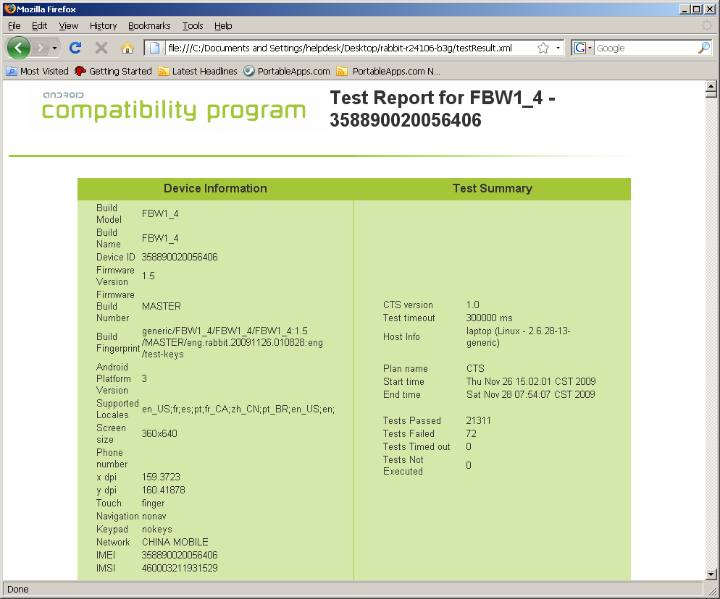
test report
firefox repository/results/20xx.../testResult.xml
Notes:
1

Slide 20
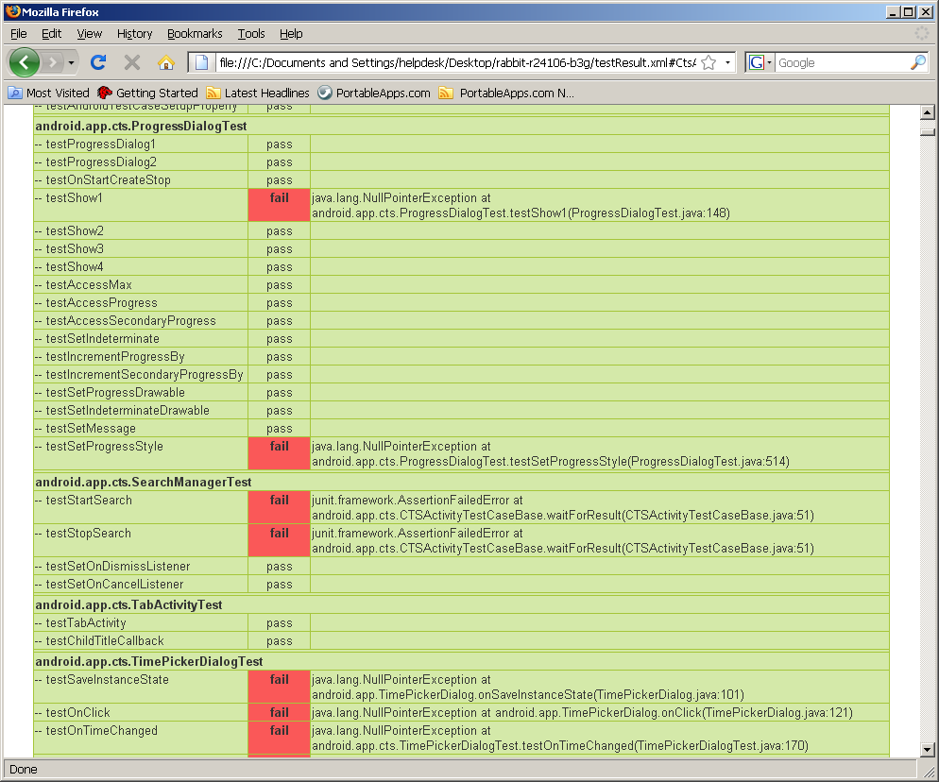
Fail Cases
Notes:
1

Slide 21
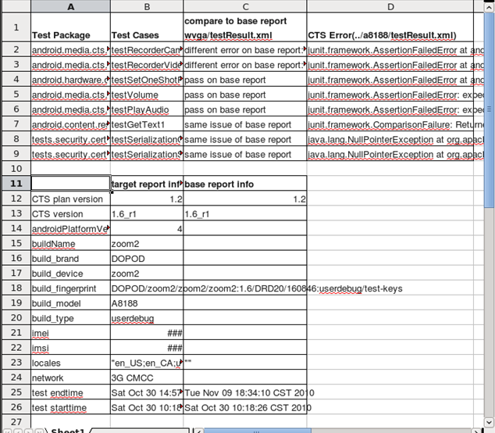
parsects.py
parsects.py wvga/testresult.xml a8188/testresult.xml
Notes:
1

Slide 22
how to manage test report
suppose several testers test several products each week/month...
prefer to use source control tools, such as svn, git, ...
five files to check in for each report:
1, cts_result.css
2, cts_result.xsl
3, logo.gif
4, newrule-green.png
5, testResult.xml
Notes:
1

Slide 23
fail to open test result?
1, remember the error line number shown by firefox
2, wait test finish
3, edit testResult.xml, delete error line
4, save and reopen testResult.xml with firefox
5, repeat 3 and 4 until no error
Notes:
1

Slide 24
re-test fail cases
1, edit testResult.xml
2, replace all the result=”fail” to result=”notExecuted”.
3, reset “Summary failed=” to 0 and “notExecuted=” to fail case number.
4, start test in CTS shell and choose the historical session.
Notes:
1

Slide 25

typical bugs
Notes:
1
please place a funny picture on this page

Slide 26
root process(security)‏
case: no
error: the test report will list all root process except kernel process. CTS get root process by read /proc
solution: change privilege of all the process to normal user, except netd which Google gave waiver.
Notes:
1

Slide 27
null pointer (screen timeout)‏
case: android.app.cts.AlertDialogTest#testAlertDialog
error: java.lang.NullPointerException at android.app.cts.AlertDialogTest.doTestAlertDialog(AlertDialogTest.java:125)‏
solution: set screen timeout to never.
Notes:
1

Slide 28
auto-focus (build parameters)‏
case: start --plan RefApp
error: install_failed_missing_feature: android.hardware.camera
solution: just add camera feature is ok. we usually add below line to build/target/product/generic.mk
PRODUCT_COPY_FILES += \
frameworks/base/data/etc/android.hardware.camera.autofocus.xml:system/etc/permissions/android.hardware.camera.autofocus.xml
Notes:
1

Slide 29
Fingerprint (build parameters)‏
case: android.os.cts.BuildVersionTest#testBuildFingerprint
error: junit.framework.ComparisonFailure: expected:<unknown> but was:<> at android.os.cts.BuildVersionTest.testBuildFingerprint(BuildVersionTest.java:60)‏
root cause: the ro.product.board and ro.build.fingerprint in /system/build.prop not match. fingerprint should in the format of $(BRAND)/$(PRODUCT)/$(DEVICE)/$(BOARD):$(VERSION.RELEASE)/$(ID)/$(VERSION.INCREMENTAL):$(TYPE)/$(TAGS)‏
solution: should add below line in build/target/generic/BoardConfig.mk
TARGET_BOOTLOADER_BOARD_NAME := unknown
Notes:
1

Slide 30
OpenGLEs Version (build parameters)‏
case: android.opengl.cts.OpenGlEsVersionTest#testOpenGlEsVersion
error: Detected OpenGL ES major version 2 but Activity Manager is reporting 0 (Check ro.opengles.version) expected:<2> but was:<0> at android.opengl.cts.OpenGlEsVersionTest.testOpenGlEsVersion(OpenGlEsVersionTest.java:61)‏
solution: set ro.opengles.version in system.prop to 131072(decimal value of 0x20000)‏
Notes:
1

Slide 31
psensor feature (build parameters)‏
case: android.app.cts.SystemFeaturesTest#testSensorFeatures
error: android.hardware.sensor.proximity returns false but SensorManager#getSensorList(8) shows sensors [psensor]. expected:<false> but was:<true> at android.app.cts.SystemFeaturesTest.assertFeatureForSensor(SystemFeaturesTest.java:148)‏
solution: if device have psensor, add android.hardware.sensor.proximity.xml to /system/etc/permissions of device by modify framework/data/etc/Android.mk in source code.
Notes:
1

Slide 32
ARMv7 (build parameters)‏
case: android.os.cts.BuildTest#testCpuAbi
error: junit.framework.ComparisonFailure: expected:<...-v7a> but was:<...> at android.os.cts.BuildTest.assertArmCpuAbiConstants(BuildTest.java:41)‏
rootcause: CTS read /proc/cpuinfo to check whether it is ARM v7 compatible, and expect specific value of ro.product.cpu.abi/abi2 according to it.
solution: if CPU is ARM v7 compatible, should change following line in build/target/board/generic/BoardConfig.mk to add armeabi support.
TARGET_CPU_ABI := armeabi-v7a
TARGET_CPU_ABI2 := armeabi
Notes:
1

Slide 33
GeoCoder (app compatibility)‏
case: android.location.cts.GeocoderTest#testGetFromLocation
error: java.io.IOException: Service not Available at android.location.Geocoder.getFromLocation(Geocoder.java:117)‏
rootcause: bug of Android2.2 platform.
solution: in frameworks/base/core/res/res/values/config.xml change below value
"config_networkLocationProvider" from @null to com.google.android.location.NetworkLocationProvider
"config_geocodeProvider" from @null to com.google.android.location.GeocodeProvider
it also need to install NetworkLocation.apk of gms and open network connection.
refer to http://code.google.com/p/android/issues/detail?id=8816
Notes:
1

Slide 34
package debuggable (security)‏
case: android.permission.cts.DebuggableTest#testNoDebuggable
error: Package com.xxx.yyy is marked as debuggable. at android.permission.cts.DebuggableTest.testNoDebuggable(DebuggableTest.java:47)‏
rootcause: pre-installed packages should not have the debuggable flag set. The debuggable flag allows should only be used during development, and never for shipping devices.
solution: remove android:debuggable=”true” in the AndroidManifest.xml of all pre-installed apps. default value will be false.
Notes:
1

Slide 35
Listening Ports (security)‏
case: android.net.cts.ListeningPortsTest#testNoListeningPorts
error: junit.framework.AssertionFailedError: Found port listening on 00000000:0035 in /proc/net/tcp at android.net.cts.ListeningPortsTest.assertNoListeningPorts(ListeningPortsTest.java:97)‏
root cause: by run “busybox netstat -l -p” in adb shell, you can find which app use the port. e.g, tcp 0 0 0.0.0.0:53 0.0.0.0:* LISTEN 1094/dnsmasq. (53 is the decimal value of 0035).
solution: app should use local socket instead of internet socket.
Notes:
1

Slide 36
IPv6 related fails
case: tests.api.java.net.SocketTest#test_getLocalAddress
error: junit.framework.AssertionFailedError:
ANY address not returned correctly (getLocalAddress) with preferIPv6Addresses=true,
preferIPv4Stack=false
0.0.0.0/0.0.0.0:49380 at tests.api.java.net.SocketTest.test_getLocalAddress(SocketTest.java:645)‏
solution: open Ipv6 in kernel.
Notes:
1

Slide 37
default input method
case: android.text.method.cts.MultiTapKeyListenerTest#testPressKey1
error: junit.framework.ComparisonFailure: expected:<h> but was:<44> at android.text.method.cts.MultiTapKeyListenerTest.testPressKey1(MultiTapKeyListenerTest.java:167)‏
solution: Chinese input method may eat some characters. so set default input language to English will work.
Notes:
1

Slide 38
send/receive message
case: android.telephony.cts.SmsManagerTest#testSendMessage
error: java.lang.IllegalArgumentException: Invalid destinationAddress at android.telephony.SmsManager.sendTextMessage(SmsManager.java:77)‏
solution: use valid SIM card and set valid phone number in Settings->Call settings->My caller number->number before test.
Notes:
1

Slide 39
GFW block network cases
case: org.apache.harmony.luni.tests.java.net.ContentHandlerFactoryTest#test_createContentHandler
error: java.lang.RuntimeException: java.net.UnknownHostException: Host is unresolved: www.google.com:80 at org.apache.harmony.luni.tests.java.net.ContentHandlerFactoryTest.test_createContentHandler(ContentHandlerFactoryTest.java:70)‏
solution: some address is blocked by somebody. use GPRS instead of WIFI to test. add 64.233.189.99 www.google.com to /etc/hosts will also work.
Notes:
1

Slide 40
low performance related
case: android.app.cts.InstrumentationTest#testSendKeySync
error: expected:<7> but was:<0> at android.app.cts.InstrumentationTest.testSendKeySync(InstrumentationTest.java:888)‏
rootcause: performance of phone is not high enough.
solution: it may fail under plan/package mode, but will pass under single case mode. another case is android.widget.cts.TextViewTest#testHeightAndWidth. it may pass on some phone when test, but fail when test on other computer. while some phone always pass.
Notes:
1

Slide 41
INJECT_EVENT (performance)‏
case: android.widget.cts.GridViewTest#testPressKey
error: java.lang.SecurityException: Injecting to another application requires INJECT_EVENT permission at android.os.Parcel.readException(Parcel.java:1219)‏
solution: run case in single mode
Notes:
1

Slide 42
test_delete
case: tests.api.java.io.FileTest#test_delete
error: Directory Should Not Have Been Deleted. at tests.api.java.io.FileTest.test_delete(FileTest.java:706)‏
rootcause: the folder should not be deleted if it contain files. can't reproduce by adb shell.
solution: need kernel team fix issue in function mkdir()‏
Notes:
1

Slide 43
high performance related
case: android.app.cts.LifecycleTest#testScreen
error: java.lang.RuntimeException: Intent { act=Activity lifecycle incorrect: received onResume but expected onStop at 5 } at android.app.cts.ActivityTestsBase.waitForResultOrThrow(ActivityTestsBase.java:149)‏
rootcause: performance of phone is too high.
solution: it may fail under case mode, but pass under plan mode. it may pass by run some heavy service in background.
Notes:
1

Slide 44
landscape and portrait (bug of Android)‏
case: android.widget.cts.TextViewTest#testHeightAndWidth
error: expected:<185> but was:<184> at android.widget.cts.TextViewTest.testHeightAndWidth(TextViewTest.java:975)‏
rootcause: google's bug. it fail on froyo emulator(HVGA and WVGA) and G2-froyo in landscape mode. but pass on froyo if set display to 1024*600.
solution: it will pass in portrait mode but fail in landscape mode. just test the phone in portrait mode is O.K.
Notes:
1

Slide 45

jpeg codec related
case: android.media.cts.FaceDetectorTest#testFindFaces
error: only detect 4 faces in a picture with 5 faces
solution: can pass if use standard libskia.so.
Notes:
1

Slide 46
sensor operations (hardware)‏
case: android.hardware.cts.SensorTest#testSensorOperations
error: java.lang.NullPointerException at android.hardware.cts.SensorTest.testSensorOperations(SensorTest.java:82)‏
rootcause: no error handling if the sensor is absent, while the sensor is not required in CDD.
sensor = mSensorManager.getDefaultSensor(Sensor.TYPE_ACCELEROMETER);
assertEquals(Sensor.TYPE_ACCELEROMETER, sensor.getType());
sensor = mSensorManager.getDefaultSensor(Sensor.TYPE_MAGNETIC_FIELD);
assertEquals(Sensor.TYPE_MAGNETIC_FIELD, sensor.getType());
sensor = mSensorManager.getDefaultSensor(Sensor.TYPE_ORIENTATION);
assertEquals(Sensor.TYPE_ORIENTATION, sensor.getType());
Notes:
1

Slide 47

bug of CTS
Notes:
1

Slide 48
camera case
case: android.hardware.cts.CameraTest#testAccessParameters
error: junit.framework.AssertionFailedError: expected:<2048> but was:<2560> at android.hardware.cts.CameraTest.assertParameters(CameraTest.java:392)‏
source:
381 private void assertParameters(Parameters parameters) {
...
387 final int ORIGINALPICWIDTH = 2048;
388 final int ORIGINALPICHEIGHT = 1536;
389
390 // Before Set Parameters
391 assertEquals(PixelFormat.JPEG, parameters.getPictureFormat());
392 assertEquals(ORIGINALPICWIDTH, parameters.getPictureSize().width);
Notes:
1

Slide 49
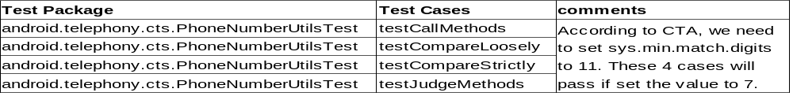
phone number util cases
android use 7 bit phone number match rule. it will cause incoming call mismatch issue.
e.g. create user A(tel: 01150xxx) and user B(mobile:13701150xxx) in sequence in Contacts, when mobile 13701150xxx incoming call, phone will always show user A incorrectly on screen.
Notes:
1

Slide 50
known failure actually passed
case: android.provider.cts.ContactsTest#testGroupMembershipTable
error: bug 2258907, needs investigation
rootcause: Test will fail on products that do not include GMS apps because the test requires a Google account to be activated on a device.
solution: It will pass after install GMS(Google Mobile Services).
Notes:
1

Slide 51
WebHistory
case: android.webkit.cts.WebHistoryItemTest#testWebHistoryItem
error: expected:<1> but was:<0> at android.webkit.cts.WebHistoryItemTest.testWebHistoryItem(WebHistoryItemTest.java:84)‏
rootcause: the case check history list without wait sufficient time after invoke WebView.loadUrl(), so get wrong result. froyo emulator also get the same error.
Notes:
1

Slide 52
StoreAudio
case: android.provider.cts.MediaStore_Audio_Genres_MembersTest#testStoreAudioGenresMembersExternal
error: Should throw SQLException because there is no column with name "Members.AUDIO_ID" in the table at android.provider.cts.MediaStore_Audio_Genres_MembersTest.testStoreAudioGenresMembersExternal(MediaStore_Audio_Genres_MembersTest.java:183)‏
rootcause: it is marked as @ToBeFixed in CTS source code: The result cursor of query for all columns does not contain the column Members.ALBUM_ART, Members.GENRE_ID and Members.AUDIO_ID.
Notes:
1

Slide 53
copy pixels case
case: android.graphics.cts.BitmapTest#testCopyPixelsToBuffer
error: ‏java.lang.RuntimeException: Buffer not large enough for pixels at android.graphics.Bitmap.copyPixelsToBuffer(Bitmap.java:262)‏
rootcause: This case malloc buffer to copy pixels. The product uses more bytes for each pixel than generic android, so this case fails for no enough buffer. It can pass by double the buffer.
solution: use 16bit colour instead of 32bit colour.
Notes:
1

Slide 54
ddmlib error
case: any case
error: ‏Failed to execute shell command am ..., com.android.ddmlib.ShellCommandUnresponsiveException‏
rootcause: ddmlib.jar changed when Google release android sdk tools r7.
solution: use ddmlib.jar from android sdk tools r6.
Notes:
1

Slide 55
rule to pass CTS
do not modify framework.
follow CDD strictly
Notes:
1

Slide 56

any questions?
Notes:
1

