Slide 1

CTS introduction
Jingtao

Slide 2

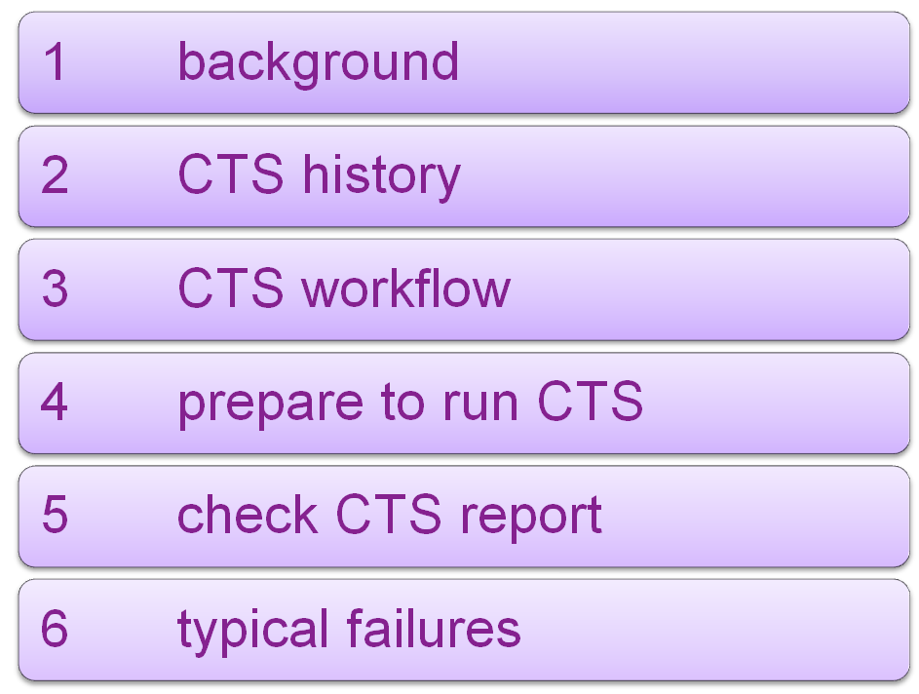
Agenda
Notes:
1

Slide 3
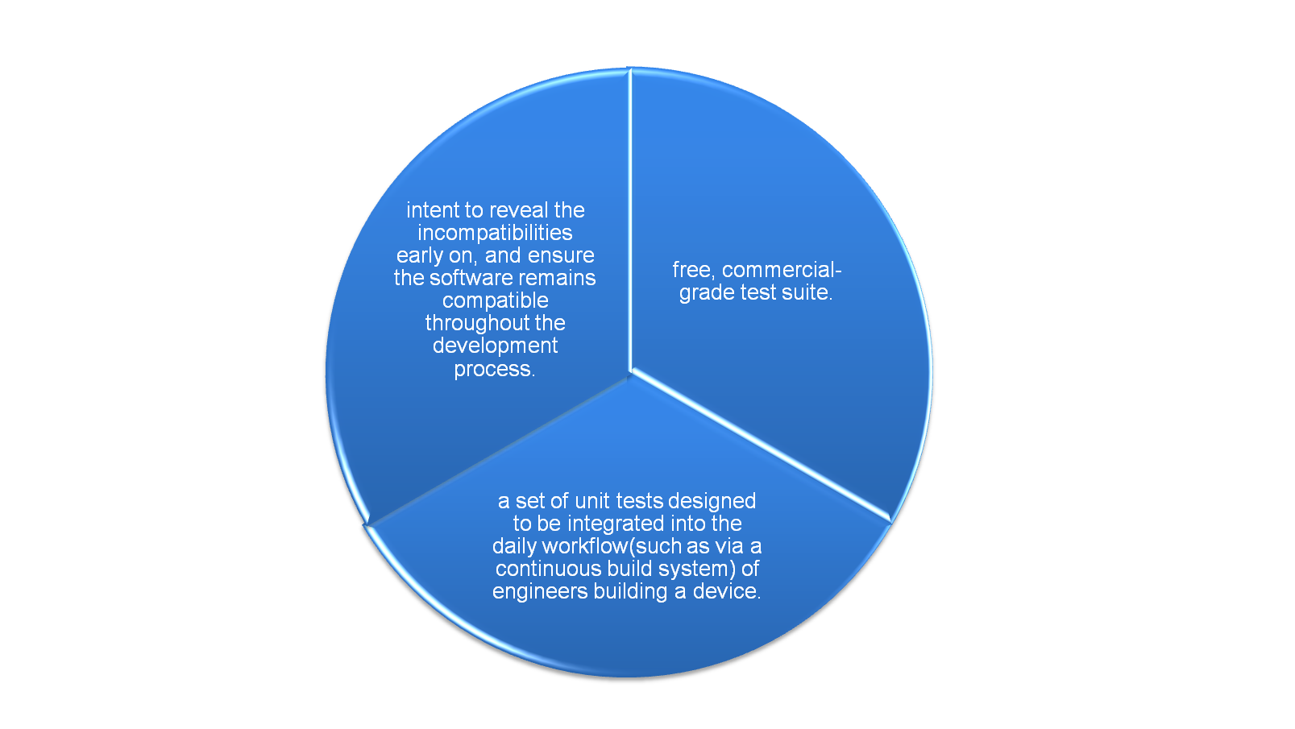
Compatibility Test Suite(CTS)‏
Notes:
1

Slide 4
process to get Google's certification
Google release CTS according to each Android platform publicly.
manufacturer run CTS on their device.
manufacture fix any bug found by CTS.
if manufacture think any CTS case is wrong, he should upload the CTS report and detail description to Google's database.
if Google accept manufacture's description, he will grant wavier to that device.
Google will think the device is Android compatible if it pass all the CTS case or all the fail cases have waiver.
Notes:
1
标题 字号28 字体：Arial （加粗）颜色：RGB：51 51 153
内容：
一级标题 字号18 字体：Arial （加粗）
二三级标题 字号18 字体：Arial

Slide 5
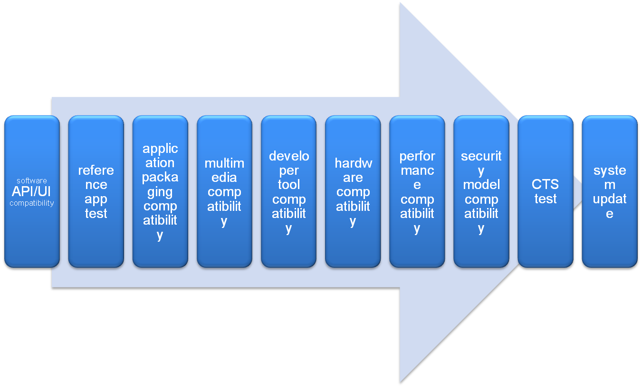
requirement in CDD
Notes:
1

Slide 6
what does CTS test
Signature
Platform API
Dalvik VM
Platform Data Model(documented content provider, eg, contacts, browser, settings...)‏
core platform intents
core platform permissions
core platform resource resources(drawables, nine-patch, animations, layouts, ...)‏
Notes:
1
unit test, function test, performance test, robust test

Slide 7
CTS History
Android1.0 - 16784 cases
Cupcake - 21383
Donut - 22756
Eclair r3 - 23138
Froyo r2 - 23830
Notes:
1
2.1-r4 just released

Slide 8
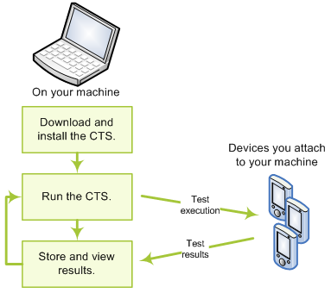
CTS work flow
Notes:
1

Slide 9
download CTS
binary: http://source.android.com/compatibility/downloads.html
source:
1, git ls-remote --heads git://192.168.1.250/android-mirror/platform/manifest.git
...
refs/heads/android-cts-2.1_r4
refs/heads/android-cts-2.2_r1
refs/heads/android-cts-2.2_r2
...
2, repo init -u git://192.168.1.250/android-mirror/platform/manifest.git -b android-cts-2.2_r2
3, repo sync cts
Notes:
1

Slide 10
build CTS
from svn://192.168.1.250/oms/branches/horse
make BUILD_CTS=true cts
from git://android.git.kernel.org/platform/manifest.git
make cts
Notes:
1
the command to generate test plan
cts/tools/utils/buildCts.py cts/tests/tests/ out/host/linux-x86/cts/android-cts out/host/linux-x86/cts/temp . out/host/linux-x86/framework/descGen.jar
Generating test description for package android.tests.sigtest
Generating test description for package android.apidemos.cts
Generating test description for package android.tests.appsecurity
...
Generating test description for package android.os
Generating test plan CTS
Generating test plan Android
Generating test plan Java
Generating test plan VM
Generating test plan Signature
Generating test plan RefApp
Generating test plan Performance
Generating test plan AppSecurity

Slide 11
install CTS
1. install Android SDK tool(http://androidappdocs.appspot.com/sdk/index.html)‏
2. unzip CTS package(eg, android-cts-2.1_r3-x86.zip)‏
android-cts
|-- docs
|-- repository
| |-- host_config.xml
`-- tools
|-- cts.jar
`-- startcts
3. edit android-cts/tools/startcts, set
SDK_ROOT=<absolute fold of Android SDK>
Notes:
1

Slide 12
run CTS
1. connect phone/emulator to PC.
2. android-cts/tools/startcts to enter CTS shell.
three modes to run case:
plan mode
package mode
case mode
Notes:
1

Slide 13
Sample of CTS commands
start --plan CTS
start --plan Android -p android.app.cts.ActivityManagerTest
start --plan Android -t android.app.cts.ActivityManagerTest#testGetRunningServices
Notes:
1

Slide 14
tricky in host_config.xml
in plan mode, set “maxTestCount” to 0 will avoid restart phone from time to time.
in case mode, must set “maxTestCount” to none zero.
Notes:
1

Slide 15
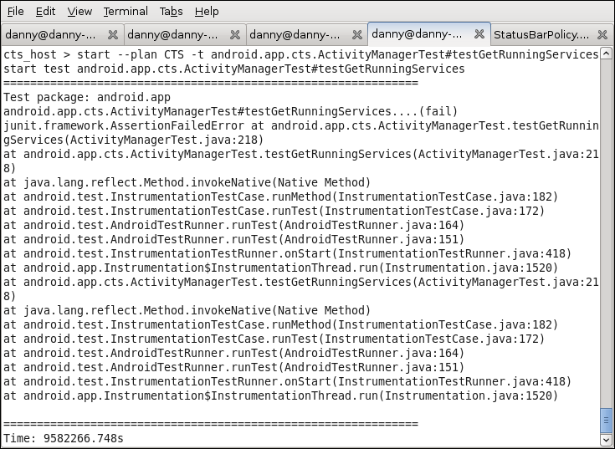
screen shot of CTS
Notes:
1

Slide 16



what does CTS do
install test case apk
(adb -s deviceID install -r ...apk)‏
execute test
(am instrument -w -e [para] <component>...)‏
uninstall test case apk
(adb -s deviceID uninstall ...)‏
Notes:
1
plan mode:
CTS framework need to find each package in the plan and run it by -p mode.
-p mode example:
am instrument -w -r -e package android.accessibilityservice.cts.AccessibilityEndToEndTest com.android.cts.accessibilityservice/android.test.InstrumentationTestRunner
-t mode example:
am instrument -w -r -e class android.accounts.cts.AccountManagerTest#testGet android.accounts.cts/android.test.InstrumentationTestRunner

Slide 17
run CTS under Windows
1. unzip CTS package and android SDK package to your windows PC.
2. Modified the SDK_ROOT in cts\android-cts\tools\startcts :
SDK_ROOT=D:/CTS/sdk/android-sdk_r05-windows/android-sdk-windows/tools
3. use below command to enter CTS shell:
java -Xmx512M -cp D:\CTS\cts\android-cts\tools\cts.jar; D:\CTS\cts\android-cts\tools\hosttestlib.jar;D:\\lib\ddCTS\cts\android-cts\tools\junit.jar;D:\CTS\sdk\android-sdk_r05-windows\android-sdk-windows\tools\lib\ddmlib.jar com.android.cts.TestHost D:\CTS\cts\android-cts\repository\host_config.xml
Please change red marked to you current file path.
known issue:
The file (cts_result.css, cts_result.xsl, logo.gif, newrule-green.png ) under CTS result can not automatically copy in new session folder.
Attention:
If you need to clear the data in addon emulator, Please use: emulator @addon -wipe-data
Notes:
1

Slide 18
config device before run case
insert empty Sdcard.
set screen timeout to never.
set locale to English.
open data connection, such as WIFI/GPRS.
set correct date/time.
install CtsDelegatingAccessibilityService.apk
Notes:
1

Slide 19
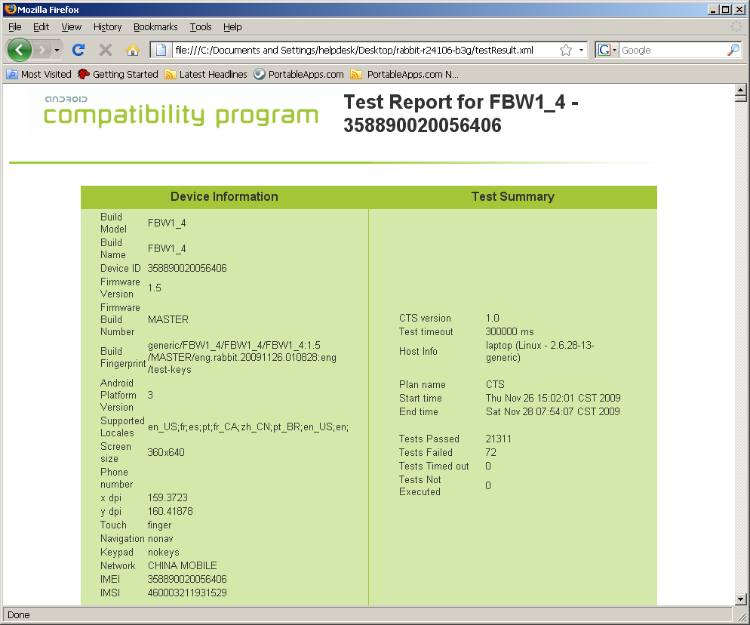
test report
firefox repository/results/20xx.../testResult.xml
Notes:
1

Slide 20
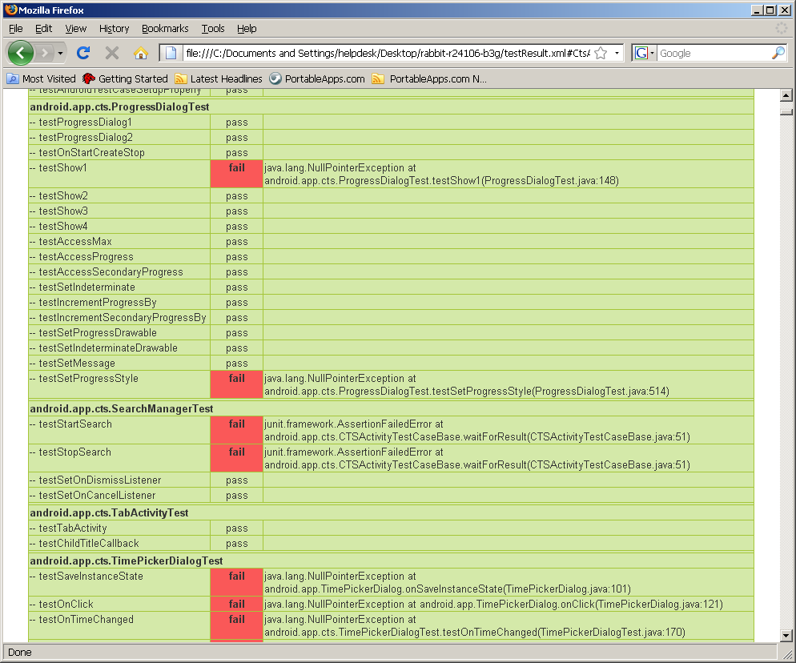
Fail Cases
Notes:
1

Slide 21
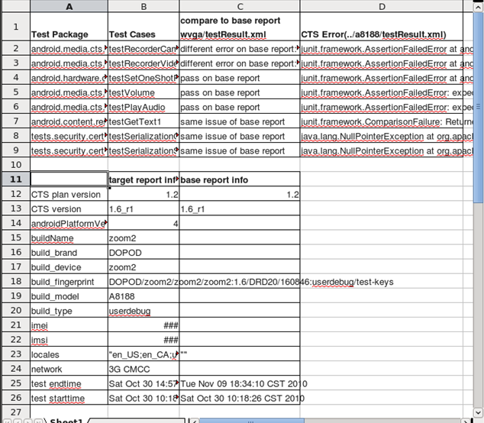
parsects.py
parsects.py wvga/testresult.xml a8188/testresult.xml
Notes:
1

Slide 22
how to manage test report
suppose several testers test several products each week/month...
prefer to use source control tools, such as svn, git, ...
five files to check in for each report:
1, cts_result.css
2, cts_result.xsl
3, logo.gif
4, newrule-green.png
5, testResult.xml
Notes:
1

Slide 23
fail to open test result?
1, remember the error line number shown by firefox
2, wait test finish
3, edit testResult.xml, delete error line
4, save and reopen testResult.xml with firefox
5, repeat 3 and 4 until no error
Notes:
1

Slide 24
re-test fail cases
1, edit testResult.xml
2, replace all the result=”fail” to result=”notExecuted”.
3, reset “Summary failed=” to 0 and “notExecuted=” to fail case number.
4, start test in CTS shell and choose the historical session.
Notes:
1

Slide 25
typical failures
auto-focus
psensor
build finger print
ARMv7
port listening
Ipv6
Input method
send/receive message
GFW block network cases
performance related cases
Notes:
1

Slide 26
auto-focus case
case: start --plan RefApp
error: install_failed_missing_feature: android.hardware.camera
solution: just add camera feature is ok, but we usually add below line to build/target/product/generic.mk
PRODUCT_COPY_FILES += \
frameworks/base/data/etc/android.hardware.camera.autofocus.xml:system/etc/permissions/android.hardware.camera.autofocus.xml
Notes:
1

Slide 27
build finger print
case: android.os.cts.BuildVersionTest#testBuildFingerprint
error: junit.framework.ComparisonFailure: expected:<unknown> but was:<> at android.os.cts.BuildVersionTest.testBuildFingerprint(BuildVersionTest.java:60)‏
root cause: the ro.product.board and ro.build.fingerprint in /system/build.prop not match. fingerprint should in the format of $(BRAND)/$(PRODUCT)/$(DEVICE)/$(BOARD):$(VERSION.RELEASE)/$(ID)/$(VERSION.INCREMENTAL):$(TYPE)/$(TAGS)‏
solution: should add below line in build/target/generic/BoardConfig.mk
TARGET_BOOTLOADER_BOARD_NAME := unknown
Notes:
1

Slide 28
psensor case
case: android.app.cts.SystemFeaturesTest#testSensorFeatures
error: android.hardware.sensor.proximity returns false but SensorManager#getSensorList(8) shows sensors [psensor]. expected:<false> but was:<true> at android.app.cts.SystemFeaturesTest.assertFeatureForSensor(SystemFeaturesTest.java:148)‏
solution: if device have psensor, add android.hardware.sensor.proximity.xml to /system/etc/permissions of device by modify framework/data/etc/Android.mk in source code.
Notes:
1

Slide 29
ARMv7 case
case: android.os.cts.BuildTest#testCpuAbi
error: junit.framework.ComparisonFailure: expected:<...-v7a> but was:<...> at android.os.cts.BuildTest.assertArmCpuAbiConstants(BuildTest.java:41)‏
rootcause: CTS read /proc/cpuinfo to check whether it is ARM v7 compatible, and expect specific value of ro.product.cpu.abi/abi2 according to it.
solution: if CPU is ARM v7 compatible, should change following line in build/target/board/generic/BoardConfig.mk to add armeabi support.
TARGET_CPU_ABI := armeabi-v7a
TARGET_CPU_ABI2 := armeabi
Notes:
1

Slide 30
Listening Ports case
case: android.net.cts.ListeningPortsTest#testNoListeningPorts
error: junit.framework.AssertionFailedError: Found port listening on 00000000:0035 in /proc/net/tcp at android.net.cts.ListeningPortsTest.assertNoListeningPorts(ListeningPortsTest.java:97)‏
root cause: by run “busybox netstat -l -p” in adb shell, you can find which app use the port. e.g, tcp 0 0 0.0.0.0:53 0.0.0.0:* LISTEN 1094/dnsmasq. (53 is the decimal value of 0035).
solution: app should use local socket instead of internet socket.
Notes:
1

Slide 31
IPv6 related fails
case: tests.api.java.net.SocketTest#test_getLocalAddress
error: junit.framework.AssertionFailedError:
ANY address not returned correctly (getLocalAddress) with preferIPv6Addresses=true,
preferIPv4Stack=false
0.0.0.0/0.0.0.0:49380 at tests.api.java.net.SocketTest.test_getLocalAddress(SocketTest.java:645)‏
solution: open Ipv6 in kernel.
Notes:
1

Slide 32
input method related
case: android.text.method.cts.MultiTapKeyListenerTest#testPressKey1
error: junit.framework.ComparisonFailure: expected:<h> but was:<44> at android.text.method.cts.MultiTapKeyListenerTest.testPressKey1(MultiTapKeyListenerTest.java:167)‏
solution: use original Android input method will pass the case.
Notes:
1

Slide 33
send/receive message
case: android.telephony.cts.SmsManagerTest#testSendMessage
error: java.lang.IllegalArgumentException: Invalid destinationAddress at android.telephony.SmsManager.sendTextMessage(SmsManager.java:77)‏
solution: use valid SIM card and set valid phone number in Settings->Call settings->My caller number->number before test.
Notes:
1

Slide 34
GFW block network cases
case: org.apache.harmony.luni.tests.java.net.ContentHandlerFactoryTest#test_createContentHandler
error: java.lang.RuntimeException: java.net.UnknownHostException: Host is unresolved: www.google.com:80 at org.apache.harmony.luni.tests.java.net.ContentHandlerFactoryTest.test_createContentHandler(ContentHandlerFactoryTest.java:70)‏
solution: some address is blocked by somebody. use GPRS instead of WIFI to test.
Notes:
1

Slide 35
performance related
case: android.app.cts.InstrumentationTest#testSendKeySync
error: expected:<7> but was:<0> at android.app.cts.InstrumentationTest.testSendKeySync(InstrumentationTest.java:888)‏
solution: it may fail under plan/package mode, but will pass under single case mode.
Notes:
1

Slide 36
bug of CTS
camera parameters
phone number util
known failure actually passed
copy pixel case
Notes:
1

Slide 37
camera case
case: android.hardware.cts.CameraTest#testAccessParameters
error: junit.framework.AssertionFailedError: expected:<2048> but was:<2560> at android.hardware.cts.CameraTest.assertParameters(CameraTest.java:392)‏
source:
381 private void assertParameters(Parameters parameters) {
...
387 final int ORIGINALPICWIDTH = 2048;
388 final int ORIGINALPICHEIGHT = 1536;
389
390 // Before Set Parameters
391 assertEquals(PixelFormat.JPEG, parameters.getPictureFormat());
392 assertEquals(ORIGINALPICWIDTH, parameters.getPictureSize().width);
Notes:
1

Slide 38
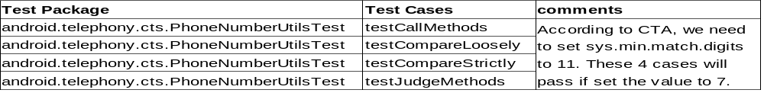
phone number util cases
android use 7 bit phone number match rule. it will cause incoming call mismatch issue.
e.g. create user A(tel: 01150xxx) and user B(mobile:13701150xxx) in sequence in Contacts, when mobile 13701150xxx incoming call, phone will always show user A incorrectly on screen.
Notes:
1

Slide 39
known failure actually passed
case: android.provider.cts.ContactsTest#testGroupMembershipTable
error: bug 2258907, needs investigation
solution: It will pass after install GMS(Google Mobile Services).
Notes:
1

Slide 40
copy pixels case
case: android.graphics.cts.BitmapTest#testCopyPixelsToBuffer
error: ‏java.lang.RuntimeException: Buffer not large enough for pixels at android.graphics.Bitmap.copyPixelsToBuffer(Bitmap.java:262)‏
rootcause: This case malloc buffer to copy pixels. The product uses more bytes for each pixel than generic android, so this case fails for no enough buffer. It can pass by double the buffer.
solution: use 16bit colour instead of 32bit colour.
Notes:
1

Slide 41
rule to pass CTS
do not modify framework.
review with compatibility team before modification.
run related CTS cases to verify after modification.
Notes:
1

