Slide 1



SPONSORSHIP OPPORTUNITIES
JOIN US FOR THE 2018 ROTARY INTERNATIONAL CONVENTION
TORONTO, CANADA, | 23-27 June

Slide 2
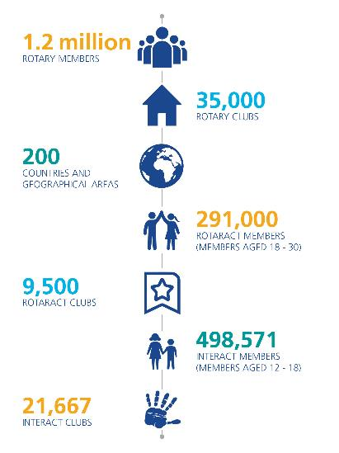
About Rotary
Rotary connects 1.2 million members of all ages and cultures around a shared purpose: to strengthen the communities in which we live. By uniting great minds with diverse perspectives, for more than 100 years, Rotary has earned its reputation as, “People of Action.”
With the strength of our membership and the help of our partners, we garner support in 200 countries and geographic areas across the globe. Our 35,000 clubs tackle the world’s most pressing humanitarian challenges to ensure a better tomorrow for its people today.

Slide 3
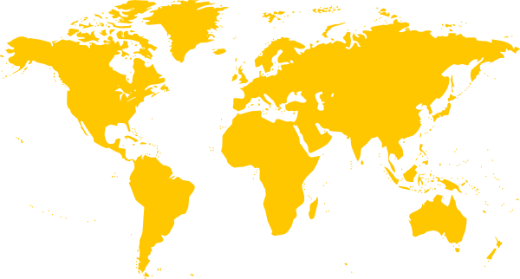




WHERE WE ARE
WHO WE ARE
1.2 million
Rotary Members
35,000
Rotary Clubs
200
Countries &
Geographic Areas
50-59
Median Age
70%
Employed
Europe
308,555
North Asia
(including Japan
And Korea)
147,714
North America
And the Caribbean
355,815
South and Southeast
Asia (including India)
202,191
Africa and
Southwest Asia
38,074
Central and
South America
94,516
Australia, Philippines
And Pacific Realm
61,048
ROTARY’s Global Reach
14.9 million unique
Web visits annually
1,060,733
fans
474,647
followers
58,326
followers

Slide 4
OUR CauseS
With a shared commitment to enhance communities and improve lives, Rotary members, also known as Rotarians, work to address today’s most persistent problems. They improve health, provide access to clean water and safe sanitation, grow local economies, support education, and promote peace all in support of bettering communities.
PEACE AND
CONFLICT RESOLUTION
MATERNAL
AND CHILD HEALTH
BASIC EDUCATION
AND LITERACY
WATER
AND SANITATION
ECONOMIC AND COMMUNITY DEVELOPMENT
DISEASE PREVENTION
AND TREATMENT

Slide 5






ROTARY’S REPUTATION
4-Star rating from Charity Navigator for eight consecutive years. 100% score 2016
Listed as #3 on CNBC’s “Top 10 Charities Changing the World in 2016” while “maintaining stellar financial management and transparency.”
Full Accreditation - BBB Wise Giving Alliance for meeting the Alliance’s 20 Standards for Charity Accountability
PRSA’s 2016 Silver Anvil Award for Best Global Communications Campaign for Rotary’s End Polio Now campaign
Top-Rated “A” Rating from Charity Watch
Named World’s Outstanding Foundation for 2016

Slide 6
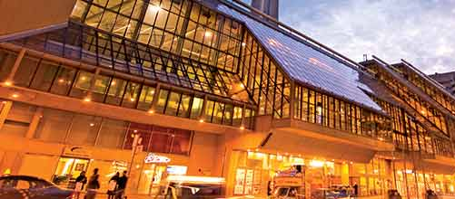
The 2018 convention will be held 23-27 June at the Metro Toronto Convention Centre and the Air Canada Centre in Toronto, Canada.
ROTARY INTERNATIONAL CONVENTION
The Rotary International Convention, Rotary’s premiere event, is held every May or June in a different world-class city. Well attended by our members, the convention is a four-day event featuring notable speakers, meeting sessions, in-depth seminars, interactive exhibit space, as well as entertainment and special events.
Tourism Toronto estimates the economic impact of the convention to be $40,062,250 CDN.

Slide 7

ROTARY CONVENTION LOCATIONS
Depending on the host city, the convention attracts between 15,000 and 45,000 Rotary members from around the world. The convention will be in Hamburg, Germany in 2019, and Honolulu, Hawaii in 2020.
25,000+
44,607
2018 Toronto, Canada
19,717
2016 Goyang City (Seoul), Korea
2013 Lisbon, Portugal
2020 Honolulu, Hawaii
2019 Hamburg, Germany
33,104
2012 Bangkok, Thailand
33,390
2017 Atlanta, Georgia, USA
14,838
18,603
2015 São Paulo, Brazil
2014 Sydney, Australia

Slide 8
ROTARY CONVENTION ATTENDANCE
Korea, 2016
Atlanta, 2017
Top 10 Country Attendance
Total: 44,607
Korea: 25,048
Japan: 6,808
United States: 2,594
Taiwan: 2,390
Philippines: 1,146
India: 827
Bangladesh: 572
Nigeria: 458
Australia: 365
Nepal: 332
Top 10 Country Attendance
Total: 33,390
United States: 16,756
Japan: 2,277
India: 1,521
Nigeria 1,224
Canada: 965
Taiwan: 893
Brazil: 527
Bangladesh: 520
Korea, Republic of: 461
Nepal: 419

Slide 9
ROTARY Demographics
Gender
Age

Slide 10
ROTARY Demographics
Income

Slide 11










ROTARIANS’ TOP SECTOR AFFINITIES
Travel - cruise
Services
Finance
Professional
Travel - booking
Travel - air
Travel - hotel
Energy
Health
Household- outdoors

Slide 12







ROTARIANS’ PURCHASING BEHAVIORS
Rotarians outspend other non-profit constituents in the following categories:
Outdoor sports
Senior products
Home & garden
Children’s products
Women’s fashion
Men’s fashion
Women’s accessories

Slide 13
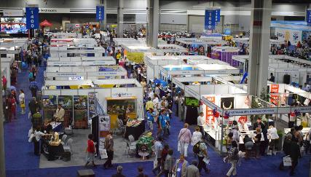
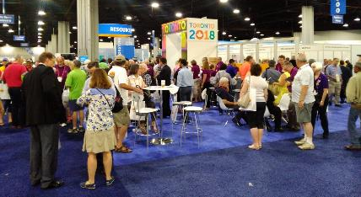
ROTARY CONVENTION HIGHLIGHTs
HOUSE OF FRIENDSHIP
Open Saturday through Wednesday, this is where the Rotary world comes together and where ideas, best practices, and project successes are proudly shared. Attendees can:
Browse booths showcasing Rotary projects, Rotary Fellowships, and Rotarian Action Groups
Shop for Rotary-licensed pins, shirts, and banners
Meet with staff in the Rotary Resource Center about Rotary’s programs and services
Engage with sponsors and supporters who support Rotary’s causes around the world
Enjoy food and entertainment unique to our host city
Register for the 2019 convention in Hamburg, German

Slide 14
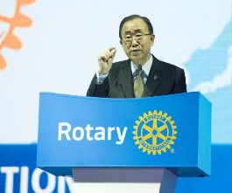
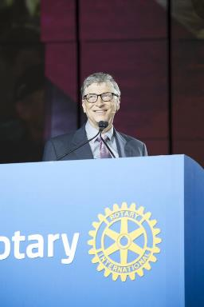
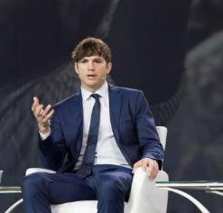
ROTARY CONVENTION HIGHLIGHTs
GENERAL SESSIONS
Five general sessions, including the Opening & Closing Ceremonies, provide attendees an opportunity to hear from world-class speakers and leaders from government, industry, and the Rotary world.
Past years’ speakers have included:
Bill Gates, Philanthropist
Ban Ki-moon, United Nations General Secretary
Ashton Kutcher, Actor and Activist
James Quincey, President and CEO, The Coca-Cola Company
Her Majesty Queen Noor of Jordan

Slide 15
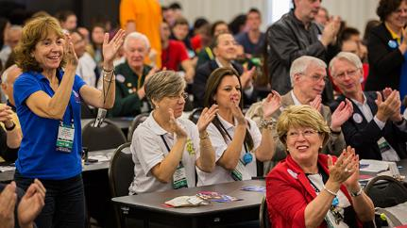
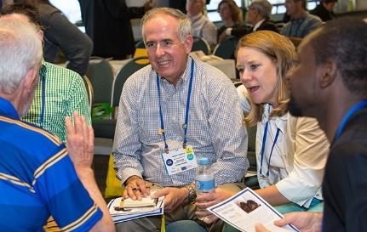
ROTARY CONVENTION HIGHLIGHTs
BREAKOUT SESSIONS
Breakout sessions can inspire attendees, and help them polish their leadership skills and get new ideas for projects, fundraising, strengthening membership, and more. Presentations, workshops, and discussions provide a chance to learn from and work with experts in a variety of fields, including experience Rotarians, guest speakers, and young leaders.
Topics range from ways to strengthen membership, design effective and sustainable projects, working with corporate and community partners, and developing leadership.

Slide 16
ROTARY CONVENTION Digital
The 2017 Atlanta Convention reported a significant increase in digital engagement over the 2016 Convention:
cross-channel reach increased from 6,000,000 to 9,950,000
cross-channel engagements increased from 433,000 to 597,000
a 597% increase to 243,219 video views of the “Convention Minute”, a daily report during the week of the Convention
a 636% increase to 233,000 Facebook views of Convention posts
a 428% increase to 27,980 Facebook engagements with Convention posts
211,700 convention emails were sent with 86,000 unique opens – a 40% open rate
and 21,417 clicks were recorded to the 2018 Convention registration page during the Atlanta convention

Slide 17
ROTARY CONVENTION Sponsorship
Depending upon level, sponsorship recognition can include:
Sponsor “Thank You” ad in The Rotarian magazine (circulation 427,000+)
Sponsor Page of Convention Program Guide
Rotary International Convention microsite
Toronto Host Committee Convention microsite
Convention mobile app
Convention e-newsletters
Convention general sessions
Public address announcements within House of Friendship
Signage throughout convention
Attendee welcome bag
Transportation Guide
Advertising:
Full-page, full-color display advertisement in The Rotarian magazine (circulation 427,000+)
Full-page, full-color advertisement in Convention Program Guide

Slide 18
ROTARY CONVENTION Sponsorship
Hospitality and Engagement:
Complimentary convention registrations
Tickets to convention special events
Thought Leadership:
Opportunity to present a break-out session at Convention
Exhibition/Promotion:
Booth in the House of Friendship exhibition hall
Opportunity to include promotional item in Welcome Bag
Custom campaign development with Rotary to align with Rotary brand and causes

Slide 19
ROTARY CONVENTION Sponsorship
Sponsorship Levels:
Diamond Level – CAN$338,000
Platinum Level – CAN$236,000
Gold Level – CAN$135,000
Silver Level – CAN$68,000
Bronze Level – CAN$34,000
House of Friendship Supporter Levels
Level One Supporter – CAN$15,000
Level Two Supporter – CAN$10,000
Level One Supporter – CAN$$7,000

Slide 20
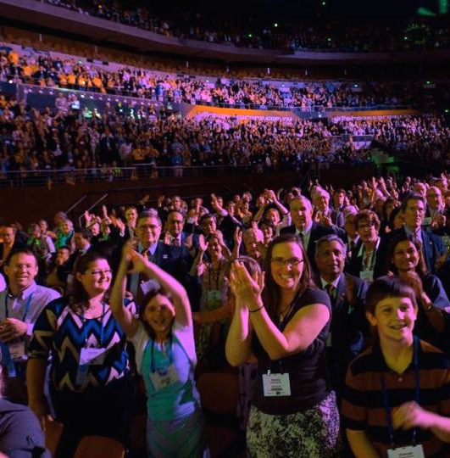
Become a sponsor
We offer sponsors maximum exposure and the opportunity to showcase your brand to attendees and to millions of visitors on our website and followers on social media channels.
Raise awareness of your brand among an international audience of professionals and community leaders
Connect directly with attendees by becoming an exhibitor and distributing samples
Offer special promotions to attendees
Extend your message beyond the convention through online and print recognition and special activations and promotions.
CONTACT INFORMATION
Ross Amos
Sponsorship//Fundraising
Host Organizing Committee
rossamos@rogers.comossamos@ro416 456 5964

