Slide 1
That’s How We Scroll (with Flutter)

Slide 2

A little intro
Software Developer with 12 years of professional experience
Google Developer Expert for Dart & Flutter
Co-org of Flutter Europe
Founder/Tech Lead of Widgeters

Slide 3
What’s the plan
Intro to Slivers
Work work work
Q&A

Slide 4

What we’ll try to achieve
By Ethan Hoover, source: https://unsplash.com/photos/zyU2gQ9mWLM

Slide 5
Repository
https://github.com/widgeters/
custom_scroll_workshop

Slide 6


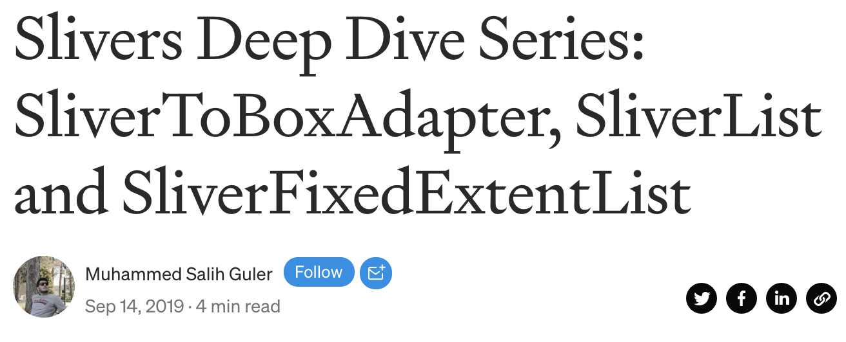
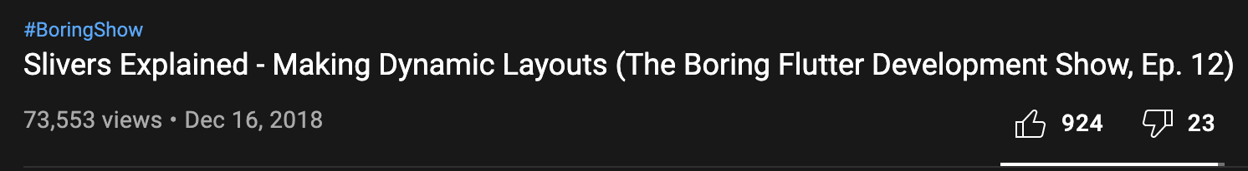
I saw that before!

Slide 7
What’s a Sliver, anyway?
A Sliver is a widget occupying part of a scrollable viewport

Slide 8

Some useful Slivers
SliverList
SliverGrid

Slide 9
Some useful Slivers
SliverFillViewport
SliverFillRemaining

Slide 10
Some useful Slivers
LayoutBuilder
SliverLayoutBuilder
Padding
SliverPadding
Opacity
SliverOpacity
Offstage
SliverOffstage
SafeArea
SliverSafeArea
Visibility
SliverVisibility
…
Sliver…

Slide 11
Quick recap of RenderObjects
Widgets
Elements
RenderObjects

Slide 12
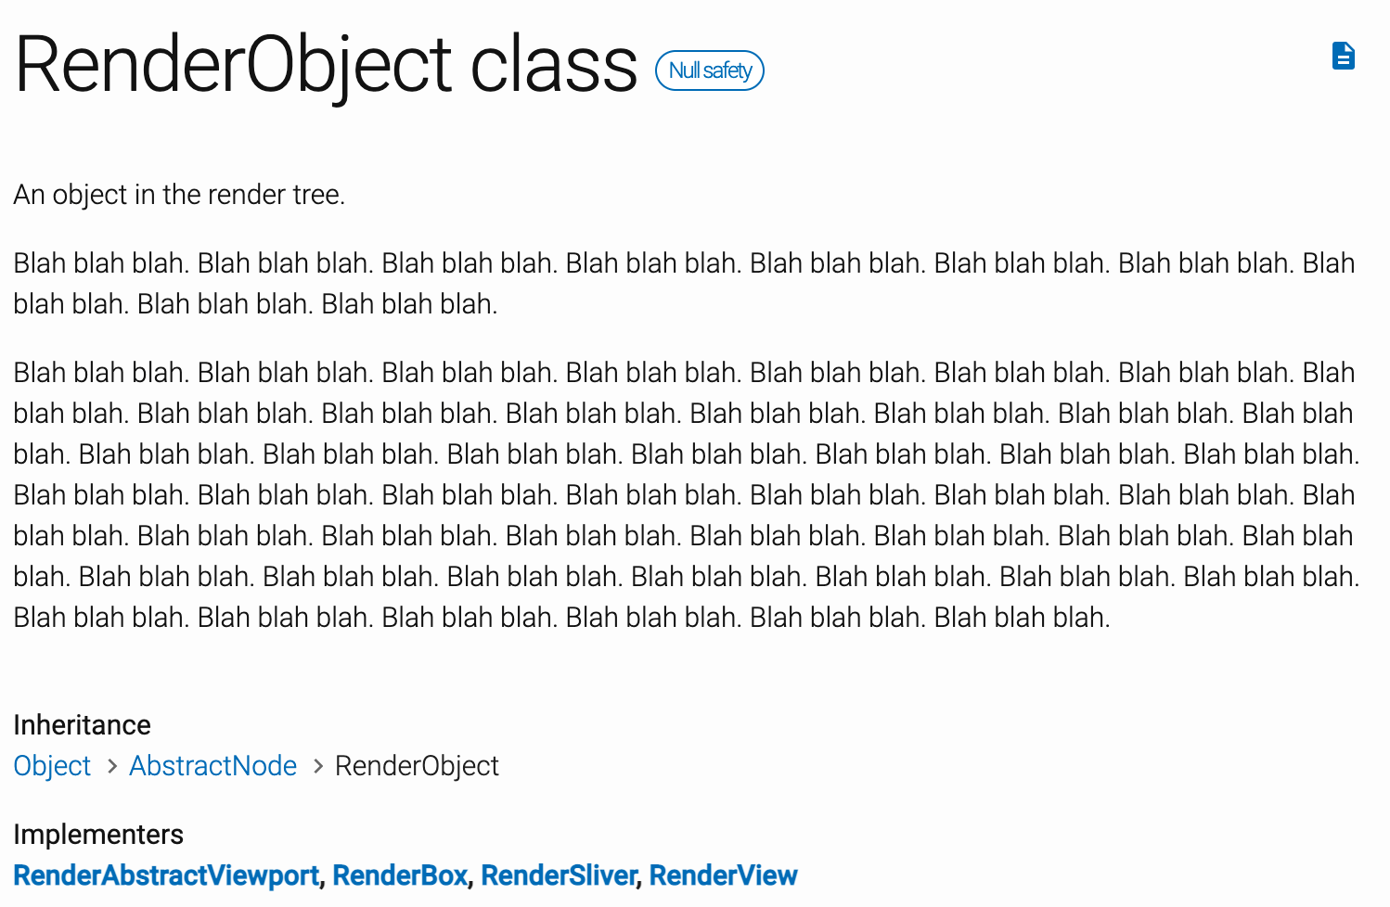

Slide 13
RenderBox vs RenderSliver
BoxConstraints
SliverConstraints
RenderBox
RenderSliver
Size
SliverGeometry

Slide 14
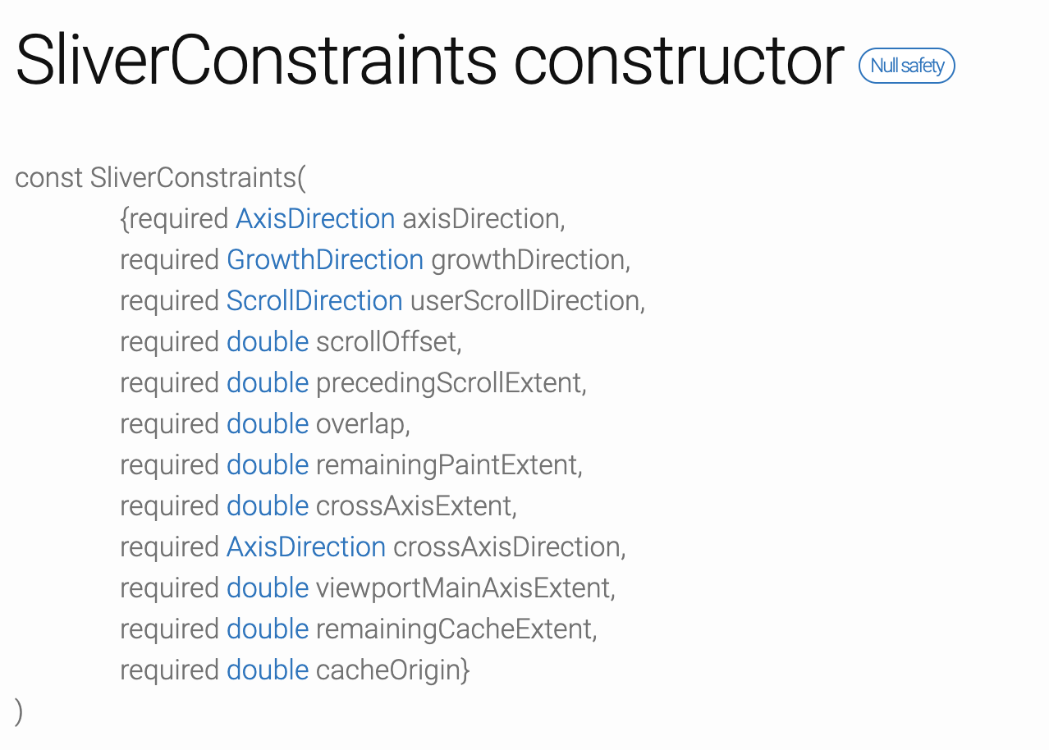
SliverConstraints is a lot

Slide 15
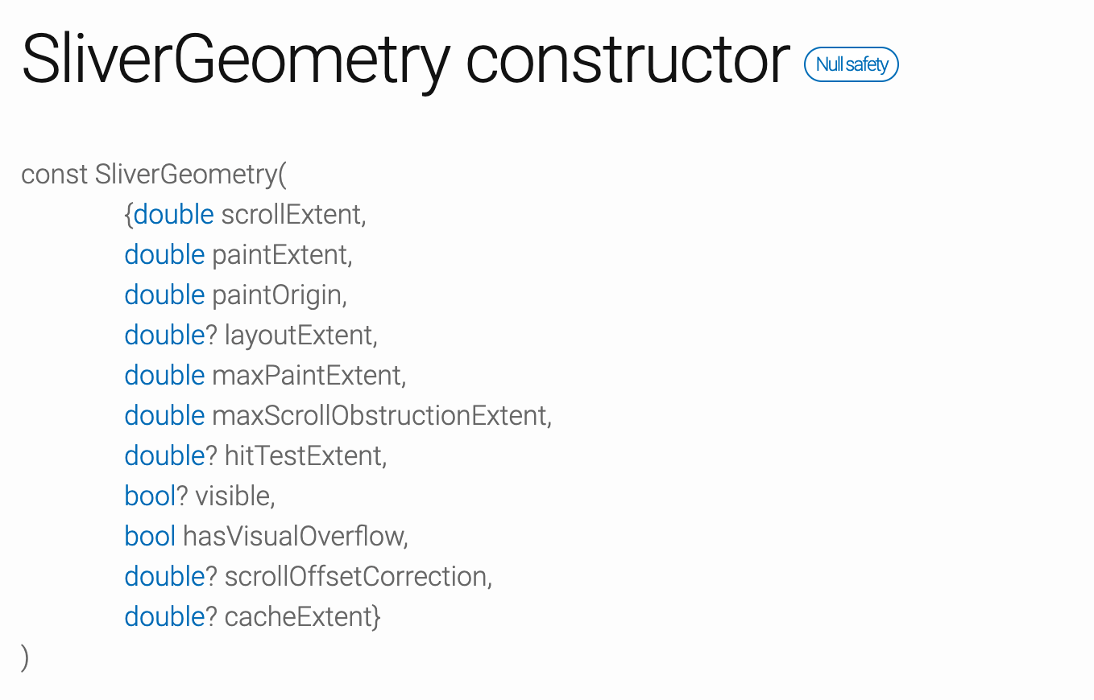
What about SliverGeometry?

Slide 16
Viewport vs Cache
Viewport
Cache

Slide 17
Time for some fun
https://github.com/widgeters/
custom_scroll_workshop

Slide 18

Thanks for listening!
krzysztof@widgeters.dev
https://widgeters.dev/
@kpsroka @widgeters

