Slide 1

WL-MIO
Industrial Automation Simplified
System Design
Rev. 0.8 July 20, 2020
"Perfection is achieved, not when there is nothing more to add, but
when there is nothing left to take away."
― Antoine de Saint-Exupéry, Airman's Odyssey
© 2020 VP Process Inc.
(Widgetlords Electronics)
West Kelowna, BC
Canada V1Z 3M6
www.widgetlords.com

Slide 2
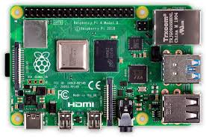
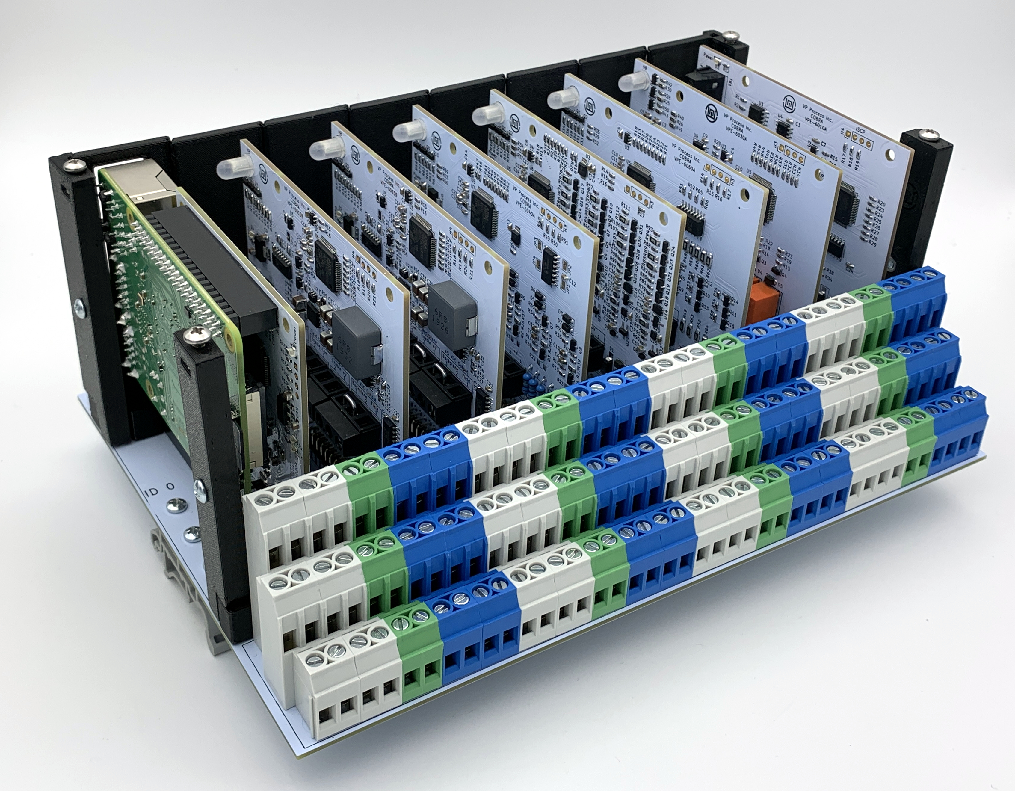
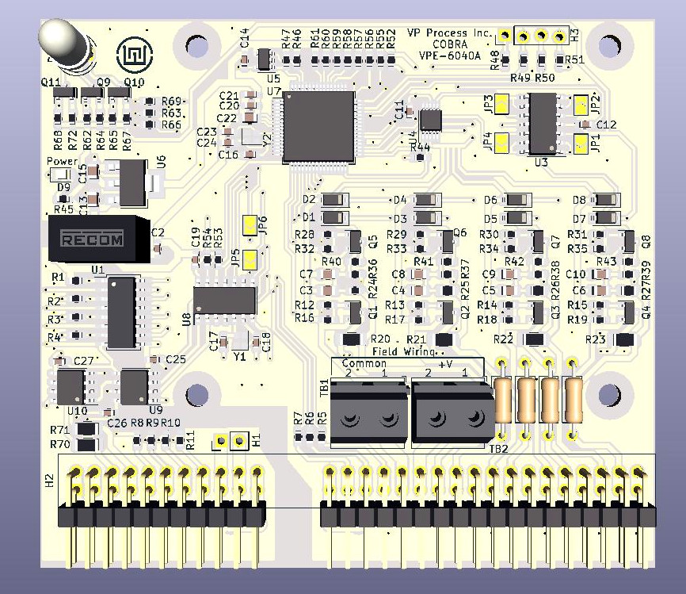
WL-MIO
© 2020 VP Process Inc.(Widgetlords Electronics)
Step 1.
Open Source Linux Based Controller - The Raspberry Pi 4 Series
(Or Equivalent)
Step 2.
WL-MIO Landing Wires One Last Time Platform
DIN Rail Backplane 8 x 4 Pt. Modules
16 Platforms per System = up to 508 I/O Points per Raspberry Pi
WL-MIO
Step 3.
WL-MIO 4 Pt. Isolated I/O Modules
Analog Input/Output Digital Input/Output
Temperature, Pressure, Motion, etc.

Slide 3
Height above Panel
4.0” (VPE-6000-N)
4.1” (VPE-6000-E)
(includes DIN Clips)
5.8” (VPE-6000-N)
5.9” (VPE-6000-E)
Each Module has 3 SHIELD Connections
WL-MIO Module ID 7
Terminal Blocks
3 Level c/w Screw -
Rising Cage Clamp
CAN Bus
Terminal Block
Connections
WL-MIO Module ID 6
Each Module has 12
I/O Terminal Block
Connections
WL-MIO Module ID 5
8.3” (VPE-6000-N)
8.4” (VPE-6000-E)
Backplane ID
Is Set
Via a
Position
Jumper
WL-MIO Module ID 4
Module Address is
Determined by
Module Insertion
Location (0 thru 7)
Plus Backplane ID
WL-MIO Module ID 3
WL-MIO Module ID 2
Raspberry Pi Module ID
RS485 (Optional HART)
NOTE: Raspberry Pi
Controller Module can
Occupy ANY slot in the
Backplane
Multiple Raspberry Pi
Modules can be used in
One Backplane
CAN Bus
Terminal Block
Connections
WL-MIO Module ID 1
Typically Raspberry Pi Module
WL-MIO Module ID 0
Typically 5 VDC Power Supply
Power Input
24VDC (Typical)
Backplane Field Wiring
5 VDC Output Power to Backplane
NOTE: Power Supply Module
Can Occupy Any Slot In The
Backplane And Is Treated As
A 4 Pt. Analog Input Module
Multiple Power Supplies Can Be Used In A Single Backplane
Typical DIN Rail

Slide 4
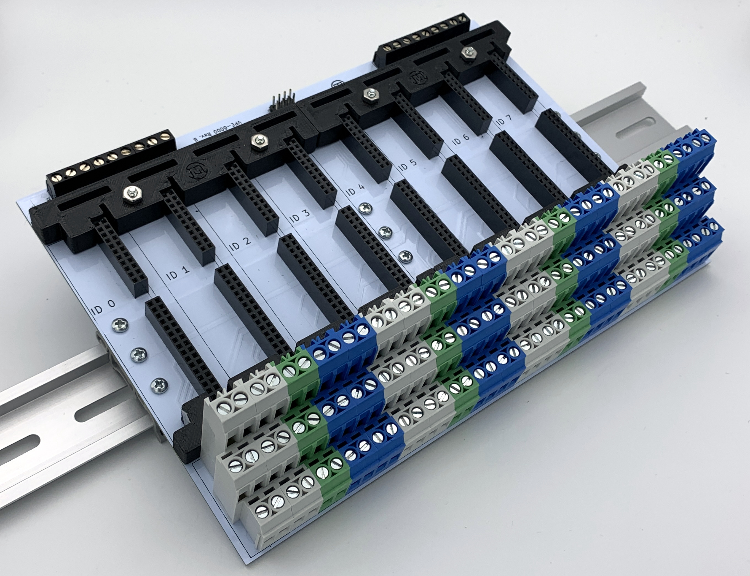
WL-MIO
© 2020 VP Process Inc.(Widgetlords Electronics)
At The Heart Of The WL-MIO Is An 8 Slot DIN Rail Mount Backplane
“Land The Wires One Last Time”
There Are NO Active Components On The Backplane
Any WL-MIO Module Can Be Used In Any Backplane Slot Position
WL-MIO
^{Backplane}

Slide 5
WL-MIO
© 2020 VP Process Inc.(Widgetlords Electronics)
CAN
Connectors x 2
WL-MIO Backplane Wiring (Simplified)
Power Output 2
+5 VDC Bus
Power Output 1
+24 VDC Bus
(Typical)
CAN
Module ID 7
Input Field Wiring
12 Terminals
(Typically 3 per Point)
CAN Low
Common
Backplane
Header
3A @ 300V
Per Pin
+24 VDC
Address Low
Determined by
Slot Position
CAN Hi
Common
Address Hi
+5 VDC
Module ID 6
Input Field Wiring
12 Terminals
(Typically 3 per Point)
Address Low
Input Field Wiring
12 Terminals
(Typically 3 per Point)
Module ID 5
Address Low
Input Field Wiring
12 Terminals
(Typically 3 per Point)
Module ID 4
Address Low
Input Field Wiring
12 Terminals
(Typically 3 per Point)
Module ID 3
Address Low
Input Field Wiring
12 Terminals
(Typically 3 per Point)
Module ID 2
Address Low
Input Field Wiring
12 Terminals
(Typically 3 per Point)
Module ID 1
Address Low
Module ID 0
Power Supply: Input 12 to 24 VDC (Typically 24 VDC)
Output 1: Input Field VDC to Input Power Bus (thru Auctioneering Diode)
Output 2: +5 VDC @ 4 Amp to Backplane (thru Auctioneering Diode)
4 Pt. Analog Input Readings Available:
+5 VDC, + 5 VDC Current
Input Voltage, Input Current
Power Input (24 VDC)
Backplane - Field Wiring Bus
Backplane
ID Jumpers
Address Low
NOTE: Power Supplies are treated as I/O Modules
Power Supply Can Be Installed Into Any Slot Postion (1 thru 8)
Backplane Supports Multiple Power Supplies
(All Power Supply Outputs go through Auctioneering Diodes)

Slide 6
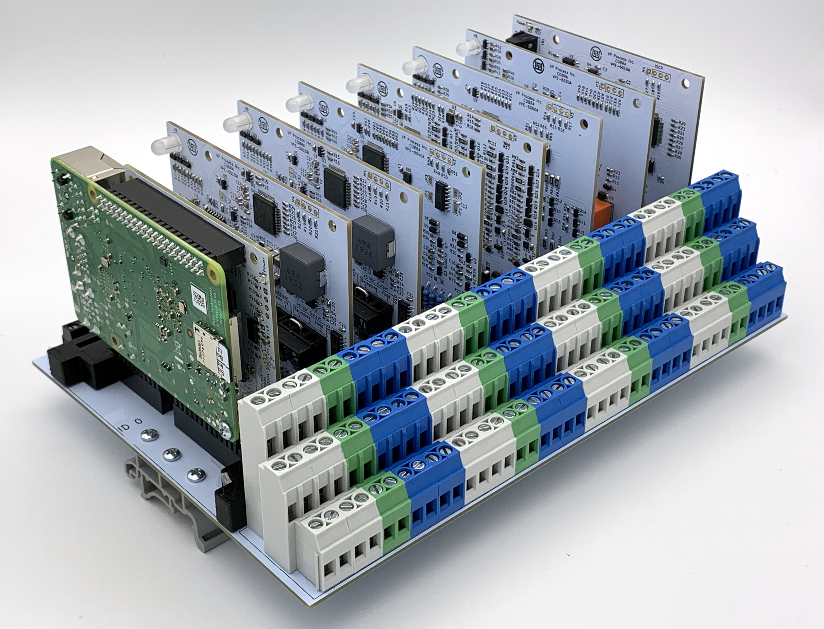
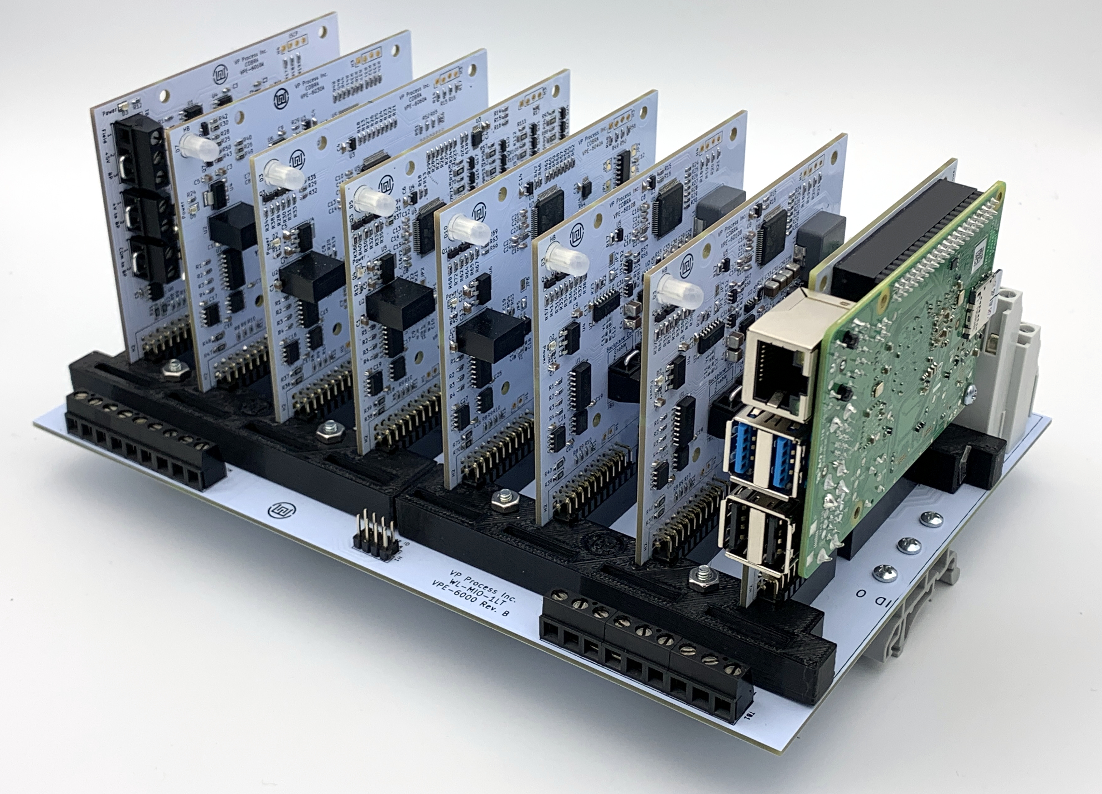
WL-MIO
© 2020 VP Process Inc.(Widgetlords Electronics)
WL-MIO Typical System
(No Enclosure – The “Naked Version”)
WL-MIO Front View
Field Wiring Side
WL-MIO Rear View
Expansion Wiring Side

Slide 7
WL-MIO
© 2020 VP Process Inc.(Widgetlords Electronics)
WL-MIO Two Backplanes with One Power Supply Module,
One Raspberry Pi Module, 14 x 4 Pt. WL-MIO I/O Modules
56 I/O Point Wiring (Simplified)
Backplane ID 8
Module CAN ID =
Backplane ID
+
Module ID
WL-MIO Module ID 7
I/O 4 – 8 Points
WL-MIO Module ID 6
I/O 4 – 8 Points
WL-MIO Module ID 5
I/O 4 – 8 Points
WL-MIO Module ID 4
I/O 4 – 8 Points
+5 VDC – Backplane Bus
WL-MIO Module ID 3
I/O 4 – 8 Points
Common
WL-MIO Module ID 2
I/O 4 – 8 Points
CAN - Hi
CAN - Low
WL-MIO Module ID 1
I/O 4 – 8 Points
SP1
SP2
SP2
WL-MIO Module ID 0
I/O 4 – 8 Points
Common
Power Input
Common
Shield
Shield
Backplane ID 0
WL-MIO Module ID 7
I/O 4 – 8 Points
Power Input (+24VDC) Jumpered If required
WL-MIO Module ID 6
I/O 4 – 8 Points
+5 VDC – Backplane Bus
WL-MIO Module ID 5
I/O 4 – 8 Points
Common
WL-MIO Module ID 4
I/O 4 – 8 Points
CAN - Hi
CAN - Low
WL-MIO Module ID 3
I/O 4 – 8 Points
SP1
SP2
SP2
WL-MIO Module ID 2
I/O 4 – 8 Points
Common
Power Input
Raspberry Pi Module ID 1
RS485, HART
Common
Shield
Power Supply Module ID 0
Power Input
(24 VDC Typical)
Shield

Slide 8
WL-MIO
© 2020 VP Process Inc.(Widgetlords Electronics)
Block Diagram of a 16 Backplane – 508 I/O Point WL-MIO System
With 1 Raspberry Pi Controller Module
CAN Bus
CAN Bus
CAN Bus
1 Raspberry Pi Module
7 WL-MIO Modules
CAN ID = 0 - 7
8 WL-MIO Modules
CAN ID = 8 - 15
8 WL-MIO Modules
CAN ID = 16 - 23
8 WL-MIO Modules
CAN ID = 24 - 31
CAN Bus
CAN Bus
CAN Bus
CAN Bus
8 WL-MIO Modules
CAN ID = 32 - 39
8 WL-MIO Modules
CAN ID = 40 - 47
8 WL-MIO Modules
CAN ID = 48 - 55
8 WL-MIO Modules
CAN ID = 56 - 63
CAN Bus
CAN Bus
CAN Bus
CAN Bus
8 WL-MIO Modules
CAN ID = 64- 71
8 WL-MIO Modules
CAN ID = 72 - 79
8 WL-MIO Modules
CAN ID = 80 - 87
8 WL-MIO Modules
CAN ID = 88 - 95
CAN Bus
CAN Bus
CAN Bus
CAN Bus
8 WL-MIO Modules
CAN ID = 96 - 103
8 WL-MIO Modules
CAN ID = 104 - 111
8 WL-MIO Modules
CAN ID = 112 - 119
7 WL-MIO Modules
CAN ID = 120 - 127

Slide 9
WL-MIO
© 2020 VP Process Inc.(Widgetlords Electronics)
WL-MIO Software Overview
libwlmio
C
Open Source
MIT Licence
pywlmio
Python
Open Source
MIT Licence
NodeJS
NXT
OpenPLC
DBUS
Open Source
BSD Licence RPi4
WLMIOD
Open Source
MIT Licence
WL-MIO Hardware ID
UAVCAN
Open Source
MIT Licence
Provided by
VP Process Inc.
UAVCAN
Open Source
MIT Licence
CAN
Hardware
Linux Kernal Driver
Setup
dtoverlay + Commands
EEPROM storage
WL-MIO
Modules
(Request, Response, Message)
Proprietary to VP Process Inc.

Slide 10
WL-MIO
© 2020 VP Process Inc.(Widgetlords Electronics)
Block Diagram of a Typical WL-MIO 4 Pt. Module
Backplane Side
Field Wiring Side
I/O
Circuit
1
Field Side
Backplane
CAN Bus
CAN Bus
Driver
Isolator
I/O
Circuit
2
Field Side
Backplane
Backplane ID Bus
Isolator
uP
ARM
Cortex-M
I/O
Circuit
3
Field Side
Backplane
Power Bus +5 VDC
Power Supply Output 2
From Backplane
Isolator
Isolator
I/O
Circuit
4
Field Side
Backplane
Galvanic Isolation Path
1 Kv
Power Supply Output 1
Typically 24VDC
From Backplane

Slide 11
WL-MIO
© 2020 VP Process Inc.(Widgetlords Electronics)
Input Field Wiring of a Typical WL-MIO 4 Pt. Module
Backplane Side
Field Wiring Side
Power Supply Output 1
Typically 24VDC
From Backplane
Non-Isolated 3 Wire Transmitter
+V Jumper IN
+24 VDC
To Input Circuit
Signal
3 Wire
Transmitter
COM Jumper IN
Common
24 VDC
Common
Non-Isolated 2 Wire Transmitter
+V Jumper IN
+24 VDC
Signal
2 Wire
Transmitter
To Input Circuit
COM Jumper IN
Isolated 3 Wire Transmitter
Remote
Power Supply
+V Jumper OUT
+24 VDC
To Input Circuit
Signal
3 Wire
Transmitter
COM Jumper OUT
Common
Isolated 2 Wire Transmitter
Remote
Power Supply
+V Jumper OUT
+24 VDC
To Input Circuit
Signal
2 Wire
Transmitter
COM Jumper OUT

Slide 12
WL-MIO
© 2020 VP Process Inc.(Widgetlords Electronics)
Block Diagram of a Typical WL-MIO Raspberry Pi Module
Backplane Side
Field Wiring Side
RS485
Field Side
Backplane
CAN Bus
CAN Bus
Driver
Isolator
Raspberry Pi
HART
Analog
Input
(Optional)
Field Side
Backplane
Backplane ID Bus
Isolator
GPIO
Drivers
(Optional)
Field Side
Backplane
Power Bus +5 VDC
Power Supply Output 2
From Backplane
Galvanic Isolation Path
1 Kv

Slide 13
WL-MIO
© 2020 VP Process Inc.(Widgetlords Electronics)
Block Diagram of the WL-MIO +5VDC Power Supply Module
Backplane Side
Field Wiring Side
Power Bus +24 VDC
Power Supply Output 1
To Backplane
Power Supply
Output 5VDC @ 4 Amp
Input: 9 to 36 VDC
Field Side
Power Input
Typically
24 VDC
Power Bus +5 VDC
Power Supply Output 2
To Backplane
CAN Bus
CAN Bus
Driver
Isolator
+ 5 VDC
+ 5 V Current
Backplane ID Bus
Isolator
uP
ARM
Cortex-M
+ Input Field Power
(24 VDC)
Power Bus +5 VDC
Power Supply Output 2
From Backplane
Isolator
+ Input Field Power
(Current)
Galvanic Isolation Path
1 Kv

