Slide 1
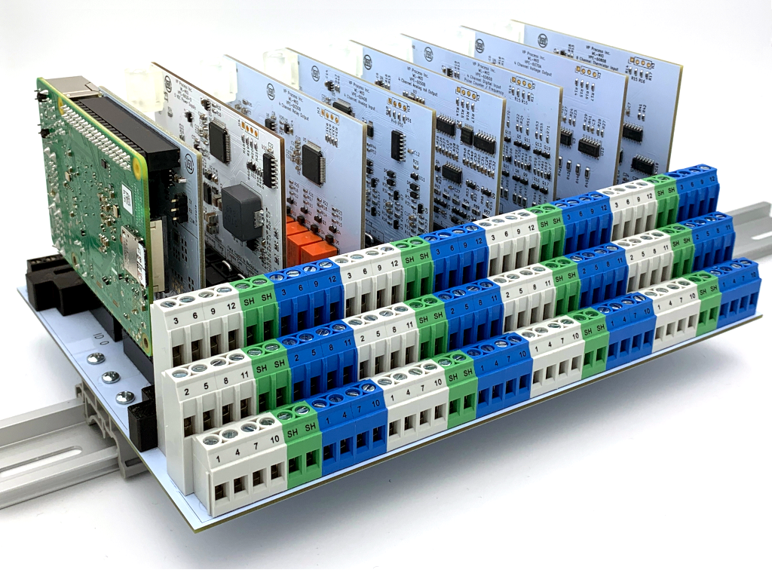
4 Point
Relay Output
4 Point
Analog Input
4 Point
mA Output
4 Point
Digital Input
Discrete, Pulse, Frequency
Power Supply
5.1 VDC, 4 A
4 Point
VDC Output
Raspberry Pi 4
c/w RS485 &
Optional HART
8 Point
Thermistor Input
5.8”
Depth
8.3” DIN Rail Length
28 I/O Points as shown
Expandable up to 1016 Points

