Slide 1
Regex Memory Game
06.22.16
William Diment
Kathryn gray
Eddie Stoian
Oscar Gandara

Slide 2
Stand-Up
What did you do last week?
What are you this week?
Are there any obstacles stopping you from doing your tasks?
Notes:
listing/describing/pictures of new features

Slide 3
Overview
Description
New Features

Slide 4
Description
For our project, we chose to do a memory game utilizing REGEX.
The reason for why we chose this is because it would be a fun and interactive game that can serve as a study guide for this class for incoming students.

Slide 5
New features
Set-up of Database
We created the database where all the questions were stored and matched to their corresponding answers
GUI
Established the home screen of the game
Also created the cards and made them separate objects in order to have an action on a mouse click

Slide 6
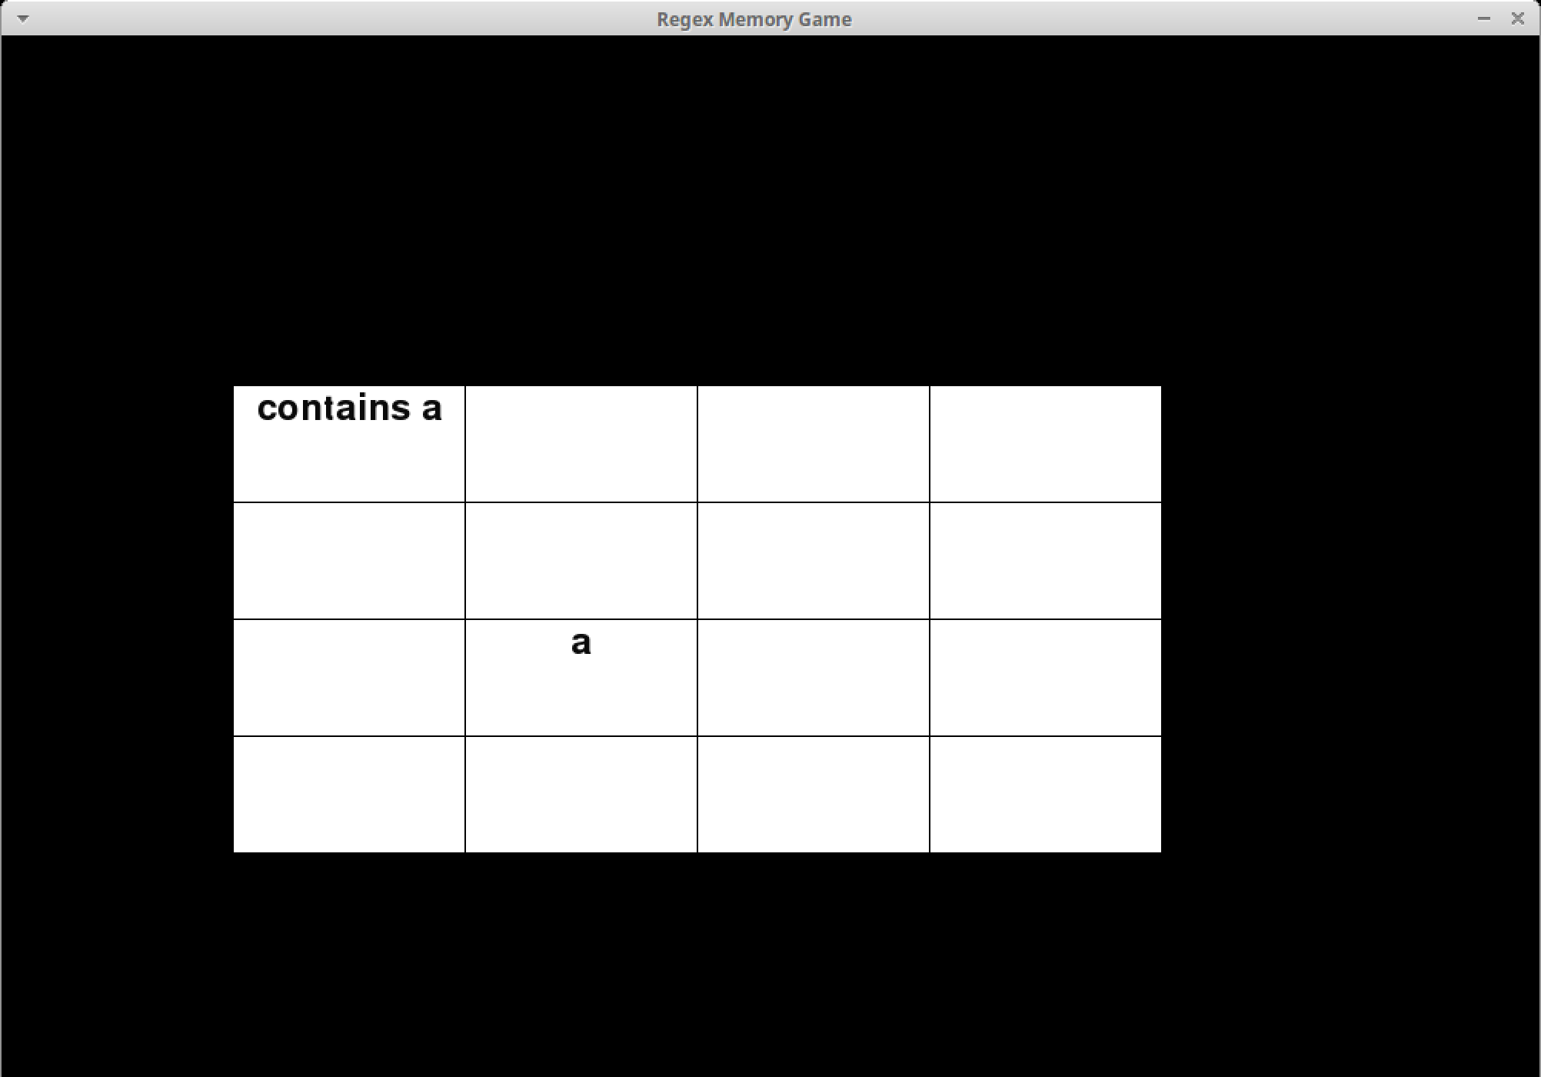

Slide 9
New features (cont.)
Question Difficulty
Within the game, the player/user has the ability to switch between easy, medium, and hard questions.
Terminal game
The game can be played directly in the terminal if you chose not to use a mouse.

Slide 10
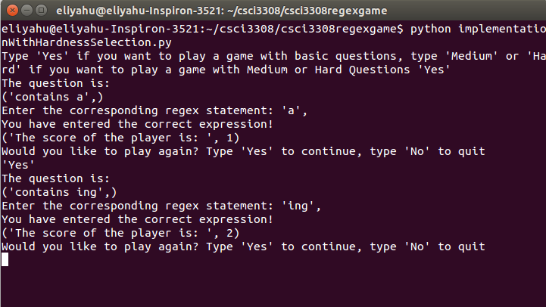
Game Startup

Slide 11
User enters ’Yes’

Slide 12
Game prompts for user answer

Slide 13
User enters ’a’

Slide 14
Question is correct, and game asks user if they want to continue

Slide 15
User inputs ‘Yes’

Slide 16
Another question is asked

Slide 17
Answer is entered

Slide 18
Score is constantly updated

Slide 19
Questions?

