Slide 1

CRM SYSTEM
CUSTOMER RELATIONSHIP MANAGEMENT
Caio Schwarcz Hoffmann 610093
Widjesh Shiva Bhaggan 610128

Slide 2
WHAT IS CRM ?
Customer relationship management (CRM) is a technology for managing assistance provided to customers and potential customers by employees of the company throughout countries and companies stores.
The goal is simple: Improve business relationships. A CRM system helps companies stay connected to customers, streamline processes, and improve profitability.

Slide 3
Introduction
CRM-System for a company located in South-America
.NET Core Framework and Entity Framework
Improve profitability
Staying in touch with customers
Problem Scenario

Slide 4
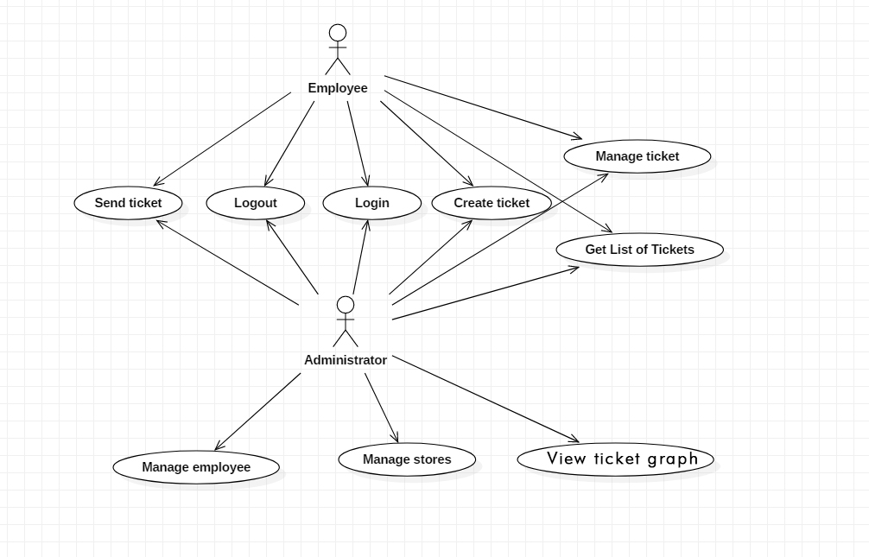
Use Cases Identified and Implemented

Slide 5
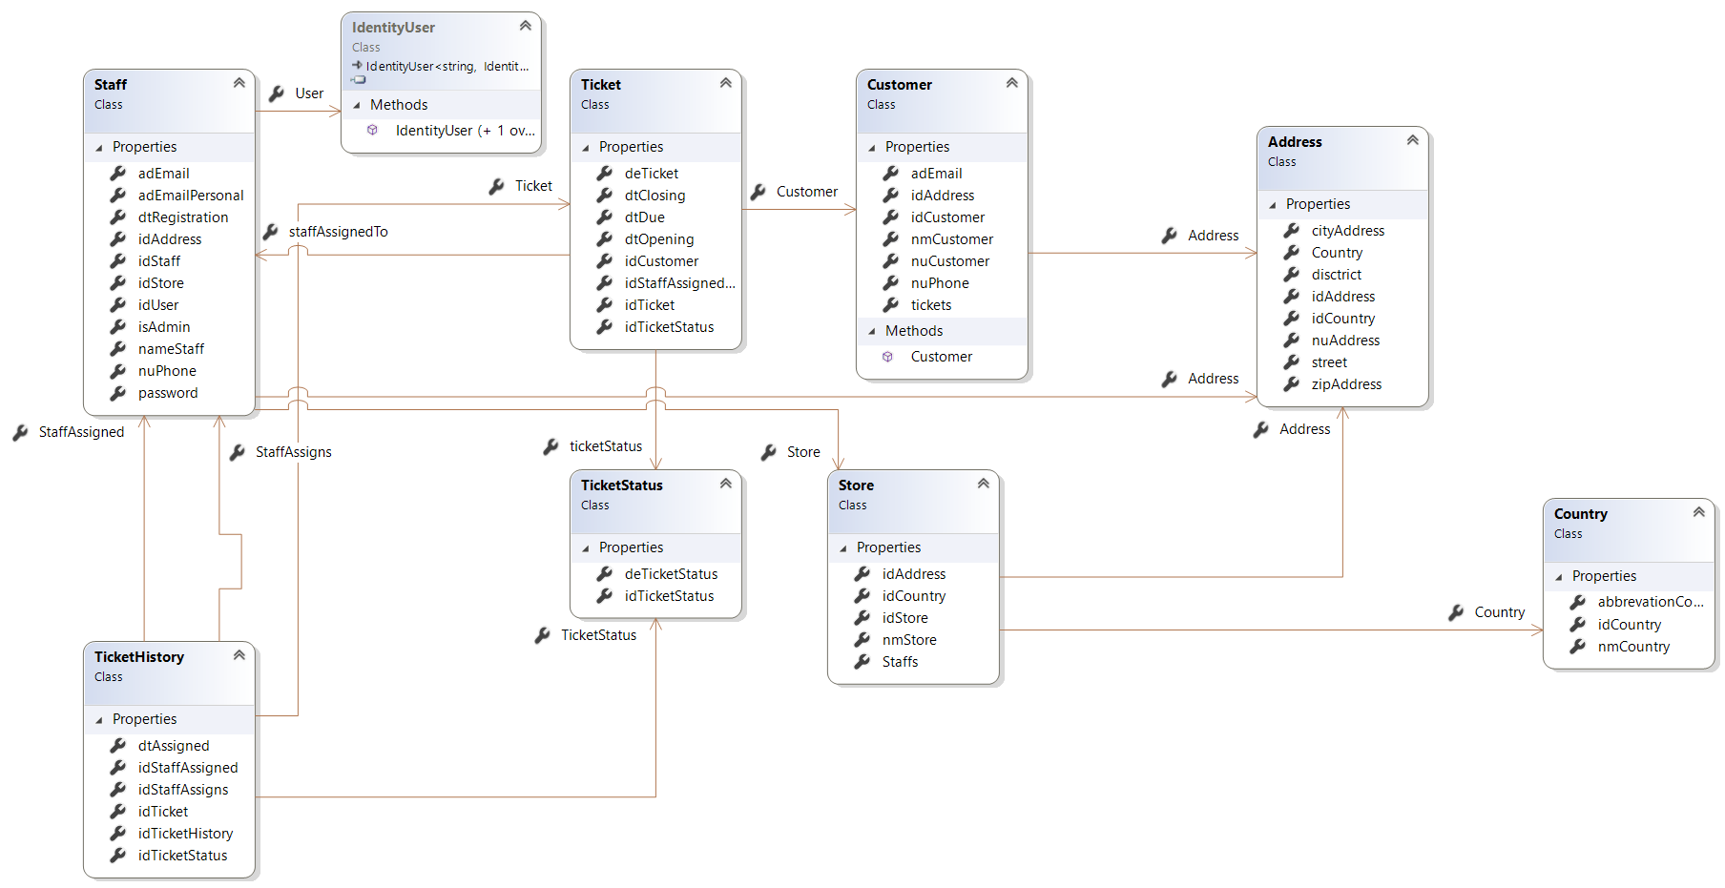
Class Diagram

Slide 6
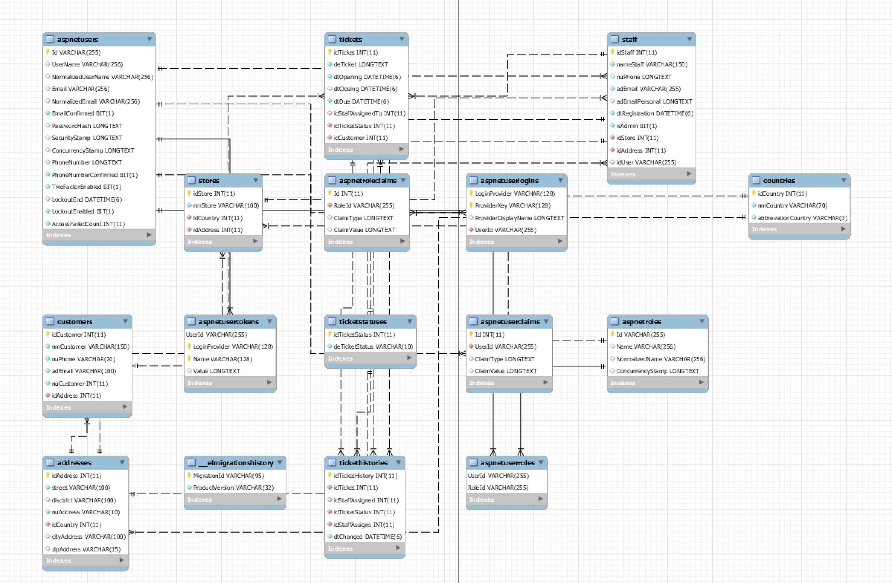
ER Diagram (Database Design Model)

Slide 7
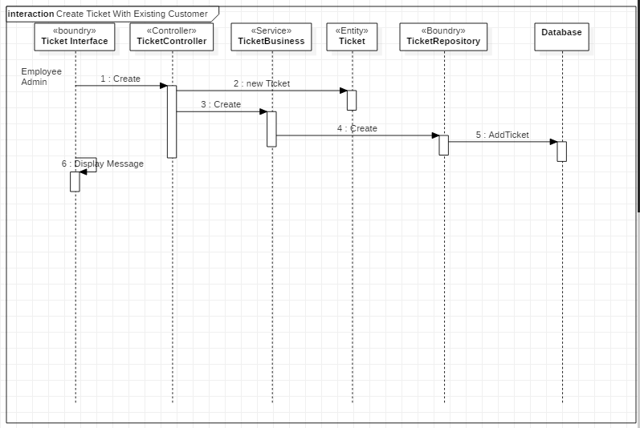
Creating Ticket with existing Customer

Slide 8
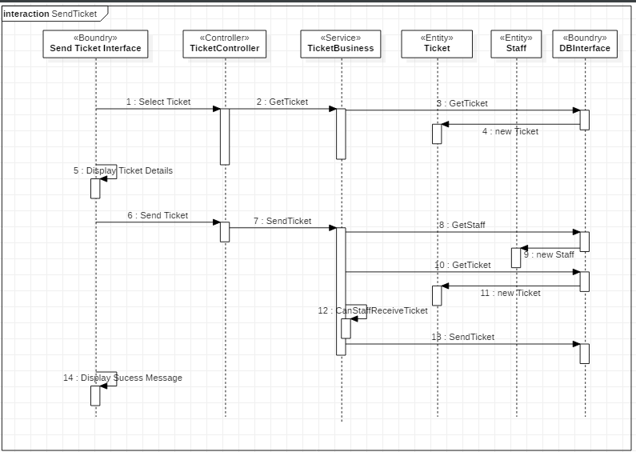
Assign a ticket to an employee

Slide 9
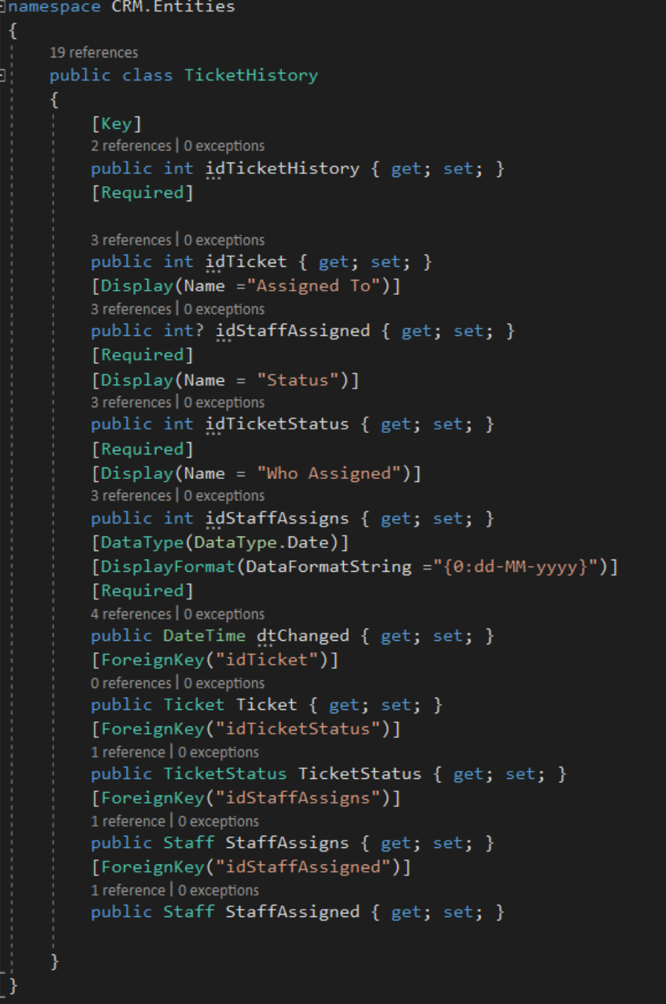
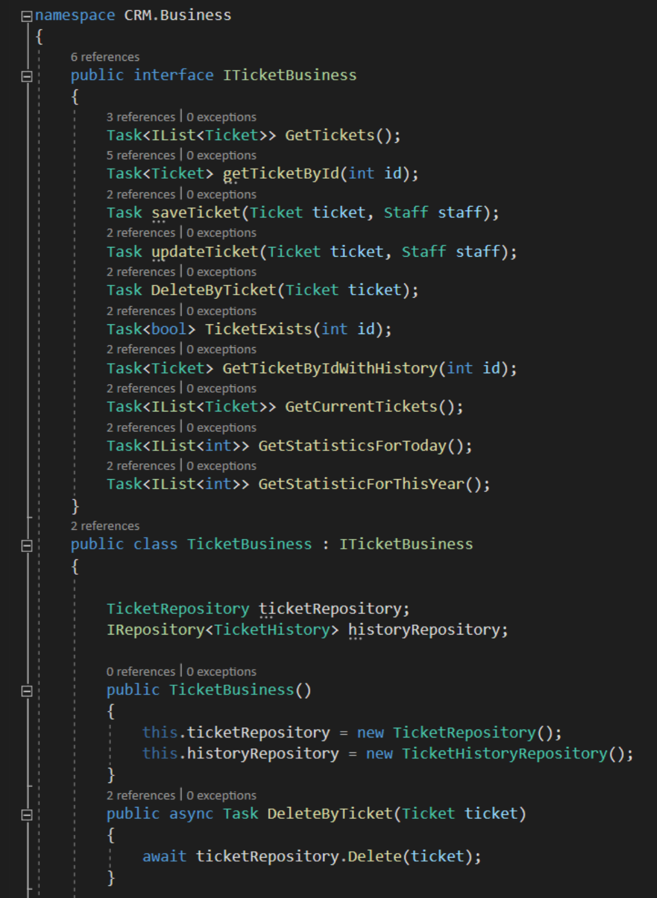
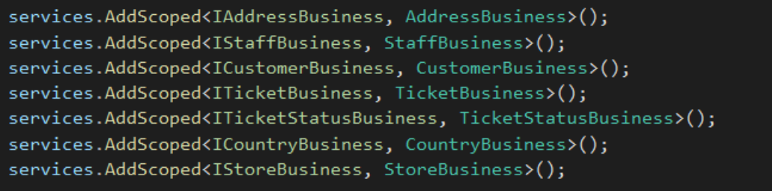
OOP Principle Used
Single
Responsibility Principle
Single Responsibilty Principle
Open/Closed Principle
Dependency Inversion
Open/Closed Principle
Dependency Inversion

Slide 10
Software Design
Factory Method Pattern
Model View Controller Pattern
Repository
Business-Service Layer

Slide 11
The solution presentation

Slide 12
Conclusion
In this course we have looked at some key concepts, themes and skills related to software development.
“Our Software Development skills have greatly shaped after this study. We have realized how developing without principle may impact our software’s. Developing with principles definitely improves the quality of software, and this project proves it.”

Slide 13
Question ?

Slide 14
THANKS

