Slide 1
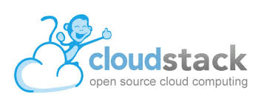
Apache CloudStack
2017 and 2018

Slide 2
My year as VP
For the last 12 months I was the VP of the CloudStack project

Slide 3
What happened in the last year?
4.10 and 4.11 release

Slide 4
What happened in the last year?
https://download.cloudstack.org

Slide 5
What happened in the last year?
CCC Miami in May 2017
(Next CCC September 2018 in Canada)

Slide 6
What happened in the last year?
Various local meetups!
UK, Germany, Japan, US and Canada
Keep organizing them and spread the word :-)

Slide 7
How many downloads?
DEB/RPM Management Server: >75,000
DEB/RPM KVM Agent: >100,000
SystemVM Template: >25,000

Slide 8
Our new VP
Mike Tutkowski

Slide 9
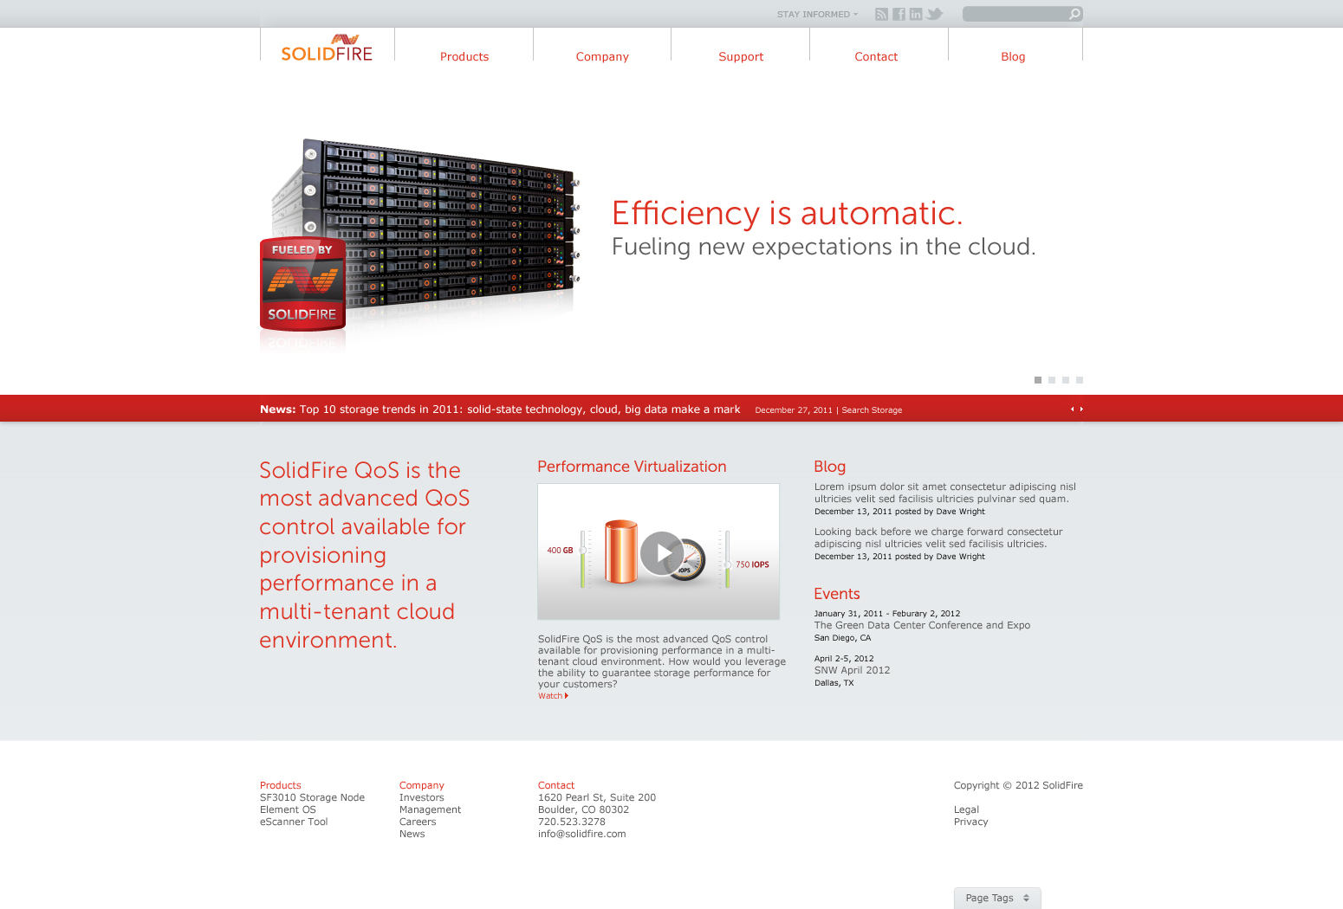
Mike Tutkowski (on Twitter as @mtutkowski)
- Full-time CloudStack software engineer (since November 2012), CloudStack PMC member (since February 2014)
- Focused on CloudStack's storage component
NetApp SolidFire (http://www.solidfire.com/)
- SolidFire is based out of Boulder, CO, USA.
- Develop a scale-out SAN technology (using industry-standard hardware)
- Built from the ground up to support guaranteed Quality of Service (QoS) on a per-volume (logical unit) basis (min, max, and burst IOPS per volume)
- All-SSD architecture (no spinning disks)
- Leverage compression, de-duplication, and thin provisioning (all inline) on a 4-KB block boundary across the entire cluster to drive down cost/GB to be on par with traditional disk-based SANs
- Rest-like API to enable automation of all aspects of the SAN

