Slide 1


Data Engineer Course – Final Project Tree Size Audit and control of disks

Slide 2
Background
“Tree Size Project” is focused on auditing and controlling computer disks by monitoring them for any potential issues and sending alerts through email or Telegram if necessary. This approach can help ensure the optimal performance and security of computer systems by detecting and addressing disk-related problems in a timely manner.

Slide 3
Our Stack
GCP (Google Cloud Platform) - A cloud computing platform offered by Google that provides a range of services including compute, storage, networking, data analytics, machine learning, and more.
DOCKER - An open-source platform for containerization of applications, which allows developers to package applications into containers and deploy them across different environments without any compatibility issues.
KAFKA - An open-source distributed event streaming platform that is designed to handle high-throughput and real-time data feeds. It is commonly used for building real-time streaming data pipelines and event-driven architectures.
PYTHON - A high-level programming language known for its simplicity, readability, and versatility. It is commonly used for web development, data analysis, scientific computing, and machine learning.
PYSPARK - A Python library for Apache Spark, a distributed computing framework for processing large-scale data sets. Pyspark provides an easy-to-use interface for developers to write parallel processing jobs in Python.
MONGODB - A document-oriented NoSQL database that uses JSON-like documents for data storage. It is known for its scalability, flexibility, and ease of use.
ELASTIC - A suite of open-source software tools for search, analytics, and visualization of large-scale data sets. It includes Elasticsearch for search and analytics, Logstash for data processing, and Kibana for visualization and reporting.
KIBANA - An open-source data visualization platform that is used to visualize and analyze data stored in Elasticsearch. It provides a range of visualization tools, including bar charts, pie charts, line graphs, and more.
Airflow - An open-source platform for programmatically scheduling and managing data workflows as DAGs.

Slide 4
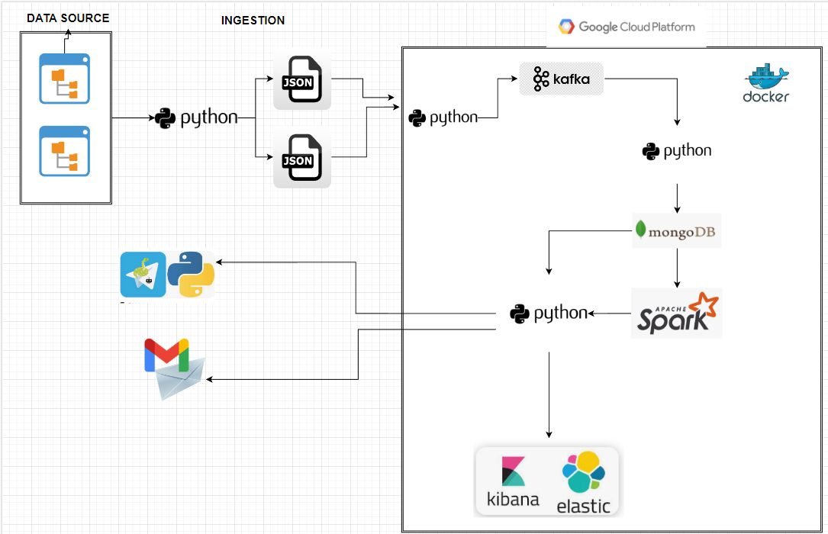
Architecture

Slide 5
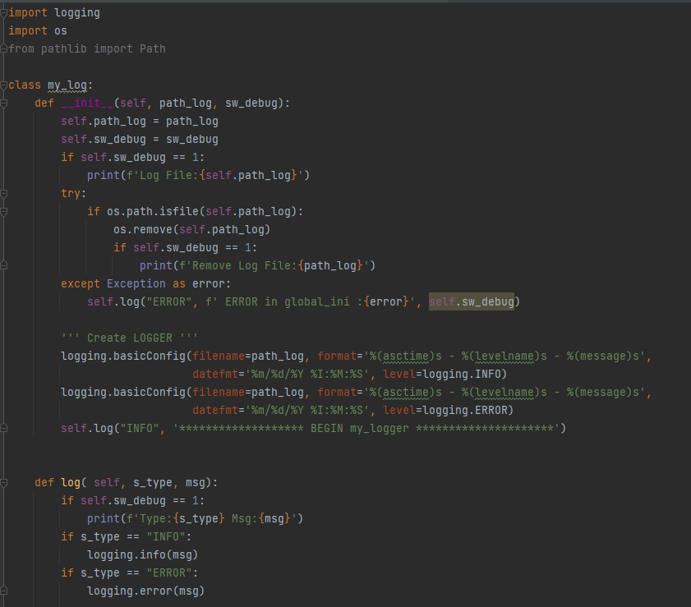

Registration of logs of launched pages of the project:
For the purpose of saving and monitoring - using the library - logging
All logs are recorded in the /logs folder of a running project.
Every run - the same log file is reset - only the last run is served for control purposes
There is an option for testing including display/printing of logs by using the sw_debug parameter
Use of log registration - against class my_log
Notes:
Avi presentation

Slide 6
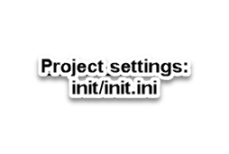
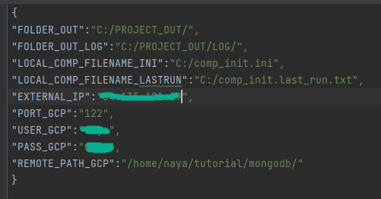
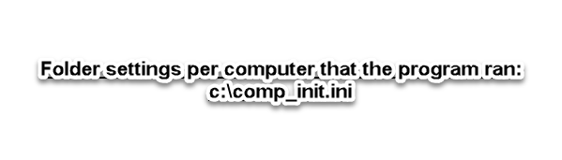
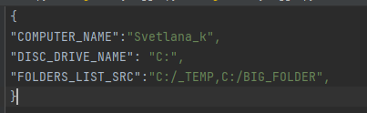
Files *.ini - settings required for work

Slide 7
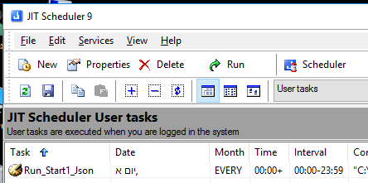
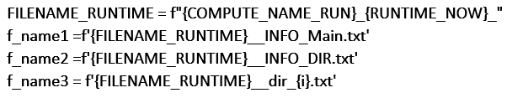


Scanning Drives and Folders tools
JIT programs can be scheduled at different times using a BAT file for Python code
Data is saved in fixed format JSON files with specific names in a shared folder
The files will be saved in the following format:

Slide 8

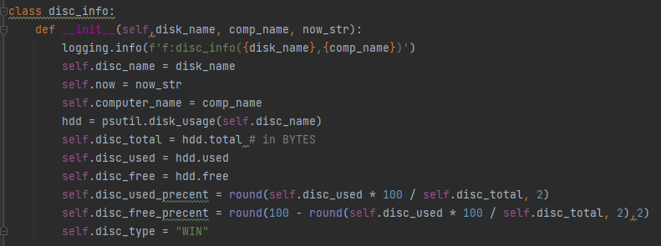
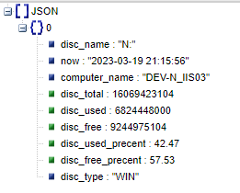
Structure files in JSON format
Information about a drive set to be tracked :

Slide 9
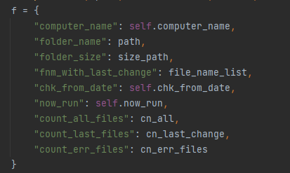
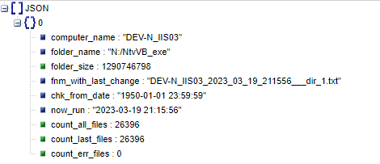
Structure files in JSON format
General information about folders set for tracking:

Slide 10
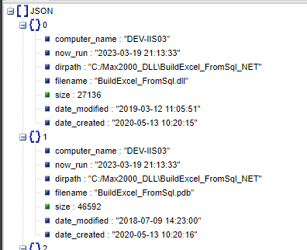
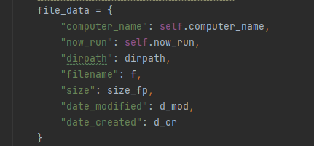
Structure files in JSON format
Structure a file with a list of files that have changed since the last run:

Slide 11
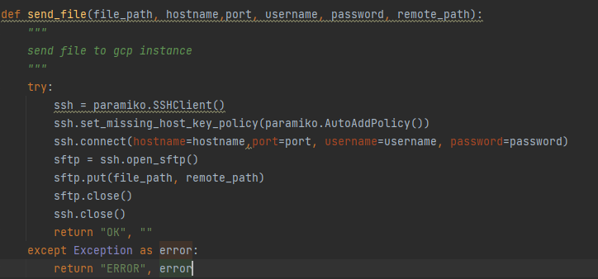
Sending files to GCP
Sending data to a predefined folder using paramiko.SSHClient
Transferring files to a predefined folder FOLDER_OUT_LOG

Slide 12
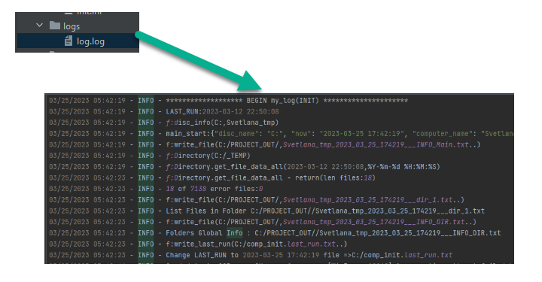
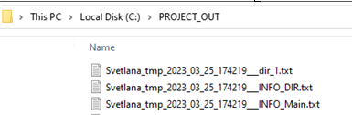
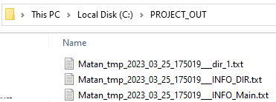
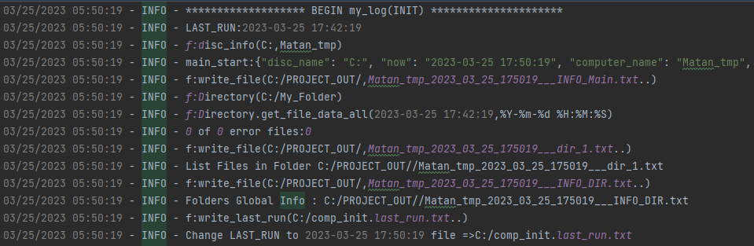
Example of running ...

Slide 13


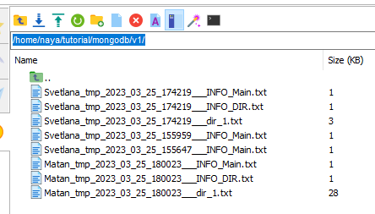
Example of running ...

Slide 14
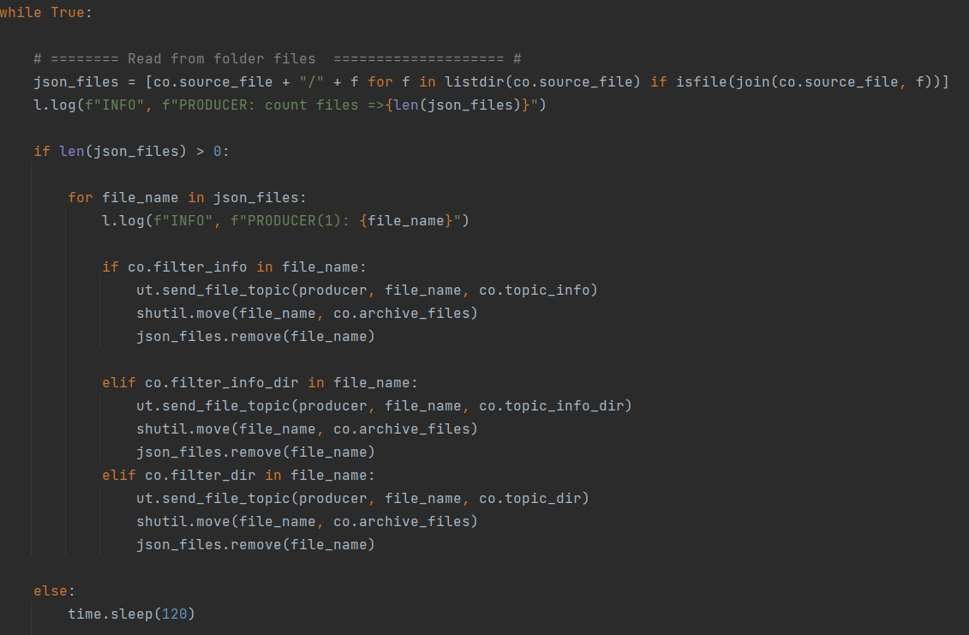
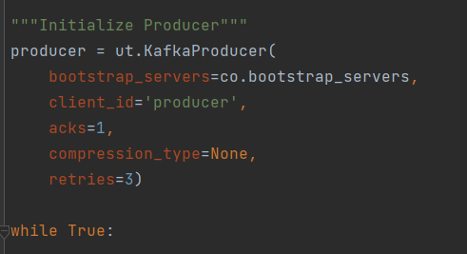
Python-Kafka(producer)
The task involves using Python to loop through all lists in a directory.
The data from these lists will be sent to a Kafka topic.
Each type of JSON data will be sent to a different Kafka topic.

Slide 15
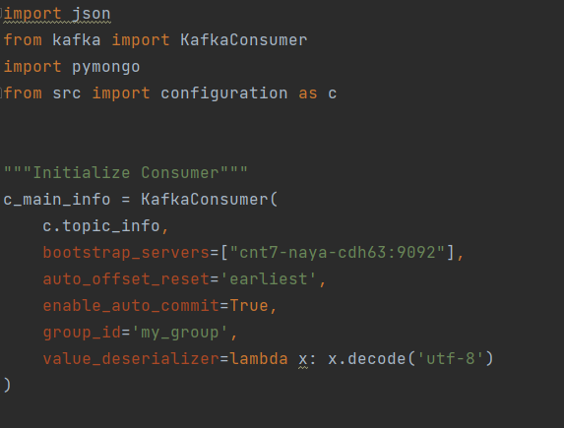
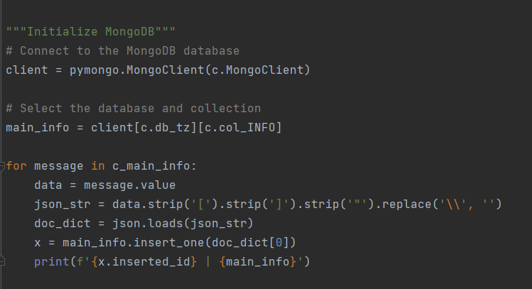
Kafka(consumer)-Python-MongoDB
The task involves using Python to pull a messages from a Kafka topic.
The message will be transformed and inserted into dictionary.
The dictionary item will then be sent to a MongoDB database.

Slide 16
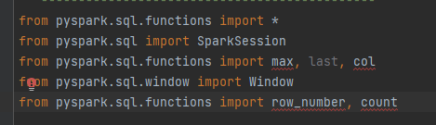
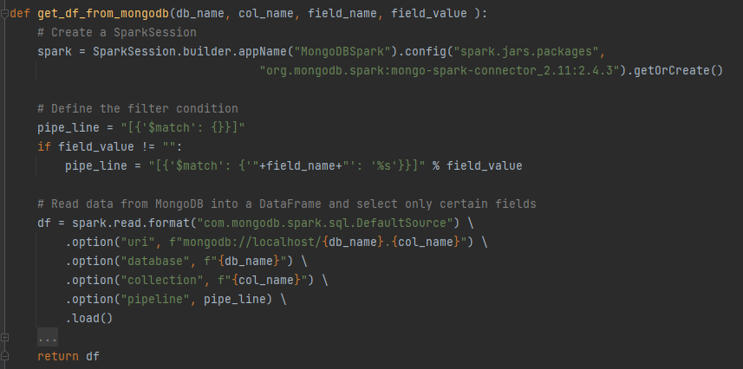

Getting information from MongoDB
The function connects to MongoDB using PySpark MongoDB Connector and SparkSession builder, with the MongoDB Spark Connector version specified in the configuration.
Constructs a pipeline to filter the data retrieved from MongoDB.

Slide 17
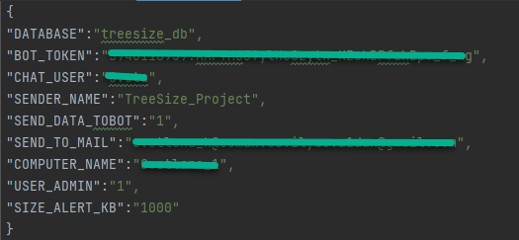
Settings to work from this part of program
Using a settings file from a project folder init/init.ini

Slide 18
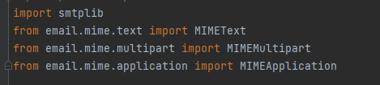
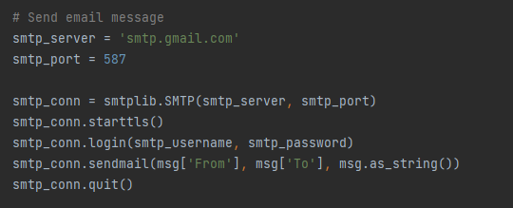
Options available for control
Receiving data by email as a CSV file:
Receiving the latest data against all disks that are monitored for the USER_ADMIN
Receiving data on a certain computer by definition: latest information on tracked folders, latest information on files in folders

Slide 19
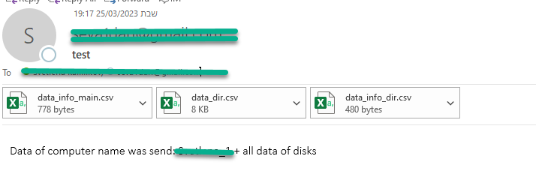
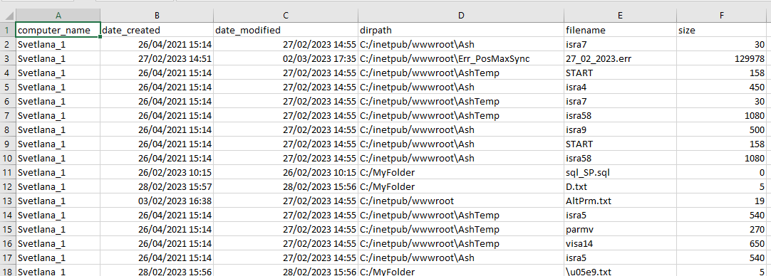


Options available for control
Example :

Slide 20
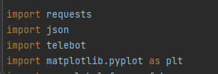
Options available for control
Option to receive data for BOT:
A user who creates a CHAT conversation and is configured to receive a message - with the help of the CHAT_USER parameter is approved to receive data:
A general measure on all drives (according to the selection of the last measure) in a graph display
In order to receive data, it is necessary for the BOT user to send the word START in a message

Slide 21
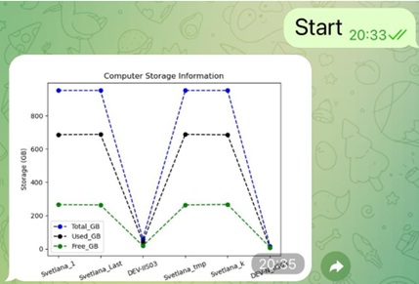
An example of receiving data in BOT

Slide 22
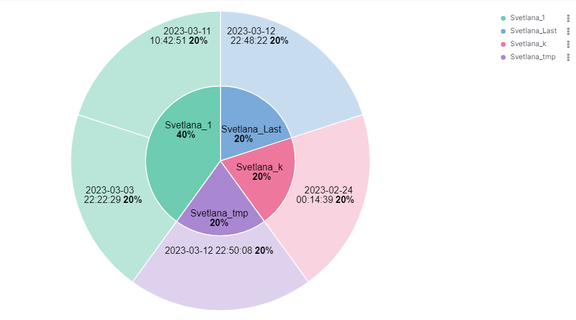

Slide 23
