Slide 1
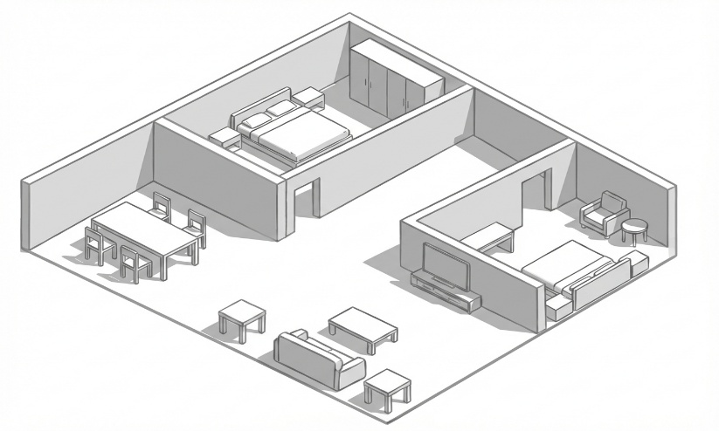



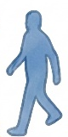




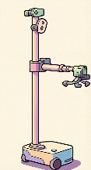

The robot hears someone calling but cannot see the human and should proceed to further exploration.
human call
“Hey robot, come here.”
The robot hears footsteps but does not see anyone.
footsteps
The robot should politely yield when it detects human or hears conversation.
conversation
The robot should yield during when it detects or hears a walking human.
footsteps
Query: human call

Slide 2

The robot hears someone calling but cannot see the human and should proceed to further exploration.
human call
“Hey robot, come here.”
The robot hears footsteps but does not see anyone.
footsteps
The robot should politely yield when it detects human or hears conversation.
conversation
The robot should yield when it detects or hears a walking human.
footsteps
Query: human call

