Slide 1
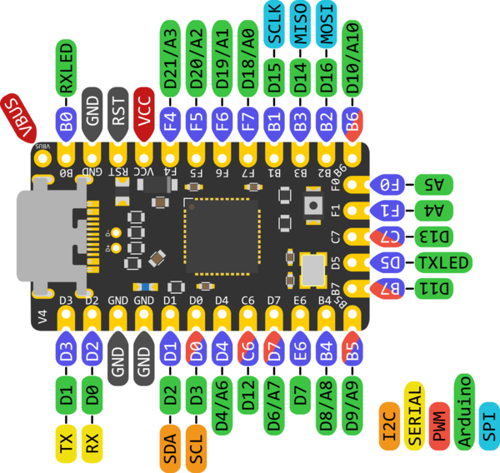
ROW1
ROW2
ROW3
ROW4
COL1
COL2
COL3
COL4
COL5
COL6
ROW1
ROW2
ROW3
ROW4
COL7
COL8
COL9
COL10
COL11
COL12
VCC
D+
D-
GND
ROW5
COL8
COL9
COL10
COL11
COL12
ROW5
COL1
COL2
COL3
COL4
COL5

