Slide 1

GitHub, GitBash, Git
Let’s git commit some shit
I’m Octocat. Your new friend. Nice to meet you!

Slide 2
Let’s have some fun
Motivation
Terminology and other things
Personal github
Practice
More terminology and more things
Collaborations
You’ll collaborate!
Please ask questions along the way
Disclaimer: There’s a lot of things I don’t know, but git has great documentation in general

Slide 3
Why? - motivation
Backup
Version control
Collaborations

Slide 4
Terminology
Repository
A place where something is stored
Local vs. Remote
Overlap
Cloning
Copy the repository

Slide 5
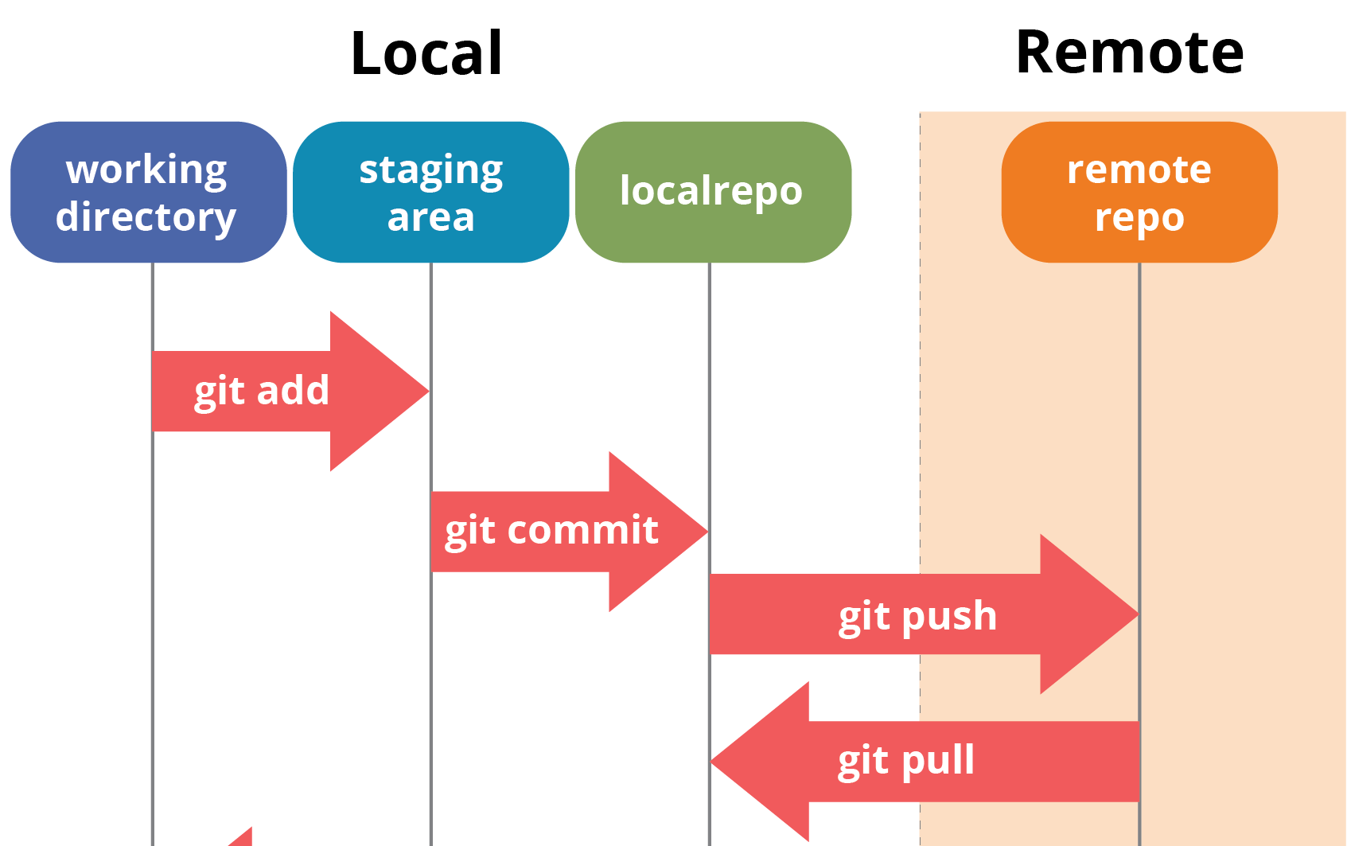

Terminology – some important commands
Git add
Git commit
Git push
Git pull
Git push and git pull do not
discriminate
Wow!
Hopf models
Cool graphs
Pending emails

Slide 6
Practice!
Wiep gives an example

Slide 7
Practice!
Create a repository on github.com
Go to the directory where you want your repo on your laptop
It might be that you need some help to link your local git to the remote one
Let me know
Clone your repo locally
Create some file locally
Add, commit, push the file
See the magic that is Git
Suggest demonstration
Feeling like a programmer?

Slide 8
Branches and other things
What about branches?
Give an example

Slide 9
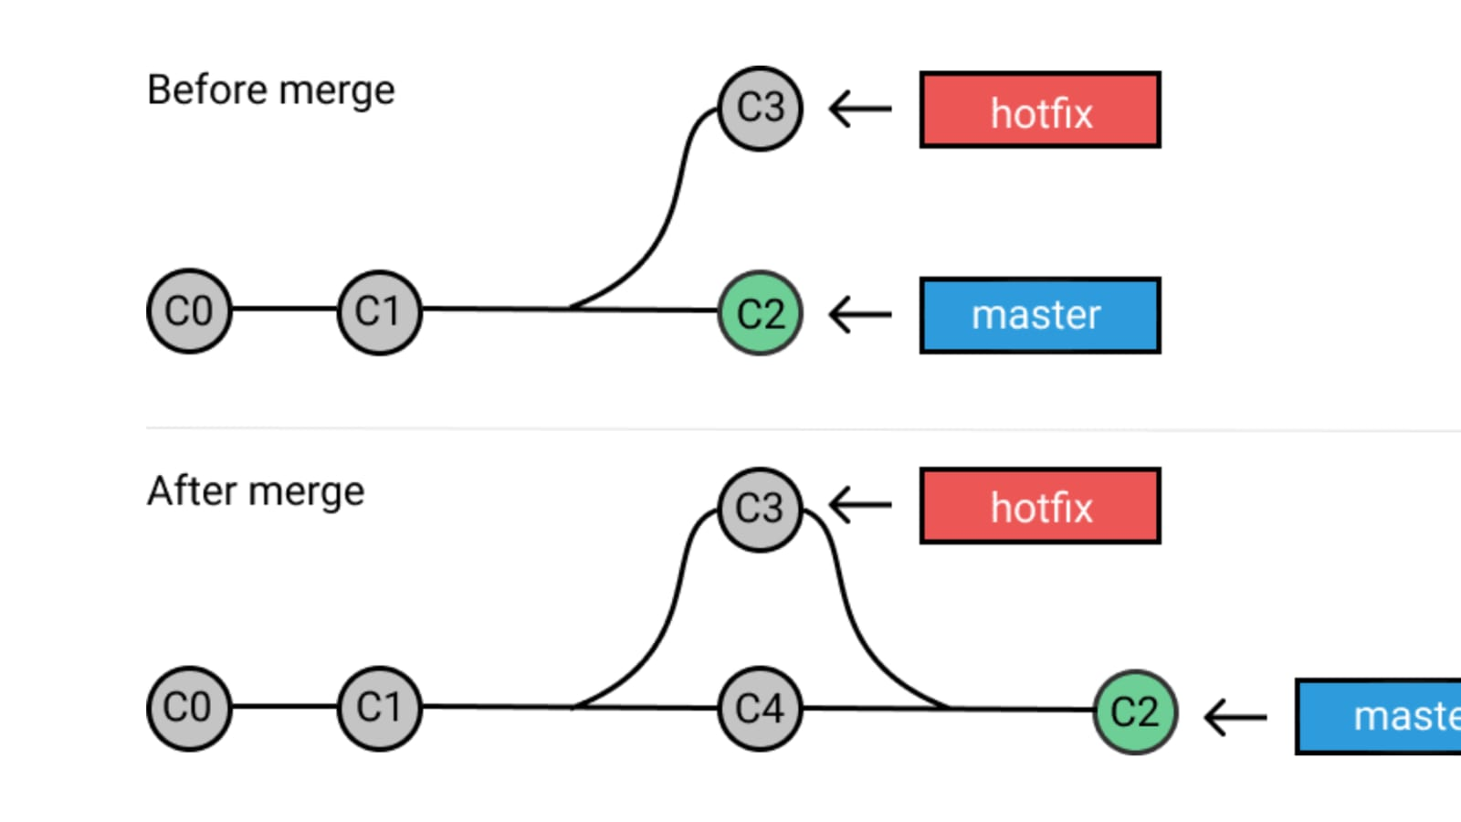
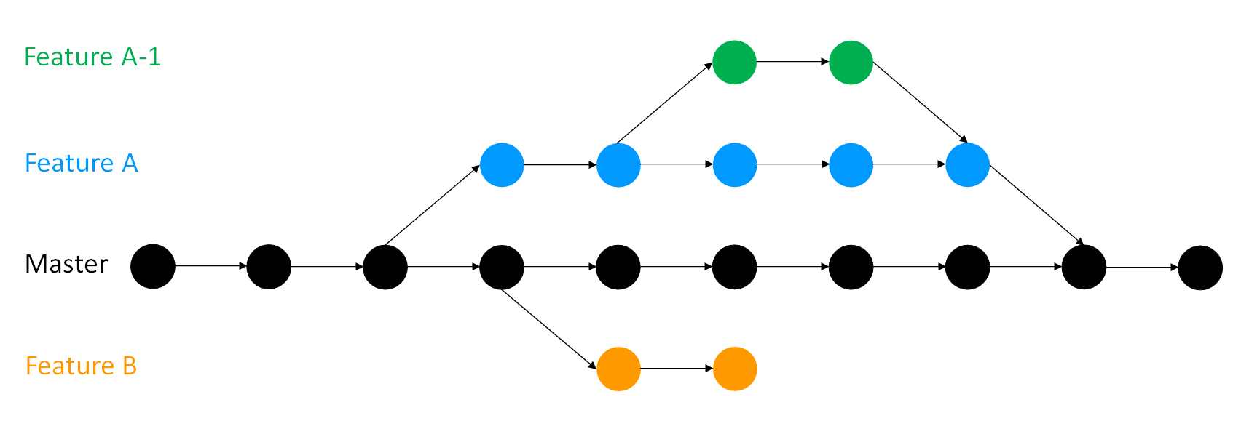
Terminology
Checkout other branches
Fetching
Merging

Slide 10
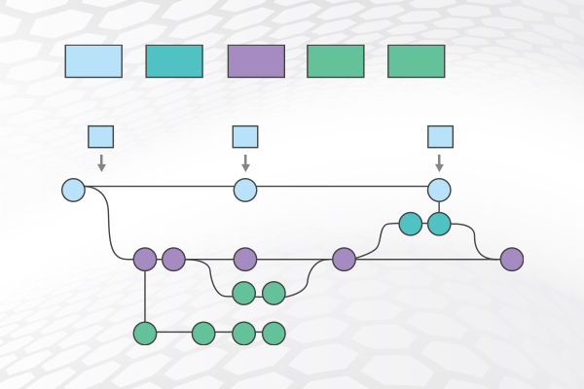
Some important commands
Git push
Git pull
Git add
Git commit
Git status
Git commit –m “commit title” –m “commit message”
Git checkout [branch_name]
Git pull origin
Git pull [branch_name]
Git merge [source_branch][target_branch]

Slide 11
Remember that everything you do locally is not seen by the remote repo, unless you put it there
Hopf models
Cool graphs
Pending emails

Slide 12
Let’s start collaborating!
Go to GitBash
Navigate to the folder where you would like to clone the repository for this collaboration
Clone the repository
git clone https://github.com/wiepstikvoort/git_introduction.git
Go to your local repository:
cd git_introduction
Are you up to date with the main branch?
git status
What’s in there?
ls

Slide 13
Create your Branch
git checkout –b <Branch_name>
Push your Branch to the remote repo
git push –u origin <Branch_name>
Practice switching branches
git checkout main
git checkout <Branch_name>
Now let’s get to work !

Slide 14
Create Branch
Create my own Branch so that they can check that out already

