Slide 1
PROGPU / BROWSER WEBGPU · LEVEL 400
ProGPU browser rendering
from C# to navigator.gpu
Architecture, binary transport, retained GPU state, worker ordering, async readback, Hot Reload, and Release AOT.
Notes:
Level 400 premise: the browser is not a second renderer. It is an execution lane beneath the same retained compositor. Source: README.md Browser implementation architecture.

Slide 2
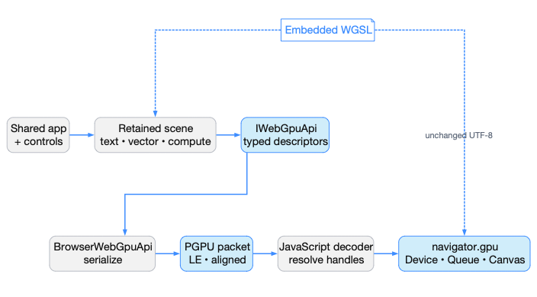
One renderer; only the host and transport are browser-specific
The end-to-end boundary
Shared ProGPU.Samples and ProGPU.Scene execute inside .NET WebAssembly. BrowserWebGpuApi serializes the same typed WebGPU calls used by SilkWebGpuApi.
progpu-browser.js decodes them into navigator.gpu; embedded WGSL crosses unchanged.
C# RETAINED SCENE → BINARY PACKET → NAVIGATOR.GPU
2
Notes:
Walk left-to-right. Application, controls, scene compilation, text, vector, and compute are shared. IWebGpuApi is the typed seam. Desktop selects SilkWebGpuApi; browser selects BrowserWebGpuApi. Source: README.md; IWebGpuApi.cs; BrowserWebGpuApi.cs; progpu-browser.js.

Slide 3
The solution split keeps browser code at the platform edge
01 ProGPU.Samples
Shared application, windows, pages, retained visuals, controls, and every shader-using sample.
02 ProGPU.Backend / Scene
IWebGpuApi, WgpuContext, compositor, atlases, resources, render and compute pipelines.
03 ProGPU.Browser
Capability runtime, binary protocol, browser WebGPU API, host, input, storage, and fallback font.
04 ProGPU.Samples.Browser
Thin browser-wasm entry point plus canvas, JavaScript module, CSS, diagnostics, and deployment assets.
3
Notes:
The project boundary is deliberately asymmetric: browser-specific code is narrow, while renderer code remains shared. Source: README.md project table and Browser WebGPU sample; ProGPU.Samples.Browser.csproj.

Slide 4
Startup establishes one external WgpuContext
1 Bootstrap .NET
progpu-browser.js creates the .NET runtime, registers JS module imports, then runs Program.Main in browser-wasm.
2 Negotiate capabilities
Select canvas; install input; choose transport; request adapter/device; select profile and canvas format.
3 Install the shared app
InitializeExternal installs opaque device/queue/surface tokens. BrowserWindowHost runs the shared app through AppBuilder.
DOTNET.JS
CAPABILITIES
APPBUILDER
4
Notes:
BrowserGpuRuntime.InitializeAsync is the one JSON startup seam because initialization is infrequent and capability-shaped. Frame rendering does not use JSON. Source: Program.cs; BrowserGpuRuntime.cs; progpu-browser.js initialize/initializeGpu; WgpuContext.InitializeExternal.

Slide 5
Every animation frame reuses the desktop RenderFrameCore path
1. Browser host tick
requestAnimationFrame supplies time. Drain DOM input, read physical canvas pixels and devicePixelRatio.
2. Ordinary WinUI frame
Run UIThread work, callbacks, animations, measure/arrange, and framebuffer/DPI reconfiguration.
3 Acquire and render
Get current surface texture, create its view, call Compositor.RenderScene, submit, present, and release tokens.
HOST
WINDOW
GPU FRAME
5
Notes:
The critical point is Window.RenderExternalFrame delegates to the same RenderFrameCore used by desktop. Physical framebuffer dimensions remain separate from logical layout dimensions. Source: BrowserWindowHost.cs; Window.cs.

Slide 6
IWebGpuApi is the only renderer-facing platform seam
1 Typed call sites
Renderer code passes Silk.NET WebGPU descriptors and opaque pointer-shaped handles through IWebGpuApi.
2 Desktop implementation
SilkWebGpuApi is a zero-policy forwarding layer into wgpu-native; no command serialization is needed.
3 Browser implementation
BrowserWebGpuApi reads the same descriptors and writes versioned resource, pass, upload, copy, and lifetime opcodes.
CALLER
SILK / NATIVE
BROWSER / WASM
6
Notes:
The interface covers creation, render and compute passes, copies, writes, submission, mapping, surface acquisition, and destruction. This keeps higher layers backend-neutral without weakening type information. Source: IWebGpuApi.cs.

Slide 7
The packet is a compact, self-validating little-endian stream
1 Packet header — 16 B
PGPU magic u32, protocol version u16, flags u16, byte length u32, command count u32.
2 Command header — 8 B
Opcode u16, flags u16, command length u32. Each record advances to the next 8-byte boundary.
3 Typed payload
Fixed-width descriptor fields, handle values, variable arrays, UTF-8 WGSL, and upload bytes are inlined.
OFFSET 0
EACH OPCODE
PAYLOAD
7
Notes:
Magic is 0x55504750 and version is 1. Both C# and JavaScript validate length and command consumption. Alignment makes 64-bit fields safe and decoding predictable. Source: BrowserGpuProtocol.cs; progpu-browser.js dispatchPacket.

Slide 8
Flush points preserve ordering without per-draw JavaScript interop
1 Record in reusable memory
BrowserGpuCommandEncoder owns a NativeMemory arena, starts at 256 KiB, grows, seals, dispatches, then resets.
2 Cross coarse seams
QueueSubmit flushes the packet. mapAsync also flushes first so all prior writes and copies are visible.
3 Preserve frame order
A worker transport copies packet bytes, microtask-coalesces them, and posts one ordered dispatch-batch task.
ARENA
FLUSH
WORKER ORDER
8
Notes:
Resource creation can cause additional coarse packets, but steady rendering converges on one handoff per managed frame. WorkerRequest flushes queued frame packets before asynchronous requests. Source: BrowserWebGpuApi.Flush/QueueSubmit/BufferMapAsync; progpu-browser.js dispatch/flushWorkerPackets.

Slide 9
Opaque handles preserve resource identity across the boundary
01 32-bit token
Bits 0–19 are the table index; bits 20–31 are a 12-bit generation. Zero remains null.
02 Managed pool
Allocation increments generation; release validates the current generation before returning an index to the free stack.
03 Pointer-shaped ABI
Silk pointer values carry tokens only. Browser code never dereferences them; C# converts token ↔ pointer.
04 JavaScript table
resources is keyed by the complete token. requireResource rejects stale or unknown handles before WebGPU execution.
9
Notes:
Generations prevent an old retained command from accidentally addressing a new GPUBuffer or GPUTexture that reused the same index. Source: BrowserGpuHandle and BrowserGpuHandlePool; BrowserWebGpuApi class comment; requireResource in progpu-browser.js.

Slide 10
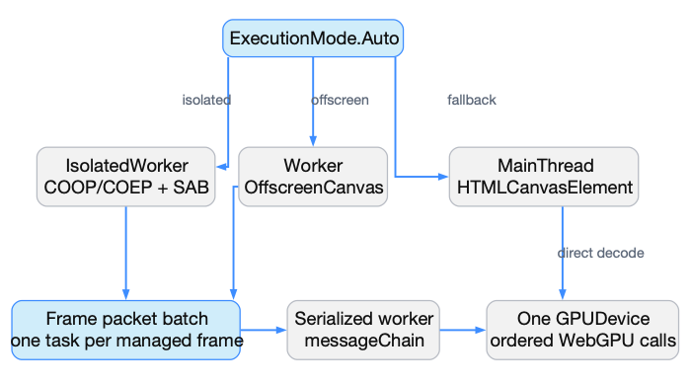
Transport selection is feature-based, not browser-branded
Three execution modes
Auto prefers an isolated OffscreenCanvas worker when cross-origin isolation and SharedArrayBuffer exist, then an ordinary worker, then main-thread decode.
All modes consume the same PGPU packet. Worker messages are serialized so surface texture and submission order cannot interleave.
ONE PACKET FORMAT · THREE EXECUTION MODES
10
Notes:
COOP same-origin and COEP require-corp enable crossOriginIsolated. An explicit IsolatedWorker request downgrades to Worker when headers are absent and records the reason. Source: docs/browser.md; chooseExecutionMode; handleDispatcherWorkerMessage.

Slide 11
JavaScript decodes PGPU into deterministic WebGPU calls
1 Validate packet
Check WASM bounds, magic, version, declared length, command count, and final byte consumption.
2 Decode records
Read opcode and length through DataView, execute payload fields with explicit little-endian reads, then align by 8.
3 Issue WebGPU calls
Resolve handles and call GPUDevice, command encoders, render/compute passes, GPUQueue, textures, and buffers.
VALIDATE
DECODE
EXECUTE
11
Notes:
The decoder avoids JSON, reflection, and a JS interop call per draw. Descriptor enums are converted through explicit lookup tables, and truncation fails before issuing a partial command. Source: progpu-browser.js dispatchPacket/execute.

Slide 12
A frame batch owns one current surface texture lifetime
1 Acquire token
SurfaceGetCurrentTexture allocates a handle and records CreateSurfaceTexture; Window creates a texture view from it.
2 Resolve current texture
Opcode 26 calls context.getCurrentTexture(). Render-pass attachments reference the resulting texture view handle.
3 Submit and retire
QueueSubmit flushes. Browser presentation is implicit; deferred view/texture releases join the next ordered packet.
ACQUIRE
ENCODE
SUBMIT
12
Notes:
This is why worker packets created by one managed frame are coalesced into one task: a current canvas texture cannot safely span unrelated worker work. SurfacePresent is intentionally a no-op in the browser backend. Source: BrowserWebGpuApi.SurfaceGetCurrentTexture/SurfacePresent; opcode 26; docs/browser.md.

Slide 13
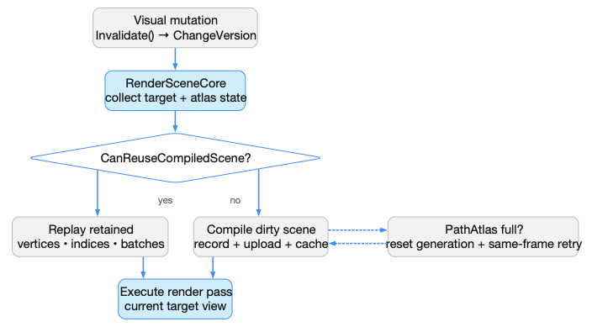
Retained rendering determines whether the CPU recompiles a scene
ChangeVersion is the contract
Pixel-affecting mutations invalidate the visual and propagate a monotonically changing version to the root. RenderSceneCore snapshots target and atlas state.
A cache hit skips scene compilation and uploads but still executes the current render pass and present path.
INVALIDATION → CACHE PREDICATE → REPLAY OR RECOMPILE
13
Notes:
Compiled reuse is not “skip rendering.” It is “reuse compiled CPU/GPU-facing batch data.” Dynamic diagnostics, mutable drawing visuals, masks, effects, and stale layers deliberately force misses. PathAtlas recoverable exhaustion resets once and retries the same frame. Source: Visual.cs; Compositor.cs.

Slide 14
Compiled scene reuse is a strict pixel-validity predicate
01 Visual state
Same root identity and root ChangeVersion; no dynamic diagnostics; retained content must have an immutable contract.
02 Target state
Same logical size, physical framebuffer, viewport, and DPI scale. Resize and display changes invalidate reuse.
03 Atlas state
GlyphAtlas.Generation and PathAtlas.Generation must match the versions captured during compilation.
04 Layer state
Tooltip and external layer identity/version plus every CacheAsLayer texture, ownership, visibility, and dirty flag must remain valid.
14
Notes:
The predicate is intentionally conservative because performance and pixel correctness are one contract. Source: Compositor.CanReuseCompiledScene and CaptureCompiledScene.

Slide 15
WGSL is shared source—not translated browser output
A Embedded modules
Production WGSL lives in each owning Shaders directory and is loaded once through ShaderResource.
B Typed descriptor
The compositor supplies ShaderModuleWGSLDescriptor through IWebGpuApi; the browser backend accepts WGSL only.
C Exact UTF-8 path
BrowserWebGpuApi encodes the source in opcode 14; JavaScript decodes and calls GPUDevice.createShaderModule({ code }).
D Stable pipelines
Shader modules, layouts, pipelines, bind groups, samplers, buffers, and textures keep generation-bearing identities across packets.
15
Notes:
There is no GLSL/HLSL translation step and no browser fork of Text.wgsl, Vector.wgsl, GlyphRasterizer.wgsl, or PathRasterizer.wgsl. Optional feature gaps downgrade the requested GPU profile rather than rewriting shader source.

Slide 16
Retained path and glyph geometry survives the browser boundary
01 Geometry identity
Path segments and font glyph outlines are compiled once into retained records keyed by geometry, style, scale, and bounded phase.
02 GPU coverage atlases
PathAtlas and GlyphAtlas keep coverage textures and GPU buffers alive; generations advance only when UV content actually moves.
03 Quality invariants
Physical framebuffer pixels, DPI-aware glyph raster size, quarter-physical-pixel text snapping, and precise half-open winding stay intact.
04 Cheap camera changes
Zoom and transforms update matrices, uniforms, or instances. They do not reparse DXF text, clone glyph paths, or lower analytic coverage.
16
Notes:
This is the retained-GPU answer to high-quality DXF zoom and crisp text: reuse glyph/path geometry and atlas residency, while changing placement transforms. Browser transport preserves those resources; it does not force raster snapshots. Source: AGENTS.md rendering contract; PathAtlas.cs; GlyphRasterizer.wgsl; PathRasterizer.wgsl.

Slide 17
Mapped buffers cross a separate asynchronous seam
1 Order prior GPU work
BufferMapAsync flushes pending commands before invoking the JavaScript mapBuffer import.
2 Await WebGPU mapping
Main thread awaits GPUBuffer.mapAsync. Worker mode sends a request and transfers a copied ArrayBuffer response.
3 Expose managed range
C# pins a managed byte array; reads copy into it. Writes copy back before unmap; callback/task completion remains asynchronous.
FLUSH
MAPASYNC
COPY BACK
17
Notes:
This coarse seam is intentionally separate from the packet protocol because WebGPU mapping is asynchronous and returns CPU-visible storage. Source: BrowserWebGpuApi mapping methods; progpu-browser.js mapBuffer/copyMappedBuffer/writeMappedBuffer.

Slide 18
DOM input is batched into the neutral WinUI input seam
1 Queue DOM records
Listeners append fixed 32-byte events. Pointer moves replace the previous move; adjacent wheel deltas accumulate; queue caps at 4096.
2 Drain per frame
BrowserInputDispatcher stackallocs 256 records and drains at most four batches before injecting InputSystem events.
3 Install platform services
BrowserWindowHost wires cursor, focus/text, clipboard, storage/file pickers, canvas metrics, and an embedded Roboto fallback.
DOM
FRAME BATCH
HOST SERVICES
18
Notes:
High-frequency DOM events never call managed code directly. Popups, flyouts, tooltips, and dialogs remain compositor layers in the one top-level canvas window. Source: BrowserInputDispatcher.cs; BrowserWindowHost.cs; progpu-browser.js input helpers.

Slide 19
WebGPU device loss rebuilds device-owned state
1 Detect
uncapturederror records the first validation failure. device.lost reports reason and message through diagnostics.
2 Signal the owner
A dispatcher worker posts device-lost to the main page; main-thread mode schedules the same reload path.
3 Rebuild cleanly
Reload reinitializes adapter/device, handle tables, pipelines, buffers, textures, atlases, and the retained shared application.
WEBGPU
HOST
RECONSTRUCT
19
Notes:
The browser cannot repair device-owned objects in place after device loss. Reloading from retained application state gives every GPU resource a coherent new device identity. Source: initializeGpu device.lost handler; handleWorkerMessage.

Slide 20
Debug Hot Reload and Release AOT converge on the same renderer
Debug / iterate
• Managed WebAssembly interpreter
• WasmEnableHotReload = true
• dotnet watch delivers metadata / IL deltas
• UIThread coalesces one Hot Reload generation
• Active and cached UI reconcile selectively
• Same packets, workers, resources, WGSL
Release / ship
• RunAOTCompilation = true
• Trimming, SIMD, and native relinking
• ProGPU assemblies compile to WebAssembly AOT
• netDxf remains supported mixed interpretation
• Metadata update handlers are inactive
• Same packets, workers, resources, WGSL
Build mode changes managed execution and deployment—not renderer semantics.
20
Notes:
Hot Reload preserves retained work by invalidating only affected roots and reserving recursive theme re-evaluation for theme/resource edits. Release AOT is trim-safe because the reflection fallback is gated off. Source: README.md Hot Reload architecture; ProGPU.Samples.Browser.csproj.

Slide 21
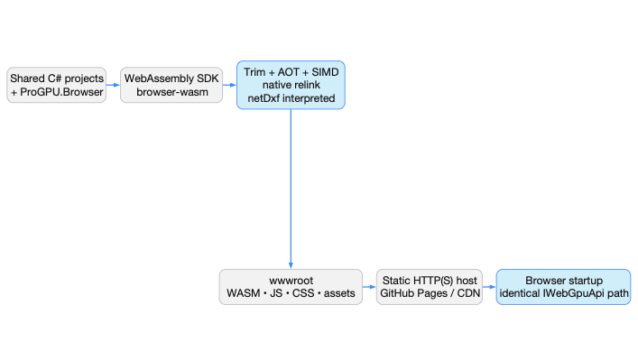
Release AOT changes code generation, not graphics architecture
The publish pipeline
Release enables AOT, trimming, SIMD, and native relinking. ProGPU code becomes native WebAssembly; netDxf is explicitly kept interpreted due to a Mono AOT compiler assertion.
Deploy only artifacts/browser-aot/wwwroot from HTTP(S). Relative assets support static hosts and GitHub Pages.
PUBLISH-TIME MODE · STATIC HOST · SAME WEBGPU PATH
21
Notes:
AOT is a publish-time mode: dotnet publish, not dotnet run. Verify logs for AOTing and native linking. The browser still starts Program.Main, initializes BrowserGpuRuntime, and uses the same navigator.gpu decoder. Source: README.md AOT mode; docs/browser.md; project file.

Slide 22
120+ FPS is a retained-work contract, not a quality preset
What must remain retained
• Compiled scene batches and draw ordering
• GPU buffers, textures, layouts, and pipelines
• Path and glyph outline identity
• Path/Glyph atlas coverage and generations
• Camera/zoom through transforms and uniforms
• One coarse worker task per managed frame
What legitimately forces work
• Visual ChangeVersion from pixel mutations
• Logical/physical target, viewport, or DPI change
• Atlas reset/repack generation change
• Mutable drawing, effects, masks, diagnostics
• Invalid cached-layer texture identity
• Resource destruction or WebGPU device loss
Never hit the target by skipping invalidation, lowering coverage, or rasterizing crisp vector text every frame.
22
Notes:
For DXF, retained entity and text geometry must survive zoom; only transform data should change. Measure steady-state compilation, upload, packet bytes, atlas churn, and frame time separately. Source: AGENTS.md Rendering Performance Regression Contract; Compositor cache predicate; PathAtlas tests.

Slide 23
IMPLEMENTATION CODE MAP
Same retained renderer.
A browser-native execution lane.
C#: IWebGpuApi → BrowserWebGpuApi → BrowserGpuProtocol
JS: progpu-browser.js → navigator.gpu
Host: BrowserWindowHost → Window.RenderExternalFrame
Start: docs/browser.md · README Browser architecture · src/ProGPU.Browser · src/ProGPU.Samples.Browser
Notes:
Final principle: keep application and renderer semantics shared; make platform differences explicit in startup, transport, and host services. The implementation is reviewable end to end from typed descriptor to JavaScript WebGPU call.

