Slide 1
PROGPU / BROWSER WEBGPU
How ProGPU renders inside the browser
One retained renderer. A batched WebAssembly transport. Direct navigator.gpu execution.

Slide 2
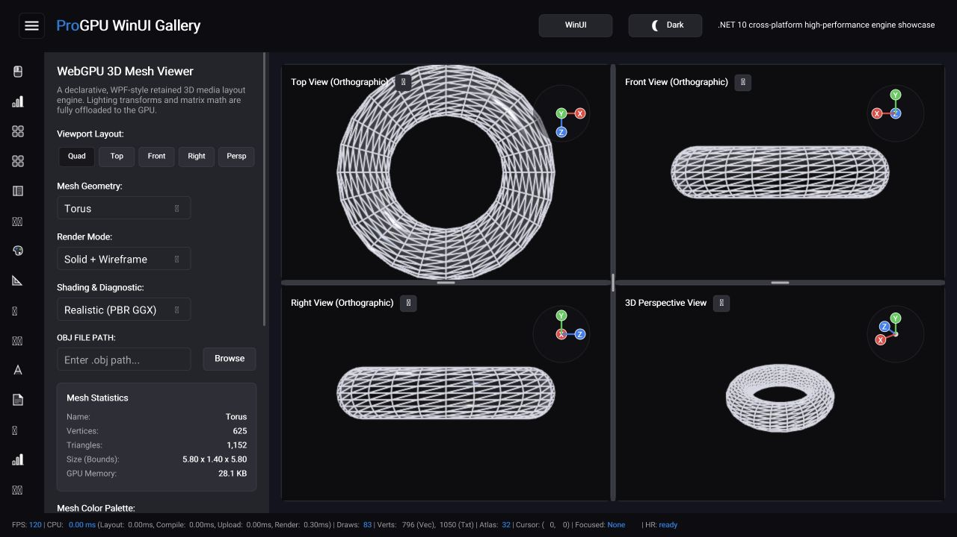
The browser runs the real ProGPU gallery
Only the host and transport change
The browser sample reuses the shared WinUI-shaped gallery, compositor, retained scene compiler, resource caches, compute passes, and WGSL shaders.
The screen at right is the locally published Release AOT build executing on navigator.gpu.
RELEASE AOT • WEBGPU • 120 FPS
2

Slide 3
Retained GPU state keeps browser frames cheap and sharp
01 Scene reuse
Unchanged visual trees replay compiled draw calls instead of rebuilding commands or uploads.
02 GPU resource identity
Opaque generation-checked handles keep buffers, textures, pipelines, bind groups, and samplers stable across packets.
03 Direct WGSL
The same embedded shader text is passed directly to GPUDevice.createShaderModule—there is no browser shader fork.
04 Analytic quality
Paths and retained glyph outlines remain GPU geometry; camera changes update uniforms while curves and antialiasing stay full quality.
4

Slide 4
A frame crosses one typed boundary, then stays ordered
1 Record in C#
Layout, animation, input, scene compilation, uploads, render passes, and compute passes use the same IWebGpuApi calls as desktop.
2 Batch the frame
BrowserWebGpuApi writes a compact, versioned, little-endian command packet. All commands for the managed frame travel as one ordered batch.
3 Decode on the web
JavaScript resolves generation-checked handles and issues GPUDevice, command encoder, queue, surface, render-pass, and compute-pass operations on navigator.gpu.
MANAGED
PACKET
WEBGPU
3

Slide 5
A frame crosses one typed boundary, then stays ordered
1 Record in C#
Layout, animation, input, scene compilation, uploads, render passes, and compute passes use the same IWebGpuApi calls as desktop.
2 Batch the frame
BrowserWebGpuApi writes a compact, versioned, little-endian command packet. All commands for the managed frame travel as one ordered batch.
3 Decode on the web
JavaScript resolves generation-checked handles and issues GPUDevice, command encoder, queue, surface, render-pass, and compute-pass operations on navigator.gpu.
MANAGED
PACKET
WEBGPU
3

Slide 6
A frame crosses one typed boundary, then stays ordered
1 Record in C#
Layout, animation, input, scene compilation, uploads, render passes, and compute passes use the same IWebGpuApi calls as desktop.
2 Batch the frame
BrowserWebGpuApi writes a compact, versioned, little-endian command packet. All commands for the managed frame travel as one ordered batch.
3 Decode on the web
JavaScript resolves generation-checked handles and issues GPUDevice, command encoder, queue, surface, render-pass, and compute-pass operations on navigator.gpu.
MANAGED
PACKET
WEBGPU
3

Slide 7
A frame crosses one typed boundary, then stays ordered
1 Record in C#
Layout, animation, input, scene compilation, uploads, render passes, and compute passes use the same IWebGpuApi calls as desktop.
2 Batch the frame
BrowserWebGpuApi writes a compact, versioned, little-endian command packet. All commands for the managed frame travel as one ordered batch.
3 Decode on the web
JavaScript resolves generation-checked handles and issues GPUDevice, command encoder, queue, surface, render-pass, and compute-pass operations on navigator.gpu.
MANAGED
PACKET
WEBGPU
3

Slide 8
A frame crosses one typed boundary, then stays ordered
1 Record in C#
Layout, animation, input, scene compilation, uploads, render passes, and compute passes use the same IWebGpuApi calls as desktop.
2 Batch the frame
BrowserWebGpuApi writes a compact, versioned, little-endian command packet. All commands for the managed frame travel as one ordered batch.
3 Decode on the web
JavaScript resolves generation-checked handles and issues GPUDevice, command encoder, queue, surface, render-pass, and compute-pass operations on navigator.gpu.
MANAGED
PACKET
WEBGPU
3

Slide 9
Retained GPU state keeps browser frames cheap and sharp
01 Scene reuse
Unchanged visual trees replay compiled draw calls instead of rebuilding commands or uploads.
02 GPU resource identity
Opaque generation-checked handles keep buffers, textures, pipelines, bind groups, and samplers stable across packets.
03 Direct WGSL
The same embedded shader text is passed directly to GPUDevice.createShaderModule—there is no browser shader fork.
04 Analytic quality
Paths and retained glyph outlines remain GPU geometry; camera changes update uniforms while curves and antialiasing stay full quality.
4

Slide 10
The browser runs the real ProGPU gallery
Only the host and transport change
The browser sample reuses the shared WinUI-shaped gallery, compositor, retained scene compiler, resource caches, compute passes, and WGSL shaders.
The screen at right is the locally published Release AOT build executing on navigator.gpu.
RELEASE AOT • WEBGPU • 120 FPS
2

Slide 11
A frame crosses one typed boundary, then stays ordered
1 Record in C#
Layout, animation, input, scene compilation, uploads, render passes, and compute passes use the same IWebGpuApi calls as desktop.
2 Batch the frame
BrowserWebGpuApi writes a compact, versioned, little-endian command packet. All commands for the managed frame travel as one ordered batch.
3 Decode on the web
JavaScript resolves generation-checked handles and issues GPUDevice, command encoder, queue, surface, render-pass, and compute-pass operations on navigator.gpu.
MANAGED
PACKET
WEBGPU
3

Slide 12
A frame crosses one typed boundary, then stays ordered
1 Record in C#
Layout, animation, input, scene compilation, uploads, render passes, and compute passes use the same IWebGpuApi calls as desktop.
2 Batch the frame
BrowserWebGpuApi writes a compact, versioned, little-endian command packet. All commands for the managed frame travel as one ordered batch.
3 Decode on the web
JavaScript resolves generation-checked handles and issues GPUDevice, command encoder, queue, surface, render-pass, and compute-pass operations on navigator.gpu.
MANAGED
PACKET
WEBGPU
3

Slide 13
The browser runs the real ProGPU gallery
Only the host and transport change
The browser sample reuses the shared WinUI-shaped gallery, compositor, retained scene compiler, resource caches, compute passes, and WGSL shaders.
The screen at right is the locally published Release AOT build executing on navigator.gpu.
RELEASE AOT • WEBGPU • 120 FPS
2

Slide 14
Retained GPU state keeps browser frames cheap and sharp
01 Scene reuse
Unchanged visual trees replay compiled draw calls instead of rebuilding commands or uploads.
02 GPU resource identity
Opaque generation-checked handles keep buffers, textures, pipelines, bind groups, and samplers stable across packets.
03 Direct WGSL
The same embedded shader text is passed directly to GPUDevice.createShaderModule—there is no browser shader fork.
04 Analytic quality
Paths and retained glyph outlines remain GPU geometry; camera changes update uniforms while curves and antialiasing stay full quality.
4

Slide 15
Retained GPU state keeps browser frames cheap and sharp
01 Scene reuse
Unchanged visual trees replay compiled draw calls instead of rebuilding commands or uploads.
02 GPU resource identity
Opaque generation-checked handles keep buffers, textures, pipelines, bind groups, and samplers stable across packets.
03 Direct WGSL
The same embedded shader text is passed directly to GPUDevice.createShaderModule—there is no browser shader fork.
04 Analytic quality
Paths and retained glyph outlines remain GPU geometry; camera changes update uniforms while curves and antialiasing stay full quality.
4

Slide 16
Retained GPU state keeps browser frames cheap and sharp
01 Scene reuse
Unchanged visual trees replay compiled draw calls instead of rebuilding commands or uploads.
02 GPU resource identity
Opaque generation-checked handles keep buffers, textures, pipelines, bind groups, and samplers stable across packets.
03 Direct WGSL
The same embedded shader text is passed directly to GPUDevice.createShaderModule—there is no browser shader fork.
04 Analytic quality
Paths and retained glyph outlines remain GPU geometry; camera changes update uniforms while curves and antialiasing stay full quality.
4

Slide 17
A frame crosses one typed boundary, then stays ordered
1 Record in C#
Layout, animation, input, scene compilation, uploads, render passes, and compute passes use the same IWebGpuApi calls as desktop.
2 Batch the frame
BrowserWebGpuApi writes a compact, versioned, little-endian command packet. All commands for the managed frame travel as one ordered batch.
3 Decode on the web
JavaScript resolves generation-checked handles and issues GPUDevice, command encoder, queue, surface, render-pass, and compute-pass operations on navigator.gpu.
MANAGED
PACKET
WEBGPU
3

Slide 18
A frame crosses one typed boundary, then stays ordered
1 Record in C#
Layout, animation, input, scene compilation, uploads, render passes, and compute passes use the same IWebGpuApi calls as desktop.
2 Batch the frame
BrowserWebGpuApi writes a compact, versioned, little-endian command packet. All commands for the managed frame travel as one ordered batch.
3 Decode on the web
JavaScript resolves generation-checked handles and issues GPUDevice, command encoder, queue, surface, render-pass, and compute-pass operations on navigator.gpu.
MANAGED
PACKET
WEBGPU
3

Slide 19
A frame crosses one typed boundary, then stays ordered
1 Record in C#
Layout, animation, input, scene compilation, uploads, render passes, and compute passes use the same IWebGpuApi calls as desktop.
2 Batch the frame
BrowserWebGpuApi writes a compact, versioned, little-endian command packet. All commands for the managed frame travel as one ordered batch.
3 Decode on the web
JavaScript resolves generation-checked handles and issues GPUDevice, command encoder, queue, surface, render-pass, and compute-pass operations on navigator.gpu.
MANAGED
PACKET
WEBGPU
3

Slide 20
Debug and Release use the same rendering architecture
Debug / iterate
• Managed WebAssembly interpreter
• .NET WebAssembly Hot Reload
• Framework reconciles active and cached UI
• Same dispatcher, packets, resources, and shaders
Release / ship
• Managed WebAssembly AOT compilation
• Trimming, SIMD, and native relinking
• Static assets deploy to any compatible host
• Hot Reload is off; rendering is unchanged
Choose the build mode for iteration speed or startup/runtime efficiency—not for a different renderer.
5

Slide 21
The browser runs the real ProGPU gallery
Only the host and transport change
The browser sample reuses the shared WinUI-shaped gallery, compositor, retained scene compiler, resource caches, compute passes, and WGSL shaders.
The screen at right is the locally published Release AOT build executing on navigator.gpu.
RELEASE AOT • WEBGPU • 120 FPS
2

Slide 22
Debug and Release use the same rendering architecture
Debug / iterate
• Managed WebAssembly interpreter
• .NET WebAssembly Hot Reload
• Framework reconciles active and cached UI
• Same dispatcher, packets, resources, and shaders
Release / ship
• Managed WebAssembly AOT compilation
• Trimming, SIMD, and native relinking
• Static assets deploy to any compatible host
• Hot Reload is off; rendering is unchanged
Choose the build mode for iteration speed or startup/runtime efficiency—not for a different renderer.
5

Slide 23
THE IMPLEMENTATION PRINCIPLE
Same renderer. Browser-native transport.
Retained C# scene
Batched binary command protocol
Direct WGSL execution on navigator.gpu
Source: ProGPU README, IWebGpuApi, BrowserWebGpuApi, and progpu-browser.js

