Slide 1
PROGPU CORE RENDERING · LEVEL 400
One GPU substrate
for multiple UI frameworks
Retained scene, compositor, resources, text, vectors, hosts, and the adapter seams behind ProGPU.WinUI, LibreWPF, and LibreWinForms.
Notes:
Premise: ProGPU is a rendering substrate with reusable framework seams—not three separate renderers. The talk follows one pixel-affecting mutation from framework semantics through retained scene compilation to WebGPU submission. Sources: README.md Architectural Hierarchy; src/ProGPU.Scene; src/ProGPU.Backend.

Slide 2
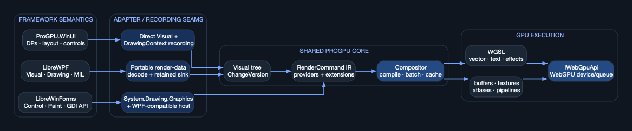
Framework semantics converge before GPU compilation
One execution architecture
ProGPU.WinUI records directly into the retained scene. LibreWPF replays portable drawing/MIL data into retained scene objects. LibreWinForms preserves Control/Paint and System.Drawing semantics, then feeds the same scene command model.
The compositor, atlases, buffers, shaders, and WebGPU backend are shared.
FRAMEWORK FRONTENDS → RETAINED SCENE → COMPOSITOR → WEBGPU
2
Notes:
Read left to right. The architectural fan-in occurs at ProGPU.Scene.Visual and DrawingContext/RenderCommand—not at final pixels. This allows all frontends to share scene caching, batching, vector/text coverage, effects, and presentation. Sources: README.md project architecture; ProGPU.Scene; ProGPU.Wpf composition bridge; LibreWinForms portable host.

Slide 3
Ownership boundaries keep UI policy out of the renderer
01 Framework layer
Properties, styling, templates, layout policy, focus, routed input, controls, and application lifetime.
02 Adapter layer
Maps framework drawing/state into stable Visuals, DrawingContext operations, portable DTOs, and resource identities.
03 Scene/compositor
Retained nodes, transforms, clips, effects, command IR, cache predicate, batching, uploads, and render passes.
04 Backend/platform
IWebGpuApi, device/queue/surface, buffers, textures, pipelines, shaders, native/browser host, DPI, and input source.
3
Notes:
The framework owns semantics; the scene owns retained render state; the compositor owns compilation and ordering; the backend owns WebGPU calls. Portable DTOs prevent WPF/WinForms types from leaking into shared hot paths. Sources: README.md Architectural Hierarchy; ProGPU.Wpf.Interop; AGENTS.md A0.

Slide 4
Three frontends, three recording seams, one retained core
1 ProGPU.WinUI
FrameworkElement already derives through LayoutNode/Visual. OnRender records public DrawingContext commands directly.
2 LibreWPF
Portable visual state and render-data snapshots are decoded; WpfVisualTreeRenderer updates retained branches and command sinks.
3 LibreWinForms
Control.OnPaint uses ProGPU-backed Graphics. WindowsFormsHost connects lifecycle/input while drawing reaches shared commands.
DIRECT
PORTABLE REPLAY
PAINT ADAPTER
4
Notes:
The adapter cost is paid when semantic state changes, not by maintaining a private renderer per framework. Sources: ProGPU.WinUI/Core/FrameworkElement.cs; wpf/src/ProGPU.Wpf/Composition/Mil/WpfVisualTreeRenderer.cs; winforms LibreWinForms portable host and System.Drawing.Common.

Slide 5
Host frame: the deterministic outer transaction
1 Service/UI phase
Drain dispatcher and platform input; advance animations once; execute framework callbacks and invalidations.
2 Layout phase
Measure and arrange only invalid nodes. Logical size remains separate from framebuffer pixels and DPI.
3 Render/present phase
Acquire target, call Compositor.RenderScene with CompositorHostFrame, submit passes, present, release transient handles.
DISPATCH
LAYOUT
GPU FRAME
5
Notes:
Window.RenderFrameCore owns the core ordering. Samples and framework adapters must not update animations twice or request frames from OnRender. Sources: ProGPU.WinUI/Core/Window.cs; ProGPU.Scene/CompositorHostFrame.cs; AGENTS.md Protect Hot Paths.

Slide 6
Pixel correctness begins with two independent validity systems
1 Layout validity
Measure/arrange flags propagate according to property semantics; equal cached inputs can skip layout work.
2 Visual validity
Every pixel-affecting mutation calls Visual.Invalidate, increments ChangeVersion, marks dirty, and propagates to the root.
3 Scene validity
The compositor compares retained versions plus target, DPI, atlas, overlay, effect, and layer state before reuse.
MEASURE / ARRANGE
CHANGEVERSION
CACHE PREDICATE
6
Notes:
Layout validity cannot substitute for render validity. A property may leave final bounds unchanged while changing clipping, brush state, content, or pixels. Sources: ProGPU.Layout/LayoutNode.cs; ProGPU.Scene/Visual.cs; Compositor.CanReuseCompiledScene.

Slide 7
Visual is the retained identity and transform boundary
1 Local state
Offset, size, transform, opacity, clips, masks, effects, hit-test ID, visibility, and CacheAsLayer live on stable nodes.
2 Tree state
ContainerVisual preserves child identity and ordering. Parent invalidation makes descendant mutations visible at the root.
3 Composite scope
Compilation derives global transforms, clip/opacity stacks, offscreen layer/effect scopes, then recurses in visual order.
NODE
TREE
COMPOSITE
7
Notes:
Stable tree identity is essential. Reparenting or rebuilding unchanged controls destroys layout, theme, and scene-cache locality. Sources: ProGPU.Scene/Visual.cs; ContainerVisual implementation; Compositor.CompileVisualTree; AGENTS.md navigation-tree identity.

Slide 8
DrawingContext is a retained command recorder—not an immediate canvas
1 Framework records intent
DrawRect, DrawPath, DrawGlyphRun, DrawTexture, state pushes/pops, pictures, static DXF, meshes, and extensions.
2 Commands retain payloads
RenderCommand carries geometry/resource identity, style, transforms, sampling, providers, and extension payloads.
3 Compositor lowers later
Compilation resolves atlases, text/vector vertices, textures, masks, blend state, and draw calls against the current target.
PUBLIC API
COMMAND IR
LOWERING
8
Notes:
OnRender records into a pooled DrawingContext. Common text remains one DrawGlyphRun command with shaped indices and positions retained; paths retain analytic geometry. Sources: ProGPU.Scene/RenderCommand.cs; DrawingContext files; Compositor.CompileVisualTree.

Slide 9
Compositor compilation is an ordered lowering pipeline
01 Traverse + state
Compose transforms; push/pop rectangular and geometry clips, opacity, blend modes, masks, effects, and layer scopes.
02 Resolve primitives
Map command kinds to vector/text/texture vertices, static buffers, retained pictures, or ICompositorExtension pipelines.
03 Preserve Z order
Commit pending vector/text work at material, texture, clip, effect, extension, and layer boundaries—never global-sort pixels.
04 Emit GPU work
Ensure buffer capacity, upload changed spans, bind cached layouts/pipelines/resources, encode passes, submit, and present.
9
Notes:
The compiler deliberately batches adjacent compatible work while retaining scene order. StaticCompilationContext and provider paths allow large retained datasets to bypass per-primitive regeneration. Sources: ProGPU.Scene/Compositor.cs; StaticCompilationContext.cs; ICompositorExtension.cs.

Slide 10
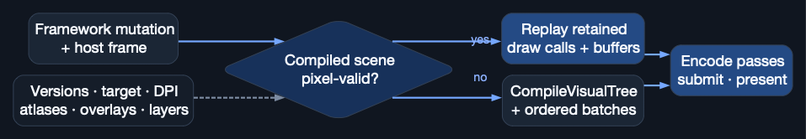
A compiled-scene hit skips compilation—not rendering
Pixel-valid reuse
RenderSceneCore checks root identity/ChangeVersion, logical and physical targets, viewport/DPI, GlyphAtlas and PathAtlas generations, tooltips, external layers, cached-layer textures, diagnostics, masks, effects, and mutable drawing state.
A hit reuses draw calls and buffers, then still encodes the current pass and presents.
STRICT PREDICATE → REPLAY OR RECOMPILE → ALWAYS PRESENT
10
Notes:
Reuse is safe only when every input that can alter pixels remains valid. Recoverable PathAtlas exhaustion resets once and retries the same frame before moved UVs are submitted. Sources: Compositor.RenderSceneCore, CanReuseCompiledScene, CaptureCompiledScene; AGENTS.md PathAtlas recovery contract.

Slide 11
Batching is dynamic, adjacent, and order-preserving
1 Accumulate compatible spans
Vector and text vertices append into reusable lists while material/clip/blend state remains compatible.
2 Commit at semantic barriers
Texture draws, state changes, effects, masks, extension passes, and visual layers flush pending spans in place.
3 Replay retained draw calls
The draw-call list references stable buffers/resources; unchanged scenes reuse it without recompiling the visual tree.
APPEND
BARRIER
REPLAY
11
Notes:
CommitPendingDrawCalls preserves correct z-order while avoiding one draw per primitive. Buffers grow geometrically and are reused. Sources: Compositor.SwitchBatchType, CommitPendingDrawCalls, EnsureBufferSize.

Slide 12
Resource identity is retained above every backend call
1 Create/cache
GpuBuffer, GpuTexture, samplers, layouts, bind groups, shader modules, and RenderPipelineCache own device identities.
2 Reuse/age
Stable scene commands reference resources; caches mark frame use and evict bounded stale entries instead of rebuilding per draw.
3 Recover coherently
Resize, atlas generation changes, resource disposal, surface changes, or device loss invalidate the precise dependent state.
IDENTITY
LIFETIME
INVALIDATION
12
Notes:
Shaders are embedded source loaded through ShaderResource and cached. Fixed WGSL is never built from C# strings in a hot path. Sources: ProGPU.Backend/GpuBuffer.cs, GpuTexture.cs, RenderPipelineCache.cs, ShaderResource.cs; AGENTS.md shader contract.

Slide 13
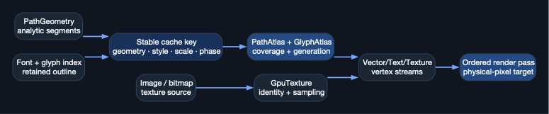
Geometry and coverage stay retained all the way to the GPU
Stable identity before placement
Paths keep analytic segments; glyph runs keep shaped glyph indices and positions; images keep texture identity and sampling. Cache keys include the quality-sensitive scale/phase data.
Path/Glyph atlas generations move only when UV content moves; final placement remains transform-driven.
RETAIN OUTLINE / TEXTURE → CACHE COVERAGE → TRANSFORMED REPLAY
13
Notes:
This is the basis for crisp fast zoom: camera transforms and uniforms change while geometry, glyph outlines, coverage, and textures remain reusable. Sources: RetainedGlyphGeometry.cs; ProGPU.Vector/PathAtlas.cs; ProGPU.Text/GlyphAtlas.cs; Compositor glyph/path/image compilation.

Slide 14
Text quality is a retained-data and physical-pixel contract
01 Shape once
Text layout produces glyph indices and positions. RenderCommand.DrawGlyphRun preserves them—no repeated character-map lookup.
02 Retain outlines
Common solid text is one glyph-run command; vector/CFF fallbacks reuse cached outlines with bounded local/device phase keys.
03 Raster at device scale
Glyph coverage uses physical size and current DPI; positions snap to quarter physical pixels then map back to logical space.
04 Invalidate precisely
Text/font/content mutations rebuild layout; caret, selection, and hover invalidate paint only; atlas generation guards UV reuse.
14
Notes:
The separation prevents missing-glyph first frames, blurry DXF text, and per-frame glyph geometry churn. Sources: AGENTS.md text contracts; ProGPU.WinUI/Controls/TextVisual.cs; ProGPU.Text; Compositor CompileGlyphRunCommand.

Slide 15
Offscreen composition and extensions remain first-class scene work
01 CacheAsLayer
A stable subtree renders once into a GpuTexture; reuse requires the same owner, clean state, texture identity, size, and device.
02 Effects + masks
Dynamic source/destination textures and intermediate passes preserve opacity, blend, clip, backdrop, and shader-effect semantics.
03 Extension pipelines
ICompositorExtension lowers static DXF, charts, splines, 3D, hatches, images, and ShaderToy without forking the scene model.
04 Retained providers
GpuPicture and IRenderDataProvider replay large immutable command/data sets without reconstructing managed objects per frame.
15
Notes:
Effects and mutable DrawingVisual content deliberately restrict whole-scene reuse unless they expose an immutable version contract. Sources: Compositor effect/layer paths; Extensions directory; SharedCompositorCache.cs; README CacheAsLayer and extension architecture.

Slide 16
Rendering and interaction share transforms—but not one mandatory hit-test engine
01 CPU framework hit testing
ProGPU.WinUI InputSystem walks the visual tree with inverse transforms, clips, z-order, enablement, and control bounds.
02 Optional GPU index
The compositor can build/query a GPU render-command hit-test index for geometry-heavy hosts and diagnostics.
03 Independent switches
EnableCompiledSceneCache and EnableGpuHitTesting are separate; WinUI avoids duplicate GPU compilation for its CPU tree path.
04 Platform injection
Hosts normalize pointer, keyboard, text, focus, drag/drop, cursor, DPI, clipboard, and storage into framework-owned services.
16
Notes:
A new framework can use CPU visual-tree hit testing, compositor GPU hit testing, or a hybrid without changing render commands. Sources: ProGPU.WinUI/Input/InputSystem.cs; ProGPU.Scene/GpuRenderCommandHitTestCache.cs; CompositorOptions.cs.

Slide 17
A platform host supplies services—not rendering policy
1 Native/browser window
Create surface and WgpuContext; publish logical size, physical framebuffer, viewport, display scale, and frame timing.
2 Framework lifetime
Own dispatcher integration, activation, popups, input injection, storage/clipboard/launcher, and shutdown semantics.
3 Scene transaction
Provide root/external layers/tooltips and invoke the same Compositor.RenderScene contract for every frontend.
SURFACE
SERVICES
COMPOSITOR
17
Notes:
The host can be GLFW/Silk, browser canvas, WPF portable window host, or another shell. It must preserve logical/physical/DPI separation and one animation update per frame. Sources: ProGPU.Backend native platforms; ProGPU.Browser host; ProGpuWpfWindowHost.

Slide 18
ProGPU.WinUI is the direct framework implementation
1 Property/layout
DependencyObject stores values and metadata; FrameworkElement invalidates measure, arrange, or pixels according to semantics.
2 Controls/templates
Control trees, resources, themes, text, virtualization, and routed input keep stable visual identities across state changes.
3 Rendering
FrameworkElement/Visual OnRender records commands; Window owns frame order; InputSystem owns CPU tree hit testing.
DP + LAYOUT
UI SEMANTICS
DIRECT SCENE
18
Notes:
WinUI is “closest” to the core because its layout nodes are scene visuals. That is an implementation choice, not a requirement for other frameworks. Sources: ProGPU.WinUI/Core/DependencyObject.cs, FrameworkElement.cs, Window.cs; Controls; ProGPU.Layout.

Slide 19
LibreWPF: portable semantics into a retained ProGPU scene
1 Portable state
Typed visual, layout, window, drawing, and render-data DTOs cross assembly boundaries without reflection.
2 Retained replay
The visual-tree renderer and MIL decoder update branch maps, resource registries, and only invalid content.
3 Native sink
The composition sink maps brushes, paths, glyphs, images, clips, effects, caches, and 3D into ProGPU.Scene.
PORTABLE DTO
MIL / TREE REPLAY
RETAINED SINK
19
Notes:
No reflection-driven drawing hot path is required. Retained branch maps and invalidation tracking let unchanged WPF content remain unchanged ProGPU scene content. Sources: src/ProGPU.Wpf.Interop; wpf/src/ProGPU.Wpf/Composition/Mil; ProGpuRetainedCompositionCommandSink.cs.

Slide 20
LibreWinForms keeps WinForms behavior while replacing native GDI rendering
WinForms semantic surface
• Application and Control lifecycle
• Handle-compatible portable hosting
• Layout, focus, messages, invalidation
• OnPaint / PaintEventArgs contract
• System.Drawing.Graphics API
• WindowsFormsIntegration host
Shared ProGPU execution
• ProGPU-backed brushes, pens, paths, text, images
• Graphics records retained drawing intent
• Host supplies WPF-compatible integration/input
• Commands converge on ProGPU.Scene
• Same compositor, atlases, effects, pipelines
• Same desktop/browser-capable backend seam
Compatibility stays at the API edge; retained GPU identity and batching stay in the shared core.
20
Notes:
LibreWinForms does not need to emulate GDI pixels as the renderer. Its compatible System.Drawing layer maps drawing operations to retained ProGPU primitives, while the portable WindowsFormsHost connects application/control lifetime. Sources: ProGPU/System.Drawing.Common; winforms LibreWinForms.System.Windows.Forms and LibreWinForms.WindowsFormsIntegration.

Slide 21
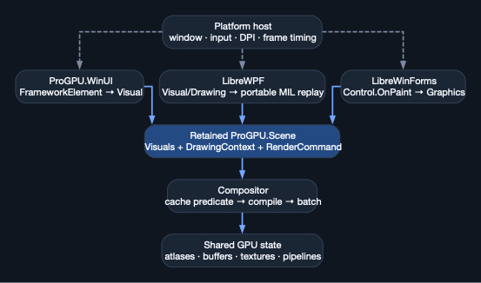
All frontends converge on the same performance substrate
Shared after convergence
Every frontend ultimately supplies stable scene identity plus drawing/resource intent. From that point onward, the same ChangeVersion propagation, compiler, z-ordered batching, buffers, textures, path/glyph atlases, effects, extension pipelines, WGSL, WebGPU device, and presentation path apply.
DIFFERENT SEMANTICS · SHARED RETENTION · SHARED GPU EXECUTION
21
Notes:
This is the key architectural payoff: fixes and optimizations in the compositor, text/vector engines, atlas recovery, device lifecycle, or backend benefit all frameworks—provided adapters preserve retained identity and invalidation. Sources: architecture diagram paths cited throughout the talk.

Slide 22
Performance and correctness are one retained-rendering contract
What framework adapters must preserve
• Stable visual/resource identity
• Precise pixel invalidation and ChangeVersion
• Layout vs paint validity separation
• Shaped glyph indices and retained outlines
• Analytic path topology and image sampling
• Ordered state scopes and dynamic content versions
What the core guarantees
• Strict compiled-scene pixel-validity checks
• Adjacent z-ordered batching and reused buffers
• Bounded atlas/cache generations and recovery
• Physical-pixel/DPI-aware text and vector quality
• Independent hit-testing policy
• Shared shaders, effects, extensions, and hosts
Never improve FPS by dropping invalidation, lowering coverage quality, rebuilding stable trees, or rasterizing retained vectors every frame.
22
Notes:
Measure layout, compile, upload, render, draw count, atlas churn, and memory separately. Required regression coverage includes unchanged reuse, invalidation, target/DPI changes, mutable drawings, atlas reset/repack, and hit-test options. Sources: AGENTS.md Rendering Performance Regression Contract; LayerRenderTests; CompositorReviewRegressionTests.

Slide 23
IMPLEMENTATION PLAYBOOK
Bring semantics and identity.
Reuse the renderer.
Frontend → stable Visual / portable adapter
Drawing → DrawingContext / RenderCommand / provider
Frame → CompositorHostFrame → Compositor.RenderScene
Code map: ProGPU.Scene · ProGPU.Backend · ProGPU.Layout · ProGPU.WinUI · ProGPU.Wpf.Interop · LibreWPF ProGPU.Wpf · LibreWinForms
Notes:
For a new framework: define property/layout/input semantics; preserve stable node and resource identity; map drawing to retained commands; provide a host; choose CPU/GPU hit testing; then adopt the compositor correctness tests. The renderer and shaders remain shared.

