Slide 1
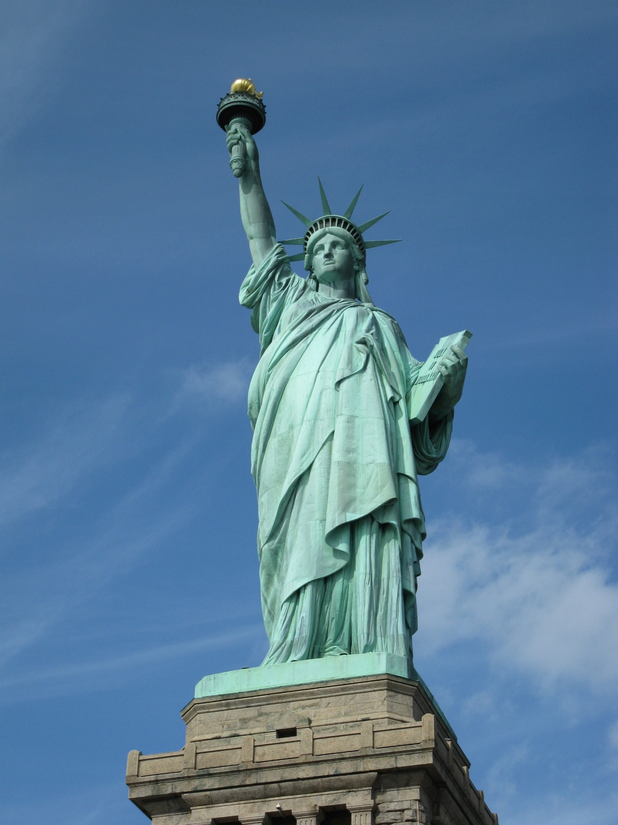
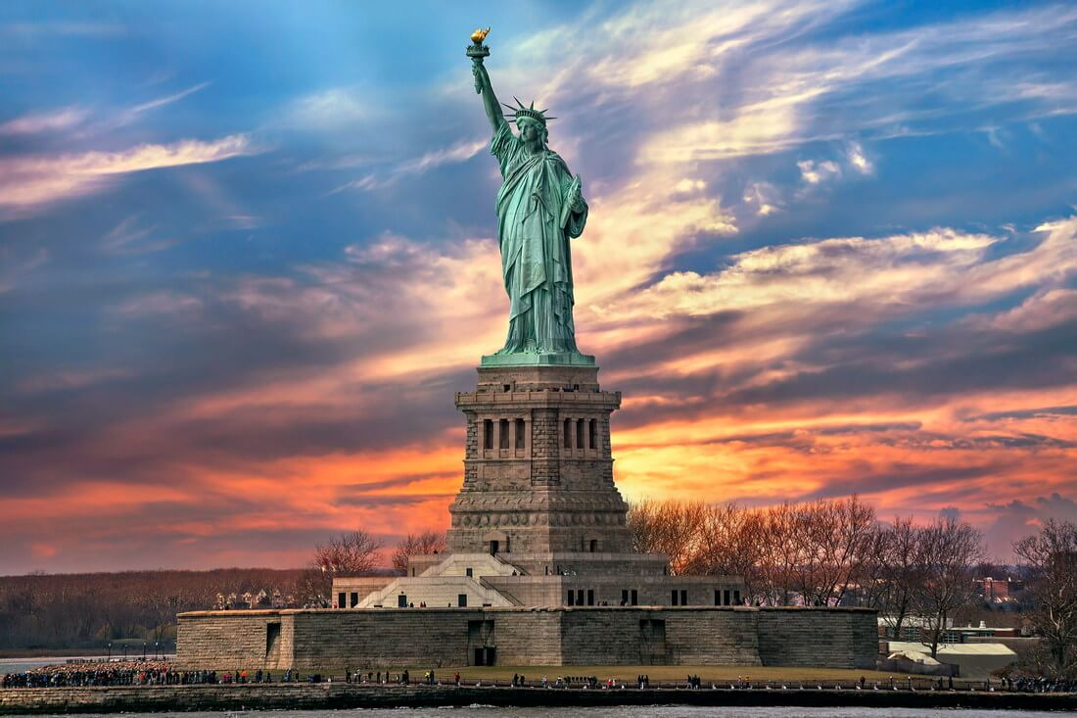
The story of the Statue
of Liberty in New York
Performed Abramova Alexandra
Student 9"K"

Slide 2
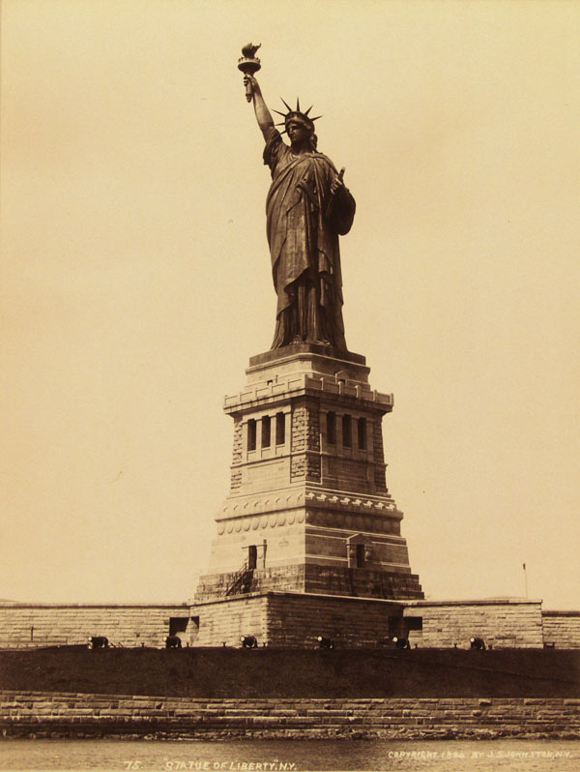
The Statue of Liberty is the main attraction of New York and a symbol of freedom for all Americans.
The statue of "Liberty illuminating the world", "Lady Liberty", "Statue of Liberty", was built by Frenchman Frederic Auguste Bartholdi and presented by French citizens to Americans, symbolizing friendship, freedom and peace.
The total height is about 93 meters.

Slide 3
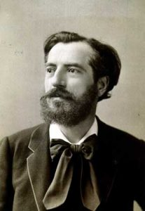
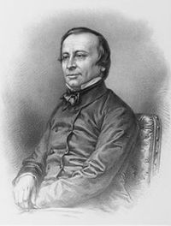
Liberty Island is located in the upper part of New York Bay, at the mouth of the Hudson River. The area is about 10 hectares.
In 1870, the first sketches of the monument were sent to the United States for approval. The approval of the two sides led to the construction of the monument.

Slide 4
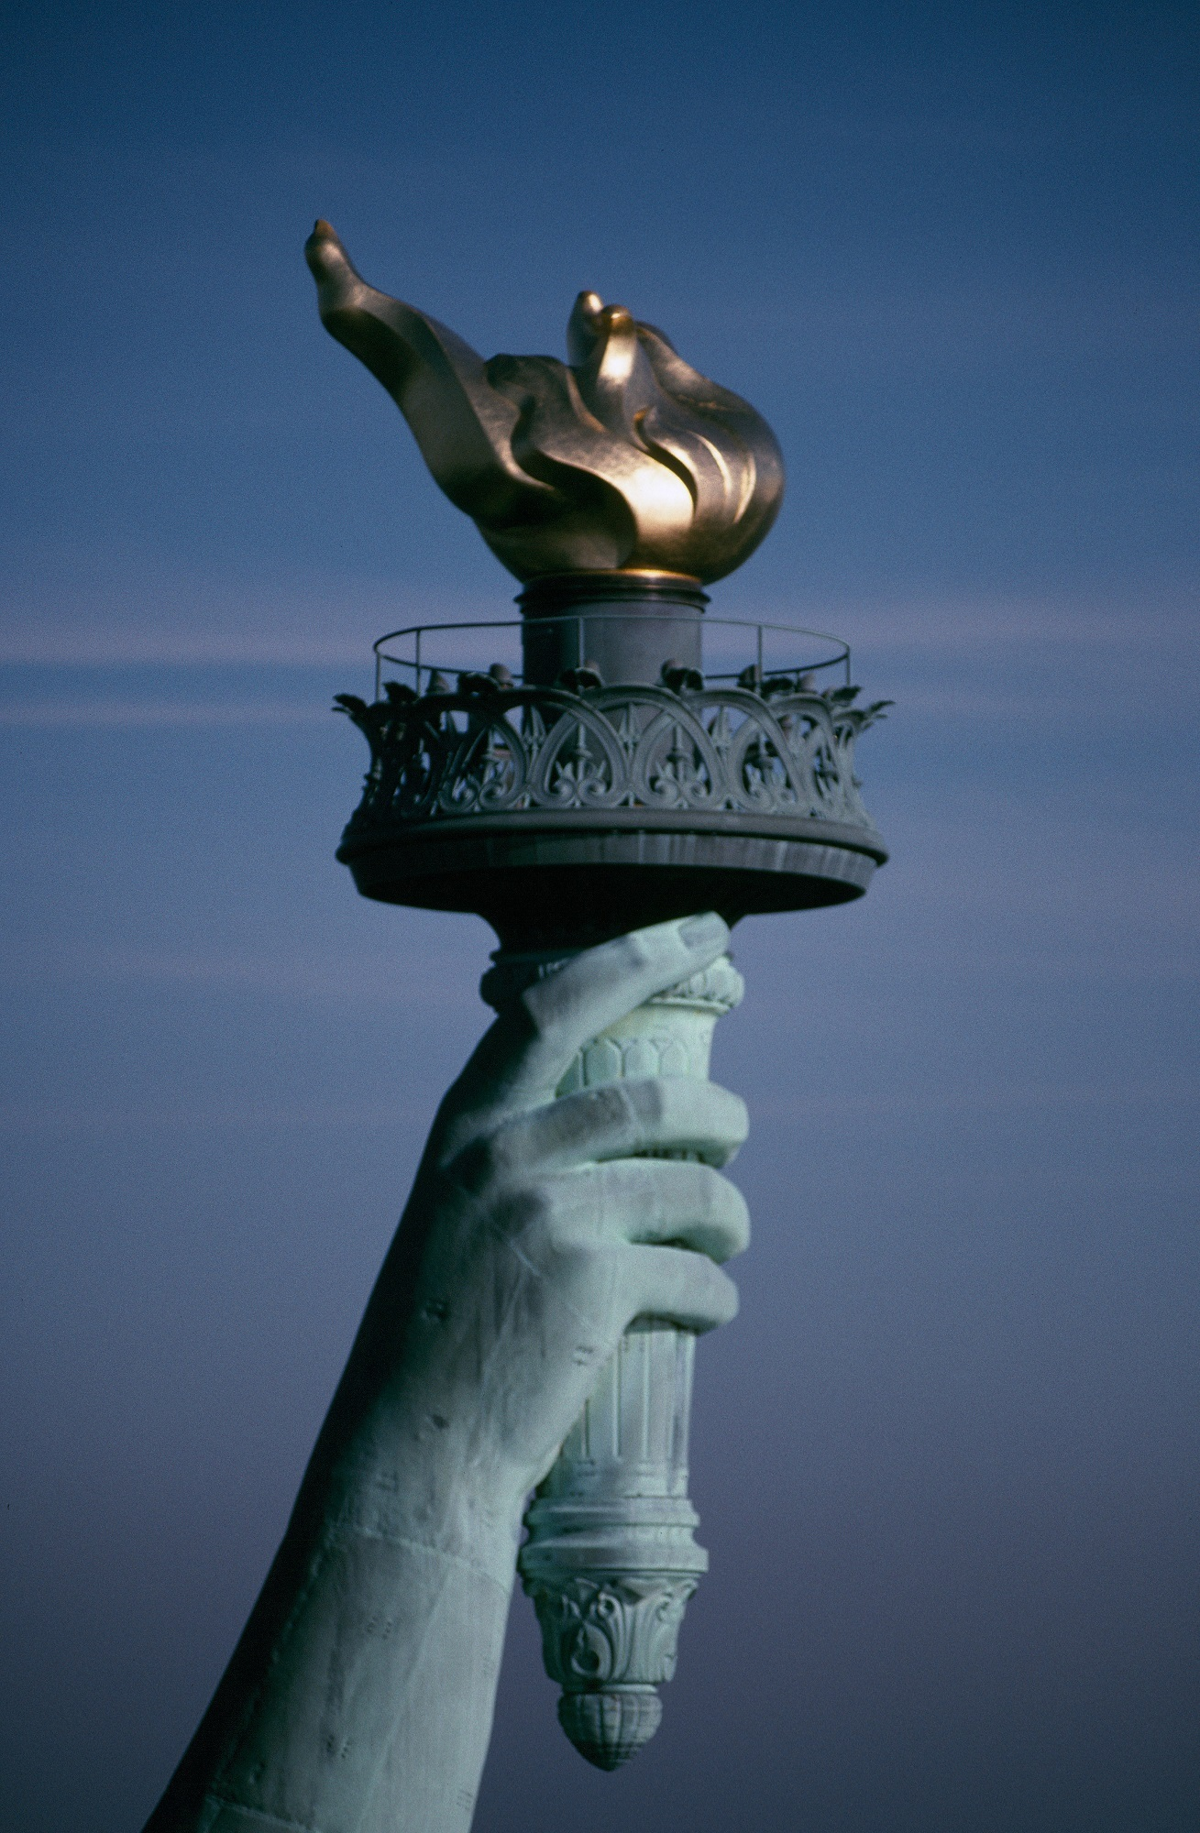
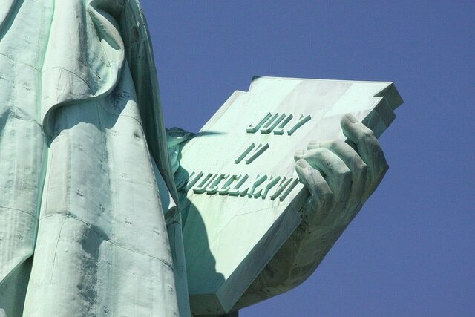
The statue is a woman
dressed in clothes
resembling a chiton, a
crown on her head,
holding a torch in her
right hand, and in her
left hand a tablet with
an inscription of English
letters and Roman numerals
("JULY IV MDCCLXXVI"), indicating "July 4, 1776" - the date of the adoption of the Declaration of Independence of the United States.

Slide 5
Thanks for watching (=

