Slide 1

Stallions
Junaid Shah
Maulik Patel
Brad Berezowski
Phonpiya Vikiset (Paul)
Afolabi Fadimu

Slide 2
Junaid Shah - Project Manager
Oversee all aspects of the project
Deadlines, assign responsibilities and monitor
Scrum meetings, status report, change requests
Communicating with sponsors
Managing time estimation, schedule
Binder

Slide 3
Maulik Patel - Business Analyst
Centralized storage system (One drive)
Tracked and maintained all the documents
Story
Instruction page
Quality assurance
Building sprite

Slide 4
Brad Berezowski - Programmer
Game Logic:
Logic behind the key press, and text display
Logic behind biruda, factory and tank
Screen Effects:
Main game screen layout, sprites movement and interactions
Others:
Quality Assurance testing
Bug fixing
Git Hub management

Slide 5
Phonpiya Vikiset (Paul) - Programmer
Screen Effect:
Screen transition
Menu navigation
Text effect
Object effect
Game Logic:
Timer
Game level advance

Slide 6
Afolabi Fadimu - Media Manager
Game Assets:
Sprites
Music
Sound effects
Itemized words
GUI:
Buttons

Slide 7

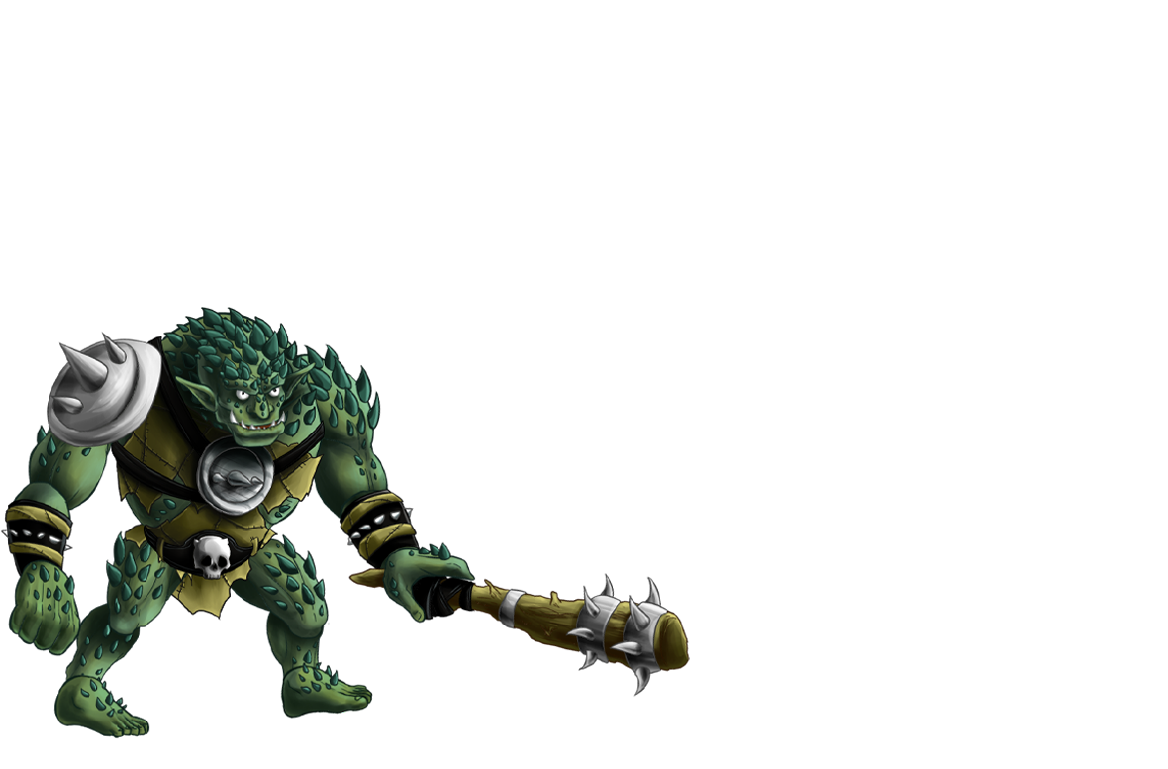
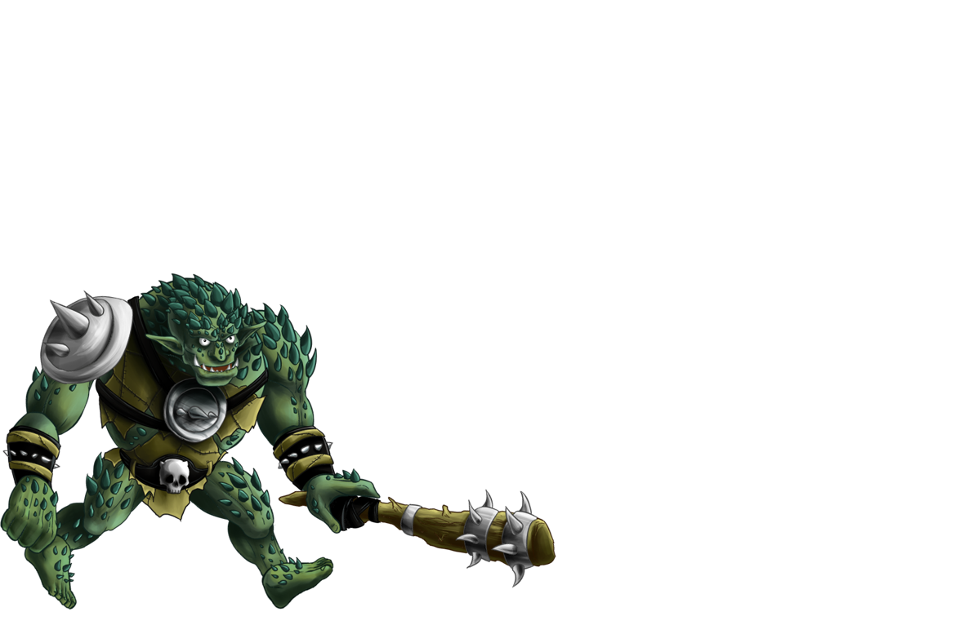
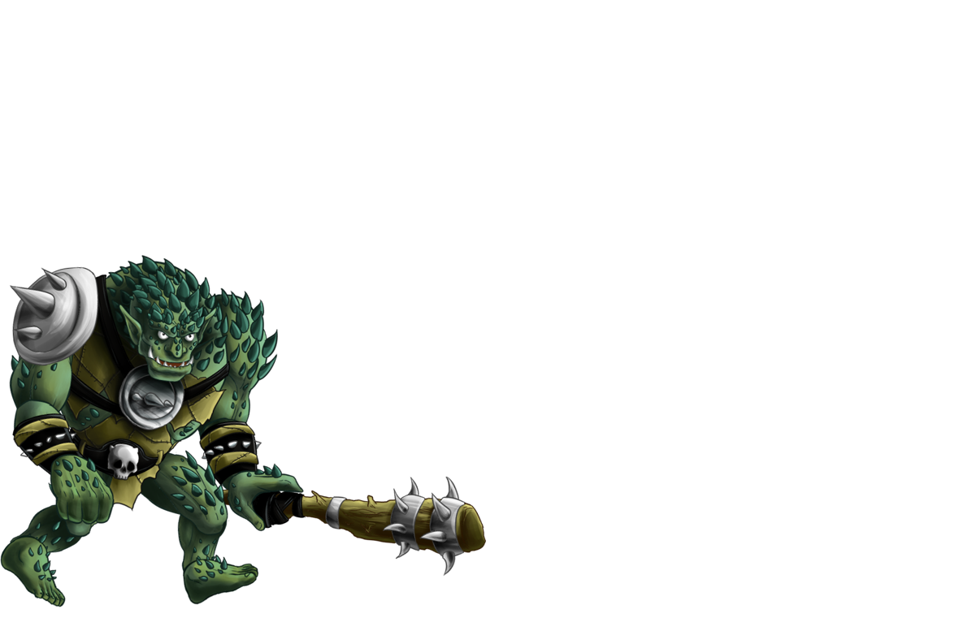
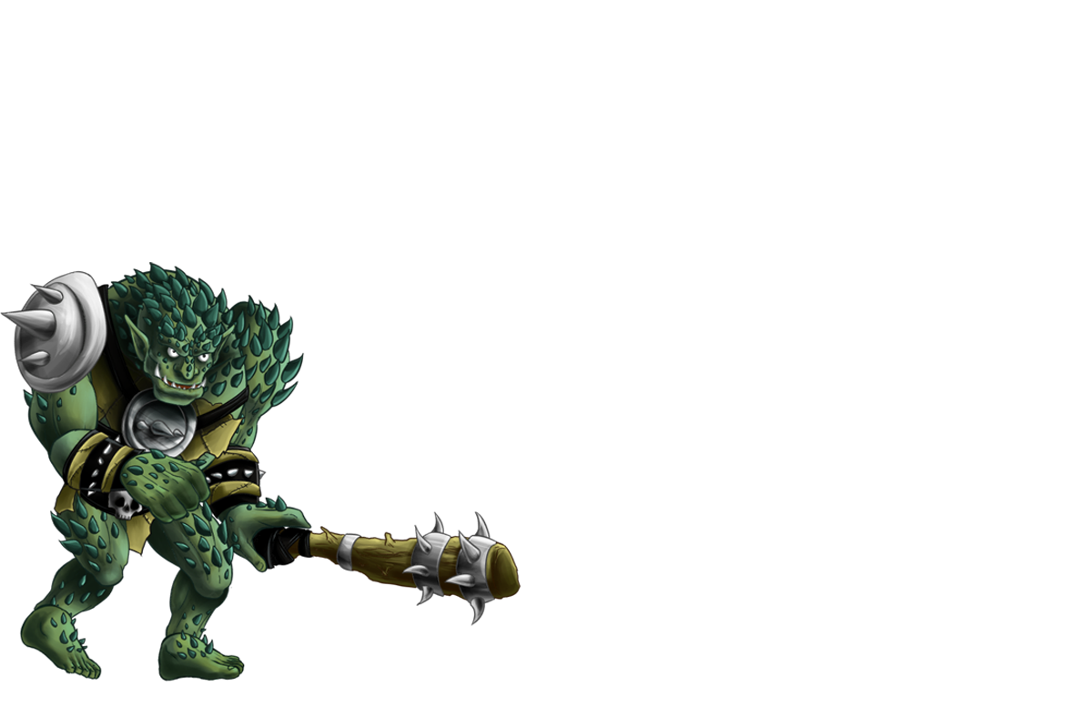
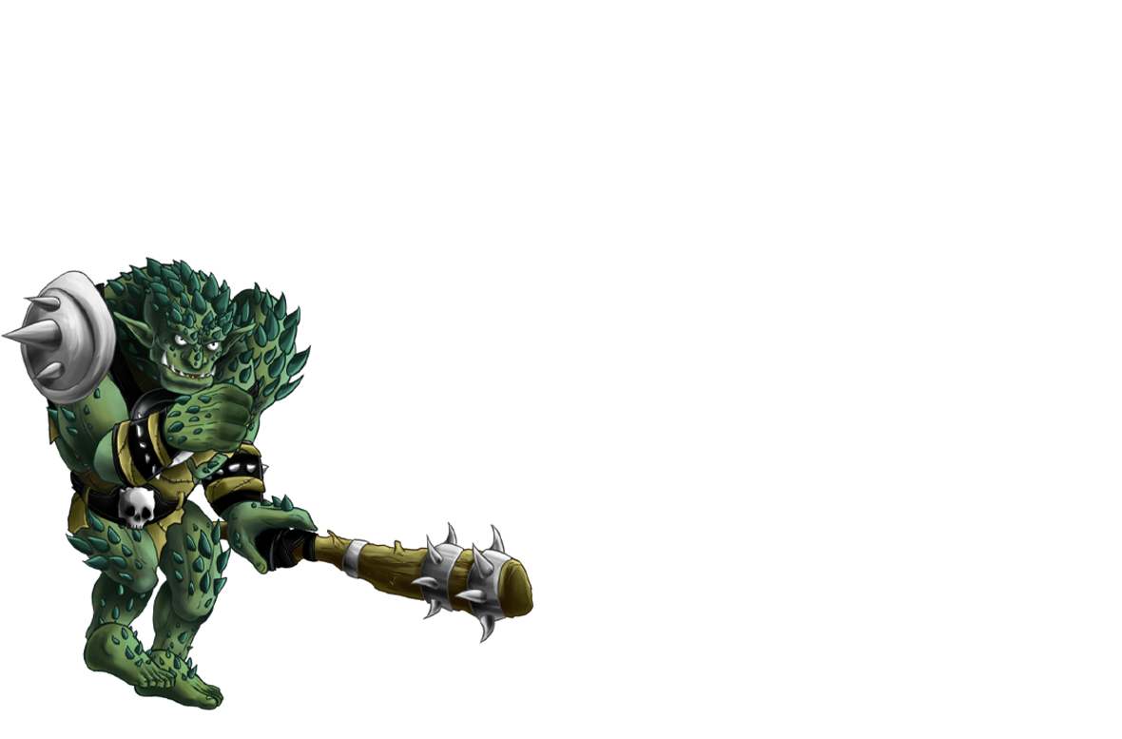
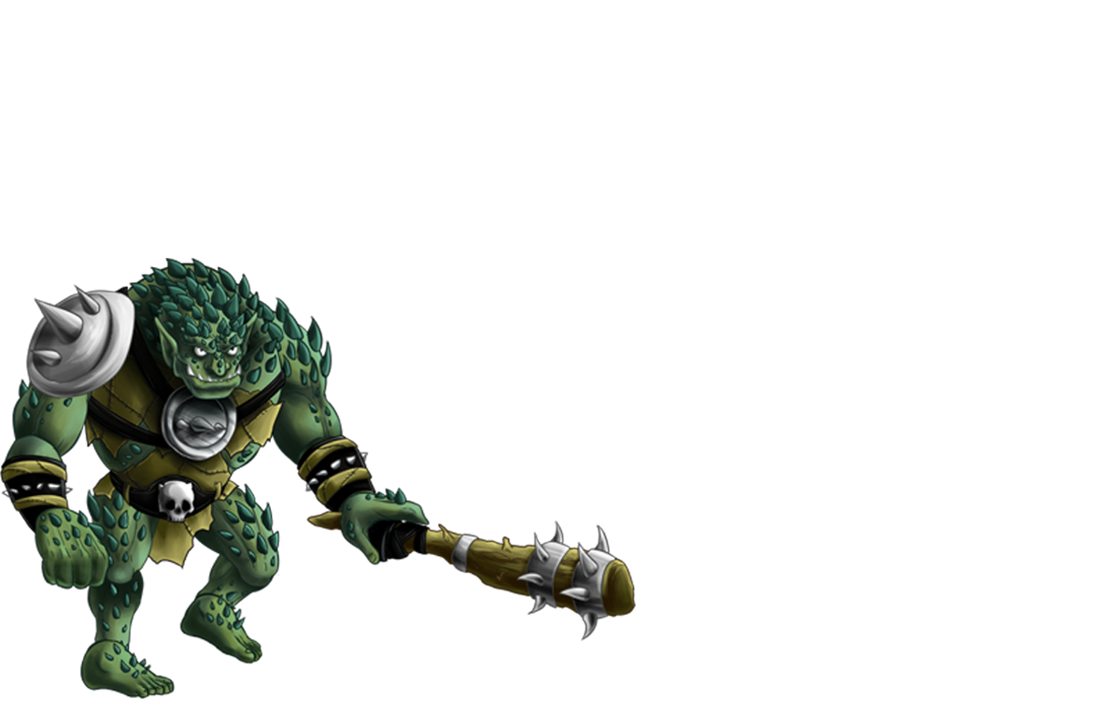
Key-Struction
This program helps you improving your typing skills.
Humans factories are polluting the Bay of Bengal. As a player you will help Biruda destroy factories by typing corresponding letters on the keyboard which are displayed on game screen
But be careful there is also a human’s defense system which will shoot at biruda if you make typing mistake and biruda will die
At the end of each level you can look at the performance evaluation to see how well you have done and be your own judge
Difficulty level increases every time you destroy a factory

Slide 8
What Type of Game Is It?
This is an educational game based on improving ones typing skills
Focused on the kids market
Game provides excitement to the kids by a combative style game but not overly based on violence
Multi level game that evaluates an individual’s typing speed and accuracy

Slide 9
The Inspiration
General idea was from generic typing tutor games
Different genre in comparison to the other groups
Had to be an educational game
Fun but interactive game
Programmatically challenging
“Team work makes the dream work”

Slide 10
Challenges We Faced
WBS and Scope matches
Schedule and timesheet
Learning new technology
Balance between personal life and project work
Communication

Slide 11
What Went Wrong!
Miscommunications / misunderstanding in passive communication
Unforeseen issues within software
Initially no ground rules were set
Time allocation

Slide 12
What Went Right!
Issues were resolved as soon as possible
Offered help to each other
Scrum meeting helped to track the project development
Positive mentality
Tasks were completed on time

Slide 13
Project Management Process:
Initiation
Project charter
Game design document
Initiation of team building activities
Time capacity analysis

Slide 14
Project Management Process:
Planning
Project Scope
Work Breakdown Structure
Time Estimating Worksheet
Work Schedule

Slide 15
Project Management Process:
Execution
Game Development
Scrum Worksheet
Status Meetings
Change Request
Update Change Log
Quality Assurance Document

Slide 16
Project Management Process:
Closing
Lesson Learned
Project Wrap-Up

Slide 17
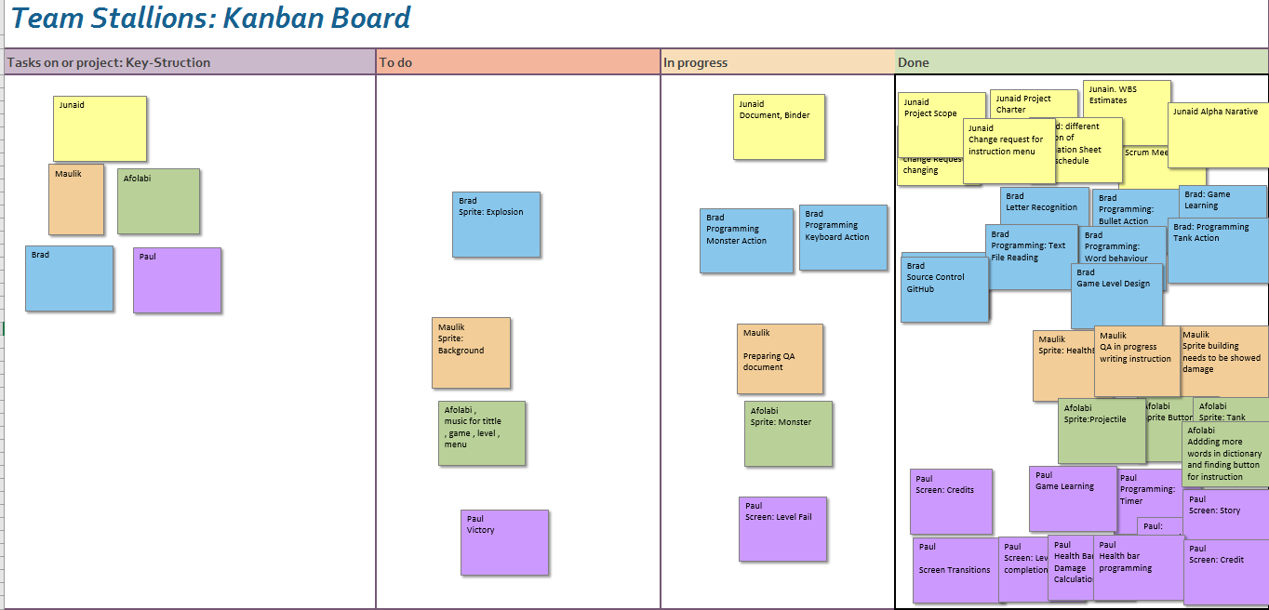
Project Management Tools:
Deadlines and Assigned Work
Kanban
Schedule Spread Sheet
Time Sheet

Slide 18



Project Management Tools:
Resource Management
Git hub
One drive
Communication Tools
WhatsApp
Email

Slide 19
Recommendation For People Going Through This Process
Spend enough time in planning and designing phase
Leave room for errors
Set ground rules at the beginning
Set and ensure to meet deadlines
Keeping the communication channel open through all phases
Use latest project management tools i.e. Trello

Slide 20
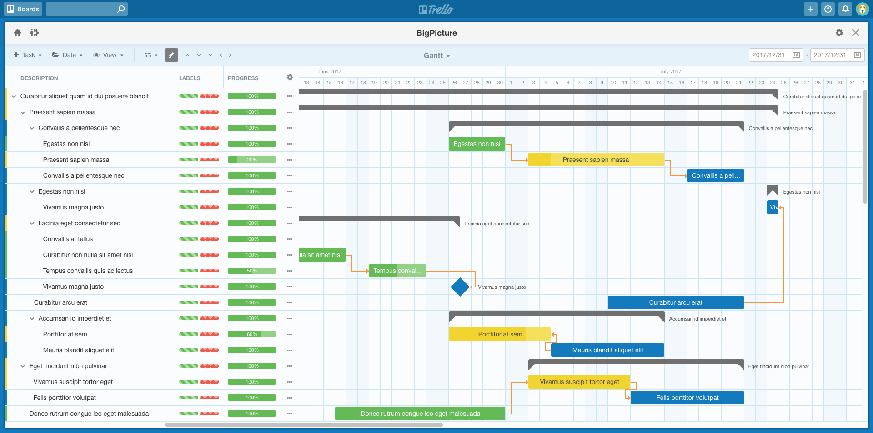

Recommendation For People Going Through This Process

Slide 21
Questions are welcome

