Slide 1

Brand and identity
Guidelines for developers and users

Slide 2

About
Integrity Hub is:
a BAE Systems owned and funded product that enables health and integrity management of fleets of vehicles,
built to utilise big data methods, cloud-ready technologies, and scalable data analytics,
designed to provide a capability that is ready for the data-rich modern defence logistics environment.
It is an evolution of the Structural Health Management Java Toolkit (SJT), which has a proven record providing structural-lifing on the Tornado and F-35 programmes.
This is a key strategic product in the domain of Integrated Vehicle Health Management (IVHM), which is a major differentiator in providing affordable through-life total cost of ownership for modern defence systems.
This guide sets out the core elements of the Integrity Hub brand so that it can be used in a strong and consistent manner. Doing so will ensure we protect our reputation and property, and maximise our opportunity for application.

Slide 3
Name
Not a monolithic system
Not a black box
Not static
It doesn’t just “Do” specific things
Not about a platform
Avoiding transactional relationships
But a distributed micro-service architecture
But based on open-standards and interfaces
But flexible and modular
But enables many
But about common approaches
By empowering collaboration
Integrity Hub represents a modern paradigm for our product.
An unconstrained name provides a framework that can approach a wide range of problems.

Slide 4


Logo
The logo implies a micro-service architecture. Each hexagon has a defined shape and purpose.
The interfaces between each hexagon are clean, but they fit together well.
Operational data is accessed through the Data Handling Service.
The Fleet Information Service provides the as-maintained fleet configuration and history.
The Algorithm Service manages, executes, and reports on a range of data analytics and model-based algorithms to provide insight to the fleet.
The logo can be oriented in column or row format or applied to a dark background

Slide 5

Use of name - formatting
Title
As a title, the name should be used in conformance with BAE Systems corporate style guide.
Typeface
font: Frutiger
colour: RGB 252 / 76 / 2
Orange tab
Integrity Hub
Paragraph
Used in a paragraph, use the full name Integrity Hub.
Integrity Hub | The Integrity Hub | The Hub | Integrity hub | IH
 | X | X | X | X
Do use the full and proper name. | Don’t use in definite article form: “The”. | Don’t shorten or paraphrase the name. | Don’t use lower case nouns. | Don’t abbreviate.

Slide 6
Use of name – other applications
Abbreviation
When a shortened format is needed, such as project tracking tools or software, the following are permitted:
IHub | IHUB | Ihub | ihub
But not iHub – for hopefully obvious reasons
In conversation
In general discussion, refer to “Integrity Hub” where reasonable.
If a shorter form is appropriate, refer to “Hub” or “The Hub”.
Camel Case
When used in software with camel case conventions, the following formats are permitted
integrityHub | IntegrityHub

Slide 7


Use of name and logo White background
As a single line
With company name

Slide 8

Use of name and logo Dark background
As a single line
With company name

Slide 9



Use of name and logo Complex background
Use minimal text, pick the colour scheme most suitable, and work with the image to achieve contrast.

Slide 10


Micro-service identities
Title
Integrity Hub brings together a set of micro-services, each with their own identity.
Use the micro-service name in isolation in the same manner as the name Integrity Hub.
When used the name in combination with Integrity Hub, separate by hierarchy or a colon to indicate the service is a sub-component.
Paragraph
Integrity Hub: Data Management Service
Data Management Service
Abbreviation
IHub: DMS
DMS

Slide 11
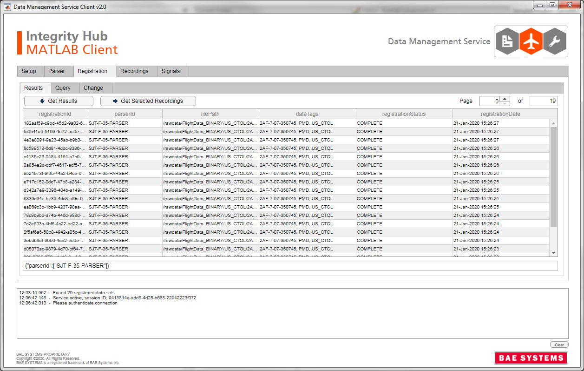
Example
Brand identity applied to a third party client UI.
Integrity Hub name used in combination with application name.
Micro-service name.
Integrity Hub logo.
Corporate logo.

