Slide 1







The 2019 Stack Overflow Developer Survey Results
Christos Kotsiavras
January 30 2024

Slide 2



OUTLINE
Executive Summary
Introduction
Methodology
Results
Visualization – Charts
Dashboard
Discussion
Findings & Implications
Conclusion
Appendix

Slide 3

EXECUTIVE SUMMARY
Overview of Data Contextualization and Objective Setting:
Initiating the exploration with an overarching view of the data landscape and the intent behind its analysis.
Synopsis of Methodological Framework:
Detailing the structured approach and techniques deployed for the investigation.
Outlining the strategies for sourcing relevant data sets.
Describing the systematic process of interpreting the data.
Capturing the transformation of data into graphical entities.
Graphical Presentation of Key Findings:
Showcasing the distilled insights through visual aids.
Interpretation of Findings and Resultant Implications:
A dialogue on the meaning and impact of the uncovered results.
Research Conclusions Synthesis:
Wrapping up the study with key takeaways and inferences.

Slide 4

INTRODUCTION
The Stack Overflow Developer Survey annually encapsulates a wide swath of insights from coders globally, making it the most extensive of its kind.
Engaging with close to 90,000 developers, the survey offers a forward-looking analysis of trends that could shape the future paths of the developer workforce.
While the results reflect a broad spectrum, they don't uniformly represent the entire developer community.
The survey is a diverse portrait of developer demographics, preferences, and aspirations across the globe.

Slide 5

METHODOLOGY
Gather and delve into survey data
Data Acquisition via:
Web Scraping Techniques
API Utilization
Usage of Request Library
Data Transformation
Preliminary Data Exploration
Assessment of Data Spread
Outlier Management
Examination of Variable Interplay
Visualization Strategies
Depicting Data Distributions
Exploring Relationships
Comparing and Contrasting Data Sets
Interactive Dashboard Creation

Slide 6
RESULTS
The report based on a survey of 88,883 software developers from 179 countries in 2019.
Covers various topics related to developers, such as demographics and technologies usage.
Uses charts to present the data and insights from the survey instrument.
Some of the top takeaways from the survey, such as Python being the fastest-growing major programming language and JavaScript retains its top position.

Slide 7
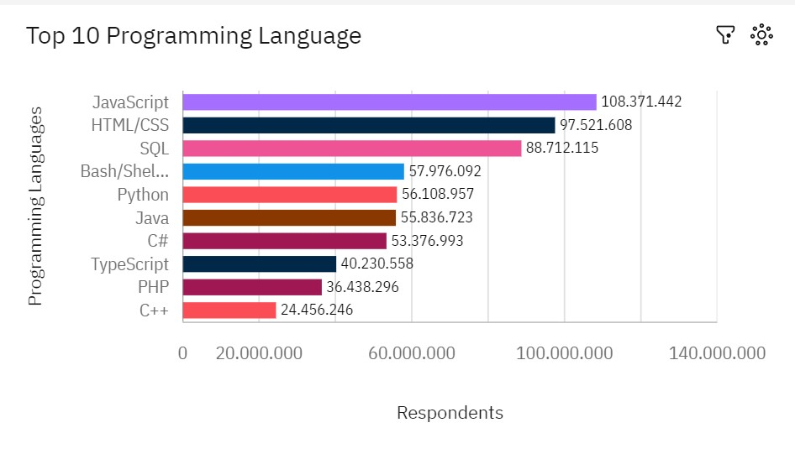
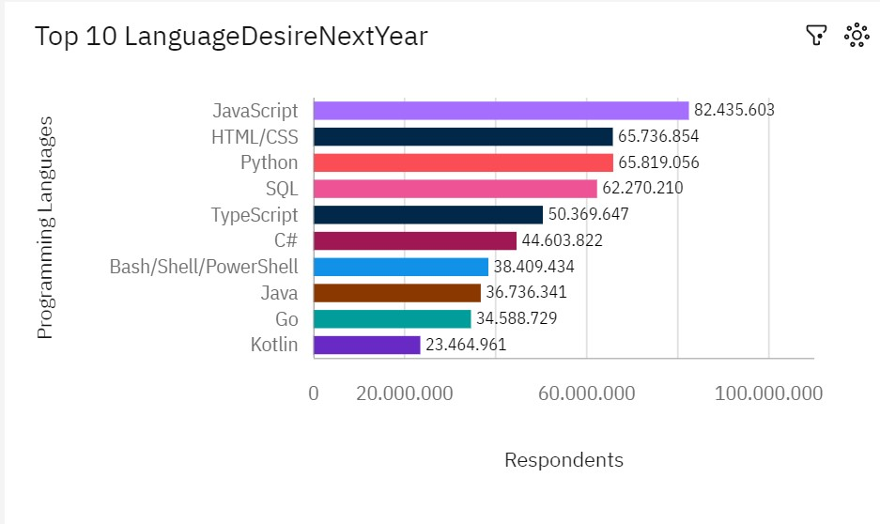
PROGRAMMING LANGUAGE TRENDS
Current Year
Next Year

Slide 8
PROGRAMMING LANGUAGE TRENDS
Findings
JavaScript retains its top position.
Python's growth rate surges.
TypeScript garners increasing attention.

Slide 9
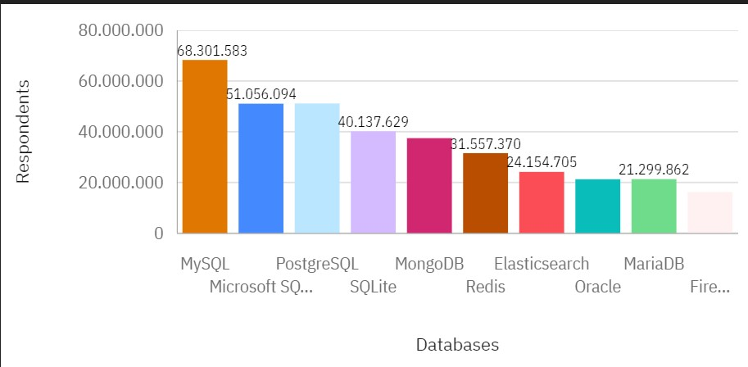
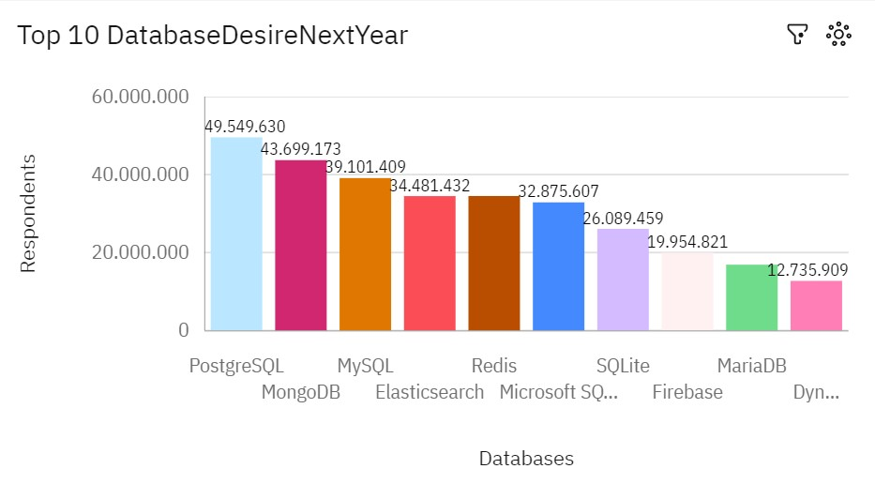
DATABASE TRENDS
Current Year
Next Year

Slide 10
DATABASE TRENDS-FINDINGS & IMPLICATIONS
Findings
• MySQL remains the predominant database choice.
• Growing affinity for PostgreSQL and MongoDB.
Implications
• Declining market traction for Microsoft SQL Server and SQLite.
• Consolidation of market presence by PostgreSQL and MongoDB.

Slide 11

DASHBOARD
https://github.com/wii4u69/IBM-data-analyst-assignments-/blob/main/Building%20A%20Dashboard%20With%20IBM%20Cognos%20Analytics.pdf

Slide 12
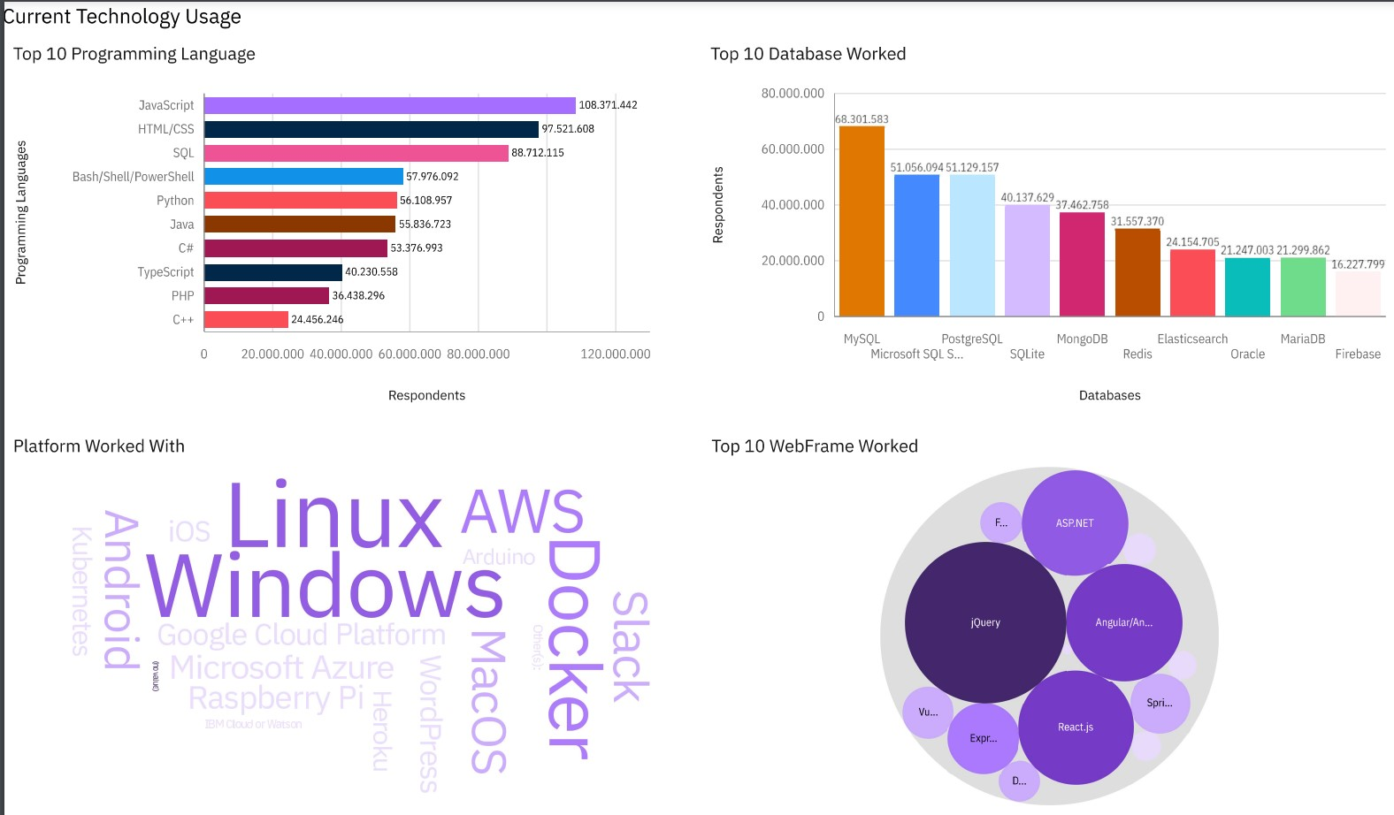
DASHBOARD Current Technology Usage

Slide 13
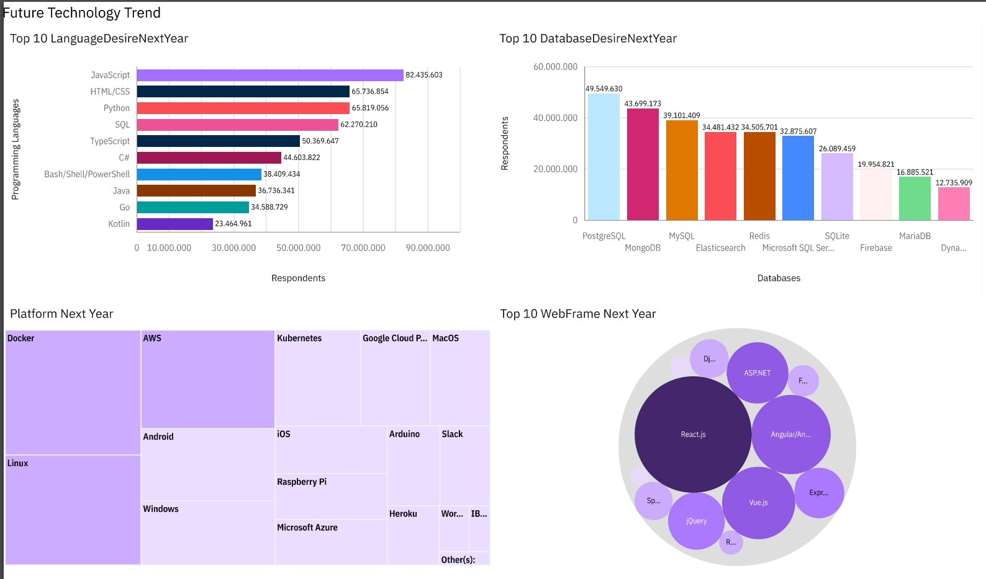
DASHBOARD Future technology trend

Slide 14
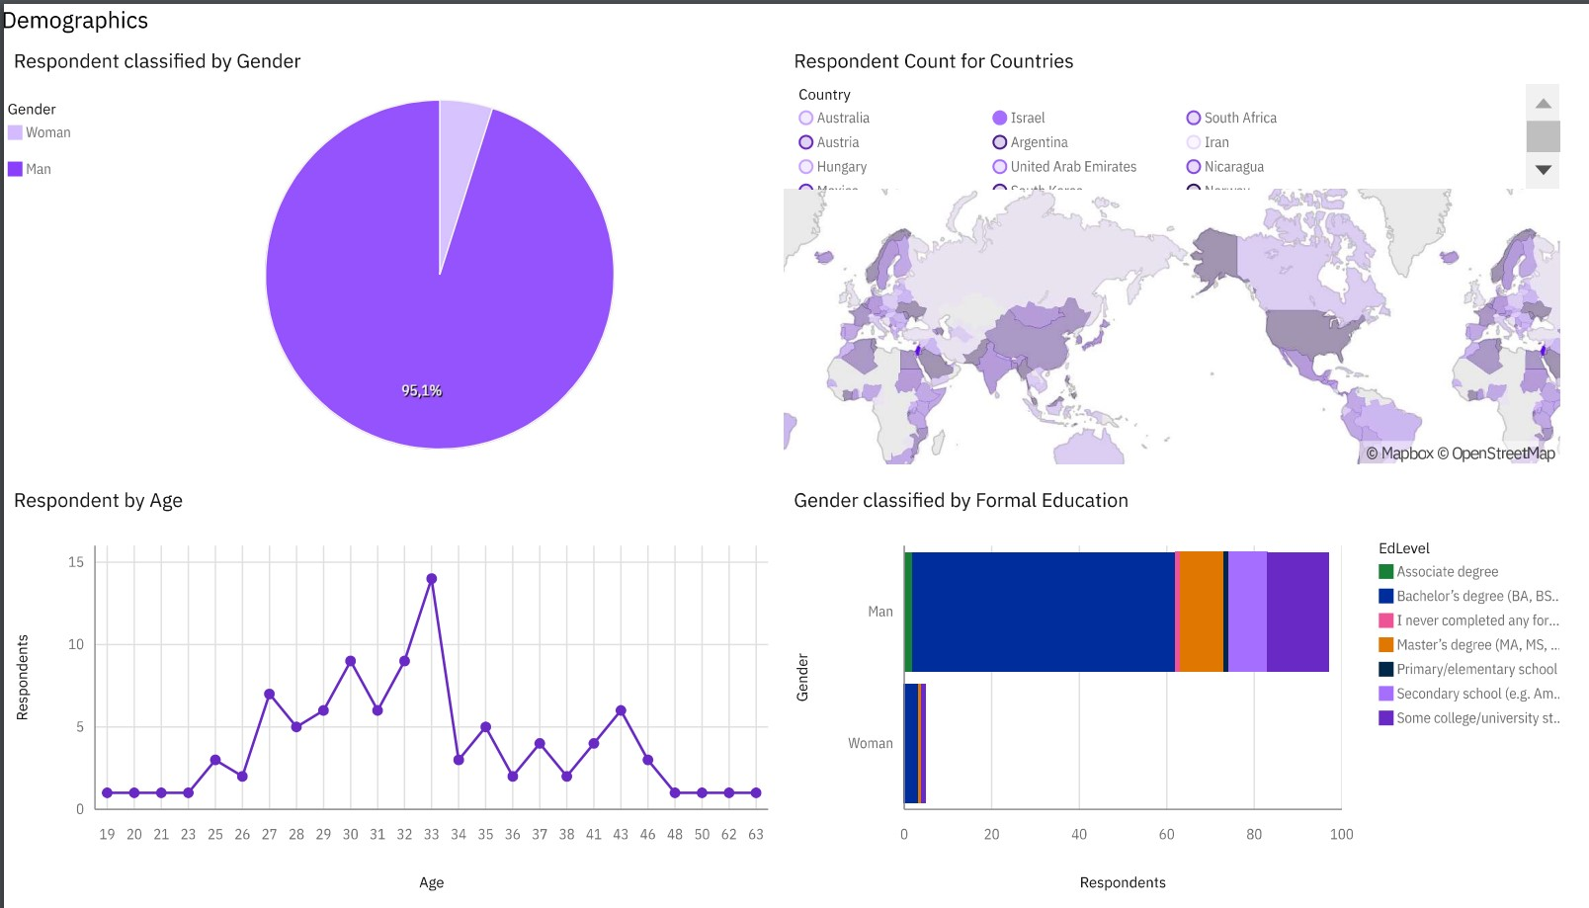
DASHBOARD Demographics

Slide 15
DISCUSSION

Slide 16
OVERALL FINDINGS & IMPLICATIONS
Findings
• Python is the fastest-growing major programming language, rising in the ranks..
• Linux and Windows are the most common platforms for development, followed by Docker and AWS.
• MySQL is the most commonly used database, followed by PostgreSQL and Microsoft SQL Server.
Implications
• The rise of Python and TypeScript suggests a growing demand for these languages
• Popularity of Linux and Windows shows their continued dominance in the developer environment.
• The use of MySQL shows their importance in data management.

Slide 17

CONCLUSION
• Developers are embracing newer and more versatile technologies that enable them to build applications across different domains and platforms
• Some of the older and more established technologies are losing popularity and relevance in the developer community.

Slide 18

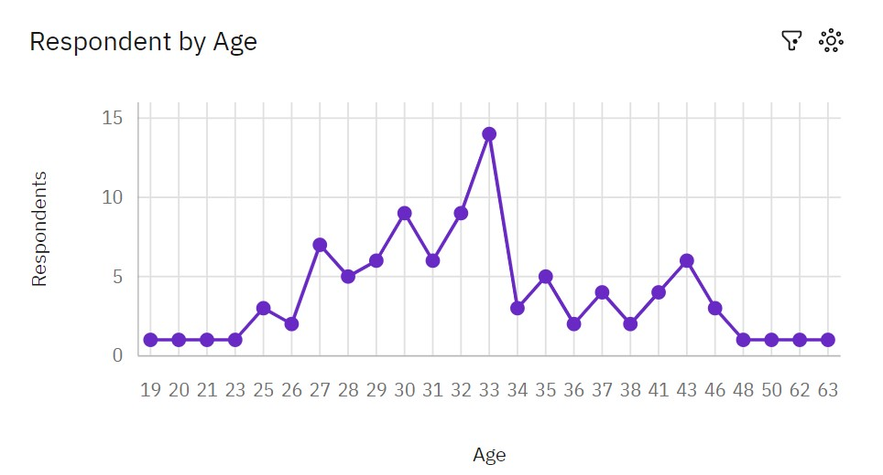
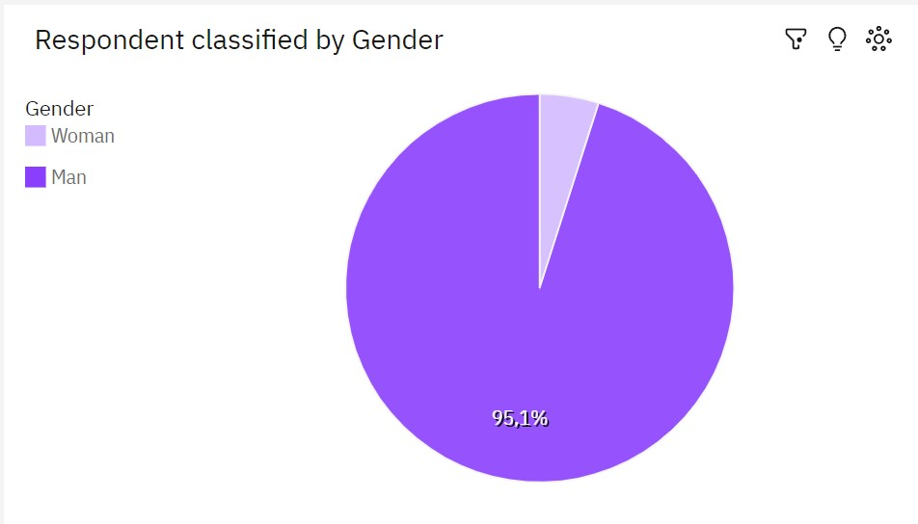
APPENDIX

Slide 19
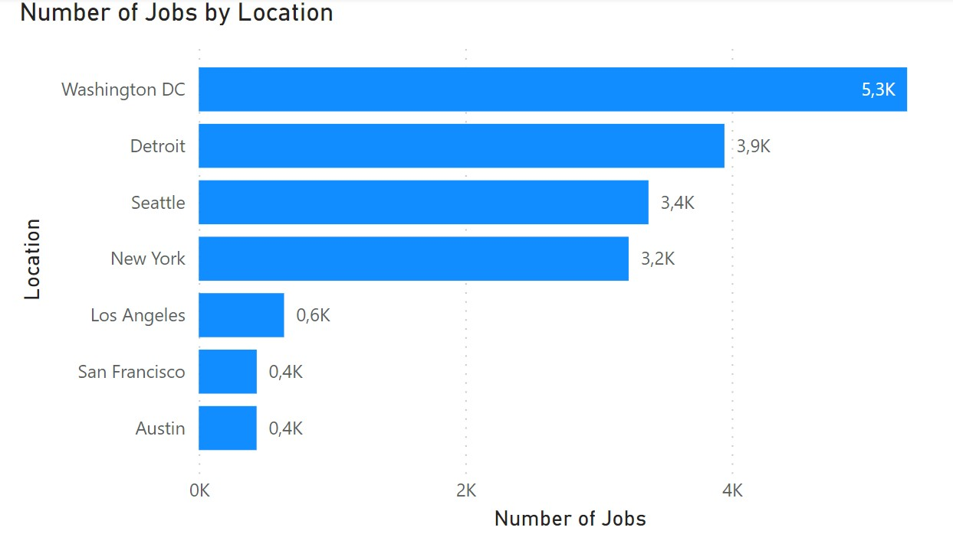
JOB POSTINGS

Slide 20
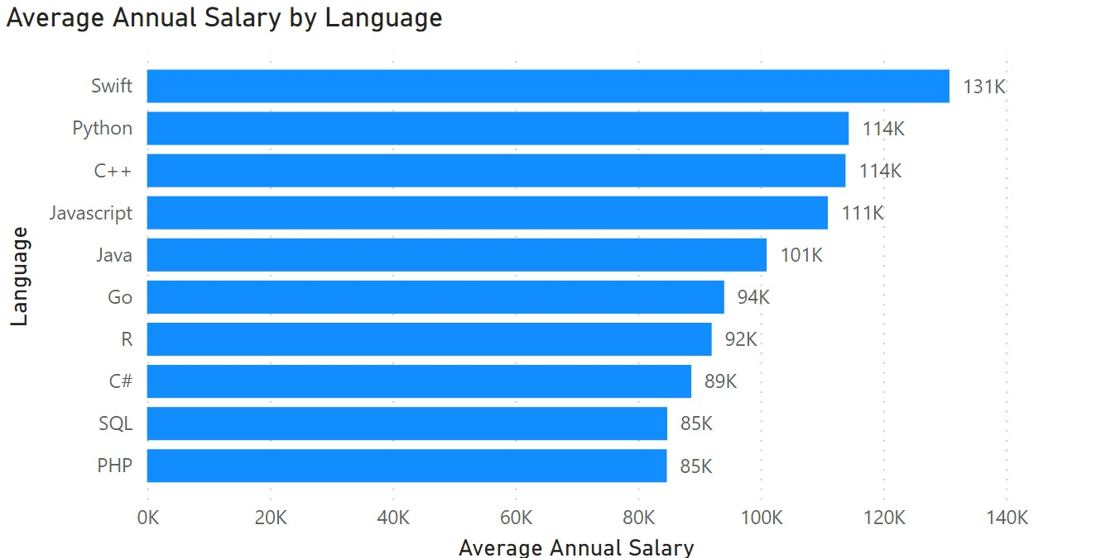
POPULAR LANGUAGES

