Slide 1
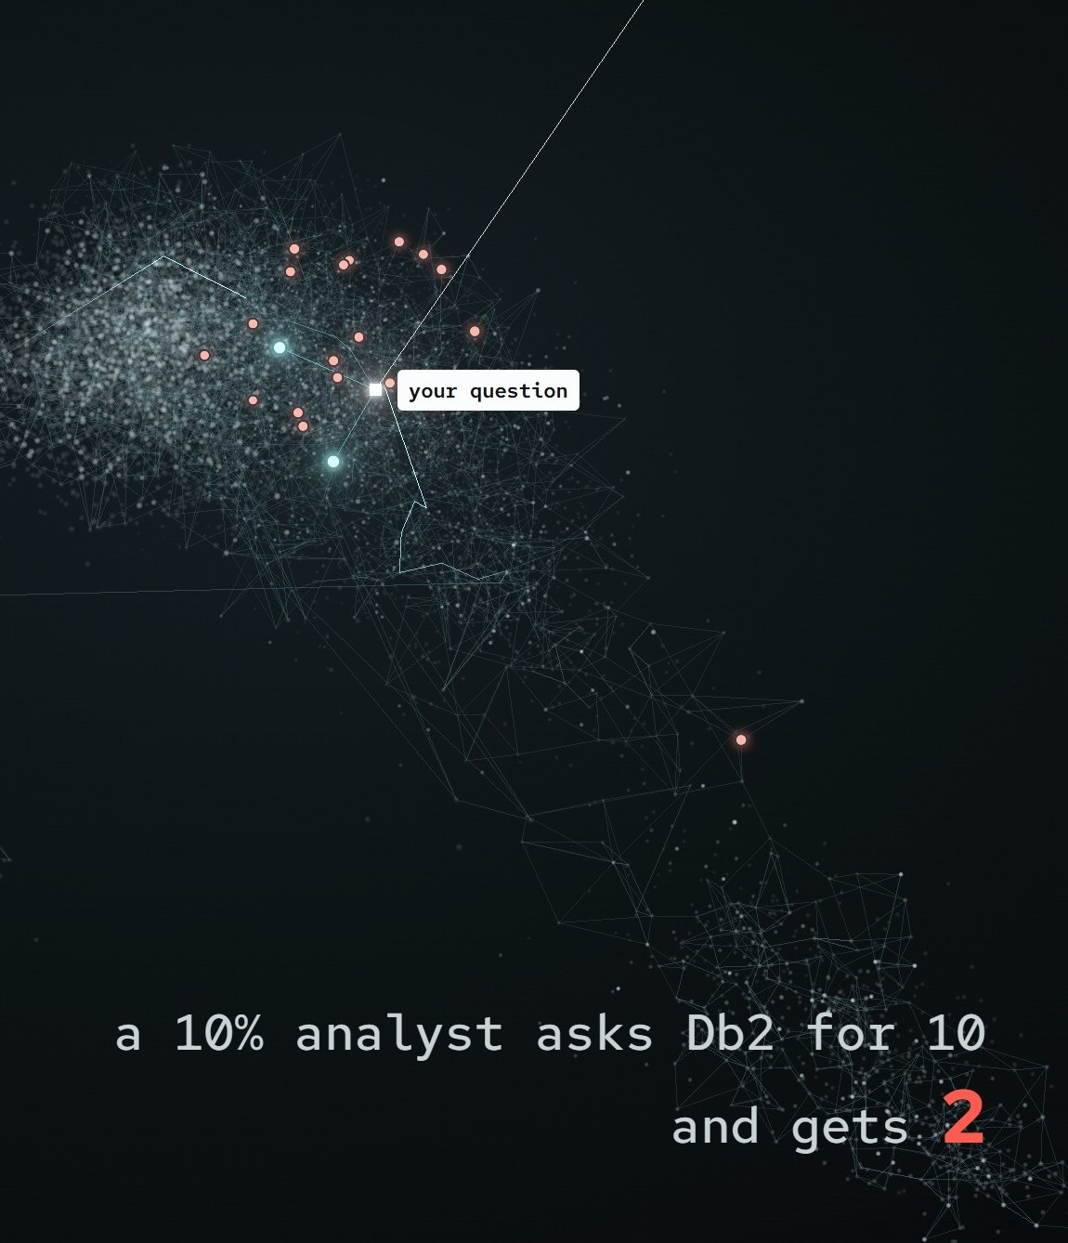
NEEDLE
IBM DB2HACK 2026
Find the needle.
NEEDLE tells you which of your services a vague security report hits, inside IBM Db2.
Team Needlepoint · Kartikeya Lathi and William Lu
IBM Db2 12.1.5
Notes:
We are team Needlepoint, Kartikeya Lathi and William Lu, and this is NEEDLE. NEEDLE tells you which of your services a vague security report hits, inside IBM Db2 12.1.5. One SQL statement finds the advisory by keyword and by meaning, Db2 row access control decides what each analyst may see, and a temporal SBOM join names the services it hits.

Slide 2



A rumour in chat, and no CVE yet
#platform-sec
Who is exposed?
“the yaml loader we use … can run arbitrary code … no CVE number … are we exposed?”
Services, versions, since when
Who may know?
Embargoes, per analyst
Notes:
A message lands in chat: someone says the yaml loader we use in a few Python services can run arbitrary code when it parses an untrusted config file, and there is no CVE number in the thread. Keyword search misses the paraphrase and vector search misses exact identifiers, so we wanted both at once. Two questions follow: which services are exposed, and who is allowed to know, because some advisories are under embargo.

Slide 3



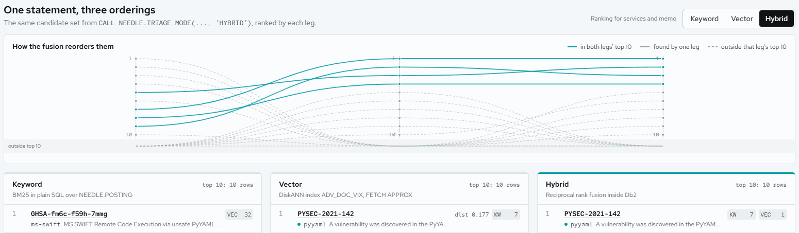
One SQL PL call does the triage
BM25 + DiskANN + RRF
Row access control
Temporal SBOM join
ranked and fused inside Db2
applied per analyst by Db2
names services (synthetic fleet)
Notes:
NEEDLE searches 26,210 real OSV PyPI advisories with one SQL PL call, NEEDLE.TRIAGE_MODE in HYBRID mode. Inside Db2 it ranks by BM25 keyword in plain SQL and by vector with FETCH APPROX on a DiskANN index, then fuses both rankings with reciprocal rank fusion. Each analyst signs in as their own Db2 user, so row access control applies to both legs, and a temporal join with a synthetic fleet's SBOM names the services hit. On this PyYAML message keyword alone ranks other projects higher, while vector and hybrid put the PyYAML advisories on top.

Slide 4
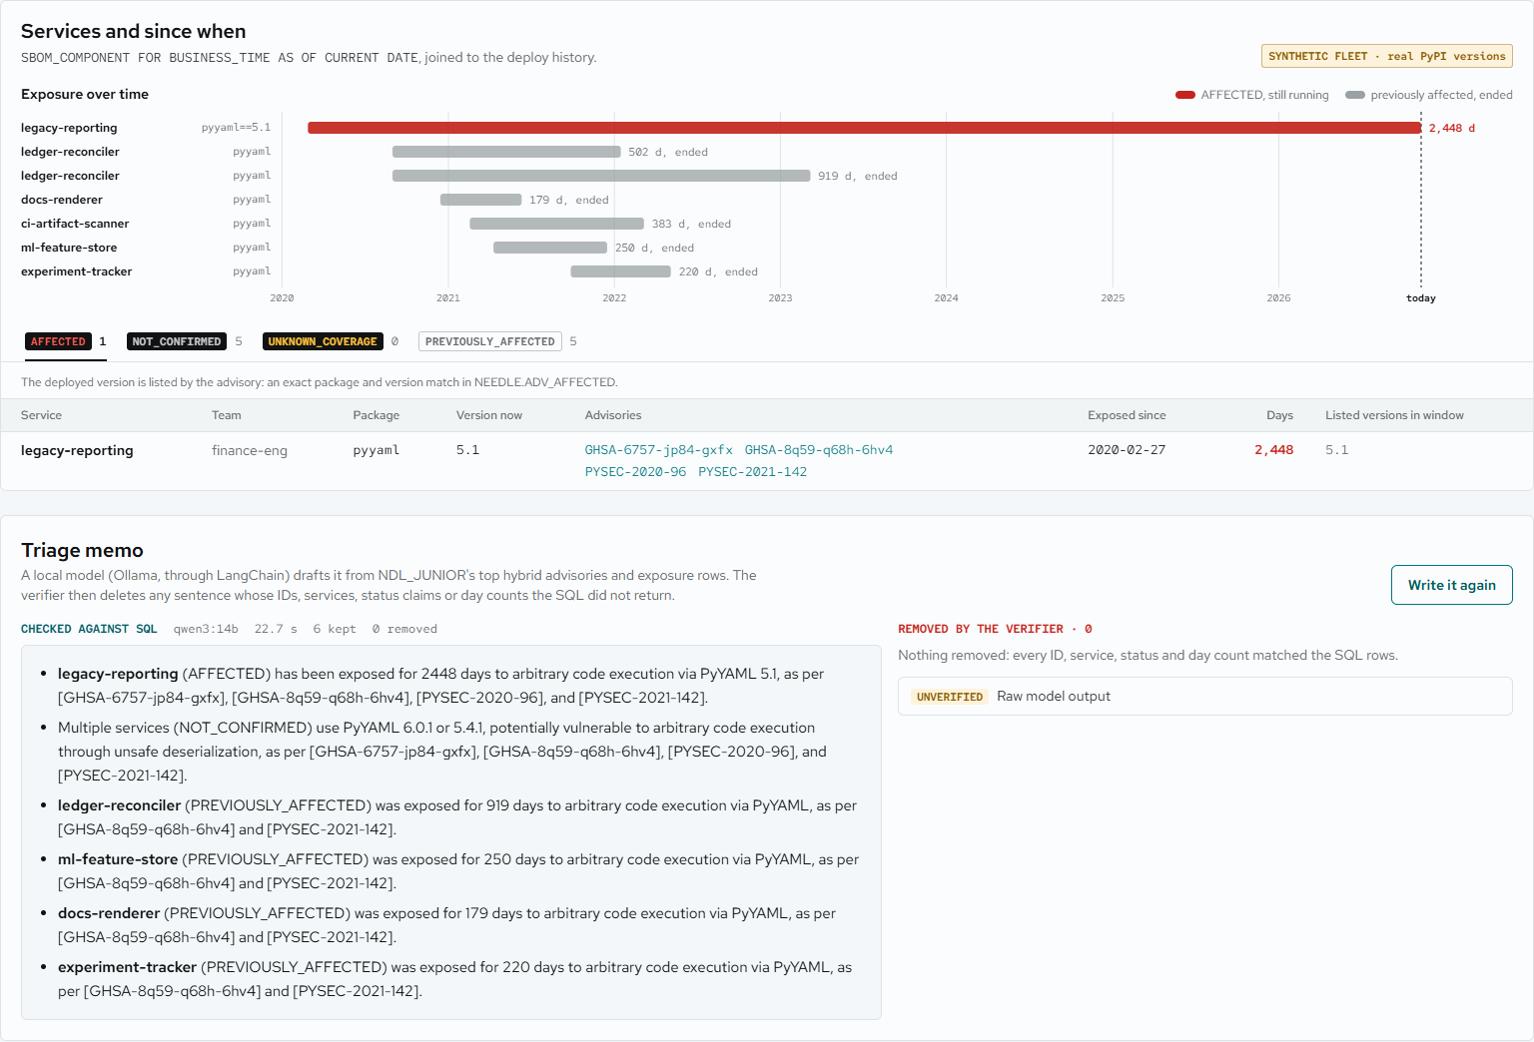

Live demo: 1 service affected now
2,448
days exposed
legacy-reporting
pyyaml==5.1
AFFECTED
since 2020-02-27
5 NOT_CONFIRMED
5 PREVIOUSLY_AFFECTED
Memo checked against the SQL rows
SYNTHETIC FLEET · REAL ADVISORIES
Notes:
The verdict for the PyYAML message: 1 service affected now, legacy-reporting on pyyaml==5.1, AFFECTED since 2020-02-27, which is 2,448 days, plus 5 NOT_CONFIRMED and 5 PREVIOUSLY_AFFECTED. The fleet is synthetic; the advisories and PyPI versions are real. A local model writes a short memo from the SQL rows, and a deterministic verifier removes any sentence with an advisory ID, service, package or day count the SQL did not return.

Slide 5

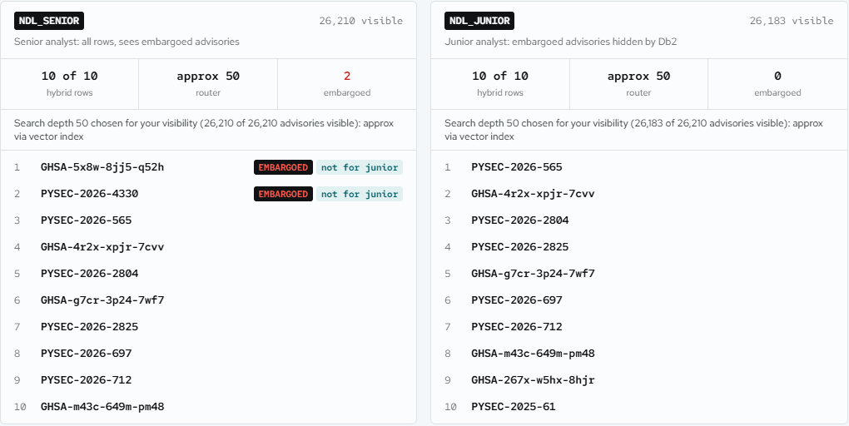
Db2 decides who may know
NDL_SENIOR
GHSA-5x8w-8jj5-q52h
hybrid rank 1
NDL_JUNIOR
never sees it
not in rankings, documents, exposure or memo
Row access control removed it, not the app.
Pillow FlashPix rumour, no CVE
Notes:
Now a Pillow FlashPix heap-overflow rumour, again with no CVE. The senior analyst, Db2 user NDL_SENIOR, gets the embargoed advisory GHSA-5x8w-8jj5-q52h at hybrid rank 1. The junior analyst, NDL_JUNIOR, asks the same and never sees it: not in any ranking, the documents, the exposure, the SQL parameters or the memo. Db2 row and column access control removed it, not the app; the embargo flag is a demo flag on a real advisory.

Slide 6

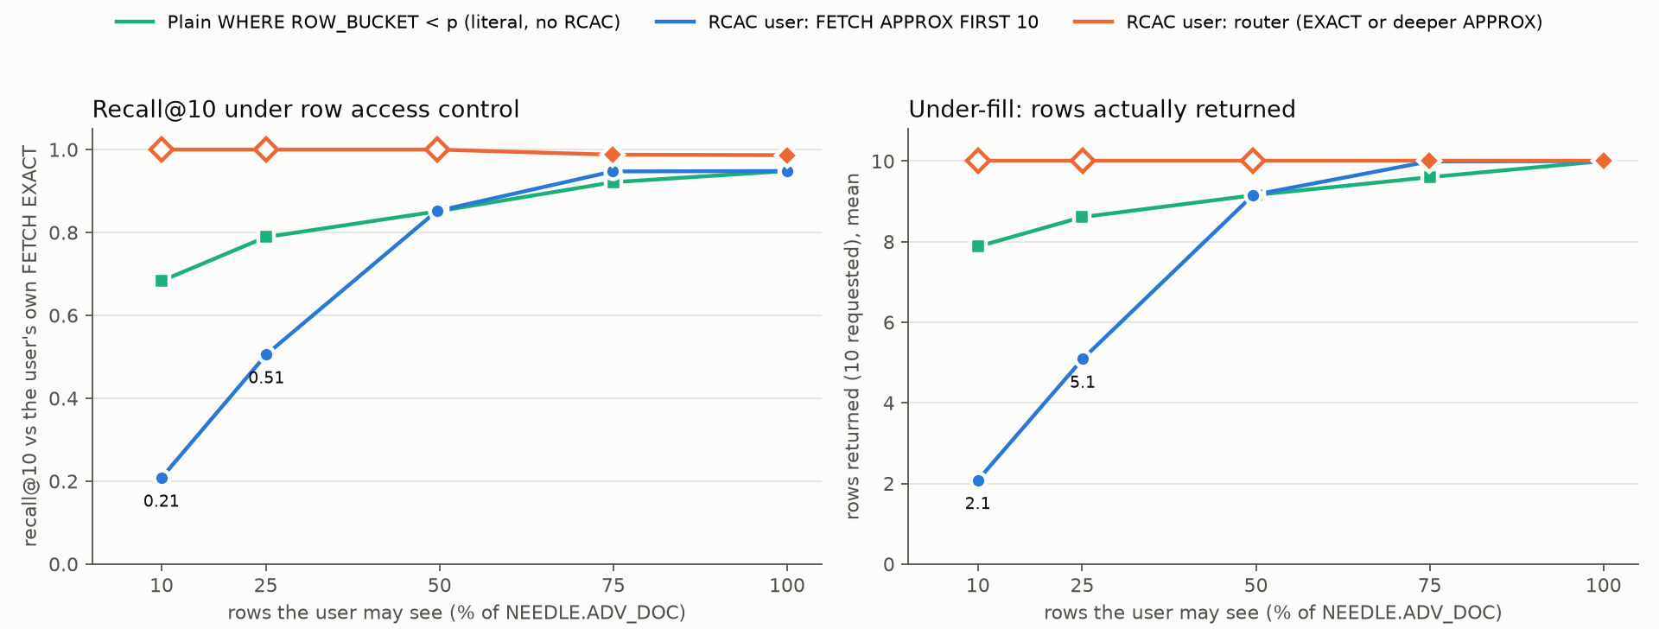
The finding: ask for 10, get 2
1
0.495
21
2.05
plan for every user
filter factor, all users
candidates for top 10
of 10 rows, 10 % analyst
recall@10, 10 % analyst
0.205
shared plan
0.765
literal control
Not an RCAC defect
89 held-out queries, Db2 12.1.5
Notes:
This is our research result. Under row access control every user shares one plan, and the optimizer gives the row permission a filter factor of 0.495 for every user, so the vector index fetches 21 candidates for a top 10 and the permission then drops the rows the user may not see. An analyst who may see 10 percent of the rows gets 2.05 of 10 rows on average, recall@10 0.205; with the same 10 percent set and the permission written as a literal, recall is 0.765. It is a selectivity-estimation and filtered top-K interaction, not an RCAC defect; RCAC makes it invisible to the application.

Slide 7
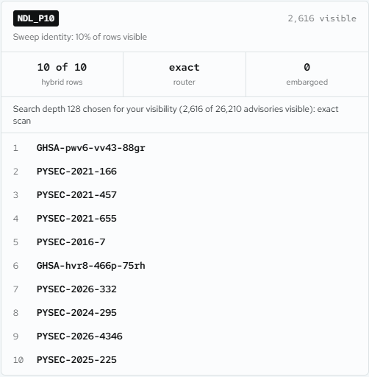
The fix: a router per analyst
NDL_P10
2,616
exact scan
10 of 10
of 26,210 visible
router's choice
rows returned
0.987–1.000
10 of 10
held-out recall@10, 89 queries, 0 leaks
correlated visibility
The router restores recall and row count.
Notes:
NEEDLE's router counts the rows each user may see and picks FETCH EXACT or a deeper FETCH APPROX with a DiskANN search-list size. Live in the app, NDL_P10 sees 2,616 of 26,210 advisories, the router picks an exact scan, and all 10 results come back. On 89 held-out queries the router restores recall and row count: recall@10 is 1.000, 1.000, 1.000, 0.988 and 0.987 from 10 to 100 percent visibility, 10 of 10 rows every time, and 0 leaks. When analysts see whole topic clusters instead of random rows, the router still returns 10 of 10 rows with 0 leaks.

Slide 8
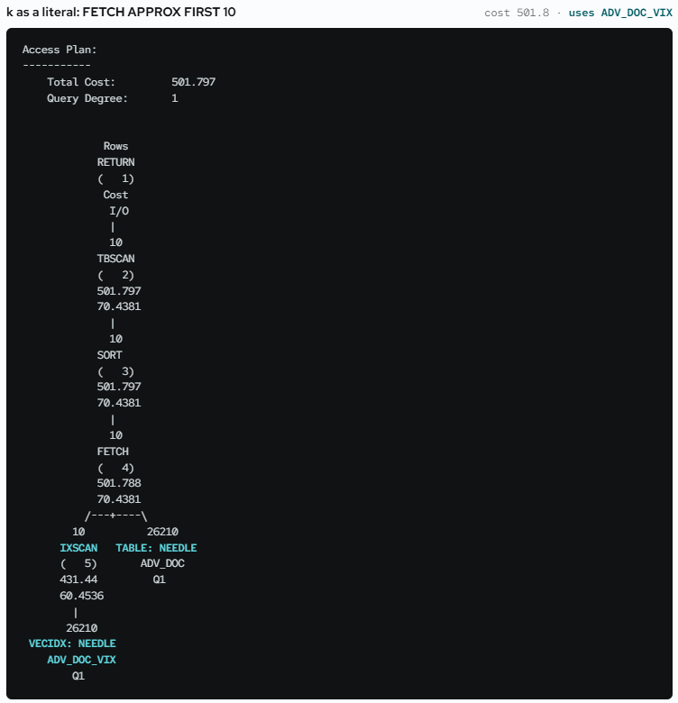
Performance and trust, measured
2.9 ms
53.5 ms
DiskANN p50; exact 73.2 ms
TRIAGE p50, RCAC on
27.2 ms
hit@10, paraphrases
BM25 p50, was 244.8 ms
Memo verifier removes claims the SQL did not return.
Notes:
These numbers are measured: vector search on the DiskANN index has a p50 of 2.9 ms against 73.2 ms for an exact table scan over 450 queries, and the whole hybrid TRIAGE call under row access control has a p50 of 53.5 ms. The row permission slowed the keyword leg, and a per-term LATERAL rewrite took BM25 p50 from 244.8 ms to 27.2 ms on 30 queries with identical results. On paraphrased chat-style queries hybrid hit@10 is 0.453, against 0.360 for vector and 0.340 for BM25. The LLM writes the memo and a deterministic verifier checks it against the SQL; Db2 decides what matches, what is affected and who may see it.

Slide 9



Built on IBM Db2 12.1.5
DB2
REPO
VECTOR
VECTOR_DISTANCE
DiskANN index
github.com/wiiqz/IBM2026
FETCH APPROX/EXACT
RCAC PERMISSION/MASK
PR
BUSINESS_TIME
SQL PL
JSON_TABLE
MERGE
github.com/KunalGolaIBM/
IBM_Db2_TechX_Project_Submission/pull/55
EXPLAIN
NEEDLEPOINT
STACK
Kartikeya Lathi · William Lu
LangChain
Haystack
FastAPI
React
Ollama
Notes:
NEEDLE runs on IBM Db2 12.1.5 with the VECTOR type, VECTOR_DISTANCE, a DiskANN vector index, FETCH APPROX and EXACT, row and column access control, BUSINESS_TIME temporal tables, SQL PL procedures, JSON_TABLE, MERGE and EXPLAIN. Around it we used Python, LangChain, a Haystack component, FastAPI, React and Ollama, and the project is open source under Apache 2.0. The code is at github.com/wiiqz/IBM2026, and our submission is pull request 55 in the IBM Db2 TechX project submission repository. Find the needle.

