Slide 1
Final Assignment Proposal: Edge Detection
By Kevin McAllister

Slide 2
How it Works
By finding areas where the view depth or surface normal changes suddenly, it is possible to find visible edges on a viewed object
It’s also possible to determine how much it “looks” like an edge (i.e. how visible or sharp the edge is to a viewer) and weigh the edges accordingly

Slide 3

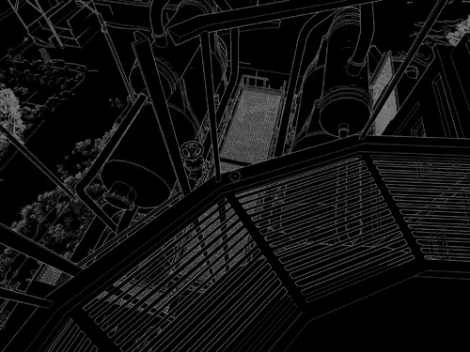
Chapter 9. Deferred Shading in S.T.A.L.K.E.R. | NVIDIA Developer

Slide 4
What it’s For
Edge detection is used in anti-aliasing to smooth out jagged edges caused by lowering resolutions.
It can also be used to generate new images based off of edge maps, such as creating blueprints or adding certain effects

Slide 5
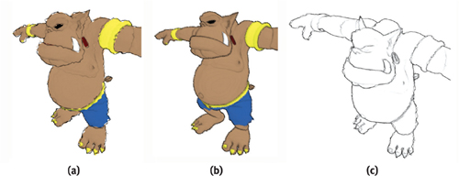
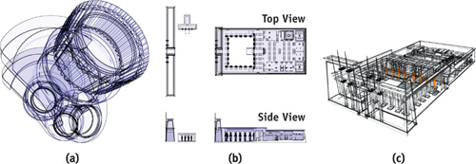
Chapter 15. Blueprint Rendering and "Sketchy Drawings" | NVIDIA Developer

