Slide 1

Daniel, Chris, Jake

Slide 2

Insert-sort Dance

Slide 3
Interactive Python
http://interactivepython.org/courselib/static/pythonds/SortSearch/TheInsertionSort.html

Slide 4
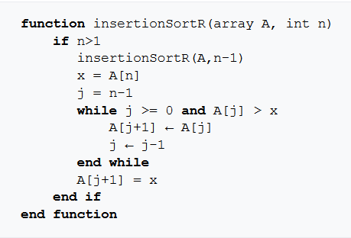
Psuedo

