Slide 1

CS109B
Spring 2020
GROUP 19E
PREDICTING PROJECT SUCCESS

Slide 2
Introduction
Exploratory Data Analysis and Findings
Model Descriptions
Results
Conclusion
CONTENT

Slide 3
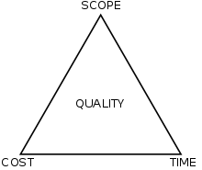
INTRODUCTION
EDA & FINDINGS
MODEL DESCRIPTIONS
RESULTS
CONCLUSION
Introduction
Projects typically multi-disciplinary, multi-dimensional
Varying perceptions of success
Dominant school of thought typically define success as ‘within budget’, ‘on time’ and ‘to specifications’
Objectives
How to evaluate project success
Which features are most predictive of project success
What we have data on
CS109B PREDICTING PROJECT SUCCESS

Slide 4
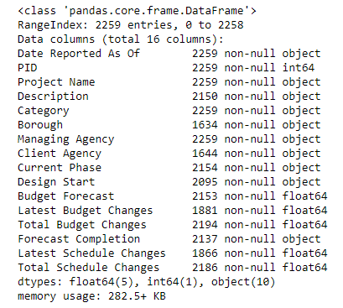
INTRODUCTION
EDA & FINDINGS
MODEL DESCRIPTIONS
RESULTS
CONCLUSION
Exploratory Data Analysis and Findings
16 fields in total
Date Reported As Of - reporting period (mm/yyyy)
PID - Project ID
Project Name - Project Name
Description - Description of the project details
Category - The purpose or type of project
Borough - Borough where the project is being built
Managing Agency - Agency that is managing the project development process
Client Agency - The agency that is the business owner/sponsor for the project
Current Phase - The project phase at the point in time of the reporting period
Design Start - The date the project started
Budget Forecast - The total cost of the project estimated at the point in time of the reporting
Latest Budget Changes - Number of dollars the project is over or under budget since the last time the data was reported
Total Budget Changes - Number of dollars the project is over or under budget since the design start date
Forecast Completion - The date projected for project completion
Latest Schedule Changes - Number of days the project is ahead or behind schedule since the last time the data was reported
Total Schedule Changes - Number of days the project is ahead or behind schedule since the design start date
CS109B PREDICTING PROJECT SUCCESS

Slide 5
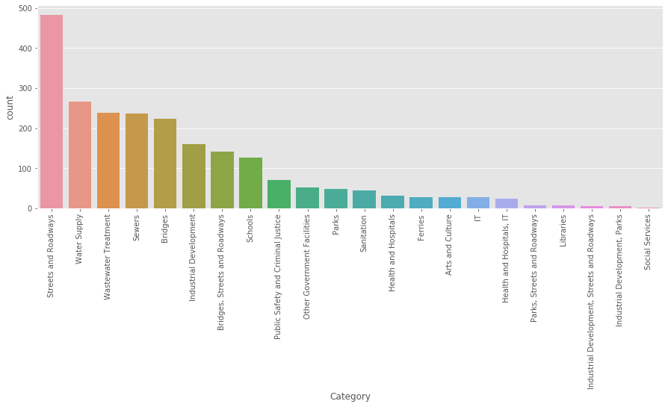
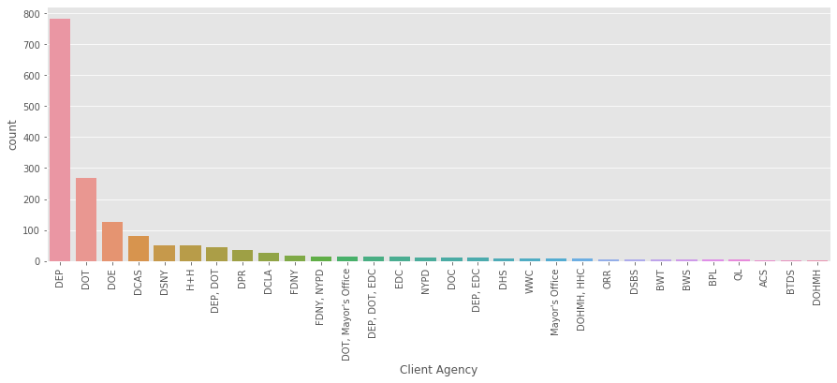
INTRODUCTION
EDA & FINDINGS
MODEL DESCRIPTIONS
RESULTS
CONCLUSION
Exploratory Data Analysis and Findings
Type of projects based on category
Type of projects based on agency
CS109B PREDICTING PROJECT SUCCESS

Slide 6
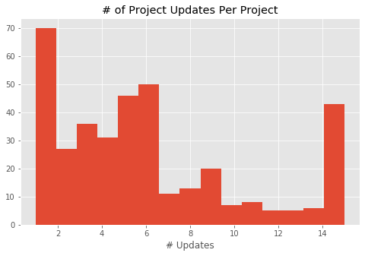
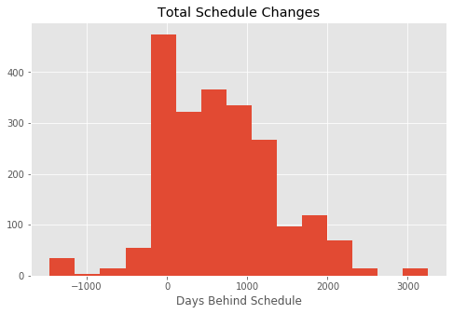
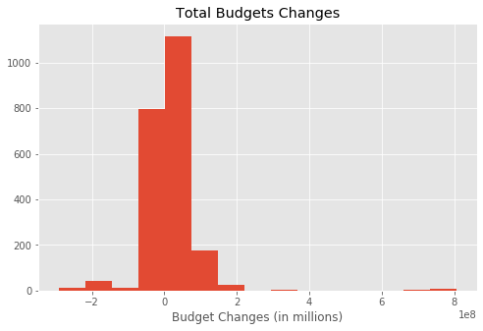
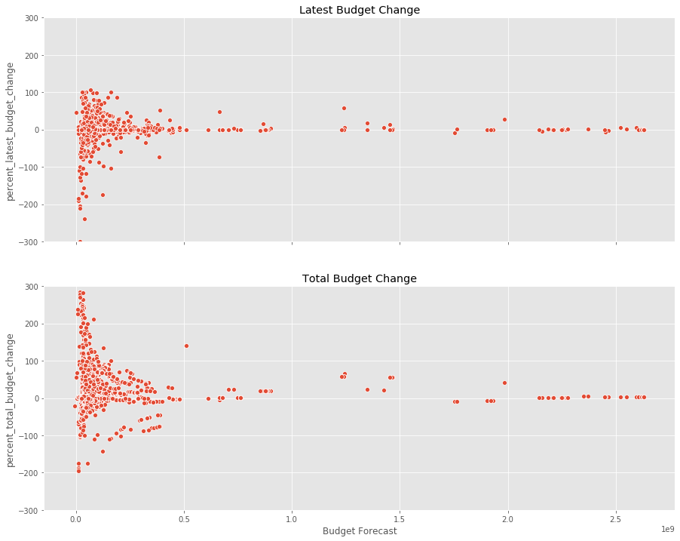
INTRODUCTION
EDA & FINDINGS
MODEL DESCRIPTIONS
RESULTS
CONCLUSION
Exploratory Data Analysis and Findings
CS109B PREDICTING PROJECT SUCCESS

Slide 7
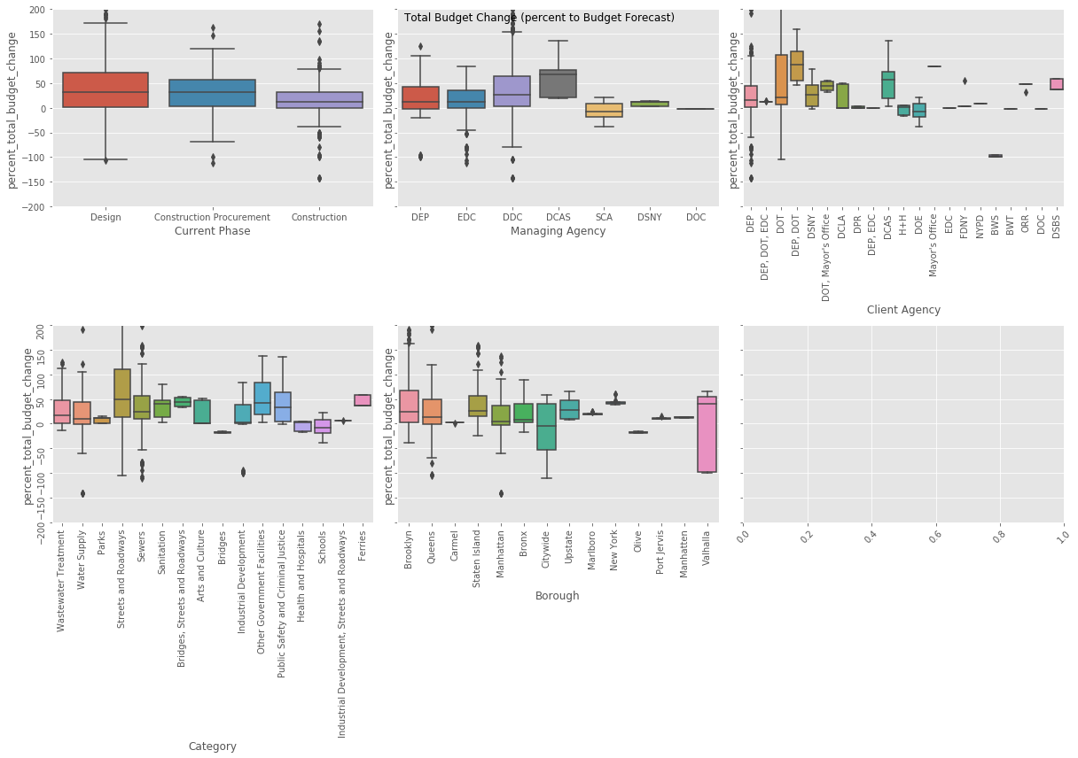
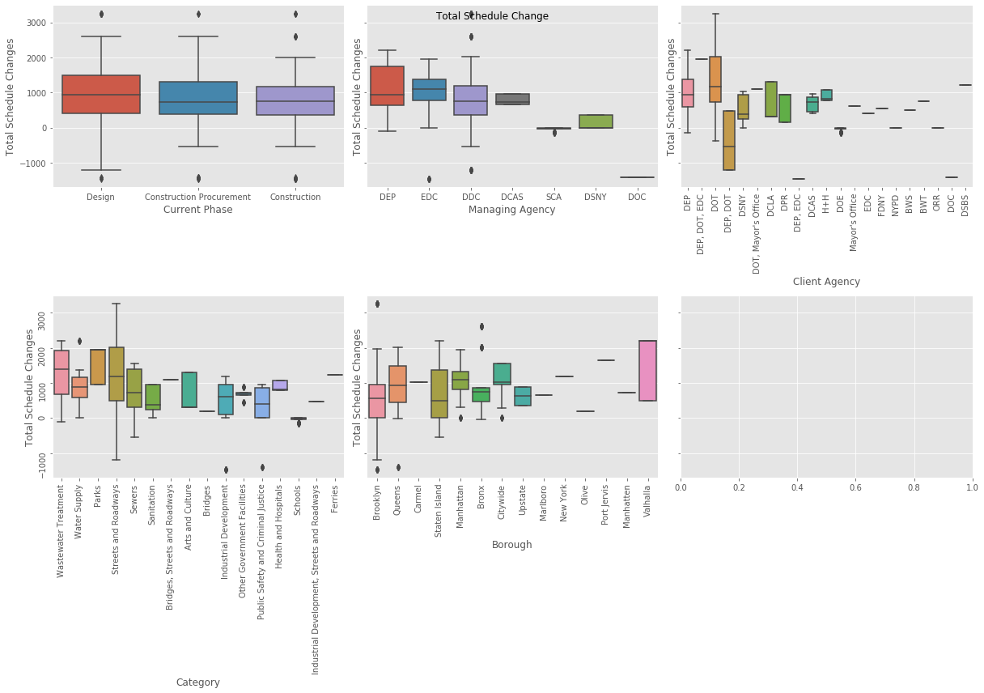
INTRODUCTION
EDA & FINDINGS
MODEL DESCRIPTIONS
RESULTS
CONCLUSION
Exploratory Data Analysis and Findings
Budget
Schedule
CS109B PREDICTING PROJECT SUCCESS

Slide 8
INTRODUCTION
EDA & FINDINGS
MODEL DESCRIPTIONS
RESULTS
CONCLUSION
Model Descriptions
We use percent budget changes and percent schedule changes as our variable of interest
Approach A: Baseline, linear model using Category and Borough categorical features
Approaches using Text Analysis
Approach B: Using TfidfVectorizer to vectorize the texts
Approach C: Using Latent Dirichlet Allocation (LDA) to cluster the projects into "topics"
Approach D: Using neural network that concatenates categorical features and embedding layer from text features
CS109B PREDICTING PROJECT SUCCESS

Slide 9
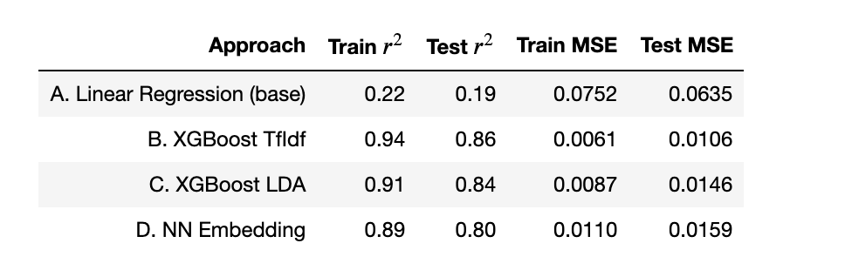
INTRODUCTION
EDA & FINDINGS
MODEL DESCRIPTIONS
RESULTS
CONCLUSION
Percent Schedule Changes Results
Our results suggest that using text from the project description and category considerably improves performance over a baseline linear regression without any text analysis
CS109B PREDICTING PROJECT SUCCESS

Slide 10
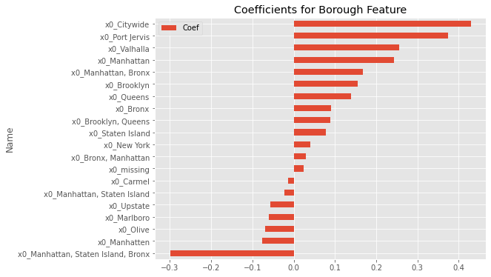
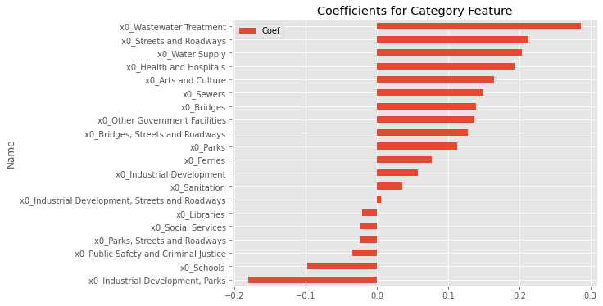
INTRODUCTION
EDA & FINDINGS
MODEL DESCRIPTIONS
RESULTS
CONCLUSION
Percent Schedule Changes- Linear Regression Coefficients
A positive coefficient indicates that the variable increases the percent of days over the initial projection. We can see that Wastewater treatment and streets and roadways have the highest coefficients, as does an indicator for the project being city-wide. The category of school and park projects are correlated with finishing projects ahead of schedule
CS109B PREDICTING PROJECT SUCCESS

Slide 11
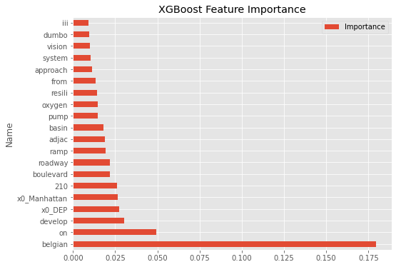
INTRODUCTION
EDA & FINDINGS
MODEL DESCRIPTIONS
RESULTS
CONCLUSION
Percent Schedule Changes- TFIDF XGBoost Feature Importance
Certain words to be more important than categorical variables like agency or location of project. However, the words “belgian”, “on” and “develop” do not have the clearest interpretation as to what project characteristics they are measuring
CS109B PREDICTING PROJECT SUCCESS

Slide 12
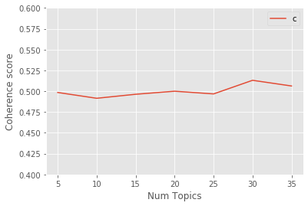
INTRODUCTION
EDA & FINDINGS
MODEL DESCRIPTIONS
RESULTS
CONCLUSION
LDA- Choosing the optimal number of categories
We started with 7 topic categories based on information from: Procedures for Dealing with Optimism Bias in Transport. However, we wanted to test if other values better fit our setting and settled on 32. We evaluate the cohesion score for both project description and project category.
CS109B PREDICTING PROJECT SUCCESS

Slide 13
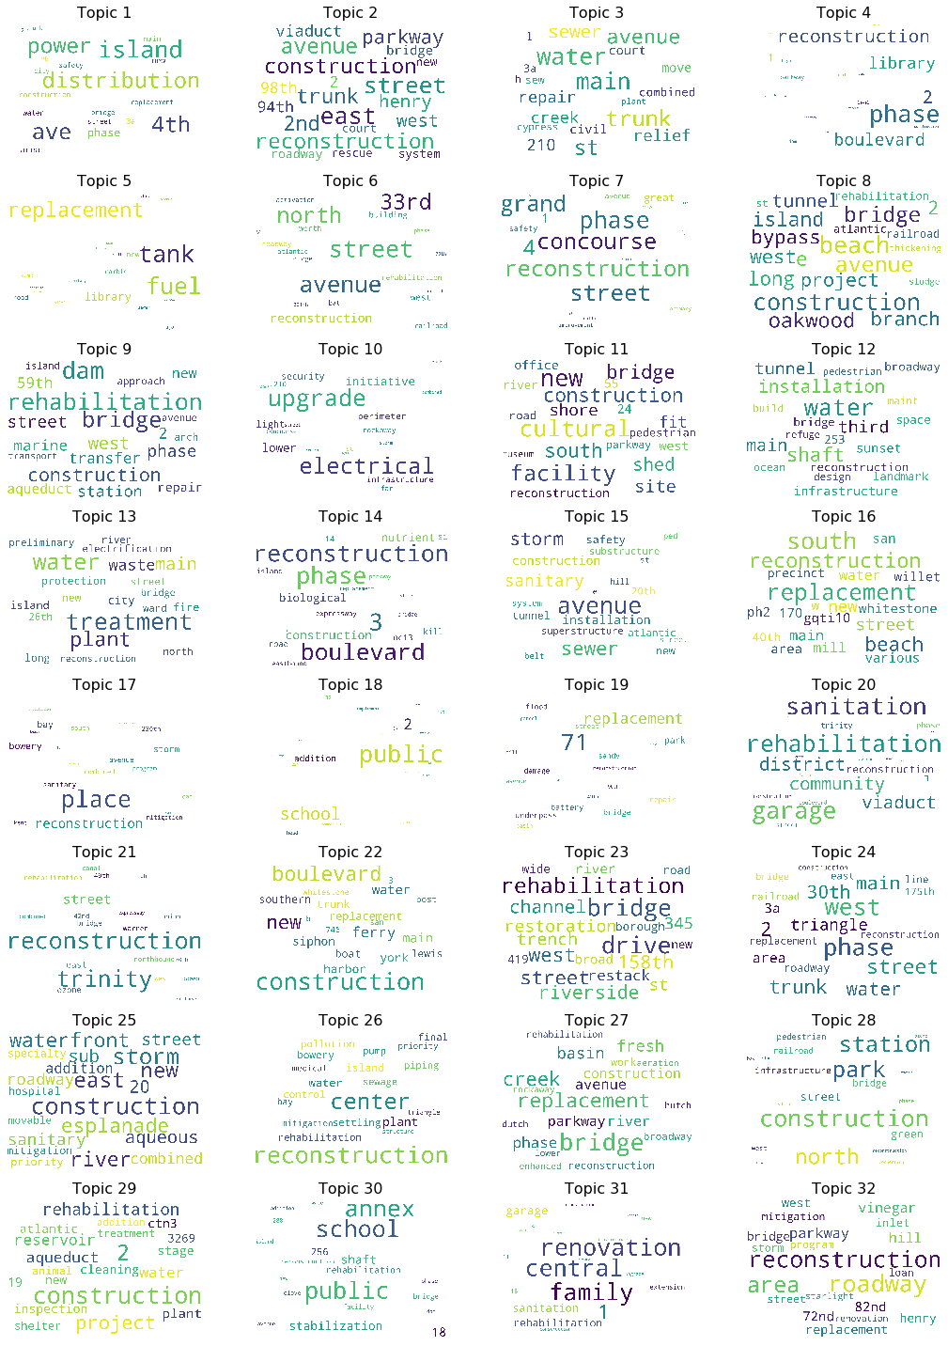
INTRODUCTION
EDA & FINDINGS
MODEL DESCRIPTIONS
RESULTS
CONCLUSION
LDA Word Groupings for Project Category
The word size corresponds to p(word|topic), where larger words have higher probabilities. Topic 4 looks like it is documenting a library reconstruction project.
CS109B PREDICTING PROJECT SUCCESS

Slide 14
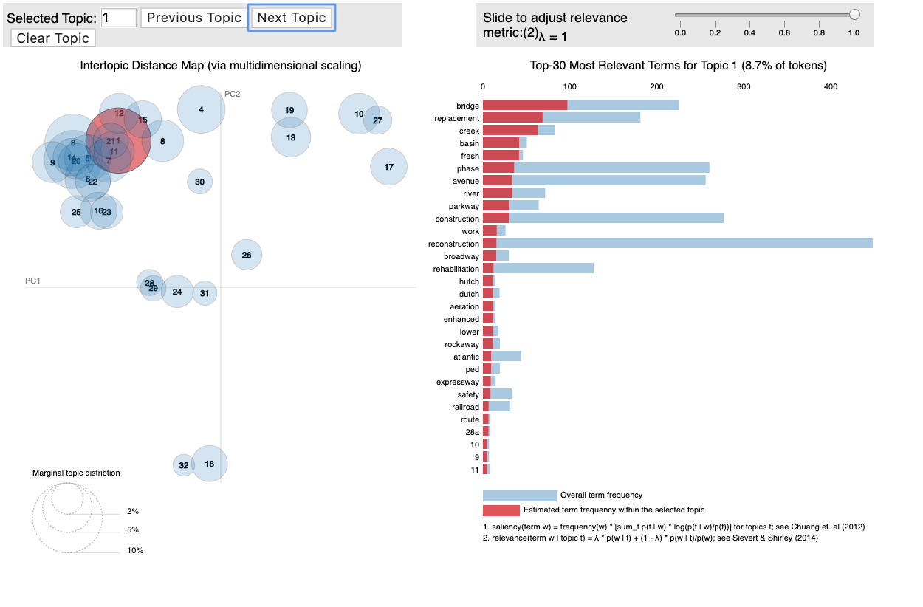
INTRODUCTION
EDA & FINDINGS
MODEL DESCRIPTIONS
RESULTS
CONCLUSION
PyLDAvis Visualizations for Project Category
This is the example for Topic 1 but similar analysis is provided for all 32 topics. The circles are highly overlapping, which suggest these are not well-separated categories.
CS109B PREDICTING PROJECT SUCCESS

Slide 15
INTRODUCTION
EDA & FINDINGS
MODEL DESCRIPTIONS
RESULTS
CONCLUSION
XGBoost Results with LDA groupings
We used the LDA groupings and XGBoost, below are the top 5 features from the feature importance of our top performing model. Overall, project name and description seem to be important features in predicting schedule delays, as well as certain client agencies.
Feature Rank | Feature Percent | Feature Name | Description
1 | 12.13 | Topic Project Name 31 | The top 10 words: roadway, reconstruction, area, parkway, hill, vinegar, 82nd, 72nd, replacement, henry
2 | 10.62 | Client Agency DSBS | Department of Small Business Services
3 | 8.98 | Client Agency DEP, EDC | Department of Environmental Protection and Economic Development Corporation
4 | 4.83 | Topic Description 22 | The top 10 words: distribution, water, main, new, trunk, installation, electrical, restoration, tunnel, avenue
5 | 4.75 | Topic Description 10 | The top 10 words: power, distribution, boulevard, bus, ave, bay, new, along, cross, reconstruction
CS109B PREDICTING PROJECT SUCCESS

Slide 16
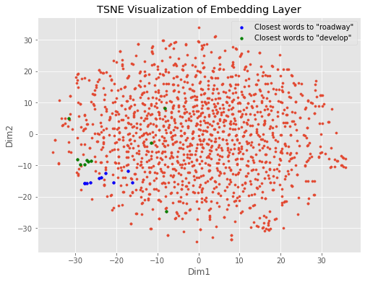
INTRODUCTION
EDA & FINDINGS
MODEL DESCRIPTIONS
RESULTS
CONCLUSION
Neural Networks- with word embedding layers
Below is the TSNE representation of the embedding layer weights. To demonstrate how this works, we are going to use the example of the word “develop”. The words most similar to “develop” are highlighted in the graph below and are: archway, four, recreat, gunhill, triangl, deliv, vital, gt. This grouping is slightly less intuitive than our previous groupings using other NLP techniques but the closest words seem to be close to each other in the TSNE representation.
CS109B PREDICTING PROJECT SUCCESS

Slide 17
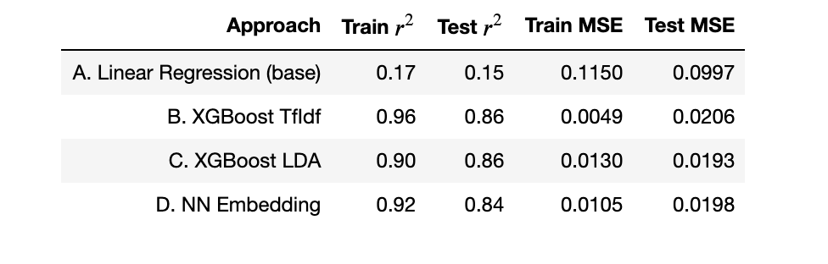
INTRODUCTION
EDA & FINDINGS
MODEL DESCRIPTIONS
RESULTS
CONCLUSION
Percent Budget Changes Results
Our results suggest that using text from the project description and category considerably improves performance over a baseline linear regression without any text analysis
CS109B PREDICTING PROJECT SUCCESS

Slide 18
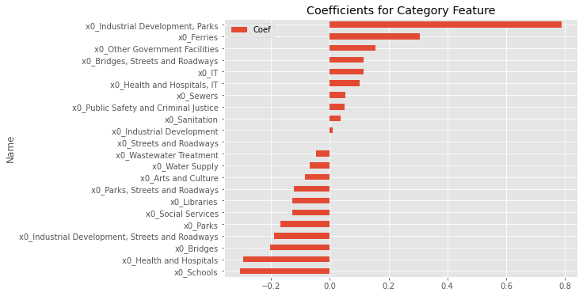
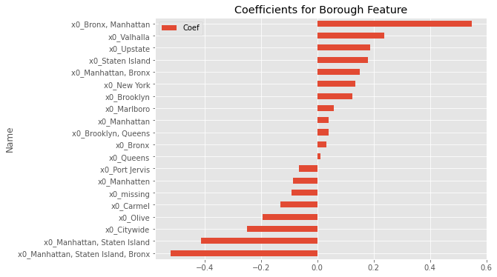
INTRODUCTION
EDA & FINDINGS
MODEL DESCRIPTIONS
RESULTS
CONCLUSION
Percent Budget Changes- Linear Regression Coefficients
As with the percent schedule changes, coefficients greater than zero indicate that the project is over-budget and negative coefficients under-budget. We see large positive coefficients on Industrial development and park projects and ferries as well as projects located in the Bronx and Manhattan. This is interesting, as parks had one of the highest rates of coming in before schedule, which may suggest that parks spend over their budget to increase the speed of completion of the projects.
CS109B PREDICTING PROJECT SUCCESS

Slide 19
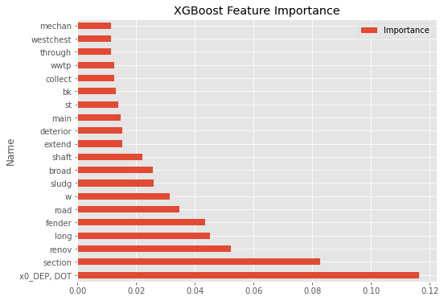
INTRODUCTION
EDA & FINDINGS
MODEL DESCRIPTIONS
RESULTS
CONCLUSION
Percent Budget Changes- TFIDF XGBoost Feature Importance
Unlike in schedule changes, the most important feature is related to government agency associated with the project. “Renov” being a top feature likely indicates that budget changes may depend on whether the project is a new construction or just a renovation
CS109B PREDICTING PROJECT SUCCESS

Slide 20
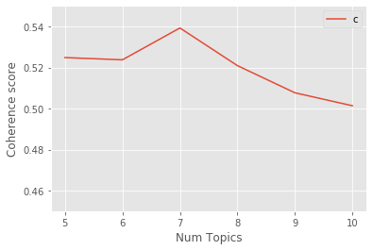
INTRODUCTION
EDA & FINDINGS
MODEL DESCRIPTIONS
RESULTS
CONCLUSION
LDA- Choosing the optimal number of categories
We started with 7, again based on information from: Procedures for Dealing with Optimism Bias in Transport. However, we wanted to test if other values better fit but in this case 7 was optimal.
CS109B PREDICTING PROJECT SUCCESS

Slide 21
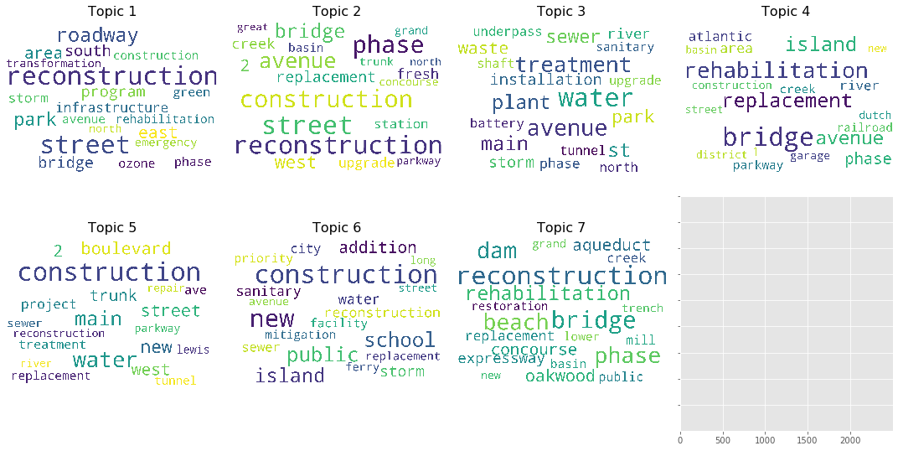
INTRODUCTION
EDA & FINDINGS
MODEL DESCRIPTIONS
RESULTS
CONCLUSION
LDA Word Groupings for Project Category
The word size corresponds to p(word|topic), where larger words have higher probabilities. While LDA methods are unsupervised, and thus shouldn’t change when using schedule vs. budget as the outcome variable, due to data availability issues (many more samples were missing budget information), the two analyses have different samples and thus different numbers of optimal topics.
CS109B PREDICTING PROJECT SUCCESS

Slide 22
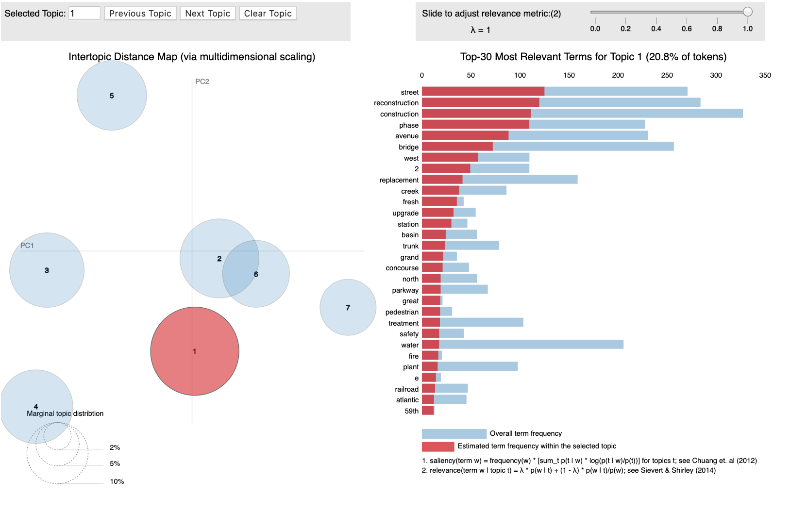
INTRODUCTION
EDA & FINDINGS
MODEL DESCRIPTIONS
RESULTS
CONCLUSION
PyLDAvis Visualizations for Project Category
This is the example for Topic 1 but similar analysis is provided for all 7 topics. The circles are much further away from each other, indicating a more clear separation in the categories.
CS109B PREDICTING PROJECT SUCCESS

Slide 23
INTRODUCTION
EDA & FINDINGS
MODEL DESCRIPTIONS
RESULTS
CONCLUSION
XGBoost Results with LDA groupings
We used the LDA groupings and XGBoost, below are the top 5 features from the feature importance of our top performing model. The most important features are disproportionately client agencies.
Feature Rank | Feature Percent | Feature Name | Description
1 | 15..53 | Client Agency: DEP, DOT | Department of Environmental Protections and Department of Transportation
2 | 11.73 | Client Agency: Mayor’s Office | Mayor’s Office
3 | 7.79 | Category Schools | Projects categorized as schools
4 | 4.83 | Topic Description 3 | The top 10 words: order, construction, design, infrastructure, sewer, combined, comply, way, manage, green
5 | 4.76 | Client Agency: ORR | Mayor’s Office of Recovery and Resiliency
CS109B PREDICTING PROJECT SUCCESS

Slide 24
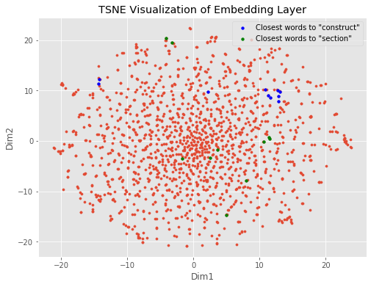
INTRODUCTION
EDA & FINDINGS
MODEL DESCRIPTIONS
RESULTS
CONCLUSION
Neural Networks- with word embedding layers
Below is the TSNE representation of the embedding layer weights. To demonstrate how this works, we are going to use the example of the word construct. These are the words found to be most similar to “construct”: roosevelt, bridg, regrad, crosstown, murray, aqueou, hs, init, stabil. It is not the most similar grouping of words. Unlike in the schedule change analysis, the words are also not clustered in the TSNE plot below.
CS109B PREDICTING PROJECT SUCCESS

Slide 25
INTRODUCTION
EDA & FINDINGS
MODEL DESCRIPTIONS
RESULTS
CONCLUSION
Conclusions
Overall, adding in NLP and text analysis dramatically improved the performance of the models, increasing both the r-squared and lowering the MSE
LDA and TF-IDF methods seemed better suited for text analysis than Neural Networks for this application, although using cohesion graphs with LDA did not point to a clear optimal number of groups for the models
The word groups and general importance of words were more prevalent in the feature importance in the percent over schedule analysis than in the percent over budget analysis. This also suggests that there may be different factors in what makes a project over budget vs. over time.
In percent over budget, the main factors were consistently the client agency involved with the projects. While in some instances, the agency and category of project are highly correlated, departments such as the small business services and those hosted within the mayor’s office, span across project categories and were still important variables. This suggests that while certain projects may be associated with predicting budget or schedule changes, the demands and interactions with the client agency also likely matter in predicting project success
CS109B PREDICTING PROJECT SUCCESS

