Slide 1

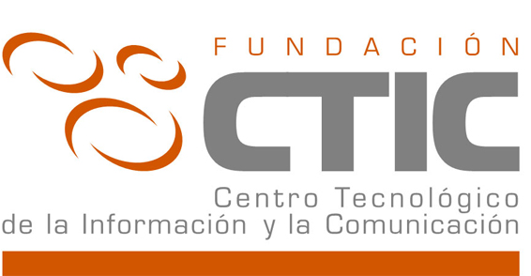


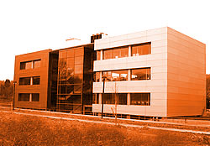


CTIC Foundation
Parque Científico y Tecnológico de Gijón,
Edificio Centros Tecnológicos
Cabueñes, s/n • 33203 Gijón (Asturias-Spain)‏
Tel.: + 34 984 29 12 12
Fax: + 34 984 39 06 12
www.fundacionctic.org

Slide 2
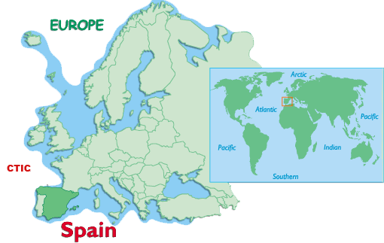
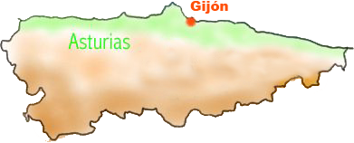

CTIC Foundation
Organization
  CTIC Foundation (Information and Communication Technological Center) is a private non-profit institution founded in 2004 by the Regional Government of the Principality of Asturias and a Consortium of regional private companies in the field of Information and Communication technologies.
Model
  Public and private participation.
Mission
  Promoting and encouraging activities related to the development of Information and Communication Technologies (ICT) in every economic, institutional and social sector, which can contribute to the development and improvement of the community of Asturias.
  CTIC Foundation hosts the W3C Spanish Office
  A national reference in Information Society
  CTIC has 100+ members (30 in R&D Department)‏
  Partnership with: industry, government, companies and academic institutions

Slide 3
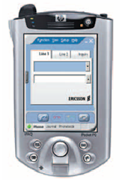




CTIC Foundation
Objectives
  Implantation of Information Society in every economic, institutional and social sector.
  Becoming a reference in terms of ICT Research and Development (R&D).
  Promoting the enterprise participation in R&D initiatives
  Transferring technology to industry and society.
R&D Department
  Taking into account the wide scope of the ICT sector, the R&D department of the CTIC Foundation has focused its portfolio on three leading technological specializations with great projection.
Semantic Web
Device Independence and Mobility
Accessibility and Usability

Slide 4
R&D&I CTIC DEPARTMENT ASSETS
Connected to companies:
- Supported by a consortium of private IT companies (Abertis Telecom,…)
  - Industrial Partners (Arcelor Mittal, Telefónica I+D,…)
Connected to universities:
  - All CTIC R&D staff are associated professors
  - Universities are involved in most CTIC R&D projects (UniOvi, UPC, UPM,…)
Technological Neutrality and Innovation capability:
  Hosting W3C Spanish Office
  Member of STI²
  Developing and applying technology
  Active membership in Technology Platforms (NESSI, INES, NEM, eNEM, eMOV, )
Multidisciplinary Research:
  - Semantic Web, 4U, Mobile Web, GRID, RFID, etc.
Experts in standardization:
  - CTIC actively participates in diverse W3C and INES Working Groups
Finnancial support:
- Development of projects funded and supported either by European (VI/VII Framework Programs,
ESTIIC, CELTIC, …), Spanish (PROFIT) and Asturian (PCTI) initiatives and by private initiatives
(Arcelor Mittal, City Council of Zaragoza, several Asturian companies).
Notes:
The objective of the Research, Development and Innovation department (R&D&i) of the CTIC Foundation is to become a technological centre considered as a national and international reference in terms of ICT. R&D&i department contributes in this way to the improvement of the regional ICT sector:
Working and participating in different key research areas for the next future.
Collaborating with several R&D groups of the University.
Encouraging companies to participate in R&D projects (ICT sector).
Contributing to technology transfer between all the agents involved (public entities, national and international companies and regional SMEs).
Creating a reserve of high-qualified researchers to increase not only the regional competitivity but also the employment and the added value of the ICT sector.
The activity of the R&D&i department takes into account the compromise of collaborating with the regional society, and keeping always in mind unbias, transparency and non-competence with the regional ICT sector factors.

Slide 5






SEMANTIC WEB AREA
eGovernment
Industry
Semantic Web Area has focused its research activity, following CTIC’s strategy, on two major areas:
BOPA: a semantic search engine for Public Administrations document bases using spreading-activation techniques over ontologies structure.
VISONTO: a web tool for ontology visualization and knowledge management: (support for DL-ontologies, SPARQL queries, etc.).
PRAVIA: a data-mediator platform for insurance domain based on Semantic Web Services using WSMO conceptual model.
MyMobileWeb: a platform for developing software applications providing device-Independence and Universal Web Access: 1) design once, 2) access with any kind of web client, 3) contextualizing user profile and preferences.
CRUZAR: a system based on ontologies that generates an specific touristic route taken into account user profile (dissabilities, preferences, date, etc.).
EzWeb: an open platform supporting the retrieval, combination (Mashup) and utilization of a front-end layer components in a global SOA, facilitating interaction between end-users and contents/services using context techniques.

Slide 6
WHAT EXPERTISE DOES CTIC BRING TO THE PROJECT?
SW Line
Experience in the following domains
Semantic search
Ontology development and management.
  e-tourism, e-industry, e-government.
  Context-aware applications.
Industrial solutions applying semantic technologies
Semantic Web Services
Social Software
Added values
CTIC is technological centre for transferring technology
  Applied research
  Collaboration with industrial and academic partners
Involvement in standardization bodies and working groups:
  W3C Working Groups
  Participation in NESSI Platform (and INES).

Slide 7
CTIC Foundation
Parque Científico y Tecnológico
de Gijón
Edificio Centros Tecnológicos
Cabueñes, s/n • 33203 Gijón (Asturias) - Spain
Tel.: + 34 984 29 12 12
Fax: + 34 984 39 06 12
www.fundacionctic.org

Slide 8
SWAML
Semantic Web Archives
of Mailing Lists

