Slide 1
Mailing Lists meet the Semantic Web

Slide 2
Contents
Motivation
Semantic Web to the rescue
Software tools: SWAML and Buxon
Conclussions and future work

Slide 3
The two towers
The social e-mail
The social web
Mailing lists
Wikis
Blogs
E-mail messages
Webmail
HTML Web pages
SMTP
@
HTTP
URL

Slide 4
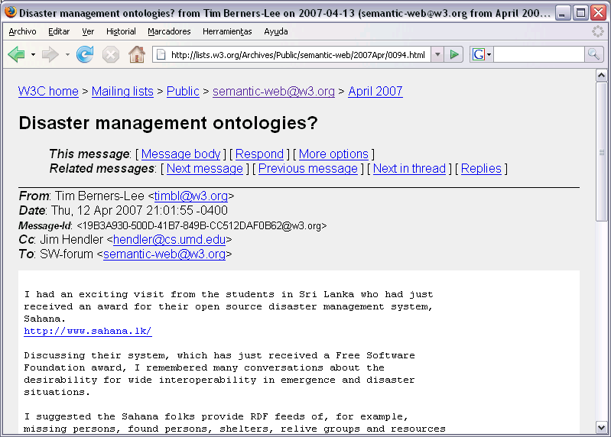
Mailing list messages as HTML pages
Author of the
message
You see it,
The machine does not

Slide 5
Anatomy of an e-mail
Received: from bat.berlios.de (bat.berlios.de [195.37.77.135]) by lagavulin.gandi.net (Postfix) with ESMTP id 8B50B1CCDD for <diego@berrueta.net>; Fri, 13 Oct 2006 19:53:46 +0200 (CEST)
From: Sergio Fdez <sergio@wikier.org>
To: swaml-devel@lists.berlios.de
Date: Fri, 13 Oct 2006 19:51:59 +0200
Message-Id: <1160761919.3787.13.camel@localhost.localdomain>
X-Mailer: Evolution 2.6.3
Subject: [swaml-devel] SWAML 0.0.2 is out
Reply-to: swaml-devel@lists.berlios.de
List-Id: <swaml-devel.lists.berlios.de>
Hi,
I have just finished the work [...]
Best regards

Slide 6
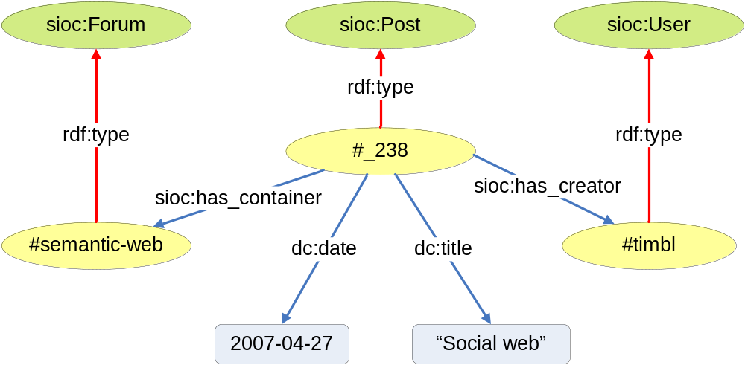
SIOC

Slide 7
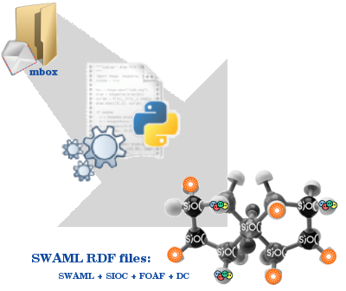
SWAML

Slide 8
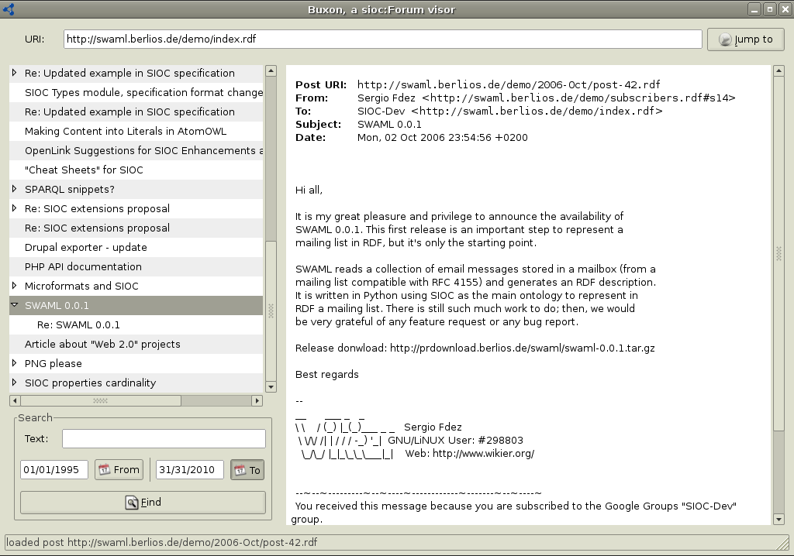
Buxon
sioc:Forum
URI
Message
threads
Search/filter
features
Message details

Slide 9
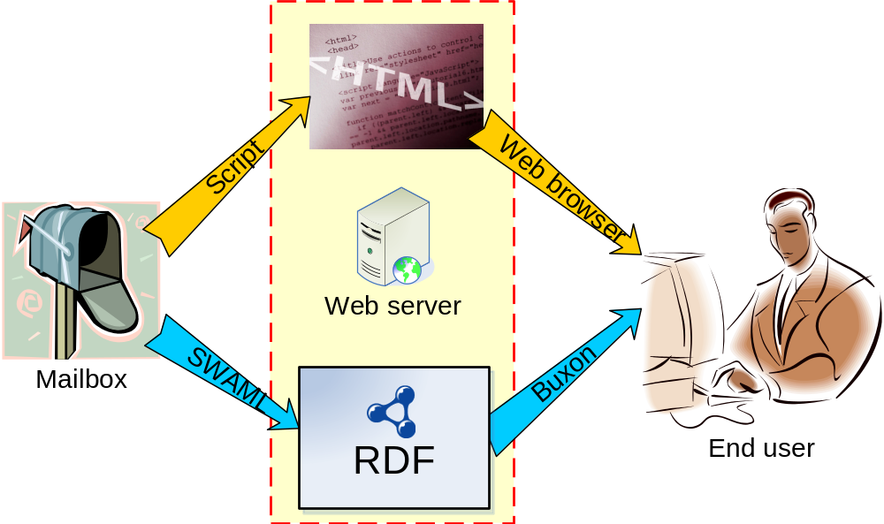
Architecture overview

Slide 10
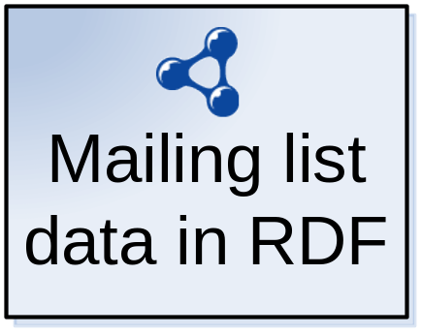
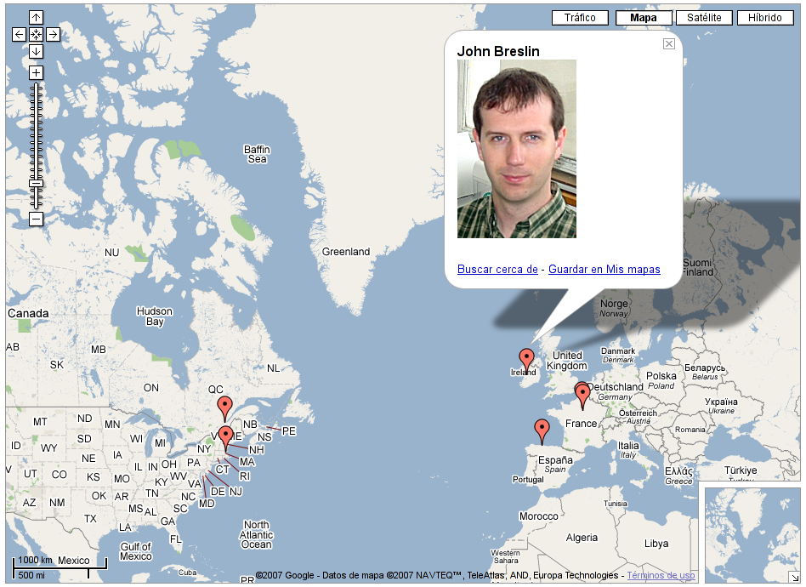
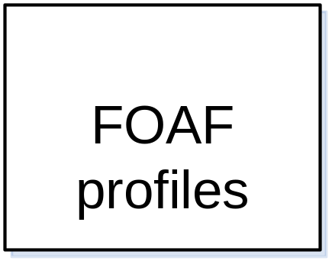

We do mash-ups too!
+
SPARQL

Slide 11
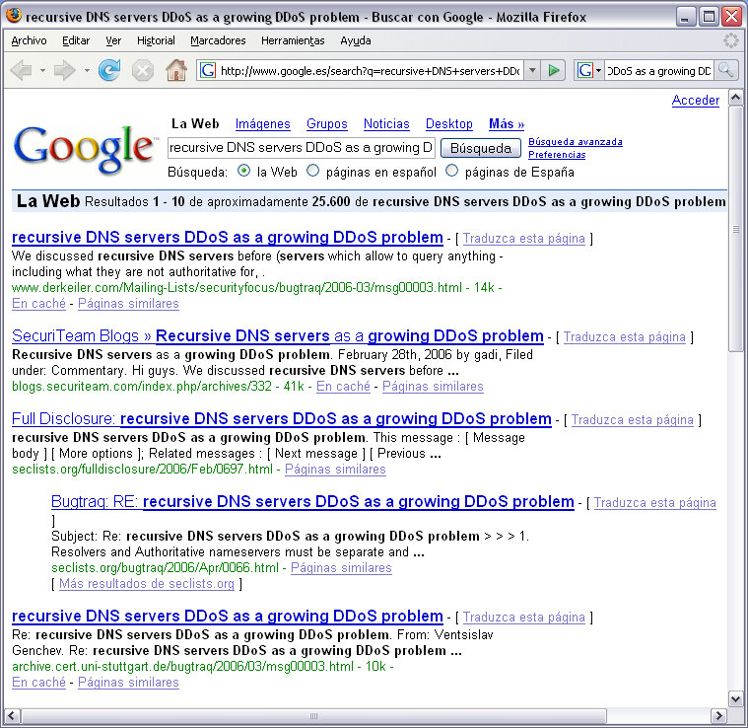
Improving search results quality
Objective: filter out
repeated results

Slide 12
Future work
Merge RDF and HTML → RDFa
  Integrate SWAML with existing scripts
Access POP accounts
  GMail support already available
Publish data as a SPARQL endpoint
  Efficient querying huge RDF graphs

Slide 13
Conclussions and results
Semantic Web technology can join “the social web” and “the social e-mail”
A vast amount of information becomes available on the (Semantic) Web

Slide 14


More information and downloads:
  http://swaml.berlios.de/
Contact:
  Diego Berrueta (CTIC Foundation)
  diego.berrueta@fundacionctic.org
Thank you for your attention!

