Slide 1


CMPE 180-92 Data Structures and Algorithms in C++ April 5 Class Meeting
Department of Computer Engineering San Jose State University Spring 2017 Instructor: Ron Mak
www.cs.sjsu.edu/~mak

Slide 2
Assignment #9: Suggested Solution
C++ is a very powerful but complicated language.
It performs operations “behind your back”.
Example: Calls to constructors, copy constructors, and destructors.
If you are not careful, vectors operations can generate much overhead.
Small tweaks to vector code can significantly reduce the overhead.

Slide 3
Function Parameters
You can pass a function as a parameter to another function.
The function that you called (the one that received a function parameter) can then call the function that it was passed.
The formal parameter for the passed function must have the function signature.
Example:
long timed_test(SortedVector& sv, const int size,
void f(SortedVector& sv, const int size));

Slide 4
Function Parameters, cont’d
long timed_test(SortedVector& sv, const int size,
void f(SortedVector& sv, const int size));
In this example, function timed_test can call the function that it was passed:
f(sv, size);

Slide 5
A Review of Iteration (Looping)
A basic loop example:
The loop body must update the value of the control variable.
Each update brings the control variable’s value closer to the terminal value.
Initialize the
control variable i
int i = 0;
while (i < 10)
{
cout << i << endl;
i++;
}
Test the value of the control variable
for the terminal value
Loop body
Update the value
of the control variable

Slide 6
A Review of Iteration (Looping), cont’d
Initialize the
control variable i
int i = 0;
while (i < 10)
{
cout << i << endl;
i++;
}
Test the value of the control variable
for the terminal value
Loop body
Update the value
of the control variable
This review of iteration is a way to introduce the concept of recursion.

Slide 7
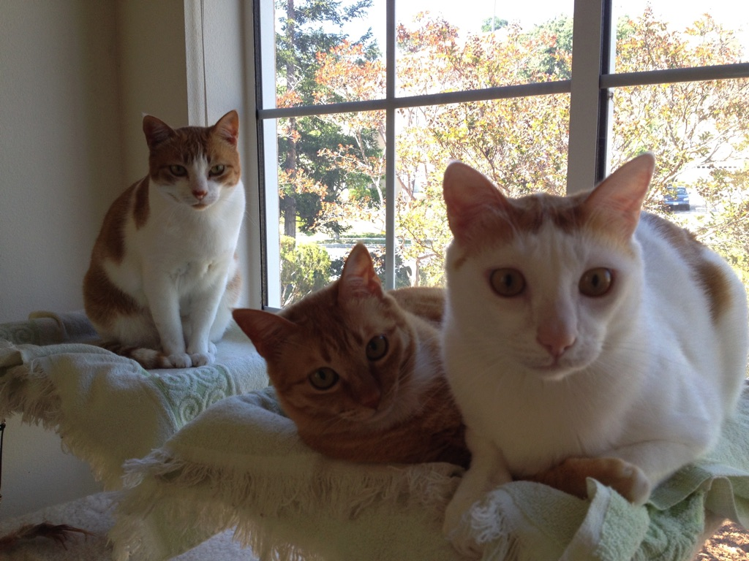
Recursion
A new way to think???
Recursion requires a whole new way of thinking.
Recursion is a required skill for all programmers.

Slide 8
How to Think Recursively
Does this problem contain a simpler but similar case of the problem?
Can I solve the overall problem if I can solve the simpler case?
Is there a simplest case that has an immediate and obvious solution?
The simplest case is called the base case.
There may be more than one base case.

Slide 9
Some Initial Examples of Recursion
We’ll start with some examples of simple problems that we’ll solve using recursion.
Recursion is not the best way to solve these problems.
But these simple problems help us to understand how to use recursion.

Slide 10
Factorials: The Classic Recursion Problem
5! = 5 x 4 x 3 x 2 x 1 = 5 x 4!
Therefore, we can solve 5! if we can solve 4!
4! is a simpler but similar case of the problem.
We can solve 4! = 4 x 3! if we can solve 3!
We can solve 3! = 3 x 2! if we can solve 2!
We can solve 2! = 2 x 1! if we can solve 1!
But by definition, 1! = 1

Slide 11
Factorials, cont’d
But by definition, 1! = 1
That’s the simplest case (base case) with an immediate and obvious solution.
Therefore, 2! = 2 x 1! = 2 x 1 = 2
Therefore, 3! = 3 x 2! = 3 x 2 = 6
Therefore, 4! = 4 x 3! = 4 x 6 = 24
Therefore, 5! = 5 x 4! = 5 x 24 = 120

Slide 12
Factorials, cont’d
Solve n! recursively:
What’s the base case?
1! = 1
What’s the simpler but similar case?
(n-1)!
Note that n-1 is closer to the base case of 1.
Factorial.cpp
int fact(int n)
{
if (n <= 1) return 1;
else return n*fact(n-1);
}
Reaching the base case stops the recursion
and returns an immediate value.

Slide 13
Recursive Multiplication
Solve i x j recursively.
Base cases:
i equals 0: product = 0
i equals 1: product = j
Simpler but similar case:
If we can solve the problem for i-1 (which is closer to 0 and 1), then i x j is j + [(i-1) x j]

Slide 14
Recursive Multiplication, cont’d
Multiply.cpp
long multiply(int i, int j)
{
switch (i)
{
case 0: return 0;
case 1: return j;
default: return j + multiply(i-1, j);
}
}

Slide 15
Iterative Fibonacci
Fibonacci sequence: 1 1 2 3 5 8 13 21 34 55
f_{n} = f_{n-2} + f_{n-1} f₁ = 1 f₂ = 1
An iterative solution:
Fibonacci1.cpp
long fibonacci(int n)
{
if (n <= 2) return 1;
else {
long older = 1;
long old = 1;
long next = 1;
for (int i = 3; i <= n; i++) {
next = older + old;
older = old;
old = next;
}
return next;
}
}

Slide 16
Recursive Fibonacci
According to the definition:
f_{n} = f_{n-2} + f_{n-1} f₁ = 1 f₂ = 1
Fibonacci2.cpp
long fibonacci(int n)
{
if (n <= 2) return 1;
else return fibonacci(n-2) + fibonacci(n-1);
}

Slide 17
Recursive Fibonacci, cont’d
Why does the recursive solution take a long time when n is large?
Let’s trace the recursive calls:
Fibonacci3.cpp
long fibonacci(int n)
{
cout << "Called fibonacci(" << n << ")" << endl;
long f;
if (n <= 2) f = 1;
else f = fibonacci(n-2) + fibonacci(n-1);
cout << "Returning fibonacci(" << n << ") = " << f << endl;
return f;
}

Slide 18
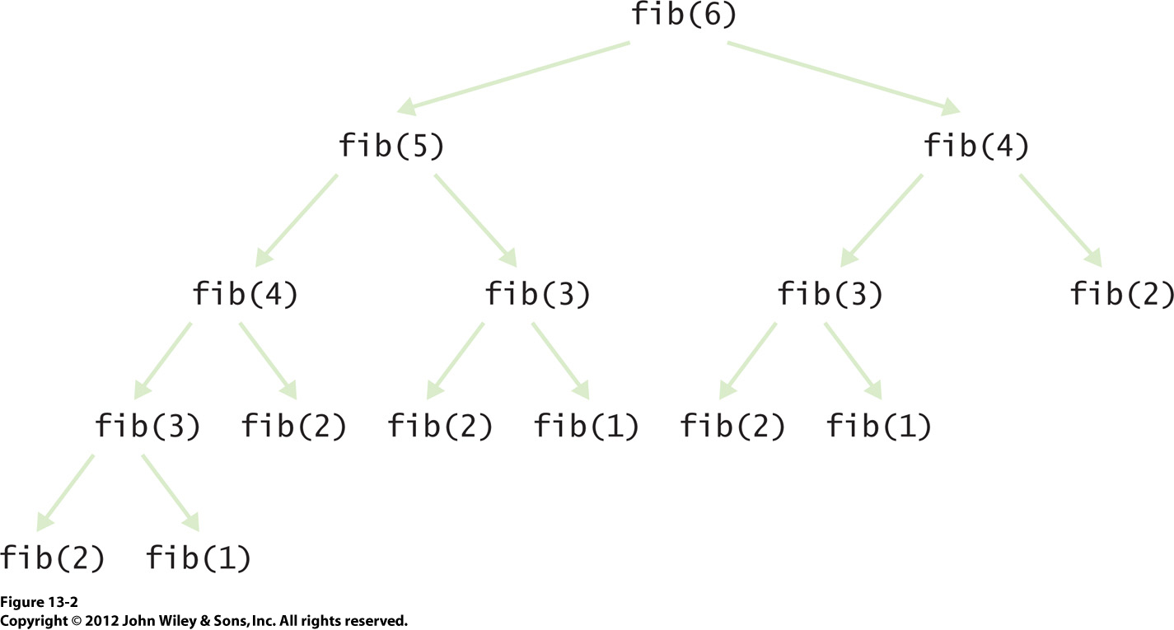
Recursive Fibonacci, cont’d
Recursion is
not always good!

Slide 19
Member of
Given a linked list of n integers, is x in the list?
Base case
The list is empty: x is not in the list.
Simpler but similar case:
Either x is equal to the first element in the list, or x is in the rest of the list.
The rest of the list is one element shorter, so it’s closer to the base case.

Slide 20
Member of, cont’d
bool member_of(const int value, const list<int>& alist,
list<int>::const_iterator it)
{
if (it == alist.end()) return false;
return (*it == value) || member_of(value, alist, ++it);
}
Member.java

Slide 21
Unique
Given a list of n integers in a list, remove all the duplicate values so that what remains is a list of unique values.
Base case
The list is empty or it contains only one value: Just return the list (it’s empty or it has a single unique value).
Simpler but similar case:
Take out the first value. Make the rest of the list unique. Then if the value we took out is not in the rest of the list, put it back. Otherwise, leave it out.

Slide 22
Unique, cont’d
Unique.cpp
void unique(list<int>& alist)
{
if (alist.size() <= 1) return;
int first = alist.front();
alist.erase(alist.begin()); // remove the first element
unique(alist); // make the rest of the list unique
if (!member_of(first, alist, alist.begin()))
{
alist.push_front(first); // put back the first element
}
}

Slide 23
Reverse
Reverse the values of a list of n integers.
Base case
The list is empty or it contains only one value: Just return the list.
Simpler but similar case:
Take out the first value of the list. Reverse the rest of the list. Append the removed value to the end of the reversed rest of the list.

Slide 24
Reverse, cont’d
Reverse.java
void reverse(list<int>& alist)
{
if (alist.size() <= 1) return;
int first = alist.front();
alist.erase(alist.begin()); // remove the first element
reverse(alist); // reverse the rest of the list
alist.push_back(first); // append the first element at the end
}

Slide 25
Quiz
Quiz 2 – 2016 Oct 28

Slide 26
Break

Slide 27
Better Recursion Problems
Some problems are a natural fit for recursion.
They are much more easily solved with recursion than without.

Slide 28
Word Permutations
Given a word, generate all the permutations of the letters of the word.
Example: “eat”: eat eta aet ate tea tae
Base cases
Empty word: No permutations.
Single-letter word: The only permutation is the letter.
Simpler but similar case:
Remove a letter and generate the permutations of the word that’s one letter shorter.
Prepend the removed letter to each permutation.

Slide 29
Word Permutations, cont’d
vector<string> generate_permutations(string word)
{
vector<string> permutations;
// Base case: Return an empty vector.
if (word.length() == 0) return permutations;
// Base case: Return a vector with a one-letter word.
if (word.length() == 1)
{
permutations.push_back(word);
return permutations;
}

Slide 30
Word Permutations, cont’d
// Simpler but similar case.
else
{
for (int i = 0; i < word.length(); i++)
{
char removed_letter = word[i];
string shorter_word = word.substr(0, i) + word.substr(i + 1);
vector<string> shorter_permutations =
generate_permutations(shorter_word);
for (string shorter_perm : shorter_permutations)
{
permutations.push_back(removed_letter + shorter_perm);
}
}
return permutations;
}
}

Slide 31
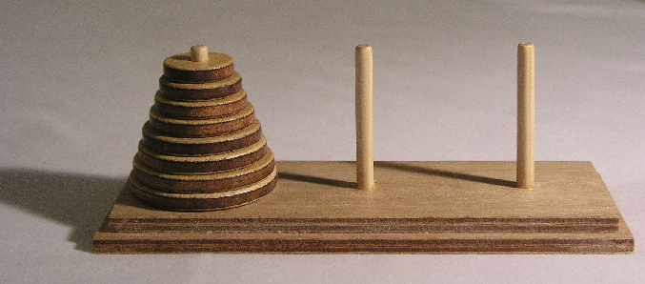
Towers of Hanoi
Goal: Move the stack of disks from the source pin to the destination pin.
You can move only one disk at a time.
You cannot put a larger disk on top of a smaller disk.
Use the third pin for temporary disk storage.
Animation: http://towersofhanoi.info/Animate.aspx

Slide 32
Towers of Hanoi, cont’d
Label the pins A, B, and C. Initial roles:
A: source
B: destination
C: temporary
Base case: n = 1 disk
Move disk from A to B (source ➔ destination)
Simpler but similar case: n-1 disks
Solve for n-1 disks: A to C (source ➔ temp)
Move 1 disk from A to B (source ➔ destination)
Solve for n-1 disks: C to B (temp ➔ destination)
During recursive calls, the pins
will assume different roles.

Slide 33
Towers of Hanoi, cont’d
Hanoi.cpp
enum Pin { A = 'A', B = 'B', C = 'C' };
void solve(const int n, const Pin source, const Pin temp, const Pin dest);
void move(const Pin from, const Pin to);
int main()
{
int n;
cout << "Number of disks? ";
cin >> n;
cout << "Solve for " << n << " disks:" << endl << endl;
solve(n, Pin::A, Pin::B, Pin::C);
}
void move(Pin from, Pin to)
{
cout << "Move disk from " << static_cast<char>(from)
<< " to " << static_cast<char>(to) << endl;
}

Slide 34
Towers of Hanoi, cont’d
Solve n disks (source = A, destination = B)
Solve for n-1 disks: A to C (source ➔ temp)
Move 1 disk from A to B (source ➔ destination)
Solve for n-1 disks: C to B (temp ➔ destination)
void solve(const int n, const Pin source, const Pin dest, const Pin temp)
{
if (n > 0)
{
solve(n-1, source, temp, dest); // solve source ==> temp
move(source, dest); // move 1 disk source ==> dest
solve(n-1, temp, dest, source); // solve temp ==> dest
}
}
Hanoi.cpp

Slide 35
Linear Search
Search for a target value in an array of n elements.
The array is not sorted in any way.
What choices do we have?
Look at all the elements one at a time.
On average, you have to examine half of the array.

Slide 36
Binary Search
Now assume the array is sorted.
Smallest value to largest value.
First check the middle element.
Is the target value smaller than the middle element?
If so, search the first half of the array.
Is the target value larger than the middle element?
If so, search the second half of the array.

Slide 37
Binary Search, cont’d
The binary search keeps cutting in half the part of the array it’s searching.
Next search either the first half or the second half.
Eventually, you’ll either find the target value, or conclude that the value is not in the array.
The order of growth of the number of steps in a binary search is expressed O(log₂ n)
To search 1000 elements, it takes < 10 steps.
Computer science logarithms are by default base 2.
Big-O notation

Slide 38
Iterative Binary Search
It’s easy to write an iterative binary search:
int search(int value, vector<int> v, int low, int high)
{
while (low <= high) {
int mid = (low + high)/2;
if (value == v[mid]) {
return mid;
}
else if (value < v[mid]) {
high = mid-1;
}
else {
low = mid+1;
}
}
return -1;
}
Get the midpoint of the subrange.
Found the target value?
Search the first half next.
Search the second half next.
The target value is not in the array.
BinarySearchIterative.cpp

Slide 39
Elegant Recursion
Al though an iterative solution may be more efficient, sometimes a recursive solution is more elegant.

Slide 40
Recursive Binary Search
A binary search can be done recursively:
int search(int value, vector<int> v, int low, int high)
{
if (low <= high) {
int mid = (low + high)/2;
if (value == v[mid]) {
return mid;
}
else if (value < v[mid]) {
return search(value, v, low, mid-1);
}
else {
return search(value, v, mid+1, high);
}
}
return -1;
}
Get the midpoint of the subrange.
Found the target value?
Search the first half.
Search the second half.
The target value is not in the subrange.
BinarySearchRecursive.cpp

Slide 41
Mutual Recursion
Mutual recursion occurs when a set of cooperating functions call each other.
Example: func_a ➔ func_b ➔ func_c ➔ func_a
Suppose we want to write a program that can read and evaluate arithmetic expressions:
Example:
Expression? (4*(8 - (2*3 - 1)))/6 =
2

Slide 42
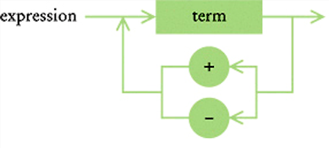
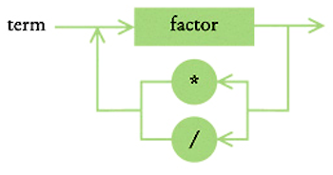
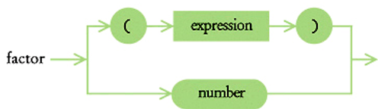
Mutual Recursion, cont’d
The following syntax diagrams specify that
An expression is composed of one or more terms separated by the operators + or –
A term is composed of one or more factors separated by the operator * or /
A factor is either a number or a parenthesized expression.

Slide 43
Mutual Recursion, cont’d
If we write functions expression, term, and factor, they will be mutually recursive:
expression ➔ term ➔ factor ➔ expression

Slide 44
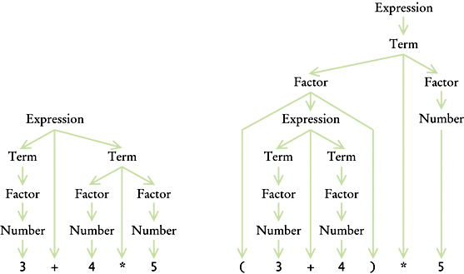
Mutual Recursion, cont’d
We can decompose expressions based on the syntax diagrams:
Note how the
syntax diagrams
determine the
operator precedence.

Slide 45
Assignment #10. Calculator
Write a program that repeatedly prompts you to type an arithmetic expression.
Use the diagrams to determine the syntax.
A number should be a double in any valid form.
End each expression with a equal sign.
Ignore all blanks.
Evaluate and print the value of each expression.
An input line containing only a period should terminate the program.

Slide 46
Assignment #10. Calculator, cont’d
Perform basic syntax error checking.
Unexpected input characters.
Unbalanced parentheses.
Missing = at the end of an expression.
And runtime error checking.
Division by zero.
Stop evaluating upon encountering an error.
Output an appropriate error message.
Prompt for the next expression.

Slide 47
Assignment #10. Calculator, cont’d
The assignment write-up and sample output will be available shortly.
Due Thursday, April 13 at 5:30 PM.

Slide 48
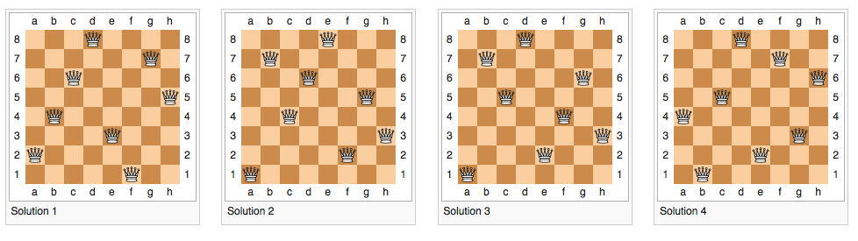
The Queens Problem
Place queens on a chessboard such that no queen can attack another.
Solve with recursion and backtracking.
https://en.wikipedia.org/wiki/Eight_queens_puzzle

Slide 49
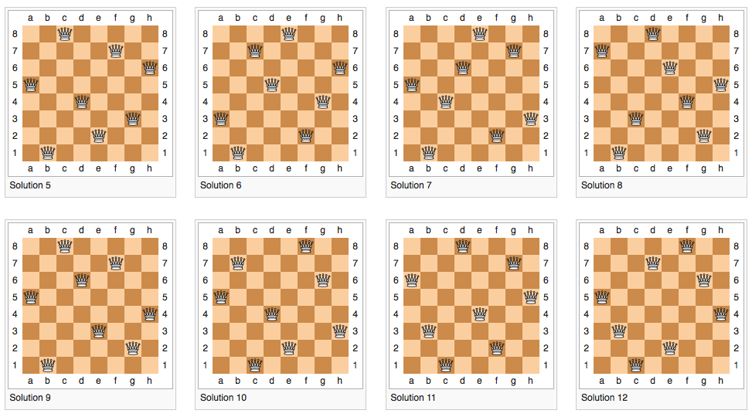
The Queens Problem, cont’d
https://en.wikipedia.org/wiki/Eight_queens_puzzle

Slide 50
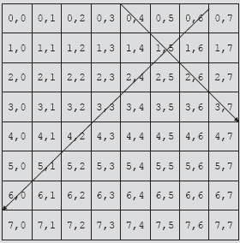
Safe Queen Positions
For each queen, check that it isn’t in the same row, column, or diagonal as another queen.
Data Structures Using C++, 2nd ed.
by D.S. Malik
Cengage Learning, 2010

Slide 51


Backtracking
Backtrack when reaching a dead end.
Example dead end with 4 queens:
Example solution with 4 queens:
(1,3,0,2)
Data Structures Using C++, 2nd ed.
by D.S. Malik
Cengage Learning, 2010

Slide 52
Backtracking Algorithm
Find problem solutions by constructing partial solutions using recursion.
Ensure that a partial solution does not violate requirements.
Extend a partial solution toward completion.
If a partial solution does not lead to a solution (i.e., it’s a dead end):
Back up
Remove most recently added part
Try other possibilities
See Malik,
pp. 376-383.

