Slide 1


CMPE 180-92 Data Structures and Algorithms in C++ April 27 Class Meeting
Department of Computer Engineering San Jose State University Spring 2017 Instructor: Ron Mak
www.cs.sjsu.edu/~mak

Slide 2
Assignment #12: Solution
Element
Node
InsertionSort::run_sort_algorithm()
ShellSortOptimal::run_sort_algorithm()
ShellSortSuboptimal::run_sort_algorithm()
QuickSorter::quicksort()
QuickSorter::partition()
QuickSortOptimal::choose_pivot_strategy()
QuickSortSuboptimal::choose_pivot_strategy()
MergeSort::mergesort()
MergeSort::merge()
LinkedList::split()
LinkedList::concatenate()

Slide 3
Trees
A tree is a collection of nodes:
One node is the root node.
A node contains data and has pointers (possibly null) to other nodes, its children.
The pointers are directed edges.
Each child node can itself be the root of a subtree.
A leaf node is a node that has no children.
Each node other than the root node has exactly one parent node.
Data Structures and Algorithm
Analysis in C++, 4th ed.
by Mark Allen Weiss
Pearson Education, Inc., 2014

Slide 4
Trees, cont’d
Data Structures and Algorithm
Analysis in C++, 4th ed.
by Mark Allen Weiss
Pearson Education, Inc., 2014
The path from node n₁ to node n_{k} is the sequence of nodes in the tree from n₁ to n_{k}.
What is the path from A to Q? From E to P?
The length of a path is the number of its edges.
What is the length of the path from A to Q?

Slide 5
Trees, cont’d
The depth of a node is the length of the path from the root to that node.
What is the depth of node J? Of the root node?
Data Structures and Algorithm
Analysis in C++, 4th ed.
by Mark Allen Weiss
Pearson Education, Inc., 2014

Slide 6
Trees, cont’d
The height of a node is the length of the longest path from the node to a leaf node.
What is the height of node E? Of the root node?
Depth of a tree = depth of its deepest node = height of the tree
Data Structures and Algorithm
Analysis in C++, 4th ed.
by Mark Allen Weiss
Pearson Education, Inc., 2014

Slide 7
Tree Implementation
In general, a tree node can have an arbitrary number of child nodes.
Therefore, each tree node should have
a link to its first child, and
a link to its next sibling:
struct TreeNode
{
Object element;
TreeNode *firstChild;
TreeNode *nextSibling;
}

Slide 8
Tree Implementation, cont’d
Conceptual view of a tree:
Implementation view of the same tree:
Data Structures and Algorithm
Analysis in C++, 4th ed.
by Mark Allen Weiss
Pearson Education, Inc., 2014

Slide 9
Tree Traversals
There are several different algorithms to “walk” or “traverse” a tree.
Each algorithm determines a unique order that each and every node in the tree is “visited”.

Slide 10
Preorder Tree Traversal
First visit a node.
Visit the node before (pre) visiting its child nodes.
Then recursively visit each of the node’s child nodes in sibling order.

Slide 11
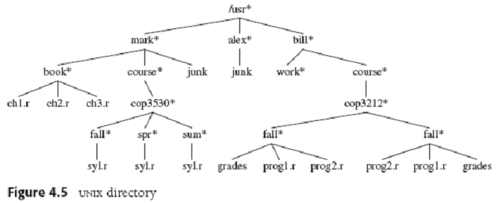
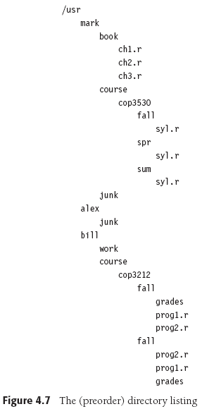
Preorder Tree Traversal, cont’d
void FileSystem::listAll(int depth = 0) const
{
printName(depth);
if (isDirectory())
{
for each file f in this directory
{
f.listAll(depth + 1);
}
}
}
Data Structures and Algorithm
Analysis in C++, 4th ed.
by Mark Allen Weiss
Pearson Education, Inc., 2014

Slide 12
Postorder Tree Traversal
First recursively visit each of a node’s child nodes in sibling order.
Then visit the node itself.

Slide 13
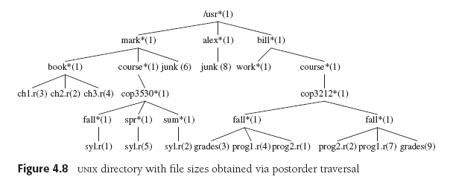
Postorder Tree Traversal, cont’d
int FileSystem::size() const
{
int totalSize = sizeOfThisFile();
if (isDirectory())
{
for each file f in directory
{
totalSize += f.size();
}
}
return totalSize;
}
Data Structures and Algorithm
Analysis in C++, 4th ed.
by Mark Allen Weiss
Pearson Education, Inc., 2014

Slide 14
Binary Trees
A binary tree is a tree where each node can have 0, 1, or 2 child nodes.
Data Structures and Algorithm
Analysis in C++, 4th ed.
by Mark Allen Weiss
Pearson Education, Inc., 2014

Slide 15
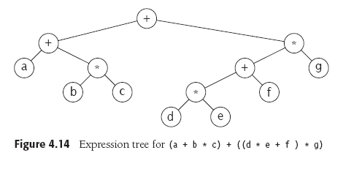
Binary Trees, cont’d
An arithmetic expression tree:
Data Structures and Algorithm
Analysis in C++, 4th ed.
by Mark Allen Weiss
Pearson Education, Inc., 2014

Slide 16
Conversion from Infix to Postfix Notation
Do a postorder walk of our expression tree to output the expression in postfix notation:
abc*+de*f+g*+
Data Structures and Algorithm
Analysis in C++, 4th ed.
by Mark Allen Weiss
Pearson Education, Inc., 2014

Slide 17
Binary Search Trees
A binary search tree (BST) has these properties for each of its nodes:
All the values in the node’s left subtree are less than the value of the node itself.
All the values in the node’s right subtree are greater than the value of the node itself.
Data Structures and Algorithm
Analysis in C++, 4th ed.
by Mark Allen Weiss
Pearson Education, Inc., 2014

Slide 18
Inorder Tree Traversal
Recursively visit a node’s left subtree.
Visit the node itself.
Recursively visit the node’s right subtree.
If you do an inorder walk of a binary search tree, you will visit the nodes in sorted order.

Slide 19
Inorder Tree Traversal, cont’d
An inorder walk of the left tree visits the nodes in sorted order: 1 2 3 4 6 8
Data Structures and Algorithm
Analysis in C++, 4th ed.
by Mark Allen Weiss
Pearson Education, Inc., 2014

Slide 20
The Binary Search Tree ADT
The node class of our binary search tree ADT.
template <class Comparable>
class BinaryNode
{
public:
BinaryNode(Comparable data);
BinaryNode(const Comparable& data, BinaryNode *left, BinaryNode *right);
virtual ~BinaryNode();
Comparable data;
BinaryNode *left;
BinaryNode *right;
};

Slide 21
The Binary Search Tree ADT, cont’d
template <typename Comparable>
class BinarySearchTree
{
public:
BinarySearchTree();
BinarySearchTree(const BinarySearchTree& rhs);
virtual ~BinarySearchTree();
BinarySearchTree& operator=(const BinarySearchTree& rhs);
BinaryNode<Comparable> *getRoot() const;
int height();
const Comparable &findMin() const;
const Comparable &findMax() const;
void clear();
bool isEmpty() const;
bool contains(const Comparable& data) const;
void insert(const Comparable data);
void remove(const Comparable& data);
...

Slide 22
The Binary Search Tree ADT, cont’d
...
protected:
virtual int height(BinaryNode<Comparable> *ptr);
virtual void insert(const Comparable& data, BinaryNode<Comparable>* &ptr);
virtual void remove(const Comparable& data, BinaryNode<Comparable>* &ptr);
private:
BinaryNode<Comparable> *root;
BinaryNode<Comparable> *findMin(BinaryNode<Comparable> *ptr) const;
BinaryNode<Comparable> *findMax(BinaryNode<Comparable> *ptr) const;
void clear(BinaryNode<Comparable>* &ptr);
bool contains(const Comparable& data, BinaryNode<Comparable> *ptr) const;
};

Slide 23
The Binary Search Tree: Min and Max
Finding the minimum and maximum values in a binary search tree is easy.
The leftmost node has the minimum value.
The rightmost node has the maximum value.
You can find the minimum and maximum values recursively or (better) iteratively.

Slide 24
The Binary Search Tree: Min and Max, cont’d
Recursive code to find the minimum value.
Chase down the left child links.
The minimum is the leftmost child.
template <typename Comparable>
BinaryNode<Comparable>
*BinarySearchTree<Comparable>::findMin(BinaryNode<Comparable> *ptr) const
{
if (ptr == nullptr) return nullptr;
if (ptr->left == nullptr) return node;
return findMin(ptr->left);
}

Slide 25
The Binary Search Tree: Min and Max, cont’d
Iterative code to find the maximum value.
Chase down the right child links.
The maximum is the rightmost child.
template < template <typename Comparable>
BinaryNode<Comparable>
*BinarySearchTree<Comparable>::findMax(BinaryNode<Comparable> *ptr) const
{
if (ptr != nullptr)
{
while(ptr->right != nullptr) ptr = ptr->right;
}
return ptr;
}

Slide 26
The Binary Search Tree: Contains
Does a binary search tree contain a target value?
Search recursively starting at the root node:
If the target value is less than the node’s value, then search the node’s left subtree.
If the target value is greater than the node’s value, then search the node’s right subtree.
If the values are equal, then yes, the target value is contained in the tree.
If you “run off the bottom” of the tree, then no, the target value is not contained in the tree.

Slide 27
The Binary Search Tree: Contains, cont’d
template < template <typename Comparable>
bool BinarySearchTree<Comparable>::contains(const Comparable& data,
BinaryNode<Comparable> *ptr) const
{
while (ptr != nullptr)
{
if (data < ptr->data)
{
ptr = ptr->left;
}
else if (data > ptr->data)
{
ptr = ptr->right;
}
else
{
return true; // found
}
}
return false; // not found
}

Slide 28
The Binary Search Tree: Insert
To insert a target value into the tree:
Proceed as if you are checking whether the tree contains the target value.
As you’re recursively examining left and right subtrees, if you encounter a null link (either a left link or a right link), then that’s where the new value should be inserted.
Create a new node containing the target value and replace the null link with a link to the new node.
So the new node is attached to the last-visited node.

Slide 29
The Binary Search Tree: Insert, cont’d
If the target value is already in the tree, either:
Insert a duplicate value into the tree.
Don’t insert but “update” the existing node.

Slide 30
The Binary Search Tree: Insert
Data Structures and Algorithm
Analysis in C++, 4th ed.
by Mark Allen Weiss
Pearson Education, Inc., 2014

Slide 31
The Binary Search Tree: Insert
template < template <typename Comparable>
void BinarySearchTree<Comparable>::insert(const Comparable& data,
BinaryNode<Comparable>* &ptr)
{
if (ptr == nullptr)
{
ptr = new BinaryNode<Comparable>(data);
}
else if (data < ptr->data)
{
insert(data, ptr->left);
}
else if (data > ptr->data)
{
insert(data, ptr->right);
}
}
ptr passed
by reference
Create a new node
only when a null link is encountered.
Attach the newly created node to
the last-visited node (pass the
pointers by reference).

Slide 32
The Binary Search Tree: Remove
After removing a node from a binary search tree, the remaining nodes must still be in order.
No child case: The target node to be removed is a leaf node.
Just remove the target node.

Slide 33
The Binary Search Tree: Remove, cont’d
One child case: The target node to be removed has one child node.
Change the parent’s link to the target node to point instead to the target node’s child.
Data Structures and Algorithm
Analysis in C++, 4th ed.
by Mark Allen Weiss
Pearson Education, Inc., 2014

Slide 34
The Binary Search Tree: Remove, cont’d
Two children case: The target node to be removed has two child nodes.
This is the complicated case.
How do we restructure the tree so that the order of the node values is preserved?

Slide 35
The Binary Search Tree: Remove, cont’d
Recall what happens you remove a list node.
Assume that the list is sorted.
If we delete target node 5, which node takes its place?
The replacement node is the node that is immediately after the target node in the sorted order.
0
1
2
3
4
5
6
7
8
9
0
1
2
3
4
6
7
8
9

Slide 36
The Binary Search Tree: Remove, cont’d
A somewhat convoluted way to do this:
Replace the target node’s value with the successor node’s value.
Then remove the successor node, which is now “empty”.
0
1
2
3
4
5
6
7
8
9
0
1
2
3
4
6
7
8
9
0
1
2
3
4
6
7
8
9

Slide 37
The Binary Search Tree: Remove, cont’d
0
1
2
3
4
5
6
7
8
9
0
1
2
3
4
6
7
8
9
0
1
2
3
4
6
7
8
9
The same convoluted process happens when you remove a node from a binary search tree.
The successor node is the node that is immediately after the deleted node in the sorted order.
Replace the target node’s value with the successor node’s value.
Remove the successor node, which is now “empty”.

Slide 38
The Binary Search Tree: Remove, cont’d
If you have a target node in a binary search tree, where is the node that is its immediate successor in the sort order?
The successor’s value is ≥ than the target value.
It must be the minimum value in the right subtree.
General idea:
Replace the value in the target node with the value of the successor node.
The successor node is now “empty”.
Recursively delete the successor node.

Slide 39
The Binary Search Tree: Remove, cont’d
X
X
The second deletion
is easy because the node
never has a left child.
Replace the value of the target node 2 with the value of the successor node 3.
Now recursively remove node 3.
Data Structures and Algorithm
Analysis in C++, 4th ed.
by Mark Allen Weiss
Pearson Education, Inc., 2014

Slide 40
The Binary Search Tree: Remove, cont’d
template < template <typename Comparable>
void BinarySearchTree<Comparable>::remove(const Comparable& data,
BinaryNode<Comparable>* &ptr)
{
if (ptr == nullptr) return;
if (data < ptr->data)
{
remove(data, ptr->left);
}
else if (data > ptr->data)
{
remove(data, ptr->right);
}
else if ( (ptr->left != nullptr)
&& (ptr->right != nullptr))
{
ptr->data = findMin(ptr->right)->data;
remove(ptr->data, ptr->right);
}
else
{
BinaryNode<Comparable> *oldNode = ptr;
ptr = (ptr->left != nullptr) ? ptr->left
: ptr->right;
delete oldNode;
}
}
ptr passed
by reference
Item not found: do nothing.
Search left.
Search right.
Two children:
Replace the target value
with the successor value.
Then recursively remove
the successor node.
No children or one child.

Slide 41
The Binary Search Tree Animations
Download Java applets from http://www.informit.com/content/images/0672324539/downloads/ExamplePrograms.ZIP
These are from the book Data Structures and Algorithms in Java, 2nd edition, by Robert LaFlore: http://www.informit.com/store/data-structures-and-algorithms-in-java-9780672324536
The binary search tree applet is in Chap08/Tree
Run with the appletviewer application that is in your java/bin directory: appletviewer Tree.html

Slide 42
Break

Slide 43
AVL Trees
An AVL tree is a binary search tree (BST) with a balance condition.
Named after its inventors, Adelson-Velskii and Landis.
For each node of the BST, the heights of its left and right subtrees can differ by at most 1.
Remember that the height of a tree is the length of the longest path from the root to a leaf.
The height of the root = the height of the tree.
The height of an empty tree is -1.

Slide 44
AVL Trees, cont’d
Data Structures and Algorithm
Analysis in C++, 4th ed.
by Mark Allen Weiss
Pearson Education, Inc., 2014

Slide 45
Balancing AVL Trees
We need to rebalance the tree whenever the balance condition is violated.
Check after every insertion and deletion.
Data Structures and Algorithm
Analysis in C++, 4th ed.
by Mark Allen Weiss
Pearson Education, Inc., 2014

Slide 46
Balancing AVL Trees, cont’d
Assume the tree was balanced before an insertion.
If it became unbalanced due to the insertion, then the inserted node must have caused some nodes between itself and the root to be unbalanced.
An unbalanced node must have the height of one of its subtrees exactly 2 greater than the height its other subtree.

Slide 47
Balancing AVL Trees, cont’d
Let the deepest unbalanced node be α.
Any node has at most two children.
A new height imbalance means that the heights of α’s two subtrees now differ by 2.
α
α
1
2
3
4

Slide 48
Balancing AVL Trees, cont’d
α
Therefore, one of the following had to occur:
Case 1 (outside left-left): The insertion was into the left subtree of the left child of α.
Case 2 (inside left-right): The insertion was into the right subtree of the left child of α.
Case 3 (inside right-left): The insertion was into the left subtree of the right child of α.
Case 4 (outside right-right): The insertion was into the right subtree of the right child of α.
1
2
3
4
Cases 1 and 4 are mirrors of each other,
and cases 2 and 3 are mirrors of each other.

Slide 49
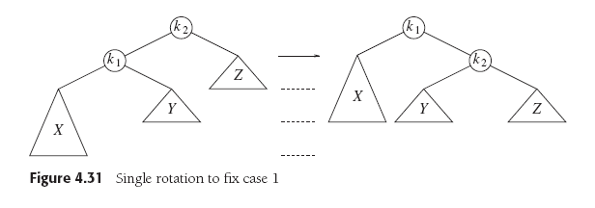
Balancing AVL Trees: Case 1
Case 1 (outside left-left): Rebalance with a single right rotation.
Data Structures and Algorithm
Analysis in C++, 4th ed.
by Mark Allen Weiss
Pearson Education, Inc., 2014

Slide 50
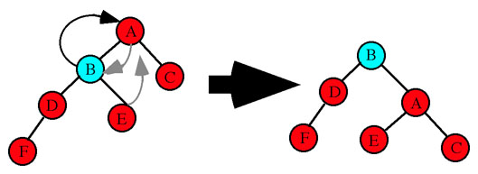
Balancing AVL Trees: Case 1, cont’d
Case 1 (outside left-left): Rebalance with a single right rotation.
Node A is unbalanced.
Single right rotation: A's left
child B becomes the new
root of the subtree.
Node A becomes the right
child and adopts B's right child
as its new left child.
Node 8 is unbalanced.
Single right rotation: 8's left
child 7 becomes the new
root of the subtree.
Node 8 is the right child.
http://www.cs.uah.edu/~rcoleman/CS221/Trees/AVLTree.html
Data Structures and Algorithm
Analysis in C++, 4th ed.
by Mark Allen Weiss
Pearson Education, Inc., 2014

Slide 51
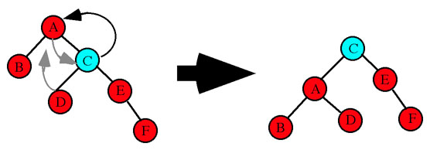
Balancing AVL Trees: Case 4
Case 4 (outside right-right): Rebalance with a single left rotation.
Data Structures and Algorithm
Analysis in C++, 4th ed.
by Mark Allen Weiss
Pearson Education, Inc., 2014
Node A is unbalanced.
Single left rotation: A's right
child C becomes the new
root of the subtree.
Node A becomes the left
child and adopts C's left child
as its new right child.
http://www.cs.uah.edu/~rcoleman/CS221/Trees/AVLTree.html

Slide 52
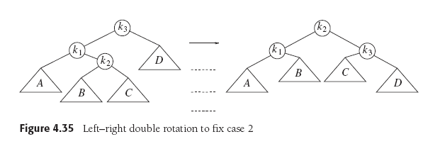
Balancing AVL Trees: Case 2
Case 2 (inside left-right): Rebalance with a double left-right rotation.
Data Structures and Algorithm
Analysis in C++, 4th ed.
by Mark Allen Weiss
Pearson Education, Inc., 2014

Slide 53
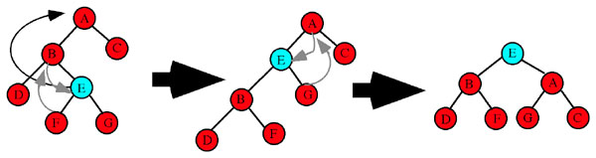
Balancing AVL Trees: Case 2, cont’d
Case 2 (inside left-right): Rebalance with a double left-right rotation.
http://www.cs.uah.edu/~rcoleman/CS221/Trees/AVLTree.html
Node A is unbalanced.
Double left-right rotation: E becomes the new root of the subtree after two rotations. Step 1 is a single left rotation between B and E. E replaces B as the subtree root. B becomes E's left child and B adopts E's left child F as its new right child. Step 2 is a single right rotation between E and A. E replaces A is the subtree root. A becomes E's right child and A adopts E's right child G as its new left child.

Slide 54
Balancing AVL Trees: Case 3
Case 3 (inside right-left): Rebalance with a double right-left rotation.
Data Structures and Algorithm
Analysis in C++, 4th ed.
by Mark Allen Weiss
Pearson Education, Inc., 2014

Slide 55
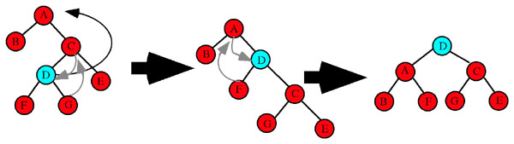
Balancing AVL Trees: Case 3, cont’d
http://www.cs.uah.edu/~rcoleman/CS221/Trees/AVLTree.html
Case 3 (inside right-left): Rebalance with a double right-left rotation.
Node A is unbalanced.
Double right-left rotation: D becomes the new root of the subtree after two rotations. Step 1 is a single right rotation between C and C. D replaces C as the subtree root. C becomes D's right child and C adopts D's right child G as its new left child. Step 2 is a single left rotation between D and A. D replaces A is the subtree root. A becomes D's left child and A adopts D's left child F as its new right child.

Slide 56
AVL Tree Implementation
Since an AVL tree is just a BST with a balance condition, it makes sense to make the AVL tree class a subclass of the BST class.
Both classes can share the same BinaryNode class.
template <class Comparable>
class AvlTree : public BinarySearchTree<Comparable>

Slide 57
The AVL Tree Node
With so many height calculations, it makes sense to store each node's height in the node itself.
template <class Comparable>
class BinaryNode
{
public:
BinaryNode(Comparable data);
BinaryNode(const Comparable& data, BinaryNode *left, BinaryNode *right);
virtual ~BinaryNode();
Comparable data;
int height; // node height
BinaryNode *left;
BinaryNode *right;
};

Slide 58
AVL Tree Implementation, cont’d
Class AVLTree overrides the insert() and remove() methods of class BinarySearchTree.
Each method calls the superclass's method and then passes the node to the balance() method.
template <class Comparable>
void AvlTree<Comparable>::insert(const Comparable& data, BinaryNode<Comparable>* &ptr)
{
BinarySearchTree<Comparable>::insert(data, ptr);
balance(ptr);
}
template <class Comparable>
void AvlTree<Comparable>::remove(const Comparable& data, BinaryNode<Comparable>* & ptr)
{
BinarySearchTree<Comparable>::remove(data, ptr);
balance(ptr);
}

Slide 59
AVL Tree Implementation, cont’d
The private AVLTree method balance() checks whether the balance condition still holds, and rebalances the tree with rotations whenever necessary.

Slide 60
AVL Tree Implementation, cont’d
template <class Comparable>
BinaryNode<Comparable> *AvlTree<Comparable>::balance(BinaryNode<Comparable>* &ptr)
{
if (ptr == nullptr) return ptr;
// Left side too high.
if (height(ptr->left) - height(ptr->right) > 1)
{
if (height(ptr->left->left)
>= height(ptr->left->right))
{
ptr = singleRightRotation(ptr);
cout << " --- Single right rotation at "
<< ptr->data << endl;
}
else
{
ptr = doubleLeftRightRotation(ptr);
cout << " --- Double left-right rotation at "
<< ptr->data << endl;
}
}
...
Case 1
Case 2

Slide 61
AVL Tree Implementation, cont’d
...
// Right side too high.
else if (height(ptr->right) - height(ptr->left) > 1)
{
if (height(ptr->right->right)
>= height(ptr->right->left))
{
ptr = singleLeftRotation(ptr);
cout << " --- Single left rotation at "
<< ptr->data << endl;
}
else
{
ptr = doubleRightLeftRotation(ptr);
cout << " --- Double right-left rotation at "
<< ptr->data << endl;
}
}
// Recompute the node's height.
node->height = (max(height(node->left),
height(node->right)) + 1);
return node;
}
Case 4
Case 3

Slide 62
Assignment #13
This assignment will give you practice with binary search trees (BST) and AVL trees.
You are provided a TreePrinter class that has a print() method that will print any arbitrary binary tree.
A template for how it prints a tree:
xx
/\
------------------------------ ------------------------------
/ \
xx xx
/\ /\
-------------- -------------- -------------- --------------
/ \ / \
xx xx xx xx
/\ /\ /\ /\
------ ------ ------ ------ ------ ------ ------ ------
/ \ / \ / \ / \
xx xx xx xx xx xx xx xx
/\ /\ /\ /\ /\ /\ /\ /\
-- -- -- -- -- -- -- -- -- -- -- -- -- -- -- --
/ \ / \ / \ / \ / \ / \ / \ / \
xx xx xx xx xx xx xx xx xx xx xx xx xx xx xx xx
/\ /\ /\ /\ /\ /\ /\ /\ /\ /\ /\ /\ /\ /\ /\ /\
/ \ / \ / \ / \ / \ / \ / \ / \ / \ / \ / \ / \ / \ / \ / \ / \
xx xx xx xx xx xx xx xx xx xx xx xx xx xx xx xx xx xx xx xx xx xx xx xx xx xx xx xx xx xx xx xx

Slide 63
Assignment #13, cont’d
TreePrinter is able to print trees with height up to 5, i.e., 32 node values on the bottom row.
An example of an actual printed tree:
24
/\
-------------- --------------
/ \
18 73
/\ /\
------ ------ ------ ------
/ \ / \
12 19 38 87
/ /\ \
-- -- -- --
/ / \ \
10 37 41 90
\
\
64

Slide 64
Assignment #13: Part 1
The first part of the assignment makes sure that you can successfully insert nodes into, and delete nodes from, a binary search tree (BST) and an AVL tree.

Slide 65
Assignment #13: Part 1, cont’d
First create a BST node by node.
You will be provided the sequence of values to insert into the tree.
Print the tree after each insertion.
The tree will be unbalanced.
Now repeatedly delete the root of the tree.
Print the tree after each deletion.
Stop when the tree becomes empty.

Slide 66
Assignment #13: Part 1, cont’d
Second, create an AVL tree node by node.
Insert the same given sequence of values.
Print the tree after each insertion to verify that you are keeping it balanced.
Each time you do a rebalancing, print a message indicating which rotation operation(s) at which node.
Example:
As you did with the BST, repeatedly delete the root of your AVL tree.
Print the tree after each deletion to verify that you are keeping it balanced.
Inserted node 10:
--- Single right rotation at node 21

Slide 67
Assignment #13: Part 1, cont’d
A handy AVL tree balance checker:
template <class Comparable>
int AvlTree<Comparable>::checkBalance(BinaryNode<Comparable> *ptr)
{
if (ptr == nullptr) return -1;
int leftHeight = checkBalance(ptr->left);
int rightHeight = checkBalance(ptr->right);
if ((abs(height(ptr->left) - height(ptr->right)) > 1)
|| (height(ptr->left) != leftHeight)
|| (height(ptr->right) != rightHeight))
{
return -2; // unbalanced
}
return height(ptr); // balanced
}

Slide 68
Assignment #13: Part 2
The second part of the assignment compares the performance of a BST vs. an AVL tree.
First, generate n random integers.
n is some large number, to be explained.
Insert the random integers one at a time into the BST and AVL trees.

Slide 69
Assignment #13: Part 2, cont’d
For each tree, collect the following statistics:
Probe counts
A probe is whenever you visit a tree node, even if you don't do anything with the node other than use its left or right link to go to a child node.
Comparison counts
A comparison is a probe where you also check the node’s value.
Elapsed time in milliseconds
Do not print the tree after each insertion.
Be sure to count probes and comparisons during AVL tree rotations.

Slide 70
Assignment #13: Part 2, cont’d
Second, generate another n random integer values.
Search the BST and AVL trees for the values one at a time.
Count probes and comparisons and compute elapsed times.
It doesn’t matter whether or not a search succeeds

Slide 71
Assignment #13: Part 2, cont’d
Choose values of n large enough to give you consistent timings that you can compare.
Try values of n = 10,000 to 100,000 in increments of 10,000
Slower machines can use a different range of values for n.

Slide 72
Assignment #13: Part 2, cont’d
Print tables of these statistics for insertion and search with BST and AVL trees as comma-separated values.
Use Excel to create the following graphs, each one containing plots for BST and AVL:
insertion probe counts
insertion compare counts
insertion elapsed time
search probe counts
search compare counts
search elapsed time

Slide 73
Assignment #13, cont’d
Do Part 1 in CodeCheck.
CodeCheck will check your output.
Do Part 2 outside of CodeCheck.
You can use any code from the lectures or from the textbook or from the Web.
Be sure to give proper citations if you use code that you didn’t write yourself.
Names of books, URLs, etc.
Put the citations in your program comments.

