Slide 1


CMPE 180-92 Data Structures and Algorithms in C++ May 11 Class Meeting
Department of Computer Engineering San Jose State University Spring 2017 Instructor: Ron Mak
www.cs.sjsu.edu/~mak

Slide 2
Unofficial Field Trip
Computer History Museum in Mt. View
http://www.computerhistory.org/
Provide your own transportation to the museum.
Saturday, May 20, 11:30 – closing time
Special free admission (for my students only).
Experience a fully restored IBM 1401 mainframe computer from the early 1960s in operation.
Do a self-guided tour of the Revolution exhibit.
New Make/Software: Change the World exhibit.

Slide 3
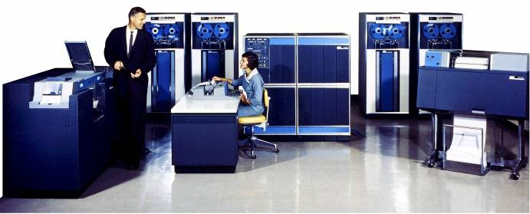
Unofficial Field Trip, cont’d
IBM 1401 computer, fully restored and operational.
A small transistor-based mainframe computer.
Extremely popular with small businesses in the late 1950s through the mid 1960s
Maximum of 16K bytes of memory.
800 card/minute card reader (wire brushes).
600 line/minute line printer (impact).
6 magnetic tape drives, no disk drives.

Slide 4
Unofficial Field Trip, cont’d
Information on the IBM 1401:
General info: http://en.wikipedia.org/wiki/IBM_1401
My summer seminar: http://www.cs.sjsu.edu/~mak/1401/
Restoration: http://ed-thelen.org/1401Project/1401RestorationPage.html

Slide 5
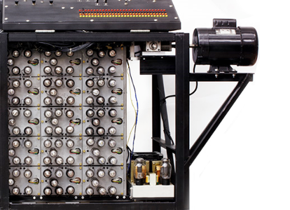
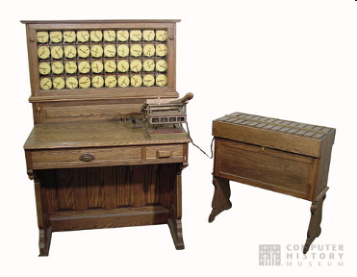
Unofficial Field Trip, cont’d
See the extensive Revolution exhibits!
Walk through a timeline of the First 2000 Years of Computing History.
Historic computer systems, data processing equipment, and other artifacts.
Small theater presentations.
Hollerith
Census
Machine
Atanasoff-Berry
Computer

Slide 6
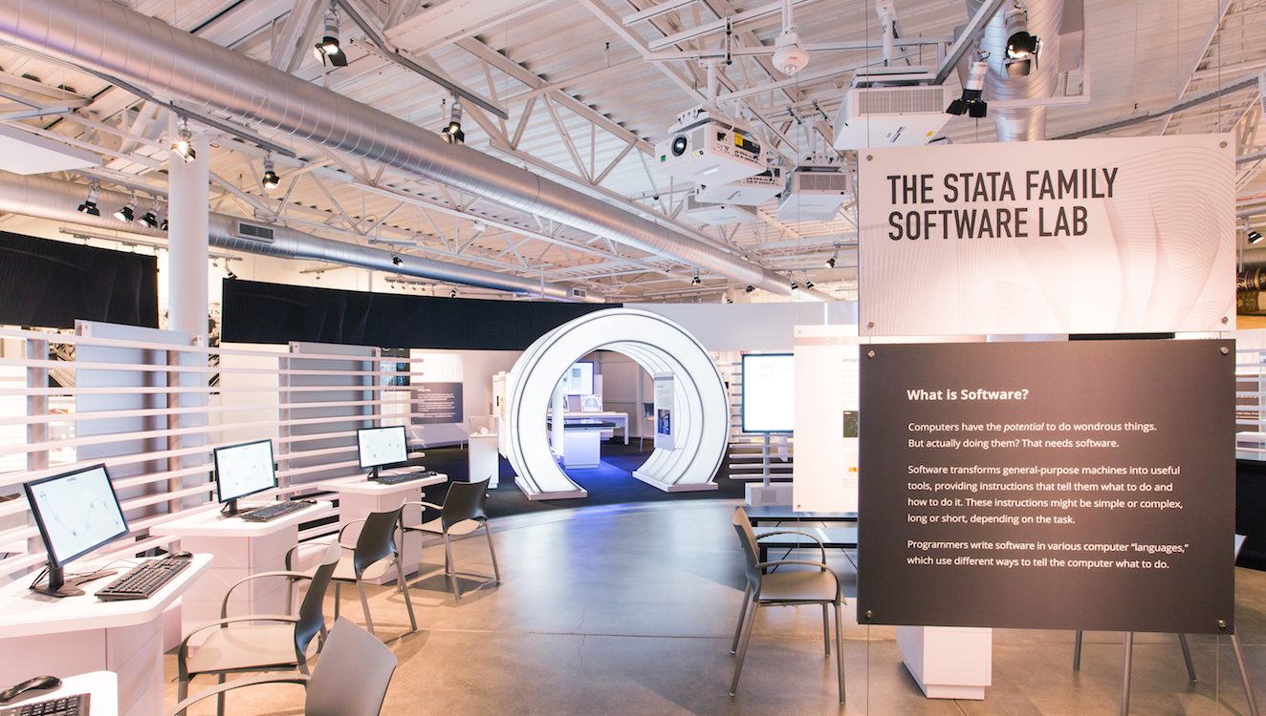
Unofficial Field Trip, cont’d
New Make/Software: Change the World exhibit.
Explore the history, impact, and technology behind seven game-changing applications: MP3, Photoshop, MRI, Car Crash Simulation, Wikipedia, Texting, and World of Warcraft.

Slide 7
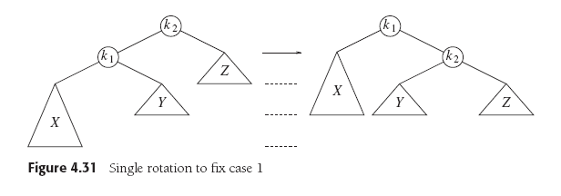
Assignment #13 Part 1 Solution
Case 1 (outside left-left): Rebalance with a single right rotation.
Data Structures and Algorithm
Analysis in C++, 4th ed.
by Mark Allen Weiss
Pearson Education, Inc., 2014

Slide 8
Assignment #13 Part 1 Solution, cont’d
/**
* Case 1 (outside left-left): Rebalance with a single right rotation.
* Update heights and return the new root node.
* @param k2 pointer to the node to rotate.
* @return pointer to the new root node.
*/
BinaryNode *AvlTree::singleRightRotation(BinaryNode *k2)
{
BinaryNode *k1 = k2->left;
// Rotate.
k2->left = k1->right;
k1->right = k2;
// Recompute node heights.
k2->height = (max(height(k2->left), height(k2->right)) + 1);
k1->height = (max(height(k1->left), k2->height) + 1);
return k1;
}
Data Structures and Algorithm
Analysis in C++, 4th ed.
by Mark Allen Weiss
Pearson Education, Inc., 2014

Slide 9
Assignment #13 Part 1 Solution, cont’d
Case 4 (outside right-right): Rebalance with a single left rotation.
Data Structures and Algorithm
Analysis in C++, 4th ed.
by Mark Allen Weiss
Pearson Education, Inc., 2014

Slide 10
Assignment #13 Part 1 Solution, cont’d
/**
* Case 4 (outside right-right): Rebalance with a single left rotation.
* Update heights and return the new root node.
* @param k2 pointer to the node to rotate.
* @return pointer to the new root node.
*/
BinaryNode *AvlTree::singleLeftRotation(BinaryNode *k1)
{
BinaryNode *k2 = k1->right;
// Rotate.
k1->right = k2->left;
k2->left = k1;
// Recompute node heights.
k1->height = (max(height(k1->left), height(k1->right)) + 1);
k2->height = (max(height(k2->right), k1->height) + 1);
return k2;
}
Data Structures and Algorithm
Analysis in C++, 4th ed.
by Mark Allen Weiss
Pearson Education, Inc., 2014

Slide 11
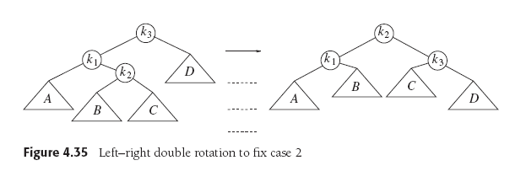
Assignment #13 Part 1 Solution, cont’d
Case 2 (inside left-right): Rebalance with a double left-right rotation.
Data Structures and Algorithm
Analysis in C++, 4th ed.
by Mark Allen Weiss
Pearson Education, Inc., 2014

Slide 12
Assignment #13 Part 1 Solution, cont’d
/**
* Case 2 (inside left-right): Rebalance with a double left-right rotation.
* @param k3 pointer to the node to rotate.
* @return pointer to the new root node.
*/
BinaryNode *AvlTree::doubleLeftRightRotation(BinaryNode *k3)
{
k3->left = singleLeftRotation(k3->left);
return singleRightRotation(k3);
}
Data Structures and Algorithm
Analysis in C++, 4th ed.
by Mark Allen Weiss
Pearson Education, Inc., 2014

Slide 13
Assignment #13 Part 1 Solution, cont’d
Case 3 (inside right-left): Rebalance with a double right-left rotation.
Data Structures and Algorithm
Analysis in C++, 4th ed.
by Mark Allen Weiss
Pearson Education, Inc., 2014

Slide 14
Assignment #13 Part 1 Solution, cont’d
/**
* Case 3 (inside right-left): Rebalance with a double left rotation.
* @param k1 pointer to the node to rotate.
* @return pointer to the new root node.
*/
BinaryNode *AvlTree::doubleRightLeftRotation(BinaryNode *k1)
{
k1->right = singleRightRotation(k1->right);
return singleLeftRotation(k1);
}
Data Structures and Algorithm
Analysis in C++, 4th ed.
by Mark Allen Weiss
Pearson Education, Inc., 2014

Slide 15
Assignment #13 Part 2 Solution

Slide 16
Assignment #13 Part 2 Solution, cont’d

Slide 17
Assignment #13 Part 2 Solution, cont’d

Slide 18
The auto Keyword
In a declaration of a variable that is also being initialized, the compiler can infer the type of the variable from the initialization expression.
type inference, AKA type determination
Use auto instead of a complicated type name.
Examples: Instead of: Use:
vector<int>::iterator current = a_container.begin();
map<string, DistanceToCity>::iterator p = cities.lower_bound(new_city.get_name());
auto current = a_container.begin();
auto p = cities.lower_bound(new_city.get_name());

Slide 19
The decltype Pseudo-Function
Takes a variable as an argument.
Returns the type associated with the variable.
Create another variable with the same type.
Ensure that two variables have the same type.
Example:
map<string, int>::iterator start_point;
decltype(start_point) end_point;

Slide 20
Function Definitions in Header Files
If a member function is small, such as a constructor, a getter, or a setter, you can put its definition inside the class declaration.
You can have definition code in the header file.
Example:
class InlineTest
{
public:
InlineTest(int v) : value(v) {}
int get_value() const { return value; }
void set_value(const int v) { value = v; }
private:
int value;
}
InlineTest1.cpp

Slide 21
Function Definitions in Header Files, cont’d
When you put a member function definition inside the class declaration, the compiler can inline the function code.
Instead of compiling a member function call the usual way, the compiler will instead insert the function code in place of the call.
This will speed execution (since no calls are executed) but increase the size of the compiled code.

Slide 22
The inline Keyword
If you define a member function outside of the class declaration, you can use the inline keyword to ask the compiler to inline the function code.
The compiler may ignore the keyword.
It’s usually better to let the compiler decide what’s best for code optimization.

Slide 23
The inline Keyword, cont’d
class InlineTest2
{
public:
InlineTest2(int v) : value(v) {}
int get_value() const;
void set_value(const int v);
private:
int value;
};
inline int InlineTest2::get_value() const { return value; }
inline void InlineTest2::set_value(const int v) { value = v; }
InlineTest2.cpp

Slide 24
The “Big Three”
Collectively called the “big three” of a class:
overloaded assignment operator
copy constructor
destructor
Rule of thumb: If you define a destructor, you should also define a copy constructor and an overloaded assignment operator.
Ensure that all three perform in a similar fashion.
Do not rely on the default implementations!

Slide 25
The “Big Three”, cont’d
Why does this code crash?
class Array1
{
public:
Array1(int s, int v[]);
~Array1();
private:
int size;
int *vals;
};
Array1::Array1(int s, int v[])
{
size = s;
vals = new int[size];
std::copy(v, v + size, vals);
}
Array1.cpp

Slide 26
The “Big Three”, cont’d
Why does this code crash? cont’d
Array1::~Array1()
{
delete vals;
vals = nullptr;
}
int main()
{
int vals[4] = { 1, 2, 3, 4 };
Array1 a1(4, vals);
Array1 a2(a1);
cout << "Done!" << endl;
return 0;
}
Array1.cpp
What happens when
array a2 goes out of scope?

Slide 27
The “Big Three”, cont’d
Explicitly define a copy constructor:
class Array2
{
public:
Array2(int s, int v[]);
Array2(const Array2& a);
~Array2();
private:
int size;
int *vals;
};
Array2::Array2(const Array2 &a)
{
size = a.size;
vals = new int[a.size];
std::copy(a.vals, a.vals + size, vals);
}
Array2.cpp

Slide 28
The “Big Three”, cont’d
int main()
{
int vals[4] = { 1, 2, 3, 4 };
Array2 a1(4, vals);
Array2 a2(a1);
a1 = a2;
cout << "Done!" << endl;
return 0;
}
Array2.cpp
What happens when
array a1 goes out of scope?

Slide 29
The “Big Three”, cont’d
Overload the assignment operator:
class Array3
{
public:
Array3(int s, int v[]);
Array3(const Array3& a);
~Array3();
Array3& operator =(const Array3& a);
private:
int size;
int *vals;
};
Array3.cpp

Slide 30
The “Big Three”, cont’d
Array3& Array3::operator =(const Array3 &a)
{
if (&a != this)
{
size = a.size;
vals = new int[a.size];
std::copy(a.vals, a.vals + size, vals);
}
return *this;
}
Array3.cpp
This concludes the Big Three!
Recently become the Big Five.
References:
http://www.technical-recipes.com/2011/the-big-three-in-c/
http://www.cppsamples.com/common-tasks/rule-of-five.html

Slide 31
Break

Slide 32
Project Phases
Requirements elicitation
Design
Implementation
Testing
Deployment
Maintenance
How do we accomplish these phases?

Slide 33
Ye Olde Waterfall Model
Requirements
Design
Implementation
Testing

Slide 34
The Waterfall Model, cont’d
Make sure each phase is 100% complete and absolutely correct before proceeding to the next phase.
Big Design Up Front (BDUF)
Set requirements in stone before starting the design.
Otherwise, you might waste design work on “incorrect” requirements.
Spend extra time at the beginning to make sure that the requirements and design are absolutely correct.
Source: Wikipedia article on “Waterfall Model”

Slide 35
The Waterfall Model, cont’d
The waterfall model has been mostly discredited.
It doesn’t work!
But it’s still commonly practiced.
Requirements
Design
Implementation
Testing

Slide 36
The Agile Manifesto for Software Development
We are uncovering better ways of developing software by doing it and helping others do it. Through this work we have come to value:
Individuals and interactions over processes and tools Working software over comprehensive documentation Customer collaboration over contract negotiation Responding to change over following a plan
That is, while there is value in the items on the right, we value the items on the left more.
Source: http://agilemanifesto.org/

Slide 37
Agile Software Development
Iterative and incremental development.
Each iteration is a “mini waterfall”:
plan (with new requirements)
refine design
add new code
unit and integration testing
Iterations are short: weeks rather than months.
Iterations are sometimes called “sprints”.
We do sprints, not marathons!
Requirements
Design
Implementation
Testing

Slide 38
Agile Software Development
The initial iteration produces a conceptual design and a prototype.
Subsequent iterations refine the design and incrementally build the actual product.
Each subsequent iteration may also include a prototype that is quickly produced (rapid prototyping).

Slide 39
Agile Software Development, cont’d
The initial iteration’s prototype and iterative development are the foundation for Rapid Application Development (RAD) tools.
Agile methodologies range from Extreme Programming (XP) to the Rational Unified Process (RUP).

Slide 40
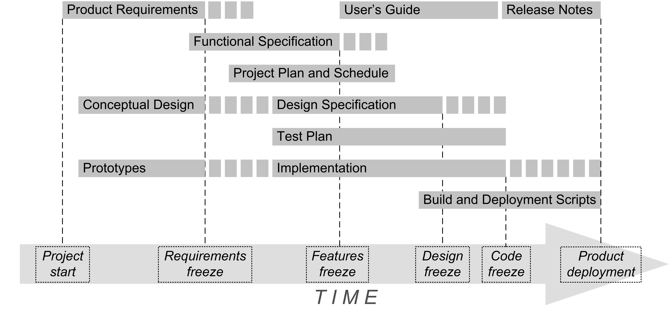
Project Phases, cont’d

Slide 41
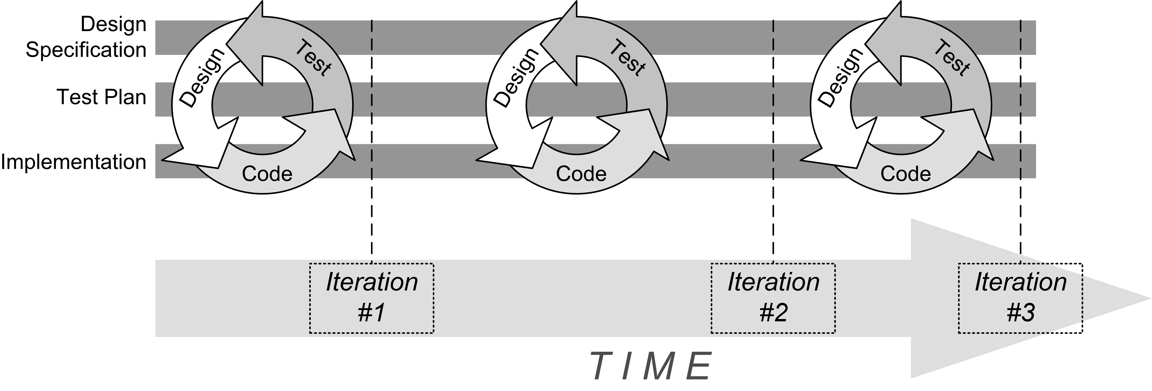
Project Phases, cont’d
Development is a series of iterations.
Each iteration is a “mini waterfall” consisting of design, code (implementation), and test.
Extreme programmers say: design, test, code

Slide 42
Requirements Elicitation
Requires communication between the developers and customers.
Customer: users, clients, and stakeholders
Client: who pays for your application
Stakeholder: whoever else is interested in the success of your application (e.g., shareholders)
Customers can validate the requirements.
Creates a contract between the customer and the developers.

Slide 43
Requirements Elicitation, cont’d
Result: a Functional Specification written non-technically so that the customers can read and understand it.

Slide 44
Bridging the Gap
Customers
Have a general idea of what the system should do.
Have little experience with software development.
Are experts in their domain.
Software developers
May have little knowledge of the application domain.
Have experience with software technology.
Are geeks with poor social skills.

Slide 45
Functional Requirements
What the system (the application) shall be able to do or allow users to do.
The application shall use GPS to determine the user’s location.
The application must default to the option most frequently chosen by the users.
The application must allow the user to choose between a text display or a graphics display.
The user shall be able to make an online withdrawal or deposit.

Slide 46
Functional Requirements, cont’d
Describe the interactions between the system and its environment, independent of its implementation.

Slide 47
Nonfunctional Requirements
Usability, reliability, performance, supportability, etc.
The application must respond to user input within 5 seconds.
The application shall run on the Windows, Mac, and Linux platforms.
The new GUI must resemble the old GUI.
Error messages shall be displayed in English and Spanish.
Constraints that the system must meet.

Slide 48
Requirements are Strong Statements
Use strong declarative statements with “shall” and “must”.
The application shall use GPS to determine the user’s location.
The application must respond to user input within 5 seconds.

Slide 49
Requirements Must Be…
Complete
Are all system features and constraints described by requirements?
Consistent
No two requirements can contradict each other.
Clear
Each requirement must be unambiguous.
Correct
No errors in the requirements.

Slide 50
Requirements Must Be, cont’d
Realistic
Can the system be implemented?
Verifiable
Can the system be tested?
Traceable
Can each requirement be traced to an application function or constraint?
Can each application function or constraint be traced to a requirement?

Slide 51
Requirements Must Be, cont’d
Understandable
Requirements must be written in non-technical jargon-free language that is meaningful to both the application’s developers and the application’s customers.

Slide 52
How to Get Requirements
Interview future users of your application.
Observe how the users currently work.
Can you improve how they currently do things?
Can you make them more productive?
Stated requirements
The customer tells you want he or she wants.
Implied requirements
What do you think the customer wants?

Slide 53
How to Get Requirements, cont’d
Customers don’t always know what they want.
They will know more after you show them a prototype.
They will change their minds.
It’s an iterative process!

Slide 54
How to Get Requirements, cont’d
If the developers force the customers to come up with the requirements too soon, they may make something up!
Such requirements will most likely be wrong or incomplete and lead you astray.

Slide 55
Where Do Classes Come From?
Textual analysis
Look for nouns and verbs in your requirements.
Nouns ➔ classes
Some nouns are actors.
Verbs ➔ functions
Class names should be nouns in the singular form, such as Product, Student, Mailbox.
How will the classes support the behaviors that your requirements describe?
Focus on concepts, not implementation.

Slide 56
Categories of Classes
Things
Examples: Product, ProductSpec
Agents
Represent doers of tasks.
Names often end in “er” or “or”
Examples: Scanner, Paginator

Slide 57
Categories of Classes, cont’d
Events and transactions
Model records of activities that describe what happened in the past or what needs to be done later
Example: MouseEvent remembers when and where the mouse was moved or clicked.
Users and roles
Stand-in for the actual users of the application.
Common in systems that are used by more than one person or where one person needs to perform distinct tasks.
Examples: Administrator, Reviewer

Slide 58
Categories of Classes, cont’d
System
Model a subsystem or the overall system being built.
Typical functions: initialize, shutdown, read input
System interfaces and devices
Interfaces to the host operating system, file system, etc.
Foundation
Typically the built-in classes. Example: string

Slide 59
Class Responsibilities
Responsibilities correspond to verbs in the requirements.
Each responsibility should be owned by one and only one class.
Common mistakes:
Assigning a responsibility to an inappropriate class.
Assigning too many responsibilities to a class.
Ideally, each class should have a single primary responsibility.

Slide 60
Class Responsibilities Example
class Automobile
start()
stop()
changeTires()
drive()
wash()
displayOilLevel()
checkOil()
class Automobile
start()
stop()
displayOilLevel()
class Driver
drive()
class CarWash
wash()
class Mechanic
changeTires()
checkOil()
Too many responsibilities!
A cohesive class does
one thing really well and does not try to be something else.

Slide 61
Class Relationships: Dependency
Class C depends on class D.
Some method of C manipulates objects of D
Example: Mailbox objects manipulate Message objects.
Dependency is asymmetric.
The Message class is not aware of the existence of the Mailbox class.
Therefore, Message objects do not depend on Mailbox objects.

Slide 62
Class Relationships: Dependency, cont’d
Loose coupling
Minimize the number of dependency relationships.
An important way for a design to handle change.

Slide 63
Class Relationships: Aggregation
Class C aggregates class A.
Objects of class C contains objects of class A over a period of time.
A special case of dependency.
The “has-a” relationship.
Example: An Inventory object has a list of Product objects.

Slide 64
Class Relationships: Aggregation, cont’d
Multiplicity
1:1 – Example: Each Person object has a single StreetAddress object.
1:n – Example: Each Inventory object has an array of multiple Product objects.

Slide 65
Class Relationships: Inheritance
Class C inherits from class S.
The “is-a” relationship.
All class C objects are special cases of class S objects.
Class S is the superclass of class C.
Class C is a subclass of class S.
An object of class C is an object of class S.

Slide 66
Class Relationships: Inheritance
Aggregation: A Mailbox object has a Message object.
Inheritance: A ForwardedMessage object is a Message object.

Slide 67
UML Diagrams
A picture is worth a thousand words!
It is much easier to extract information from a graphical notation than reading a textual document.
Show your design in graphical UML diagrams.
UML: Unified Modeling Language

Slide 68
UML Diagrams, cont’d
There are several different types of UML diagrams.
For now, we’ll use:
Class diagrams
Sequence diagrams
State diagrams

Slide 69
UML Class Diagram
Class Name
Attributes : types
Methods(parms : types) : return type
A class diagram has three compartments:

Slide 70
UML Class Diagram: Attributes and Methods
Specify the most important attributes and methods.
If you have too many attributes in a class, check if you can group them into a new class.
Example:
You have attributes that are specific to your Person class.
But your class also has name, street, city, state, and zip attributes.
Create a new Address class to contain those attributes.
Then your Person has an Address .

Slide 71
Example UML Class Diagram
Mailbox
newMessages : vector<Message> savedMessages : vector<Message>
add(msg : Message) : boolean getCurrentMessage() : Message

Slide 72
UML Class Diagram: Relationships
 | Dependency
 | Aggregation
 | Inheritance
 | Composition
 | Association
 | Direct association
 | Interface implementation
Relationships among classes using arrows.

Slide 73
UML Class Diagram: Multiplicities
Sign | Purpose
* | Zero or more
1..* | One or more
0..1 | Zero or one
1 | Exactly one
Multiplicity in a “has” relationship.

Slide 74
UML Class Diagram: Aggregation
Aggregation
A “has a” relationship.
The contained object can have an existence independent of its container.
Example
A mailbox has a set of messages.
A message can exist without a mailbox.
Therefore, a mailbox aggregates messages.
1
*
Mailbox
Message

Slide 75
UML Class Diagram: Composition
Composition
A “has a” relationship.
The contained object cannot (logically) have an existence independent of its container.
Example
A mailbox has a message queue.
The message queue cannot (logically) exist without a mailbox.
Therefore, a mailbox composes a message queue.
Mailbox
1
1
MessageQueue

Slide 76
UML Sequence Diagram
A class diagram is static.
It shows the classes that exist throughout the lifetime of the system.
A sequence diagram shows the dynamic relationships among the classes at run time.
It describes interactions among objects over time during run time.

Slide 77
UML Sequence Diagram
Withdraw cash
Display
Keypad
Bank
Account
Customer
select
notify
display confirmation
T
I
M
E
enter amount
notify
notify
display bank ads
verify
accept
notify
dispense cash
Withdraw Cash Sequence Diagram

Slide 78
UML Sequence Diagram
The dashed vertical lines are lifelines.
A rectangle on a lifeline is an activation bar.
It shows when a object has control while executing a member function.
The activation bar ends when the member function returns.
The horizontal arrows are call arrows.
Use a sequence diagram to illustrate complex interactions among a set of objects.
Don't show loops or branches.

Slide 79
UML Class Diagrams
Dependency relationship
Class A uses class B.
This is generally a transient relationship.
Example: A method of class A is passed a parameter of class B.
Example: A method of class A returns a value of class B.
In UML diagrams, draw a dashed line with an open arrowhead from class A to class B.
A
B

Slide 80
UML Class Diagrams, cont’d
Association
A relationship between class A and class B that lasts as long as class A objects and class B objects live at runtime.
In general, class A has an attribute (field) that is class B.

Slide 81
UML Class Diagrams, cont’d
Association, cont’d
In UML class diagrams, draw a solid line with an open arrowhead from class A to class B.
Label the line with the name of the attribute.
Don’t repeat the attribute inside the class box.
Can also be an aggregation or a composition.
Optionally indicate multiplicity.
Mailbox
Mailbox
Message
msgQueue
msgQueue : Message[]
1
*
Replace the attribute
with the association.

Slide 82
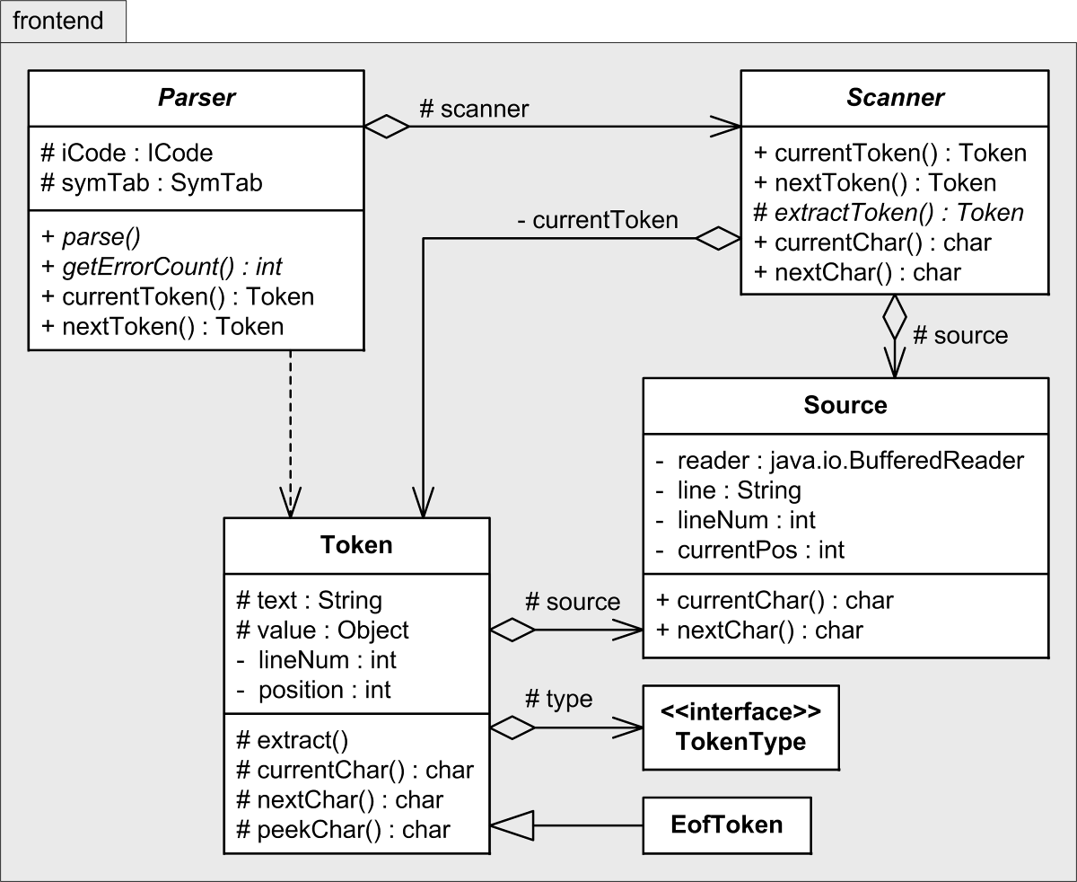
Class Diagram Examples
What’s in the frontend package of a compiler?
UML package diagram
What information can
you learn from the
class diagrams?
Access control
+ public
– private
# protected
~ package
From: Writing Compilers and Interpreters, 3rd ed., John Wiley & Sons, 2009.

Slide 83
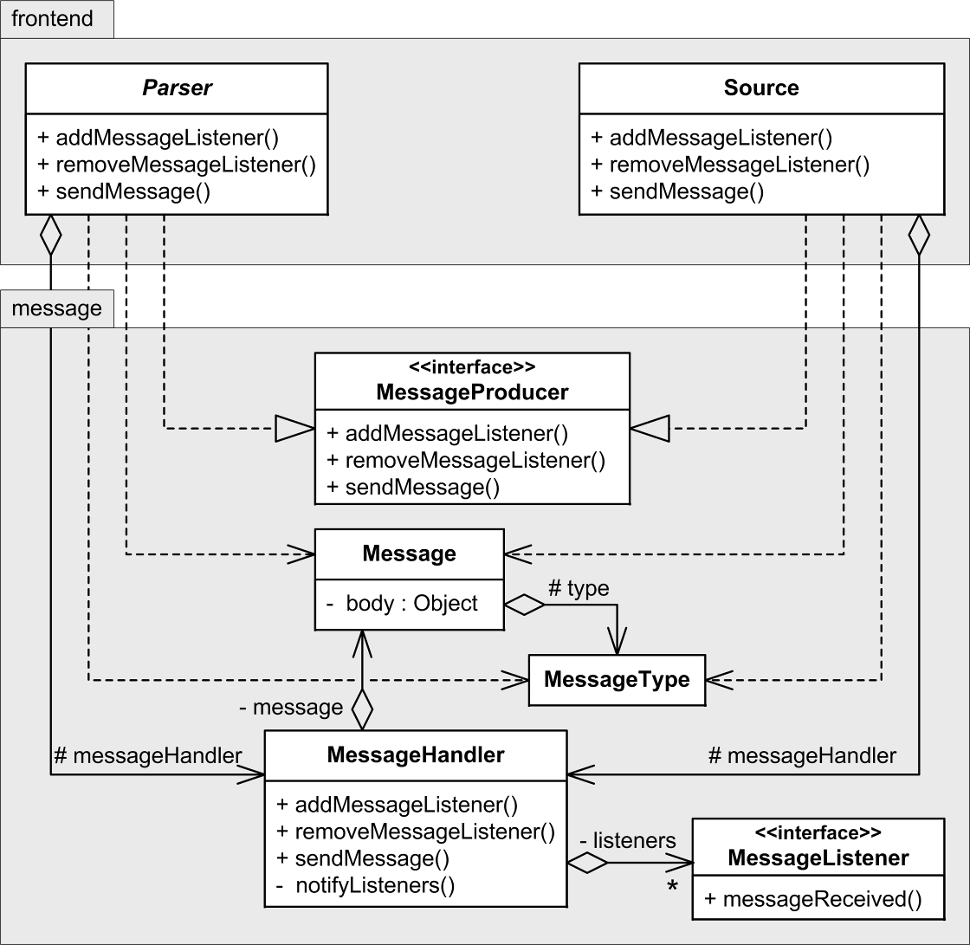
Class Diagram Examples, cont’d
Message handling in the front end of a compiler.
frontend and message packages

Slide 84
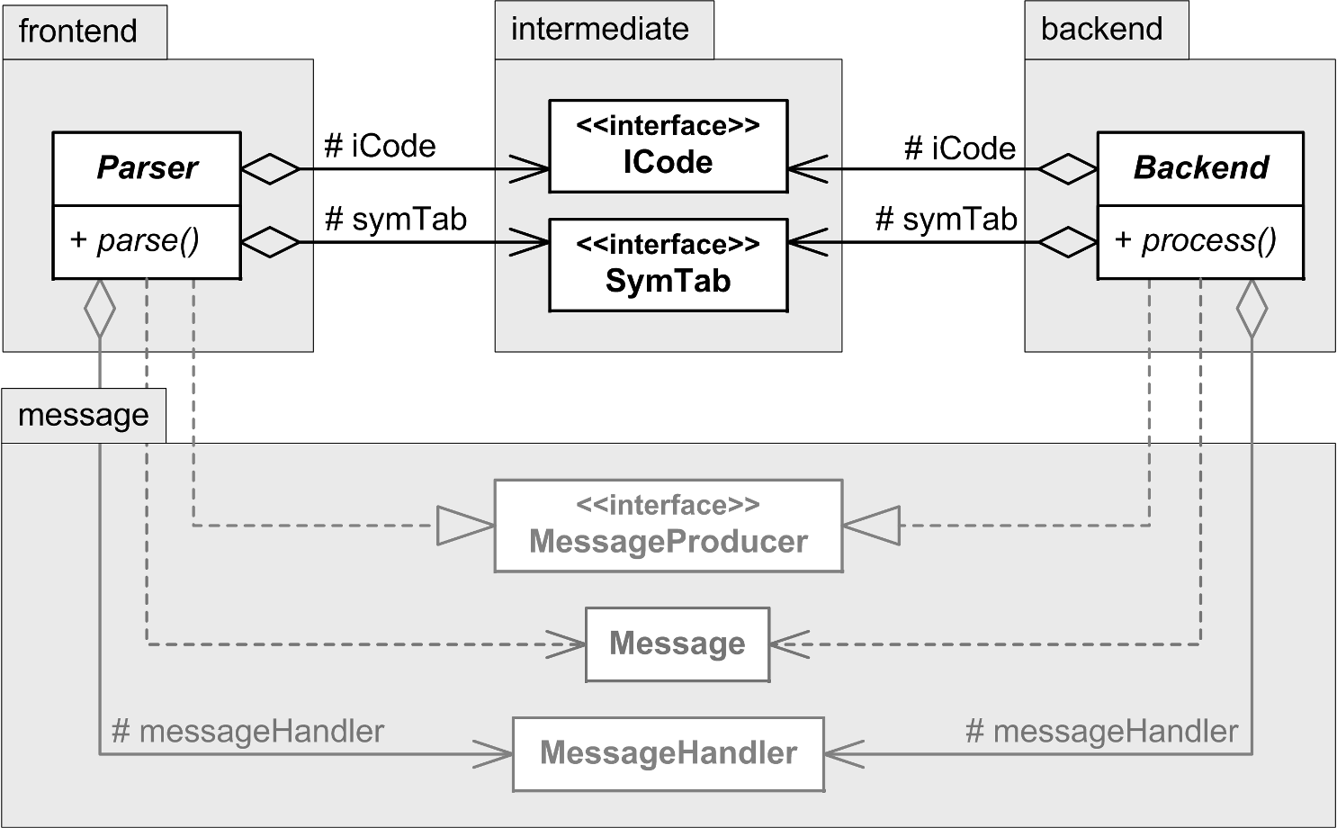
Class Diagram Examples, cont’d
The frontend, intermediate, and backend packages.

Slide 85
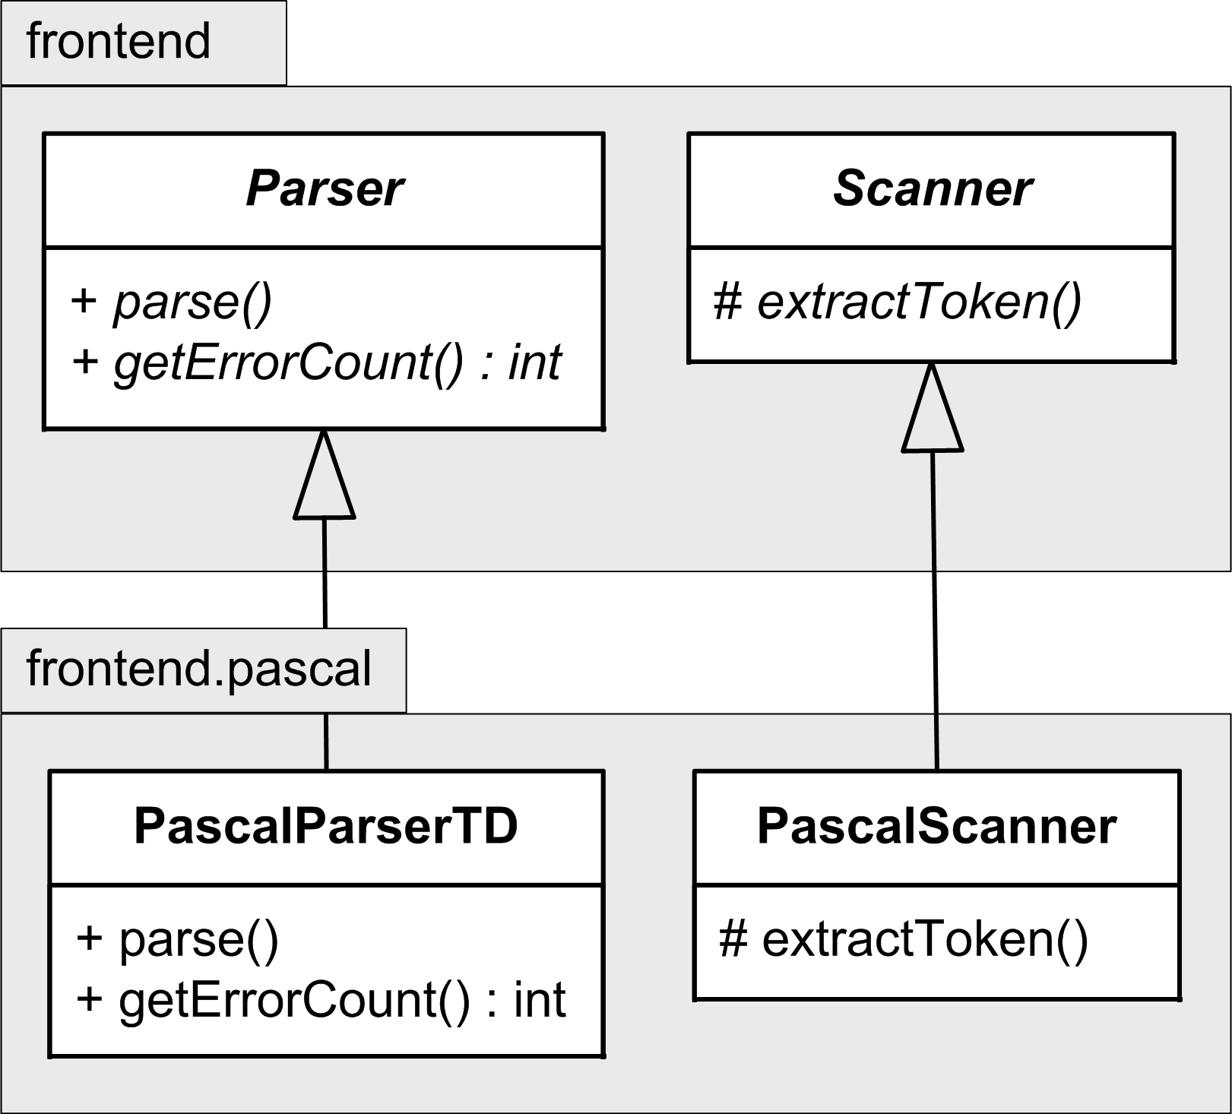
Class Diagram Examples, cont’d
Implement the abstract base classes Parser and Scanner with language-specific subclasses.

Slide 86
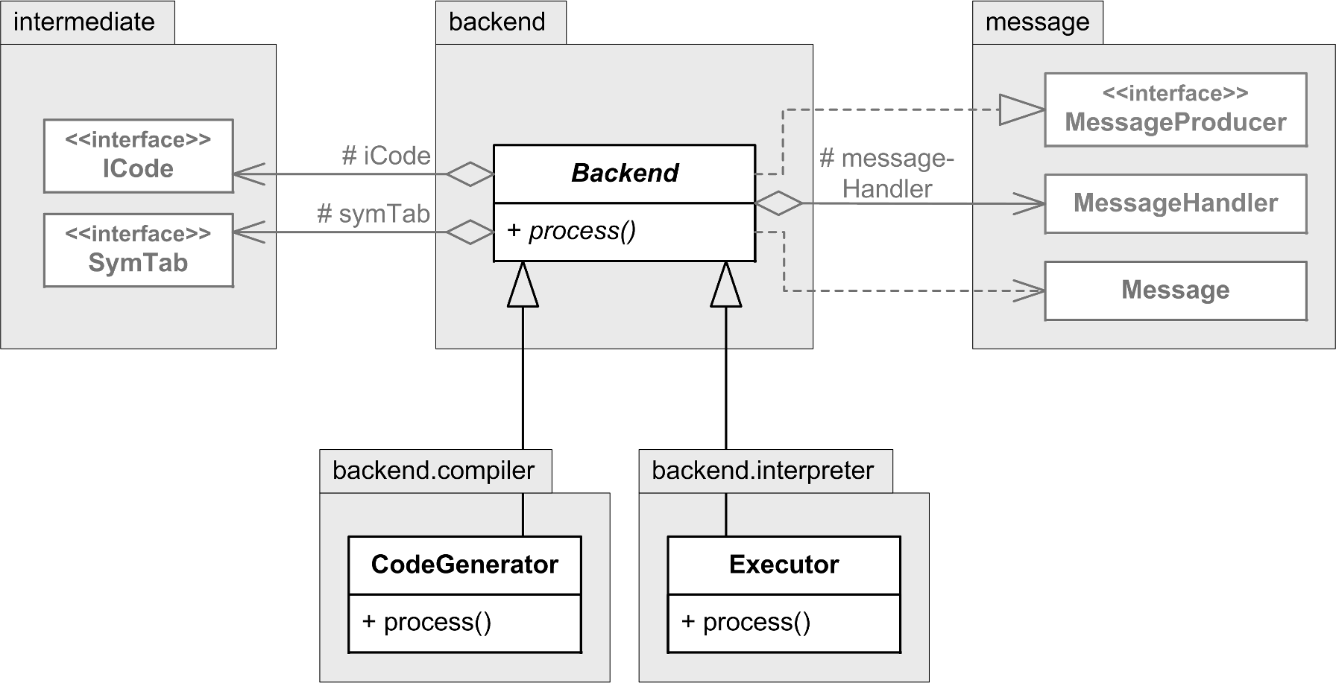
Class Diagram Examples, cont’d
The back end can be a code generator or an executor.

