Slide 1
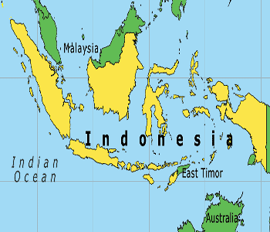
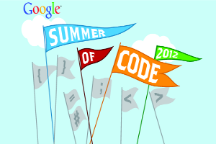
Rule-Based Machine Translation between Indonesian and Malaysian
Raymond Hendy Susanto, Septina Dian Larasati, Francis M. Tyers
raymondhs@nus.edu.sg, larasati@ufal.mff.cuni.cz, ftyers@dlsi.ua.es
Introduction
2 System
2.3 Bilingual dictionary
Indonesian (Bahasa Indonesia) and Malaysian (Bahasa Malaysia) are standards of the Malay language, a major language of the Austronesian family.
The system is based on Apertium (http://www.apertium.org/), a free/open-source rule-based machine translation platform.
The bilingual dictionary, or transfer lexicon contains mappings between lemmas, parts-of-speech and other tags.
<e><p><l>mobil<s n="n"/></l>
<r>kereta<s n="n"/></r></p></e>
<e><p><l>mobilitas<s n="n"/></l>
<r>mobiliti<s n="n"/></r></p></e>
<e><p><l>sepeda<s n="n"/></l>
<r>basikal<s n="n"/></r></p></e>
<e><p><l>modern<s n="adj"/></l>
<r>moden<s n="adj"/></r></p></e>
<e><p><l>karena<s n="cnjsub"/></l>
<r>kerana<s n="cnjsub"/></r></p></e>
Figure 2: Modules of the Apertium translation system
2.1 Morphological analysis
Our morphological analyser returns, for every Indonesian/Malay word, the possible lexical forms (analyses) of the word. For the Indonesian sentence Yakobus dan Maria sedang berada di kebun itu. (’James and Mary are in that garden.’)
Figure 4: Extract from bilingual dictionary
3 Evaluation
We evaluated our system using word error rate (WER) on a corpus of 2,000 tokens from Malaysian Wikipedia.
Figure 1: Map of Indonesian and Malaysian
^Yakobus/Yakobus<np><m><sg>$
^dan/dan<cnjcoo>$
^Maria/Maria<np><f><sg>$
^sedang/sedang<adv>$
^berada/ada<vblex><ber>$
^di/di<pr>$
^kebun/kebun<n><sg>$
^itu/itu<det><dem>/itu<prn><dem>$
^./.<sent>$
Indonesian is natively spoken by about 35 million people; Malaysian is natively spoken by about 10 million people.
Direction | WER
Indonesian-to-Malaysian | 14.43%
Malaysian-to-Indonesian | 7.58%
1.1 Language characteristics
Table 1: Word error rate of the system
Indonesian and Malaysian are characterized by:
4 Future Work
Mutually intelligible;
Similar grammar;
50% overlap in vocabulary;
Rich morphology
Figure 3: Output of morphological analysis with a finite-state transducer
Improving coverage;
Lexical selection;
More transfer rules
The analysers have a coverage over 80% for the Wikipedia corpora.
Acknowledgments
1.2 Why rule-based approach?
2.2 Part-of-speech tagging
This work was made during the Google Summer of Code 2012, a program for introducing students to free/open-source software development.
Rule-based approach is preferred to the statistical approach, since:
The part-of-speech tagging module for the system is based on a bigram HMM-based part-of-speech tagger. It can be trained on a database dump of the Indonesian Wikipedia (http://id.wikipedia.org/) and the Malaysian Wikipedia (http://ms.wikipedia.org/)..
No parallel corpora;
Both languages are closely related;
Simple word substitution works most of the time

