Slide 1

Wikipedia : evolution or revolution ?
Florence Devouard
Vice-president
Wikimedia Foundation

Slide 2
Wikipedia’s Radical Idea:
Imagine a world in which every single person is given free access to the sum of all human knowledge.
That’s what we’re doing.

Slide 3
What is Wikipedia?
A freely licensed encyclopedia
Free as in free beer and free as in free speech
Available in many languages
written by thousands of volunteers
www.wikipedia.org

Slide 4
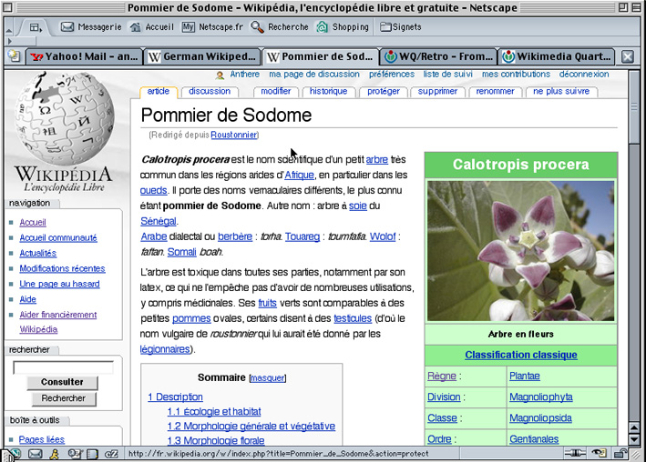

Slide 5
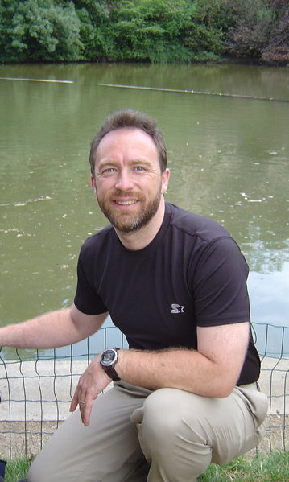
Who created Wikipedia ?
Founded January 15, 2001
by Jimmy Wales
Written by
thousands of volunteers

Slide 6
How big is Wikipedia?
English Wikipedia is largest and has over 130 million words
English Wikipedia is larger than Britannica and Microsoft Encarta combined
In 15 months the publicly distributed compressed database dumps may reach 1 terabyte total size

Slide 7
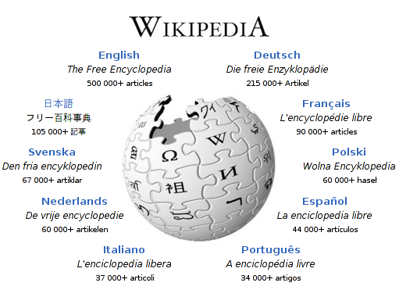
Nearly 1.5 million across 200 languages
19 with >10,000. 52 with >1000

Slide 8
Some northern european languages
Swedish (Svenska) : sv - 67787 articles
Danish (Dansk) : da - 23514 articles
Norwegian (Norsk) : no - 20993 articles
Finnish (Suomi) : fi - 17564 articles
Neo-Norwegian (Nynorsk) : nn - 4408 articles
Icelandic (Íslenska) : is - 2359 articles
Northern Sami (Sámegiella) : se - 165 articles

Slide 9
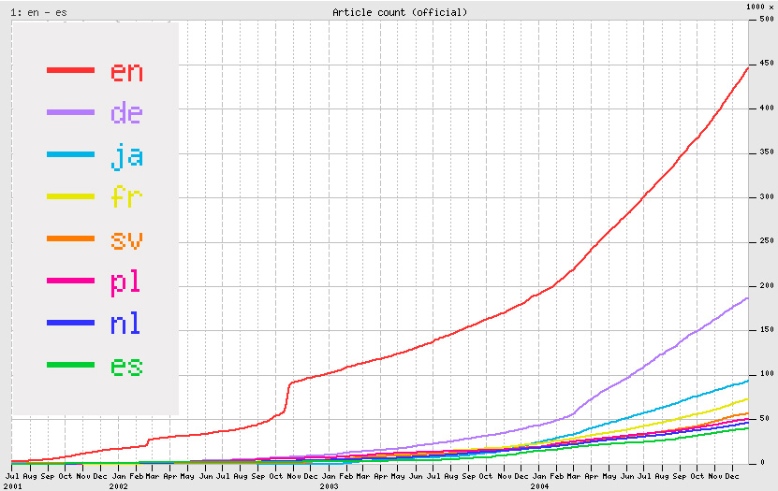
Wikipedia growth

Slide 10
How popular is Wikipedia?
~ 400 million pages viewed monthly
Top 100 of most visited websites
Dramatic ranking jumps:
Jan 2003: Slashdotting (English WP's '100,000 article' press release)
Aug 2003: Featured on CNN
Jan 2004: New servers
Aug 2004: New servers

Slide 11
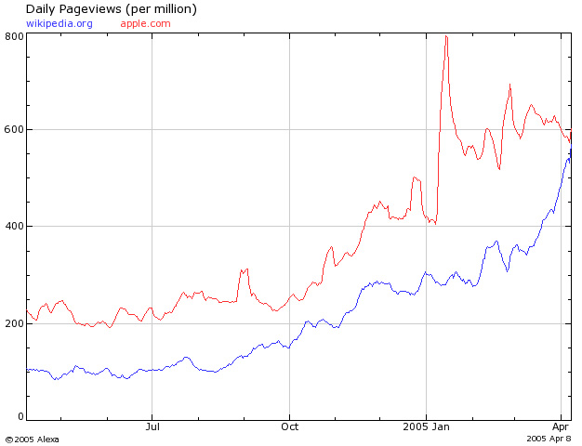
apple.com
wikipedia.org

Slide 12
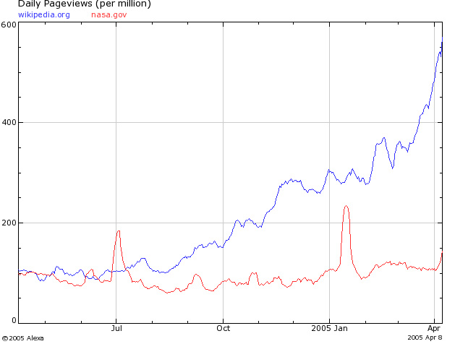
wikipedia.org
nasa.gov

Slide 13
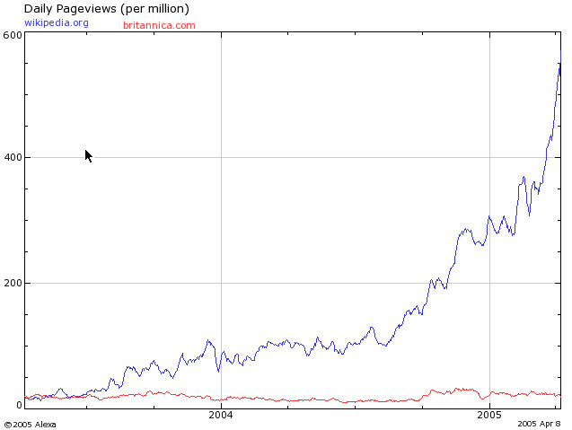
wikipedia.org
britannica.com

Slide 14
Elements of design
Collaborative software which respects the users
A community and flexible governance
Neutrality as a bedrock principle
Freedom in the sense of GNU

Slide 15
1st element:Wiki, a collaborative software
Requires a computer and an internet connection
Allows users to add or edit content
MediaWiki is one of many wiki engines
Primarily developed for Wikipedia from 2002 onwards
Scalable and multilingual

Slide 16
MediaWiki features
Editing features (simple markup)
Quality control features (versioning, recent changes)
Community features (talk pages, user pages, access levels)

Slide 17
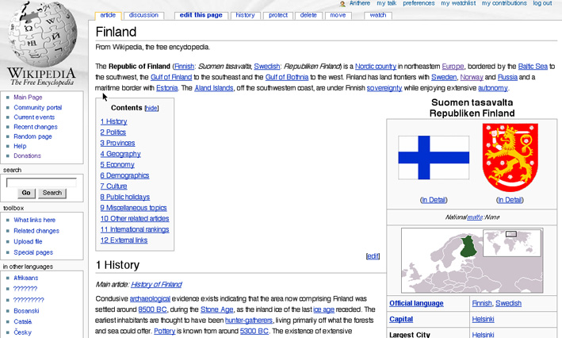
You can read!

Slide 18
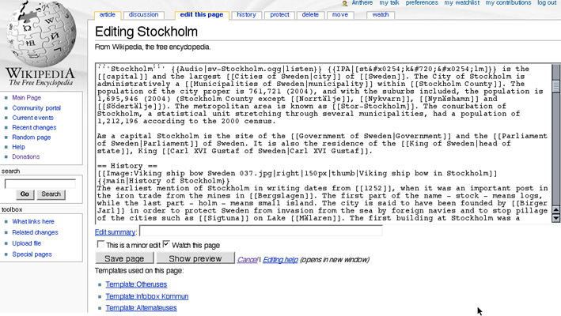
You can edit!

Slide 19
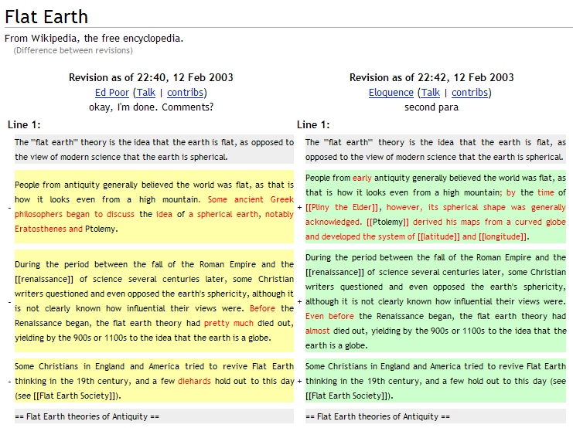
You can share!

Slide 20
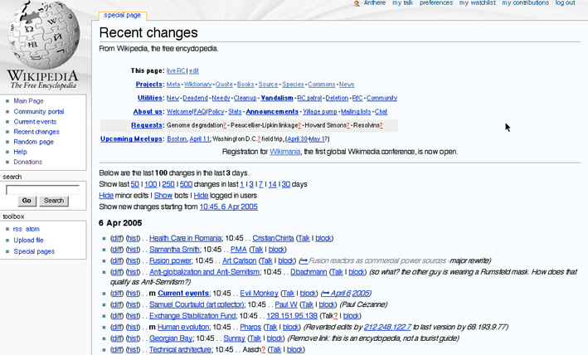
{{SoFixIt}}...

Slide 21
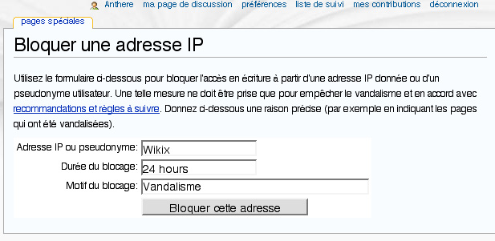

Slide 22
Nobody knows everything...
Centralized knowledge
One way communication (television…)
Expert and authority
Linguistic and geographic barriers
Dot com boom
      But everyone knows something...

Slide 23
2nd element: a community
Open to participation : large and diverse
How can such a community scale?
  Through a common goal
  Through common principles (freedom and neutrality)
  Through policy (mediation, arbitration)
  Through software features
  Through an atmosphere of love and respect

Slide 24
Wikipedia governance
A confusing but workable mix of
  Anarchy
  Consensus and precedent
  Meritocracy
  Monarchy
  Technocracy
  Democracy
  Republic
        ...a chaos under control

Slide 25
3rd element: NPOV
NPOV - Neutral Point of View
Diverse political, religious, cultural backgrounds
Kept together by our “NPOV” policy
NPOV is a social concept of co-operation, and avoids some philosophical issues.

Slide 26

4th element: Freedom
We use all free software on the website
  MediaWiki is GPL
  GNU/Linux
  Apache
  MySQL
  Php
We support free file formats (Ogg Vorbis …)
Free speech, autonomy, responsability...
The GNU logo

Slide 27
Free content is ...
any kind of functional work, artwork, or other creative content upon which:
  no legal restriction has been placed that significantly interferes…
  -…with people's freedom to use, understand, redistribute, improve, and share the content.
---> Mirrors, other websites, CD Rom, Wikireaders

Slide 28
Social innovation
All the essential tools that allow Wikipedia to work existed 6 years before Wikipedia
Wikipedia is not primarily a technical innovation, but rather a social innovation
Wikipedians are flexible about social methodology:results over process

Slide 29
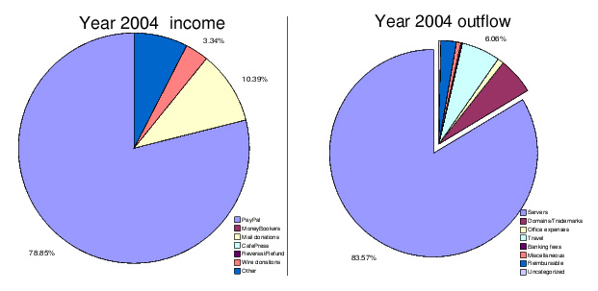
But... who pays for this ?
Individual donations
Grants, prizes
Servers, hosting
Domain names, trademarks

Slide 30
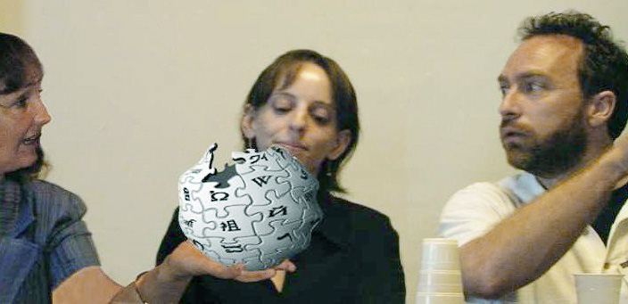
Wikimedia Foundation board members at work...

Slide 31






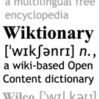

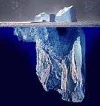

Slide 32
