Slide 1
Trusting the user: Wikipedia as an example
Daniel Mayer
Wikimedia Foundation
Free Culture and the Digital Library
14 October 2005
Notes:
Introduce myself
Wiki since Feb 2003, VP of Wikia, interested in conflict res. + org. issues on Wikipedia, international coo.

Slide 2
What are wikis?
Openly editable websites
First wiki: 1995, c2.com
Anyone can edit (almost) any page
Simplified syntax for editing
  [[link]] ''italic'' '''bold''' [[image:sample.jpg]]
User actions are logged and reversible
Stacking the deck against vandals

Slide 3
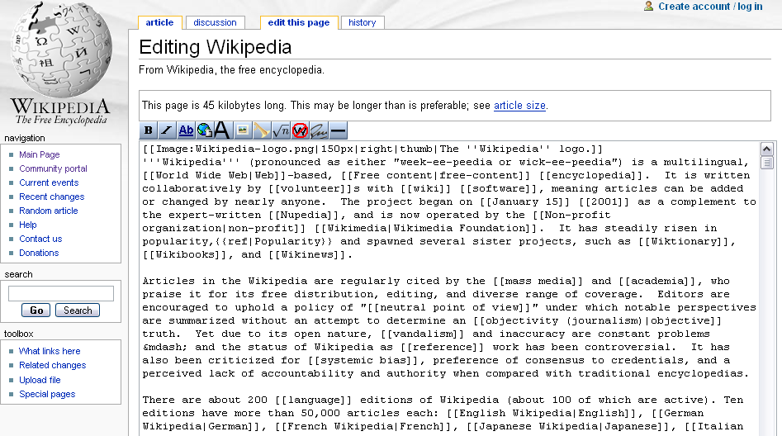
Editing a wiki

Slide 4

Wikimedia Foundation
Non-profit organization
Funded by donations and grants
Operates Wikipedia and its sister projects
  Wiktionary
  Wikibooks
    WikiJunior
  Wikinews
  Wikisource
  Wikiquote
  Wikimedia Commons
Notes:
Aims to distribute a free encyclopaedia to every single person on the planet in their own language
Created by Wikipedia Founder Jimmy Wales in 2003

Slide 5
Wikimedia’s goals
Presenting the sum total of human knowledge to every person in the world for free and in their own language.
Generating good content is the key
  Our openness is a means to that end
  The community is a means to that end
  Wikipedia is not an experiment in anarchy

Slide 6

Wikipedia
Volunteer created encyclopedia
Started in January 2001
8000 articles in the first 8 months
International
Freely licensed
  Increases sense of shared ownership
NPOV, NOR, Verifiability
Notes:
„free encyclopedia“
started in 1999 by Jimmy Wales
no open editing
strict review process
had 30 articles by 2003

Slide 7
Neutral Point of View policy
NPOV - Neutral Point of View
Diverse political, religious, cultural backgrounds
Kept together by our “NPOV” policy
NPOV is a social concept of co-operation, avoids some philosophical issues.

Slide 8
Wikipedia statistics
2 million articles in >100 languages
English Wikipedia: 750,000 articles
  http://en.wikipedia.org/
  largest encylopedia in the world
German Wikipedia: 300,000 articles
  http://de.wikipedia.org/
Over
  20,000 active Wikipedians
  5,000 new articles per day
  100,000 edits per day
Among top 50 websites according to Alexa.com
  http://www.alexa.com/data/details/main?q=&url=http://www.wikipedia.org

Slide 9
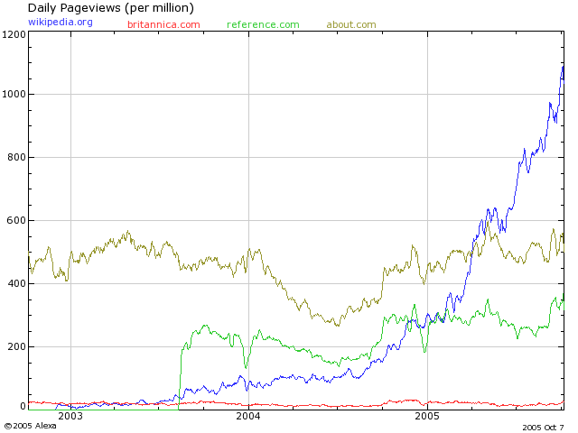
Wikipedia usage growth

Slide 10
Can the content be trusted?
Community review processes
Moderation after the fact
  Encourages growth
  Can’t be sure of validity
License allows free 3rd party use

Slide 11
Limited studies thus far
IBM History Flow study
  Major vandalism repaired in less than 5 minutes
  http://researchweb.watson.ibm.com/history/results.htm
Wikipedia vs Brockhaus and Encarta
  c’t German computer engineering magazine
  Comparison of German encyclopedias (Oct04)
  German Wikipedia won except in multimedia
  http://meta.wikimedia.org/wiki/Wikipedia_vs_Brockhaus_and_Encarta
Notes:
Computertechnik: popular magazine in Germany
German Wikipedia ; about 150K articles in OctO4, ~ English Wikipedia a year before

Slide 12
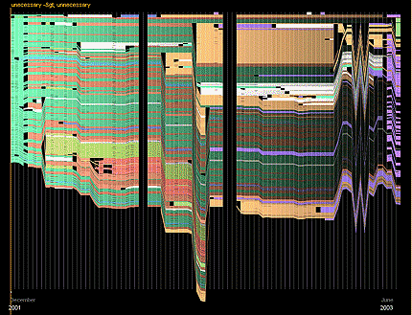
History flow: Versions
Notes:
[[Abortion]]

Slide 13
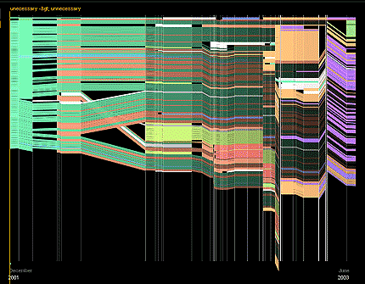
History flow: Time

Slide 14
Community self-regulation
Quality control features: recent changes, watchlists, related changes, page histories, user contributions lists
Community features: talk pages, user profiles, access levels, user-to-user email, message notification, RFC, mediation, arbitration.

Slide 15
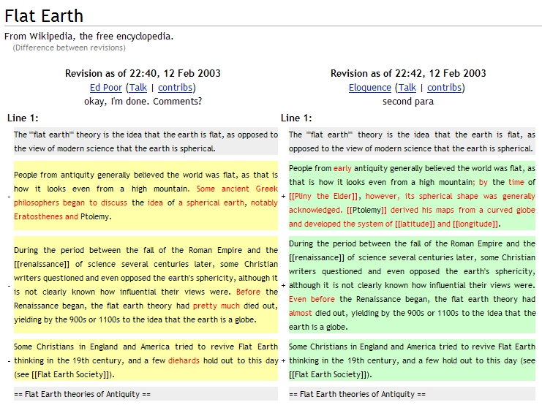
Comparing versions

Slide 16
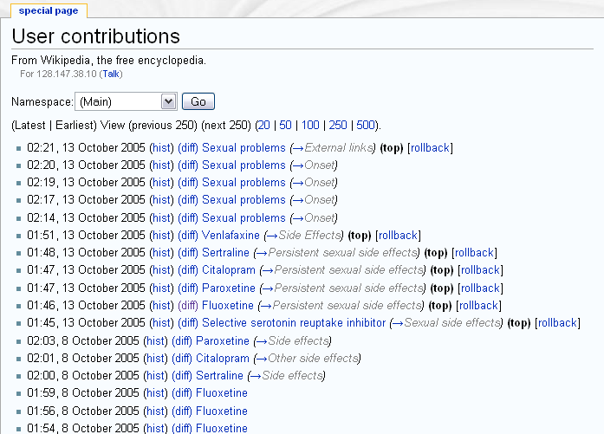
Rolling back versions

Slide 17
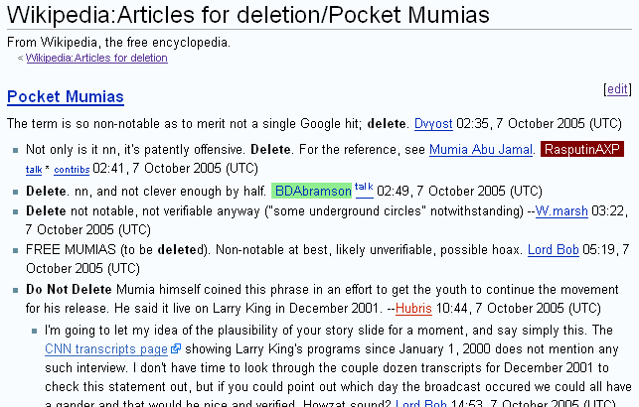
Community Organization
  Example: Articles For Deletion

Slide 18
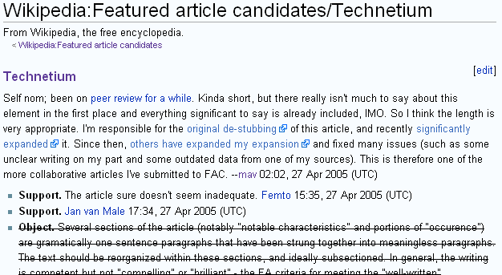
Community Organization
  Example: Featured Article Candidates

Slide 19
The future?
Referencing particular revisions
Greater participation from academics
Reader validation of articles
Development of a stable version
  Wikipedia 1.0
  German DVD

Slide 20
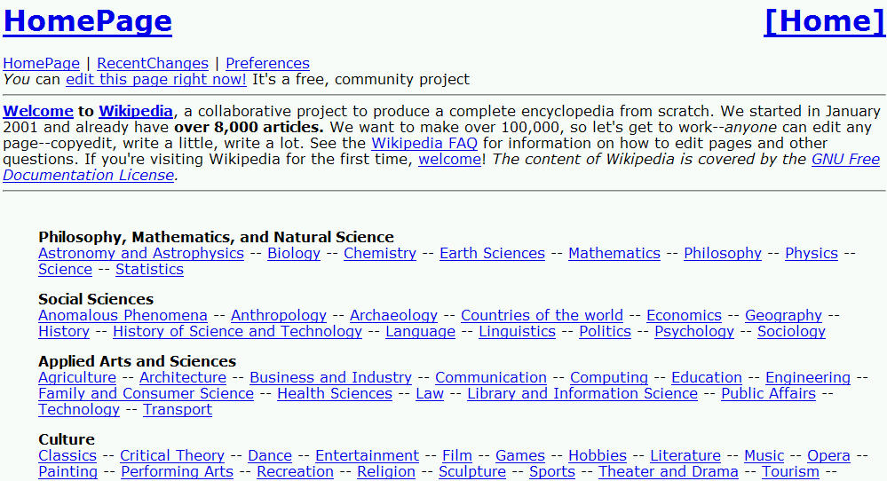
August 2001
UseMod

Slide 21
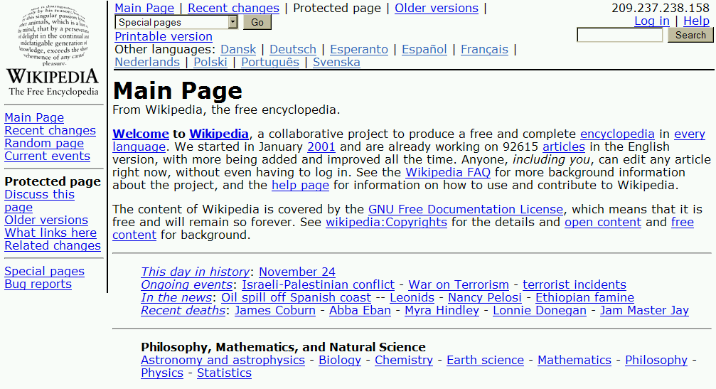
November 2002
Phase 3 – now called MediaWiki

Slide 22
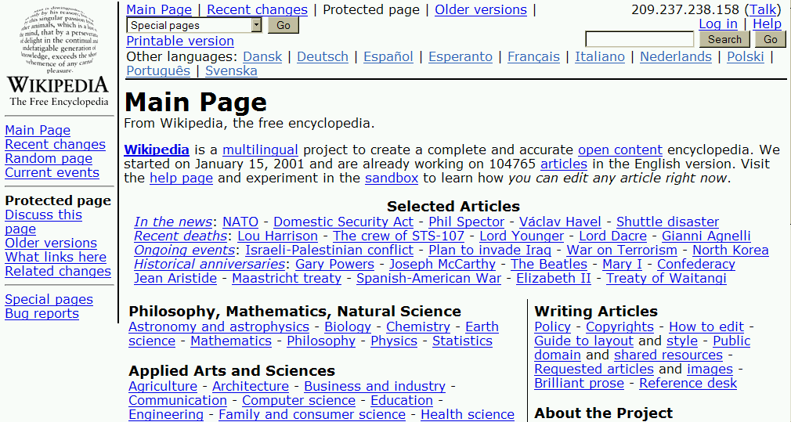
February 2003
first table-centric Main Page design

Slide 23
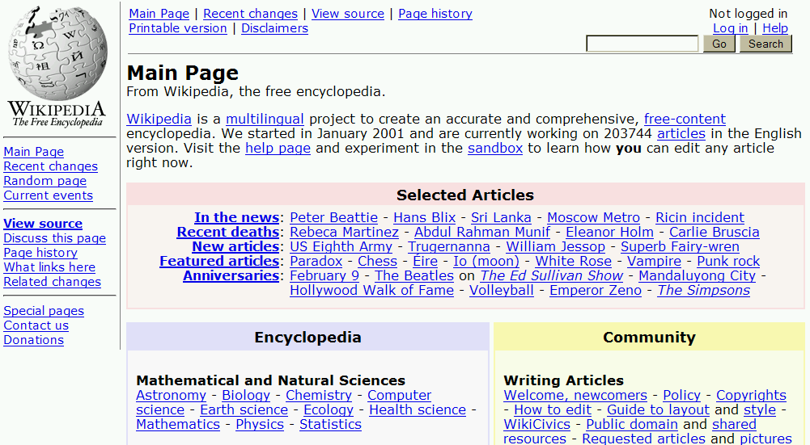
February 2004
new logo and colour

Slide 24
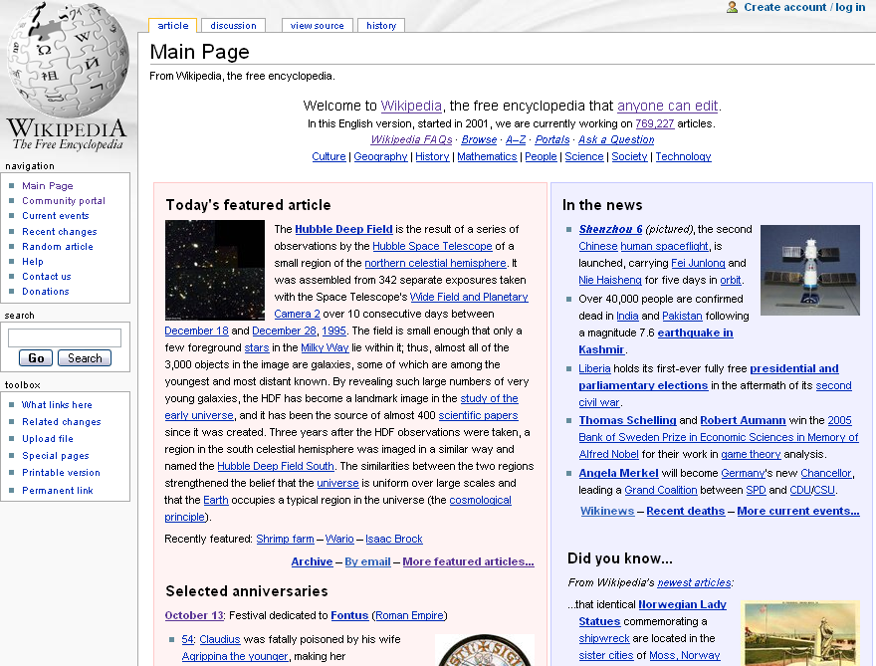
Notes:
accesskeys, user styles, templating system, language links into the sidebar

Slide 25


