Slide 1
Wikiversity : an electronic institution of learning
Florence Devouard
Wikimedia Foundation
Pretoria, 21-23 sept 2005

Slide 2
Wikimedia Foundation Inc
Imagine a world in which every single person is given
free access to the sum of all human knowledge.
An international non-profit organization
  dedicated to encouraging the growth, development and distribution of free, multilingual content,
  and to providing the full content of these wiki-based projects to the public free of charge.
  http://wikimediafoundation.org/wiki/Home

Slide 3
Wiki, a collaborative software
Requires a computer and an internet connection
Openly editable website
Propose a very simple markup
  ’’’text’’’ to put text in bold.
  [[link]] to create a link…
Typical wiki features :
  logs of changes
  page history
http://en.wikipedia.org/wiki/Wiki

Slide 4
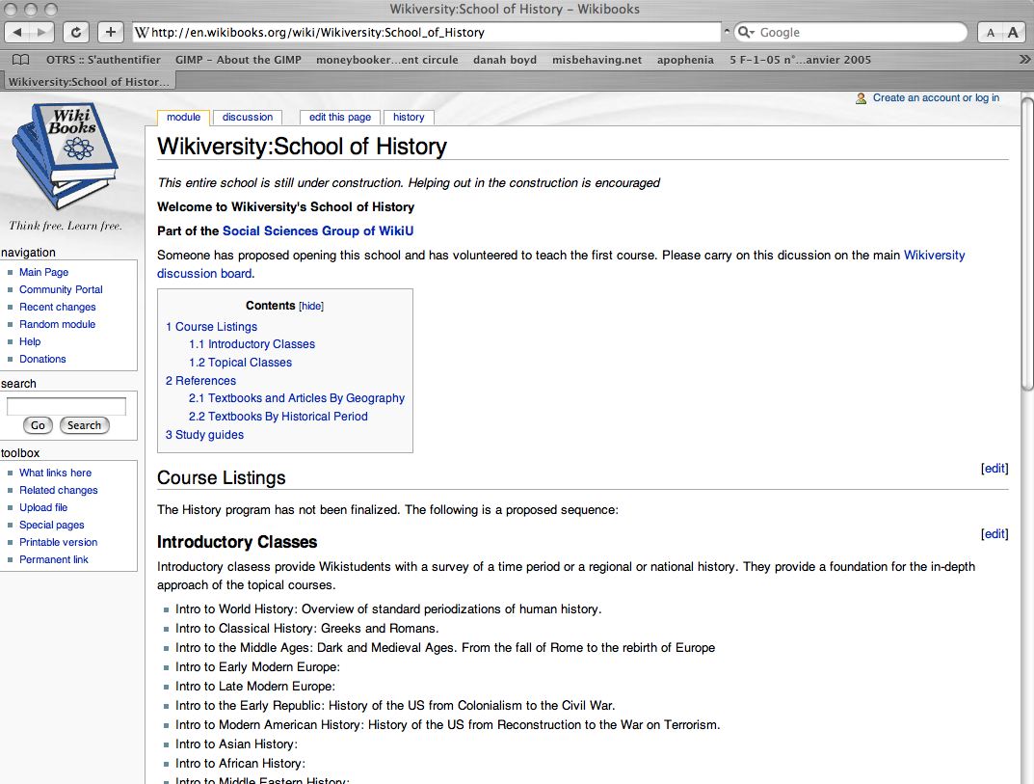

Slide 5
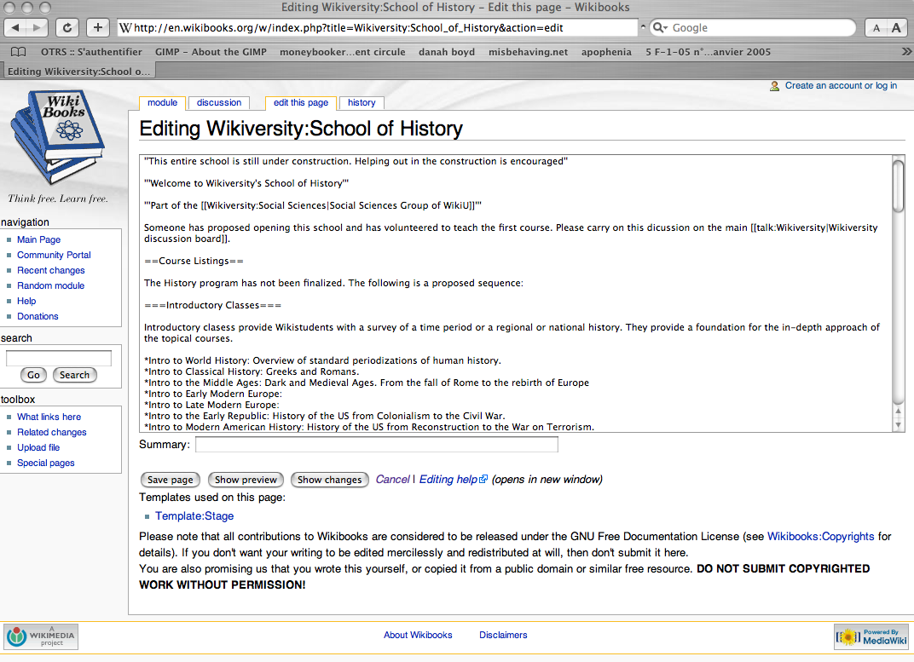

Slide 6
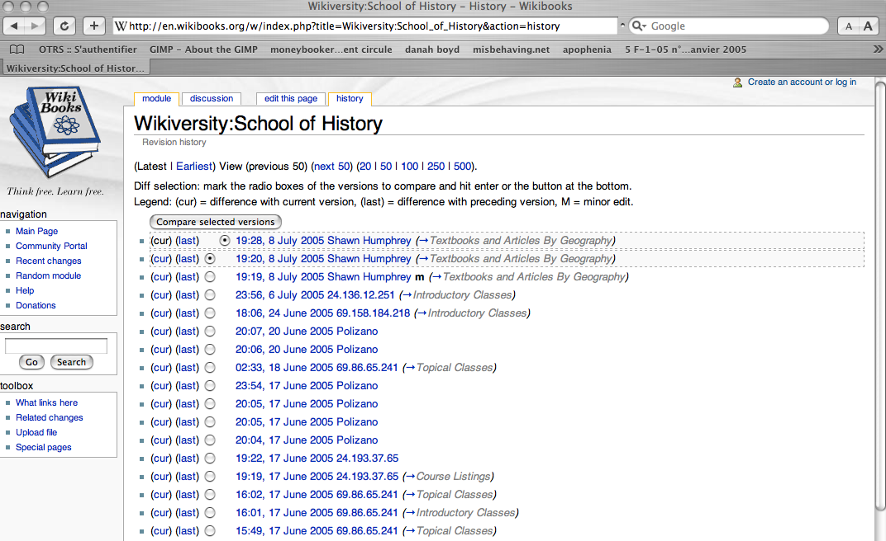

Slide 7
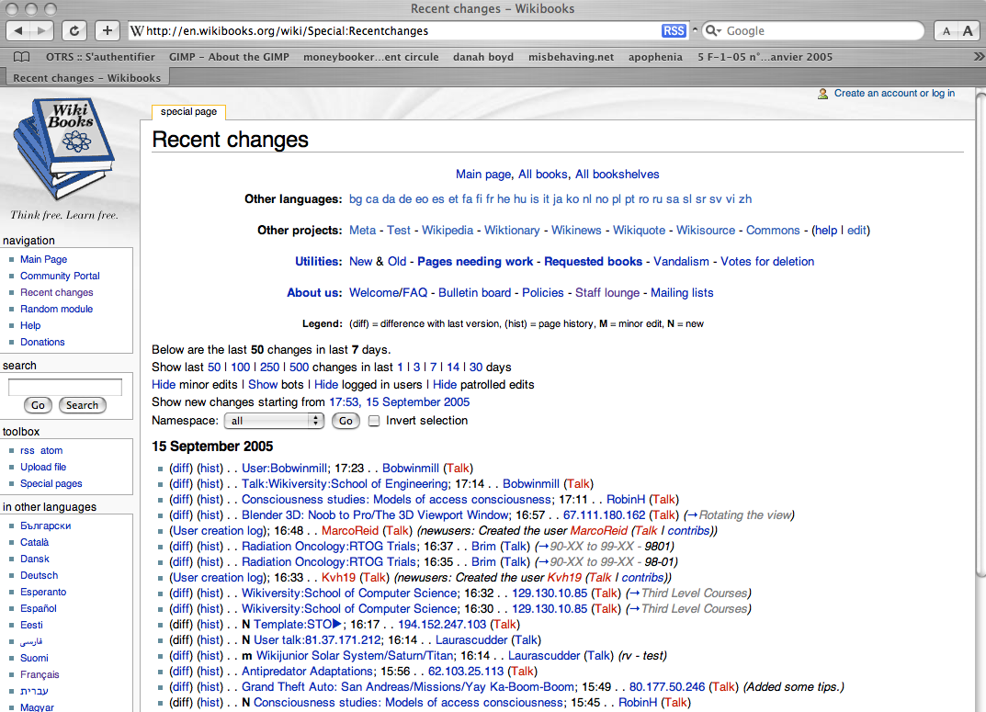

Slide 8

MediaWiki features
MediaWiki is one of many wiki engines
Primarily developed for Wikipedia from 2002 onwards
Scalable and multilingual
Features
  Editing features (simple markup)
  Quality control features (versioning, recent changes)
  Organisational features (categories…)
  Community features (talk pages, user pages, access levels)
  Other features (page protection…)
  http://www.mediawiki.org/wiki/MediaWikia

Slide 9





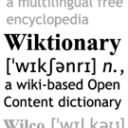


?

Slide 10
Open and free
All Wikimedia content is „free content“
  Text may be freely distributed and modified
  Derivative works have to be free content (copyleft)
  GNU Free Documentation License
MediaWiki is „open source“
  Code may be freely distributed and modified
  Copyleft
  GNU General Public License

Slide 11
Active Wikimedia projects
Wikipedia: encyclopedia
  (January 2001): 189 languages, 53816 editors, 1.8M articles, 30.5M internal links
    English: 433781 users, 729767 articles
    German: 128291 users, 289025 articles
    French: 39351 users, 161792 articles
    Japanese: 28113 users, 140986 articles
Wiktionary: dictionary/thesaurus
  (December 2002): 161 languages, 1585 editors, 311 K articles
Wikiquote: quotation collection
  (July 2003): 84 languages, 841 editors, 20K articles
Wikibooks: textbook/manual collection
  (July 2003): 118 languages, 1874 editors, 20K articles
Wikinews: news portal
  (November 2004): 13 languages, 456 editors, 7,500 articles
Wikisource: primary source repository
  (November 2003): 50 language portals, 457 editors, 28K articles/documents
Wikicommons: Media repository
  (September 2004: 938 editors, 17K articles, 60K media files

Slide 12
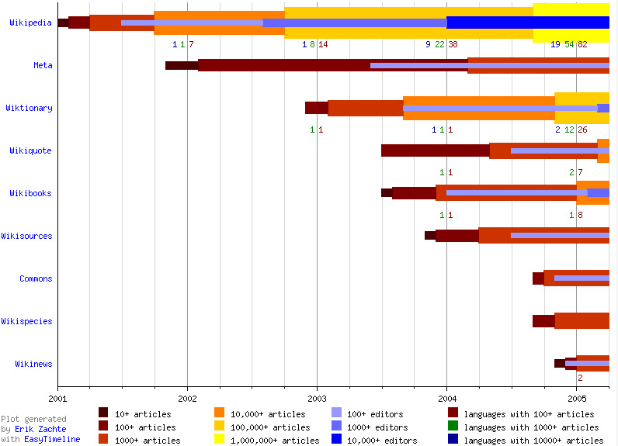

Slide 13
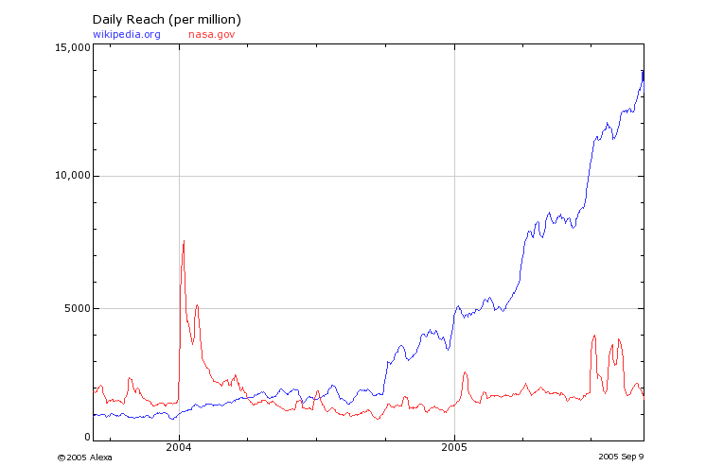
wikipedia.org
nasa.gov
Rank : around 50 in summer 2005
Notes:
Daily pageview 500 millions per day ?

Slide 14
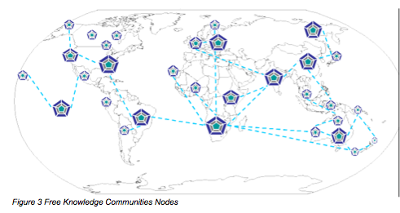
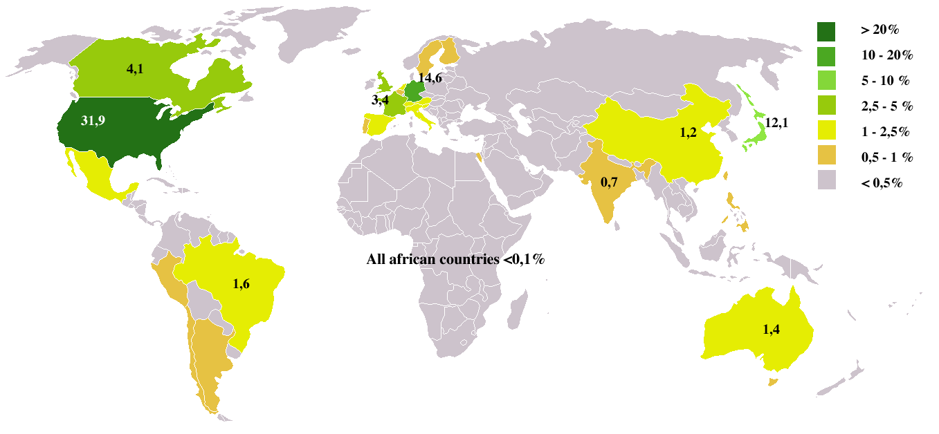
Every single person is given access...
From Wikimedia projects access hits stats - july 2005
Few hits from Africa, Eastern Europe...

Slide 15
Wikiversity’s mission… not just to impart knowledge but to facilitate learning.
An institution of electronic learning
  E-teaching materials
  E-learning framework
Methods can include but are not limited to
  => wikiforums, lectures, homework, collaborative projects, discussions, student journals, etc.

Slide 16
Wikiversity’s scope…
E-teaching materials to set complete courses
  Lecture notes
  Tutorial activities
  Assignments
  References : books from Wikibooks, research papers
  Teaching materials such as slides collections
  Audio-videos, images (might come from Wikicommons)
  The development and cataloging of tests (wikiquizz, test, exams…)
  Collection of links to usable material on our projects (Glossaries, dictionnary, encyclopedia, quotes…)
  Collection of links to usable material on the net ar

Slide 17
Wikiversity’s scope…
E-learning framework for members to take courses online
Irc lectures and assignments
Direct interaction between students and teacher (talk pages, irc meetup…)
Collaborative projects
Student journals
Latest news (wikinews, blog)…
wikiquizzes
Grading and certification ?

Slide 18
A framework for collaborative learning and teaching
Wikiversity : a wiki
  Anyone, including you, can edit any course module by clicking on the edit this page link
Wikiversity : free
  All of the site's content is under the GNU Free Documentation License.
  Contributions remain the intellectual property of their creators,
  while the copyleft licensing ensures that the content will always remain freely distributable and reproducible.
Wikiversity : free of charge
  Anyone can edit or follow the courses for free

Slide 19
Wikiversity’s target audience…
Nobody knows everything… but everyone knows something
Wikiversity is a kind of learning platform/environment/resource shaped by its students and its practitioners.
The primary audience of Wikiversity is meant to be students: College, High schools or Junior High schools
A secondary audience could be…. anyone…
Wikiversity: a multilingual resource

Slide 20
Designing learning ecologies
An environment to support learning
Collaborative software which respects the users
Experiment in the application of computer methods for learning
An open, large and diverse community
Flexible governance
Freedom in the sense of GNU
Neutrality as a bedrock principle
No frontier between teachers and learners
Gives the end user control over what he needs
Embracees a plurality of learning styles and teaching
A global community effort to create a collaborative platform

Slide 21
Wikiversity and timeline…
Has been discussed for more than 2 years
No existence as an independent project
  In development on english wikibooks
  Non official inactive german-speaking wikiversity
Software needs to be addressed
Very motivated english-speaking team but some opposition
Vote for creation is ongoing
  As of 20th of sept, 68 approved and 24 opposed

Slide 22
Wikiversity so far…
Hosted in Wikibooks.
The Schools of Wikiversity have been organised into 5 major divisions
  1.Physical Sciences
  2.Life Sciences
  3.Humanities
  4.Practical Arts and Sciences
  5.Social Sciences.
Example : Social Science > School of History > The Great War and Versailles (Christopher Polizano)
http://en.wikibooks.org/wiki/Wikiversity:The_Great_War_and_Versailles

Slide 23
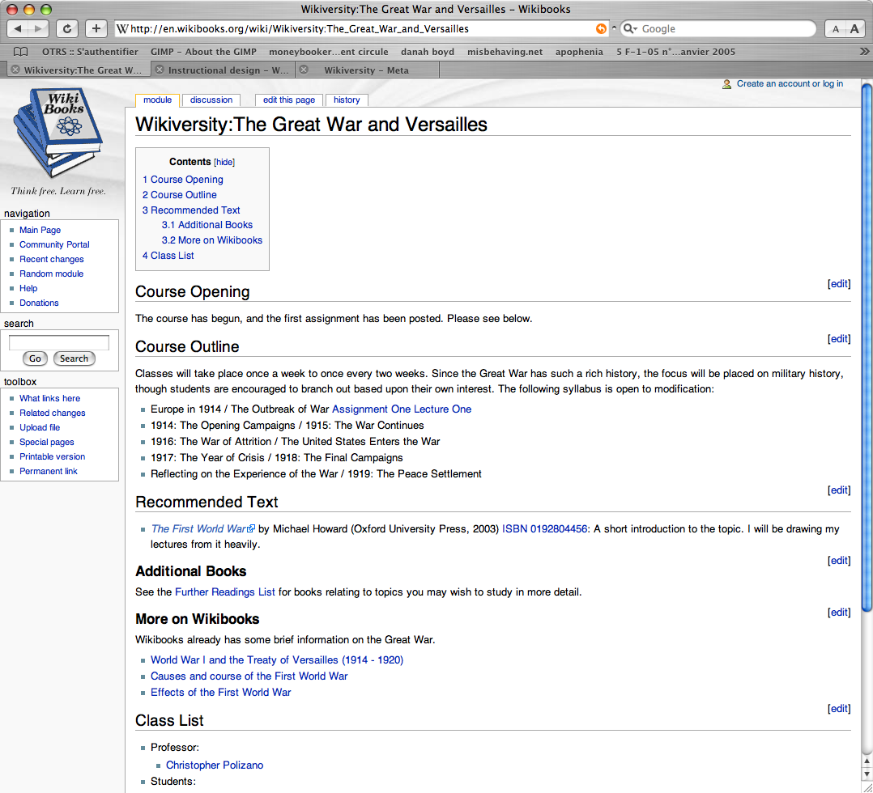

Slide 24
Wikiversity software needs
Electronic testing : Wikiquiz : a proposed extension for MediaWiki.
Web of trust or certification model to grade Wikiversity students
Collapsable note windows
Pop up windows…

Slide 25
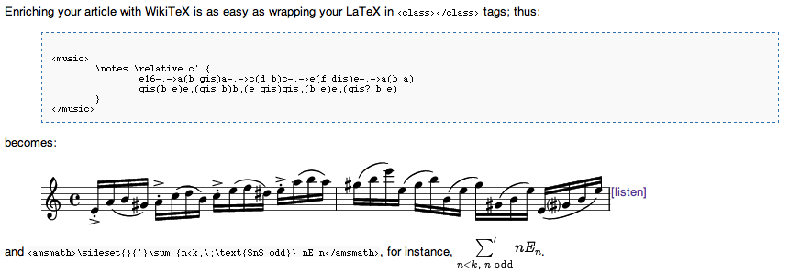
Wikiversity software needs
MediaWiki extensions for various scientific disciplines, such as WikiTeX (a modular system for incorporating LaTeX objects with MediaWiki output)

Slide 26
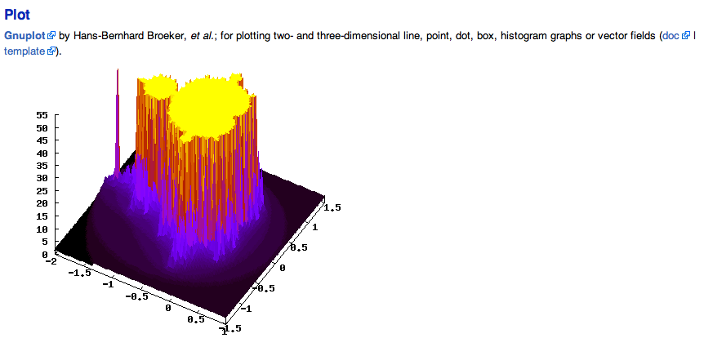
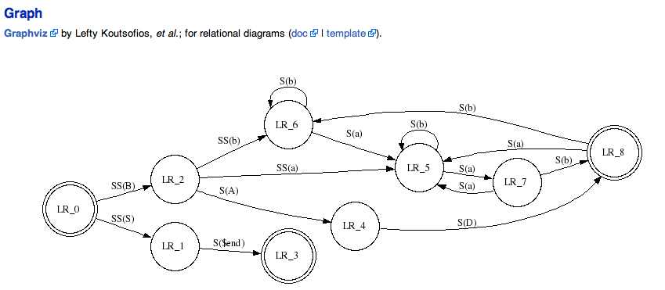
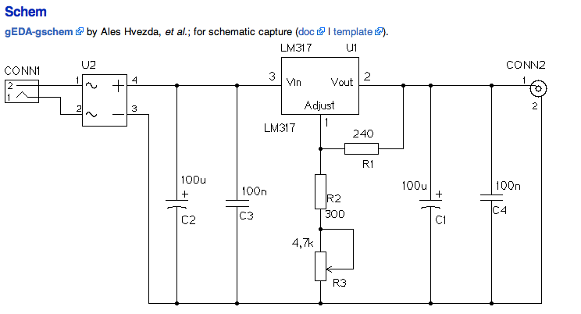
Wikiversity software needs
http://wikisophia.org/wiki/Wikitex

Slide 27
Issues …
The naming issue
  Ties the project very strongly to the idea of traditional universities
  Might cause the project being perceived primarily or only as an institution of tertiary learning
Does it aim at being a supplement or an alternative to traditional classroom approach to learning ?
  Will it model the general organisation around the concept used in traditional universities ?
  Will it include ideas of accreditation, degree confering or evaluating methods ?
Will it be used to conduct research and publishing results ?
Confusion between Wikibooks and Wikiversity

