Slide 1
WIKINDX
Google Docs Add-on
App ID:16509052442
https://wikindx.sourceforge.io
Notes:
Hello.
Welcome to the WIKINDX Google Docs Add-on tutorial.
In this tutorial, I will show you how to use the add-on to import and format references and metadata from a WIKINDX into your Google Docs document.

Slide 2
WIKINDX Google Docs Add-on
To use the WIKINDX citation tool, you will need access to a WIKINDX (> v6.4.4)
For testing the add-on, you can use the public WIKINDX Test Drive at: https://testdrive.wikindx.com/
Further information can be found at: https://wikindx.sourceforge.io
Notes:
A WIKINDX is a virtual research environment – a bibliographic database and more – accessible through a web browser, in which you can store bibliographic references and quotations and paraphrases rather like the old index card system used by academics in days of yore. It has been in continual development since 2003 and so does a lot, lot more than this.
To use the add-on, you will need access to a WIKINDX that is greater than or equal to version 6.4.4.
Feel free to test the add-on using the public testdrive WIKINDX.
To install your own WIKINDX, visit the WIKINDX website at: https://wikindx.sourceforge.io.

Slide 3
WIKINDX Google Docs Add-on
With the Google Docs add-on you can:
Save and search through multiple wikindices for metadata (quotations, paraphrases, etc.) and references
Insert metadata and references in your document in a variety of in-text bibliographic styles (e.g., APA, Harvard, MLA as available on the chosen WIKINDX)
‘finalize’ the document. This last step (re)formats the in-text references to the chosen bibliographic style and appends a bibliography in the specified order. You can continue inserting metadata and references and ‘finalize’ (with different styles and orders) as often as you like
When co-authoring an academic article, all registered google users you share your document with will have access to the WIKINDX add-on.
Notes:
Once installed in your Google Docs document, you can search multiple wikindices and import references and metadata into your document.
When the document is finished, you can then finalize it which formats the references to your chosen bibliographic style and appends a bibliography. You can go through this process as often as you want, choosing different bibliographic styles or bibliography ordering.

Slide 4
WIKINDX Google Docs Add-on
The Google Docs add-on uses the following sensitive scopes:
Connect to an external service:
https://www.googleapis.com/auth/script.external_request
Display and run third-party web content in prompts and sidebars inside Google applications:
https://www.googleapis.com/auth/script.container.ui
Both scopes are required in order:
to connect to an external WIKINDX
to display references and citations from that WIKINDX in the sidebar
On launching the add-on, you are asked to agree to their use.
Notes:
Before I begin the tutorial, please note that the add-on uses the sensitive scopes show here and, in using the add-on, you will be asked to agree to their use.
At no point does the add-on use or store any data that can be used to directly identify you.
For further information on the WIKINDX privacy policy and terms of use, visit the WIKINDX website.

Slide 5
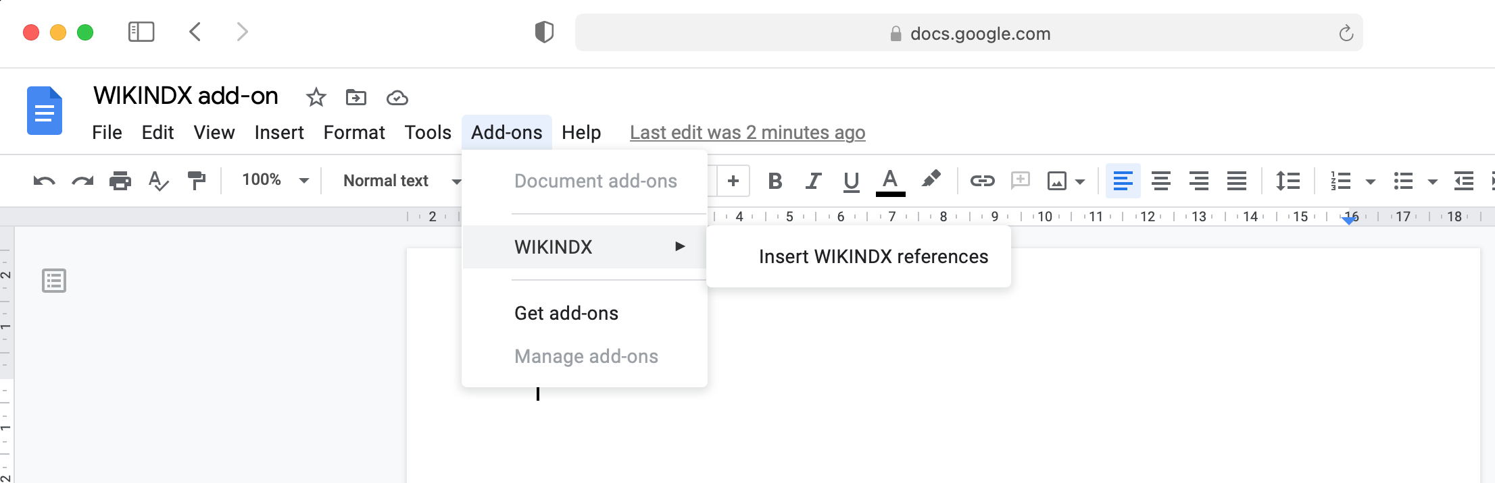
WIKINDX Google Docs Add-on
Once you have installed the add-on in Google Docs, launch it from the menu:
Notes:
Let’s begin.
Once you have selected the WIKINDX add-on in Google’s Marketplace, load it from the Add-ons menu in your Google Docs document.

Slide 6
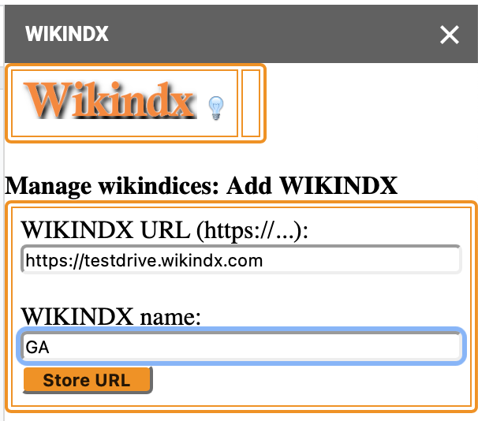
WIKINDX Google Docs Add-on
You will be asked to add a WIKINDX.
For test purposes, you can use the public WIKINDX Test Drive at: https://testdrive.wikindx.com/
Notes:
Once the add-on has loaded, you will be asked to input a WIKINDX URL.
For security reasons, the WIKINDX must be accessible through HTTPS.

Slide 7
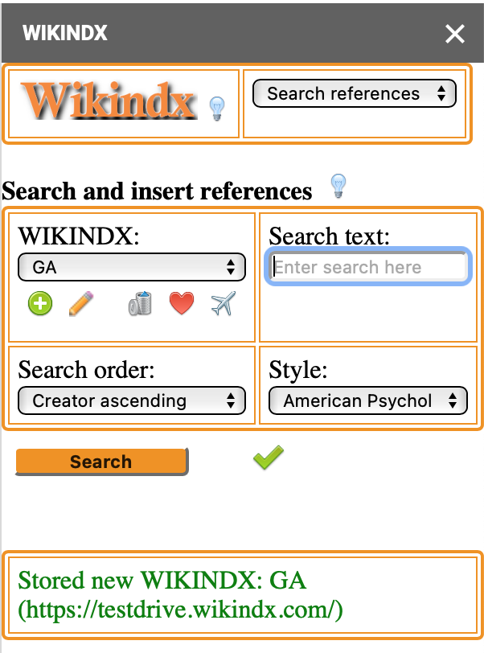
WIKINDX Google Docs Add-on
After you click on Store URL, if the WIKINDX URL is correct and compatible with the add-on, you will see:
Notes:
You can add more than one WIKINDX and the wikindices you add can be edited and deleted as you wish.

Slide 8
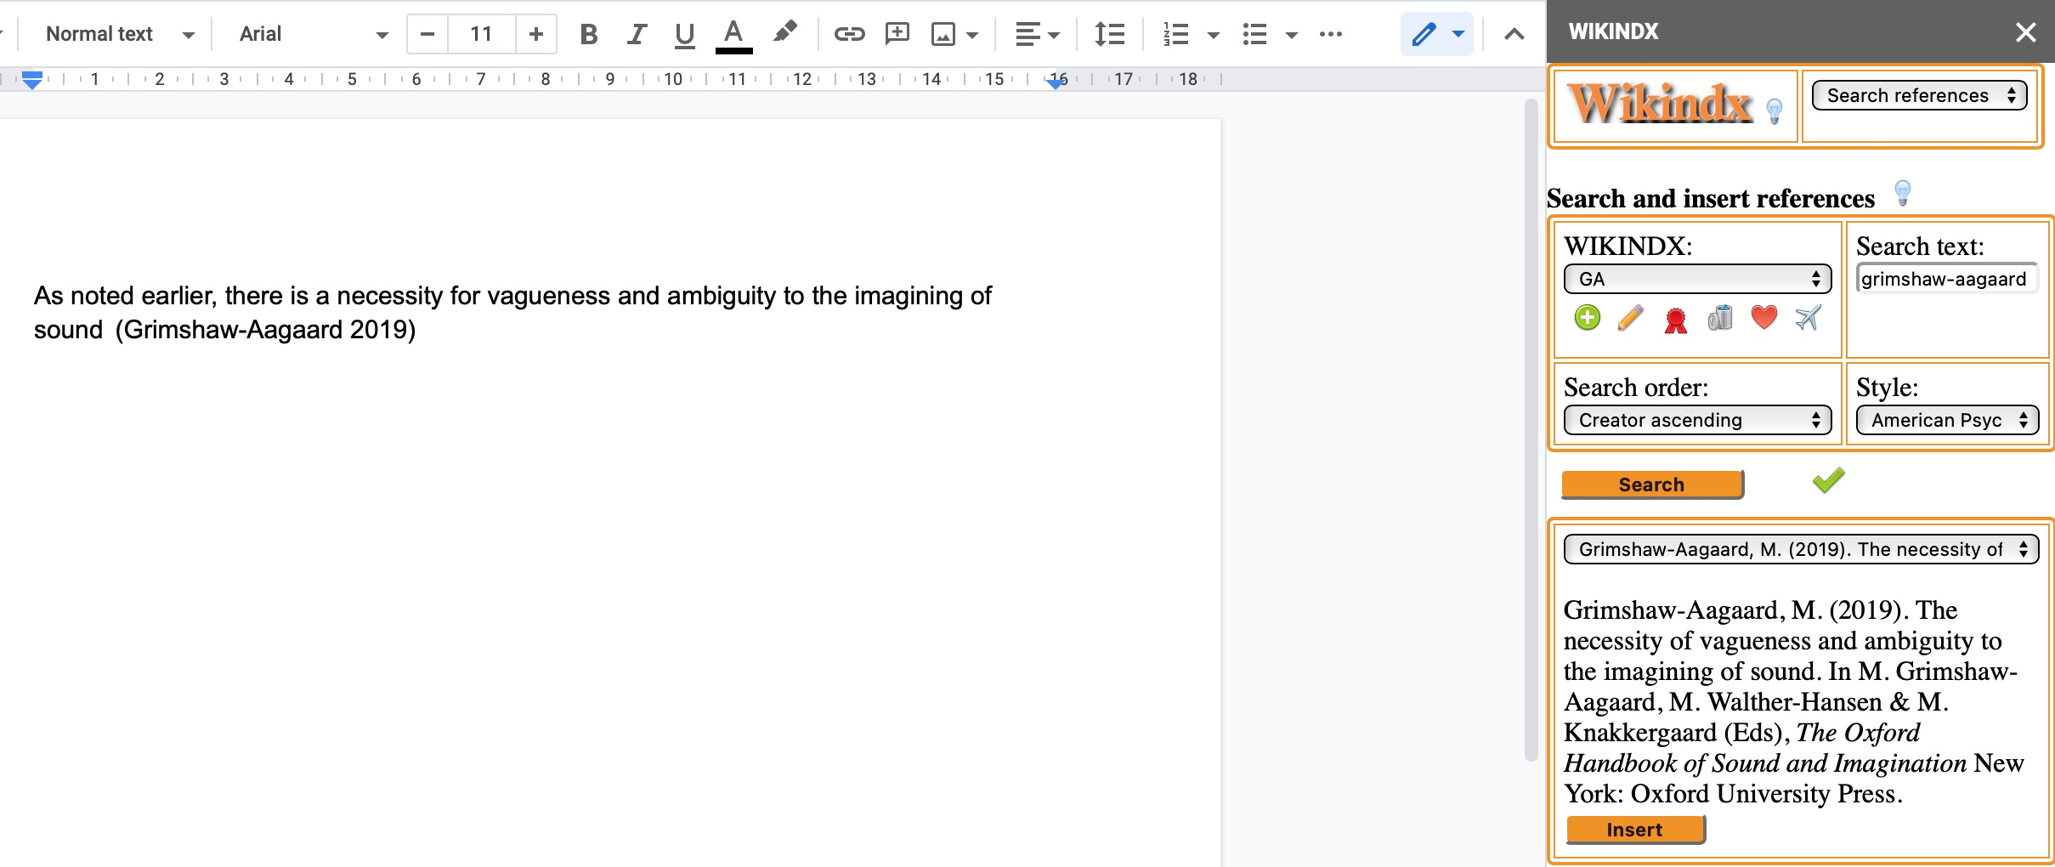
WIKINDX Google Docs Add-on
Now you can start adding references to your document.
Enter a search term
Click on Search
When the references have loaded, select the one you want and click on Insert
Notes:
To find and insert a reference into your document, enter a search term in the Search text box, click on Search, select the desired reference from the select box that is returned, then click on Insert.

Slide 9
WIKINDX Google Docs Add-on
The reference is inserted where the cursor is position in the document and is formatted to the chosen bibliographic style.
This format can be changed later.
Notes:
The reference is always inserted in the document at the cursor position and in the chosen bibliographic style.

Slide 10
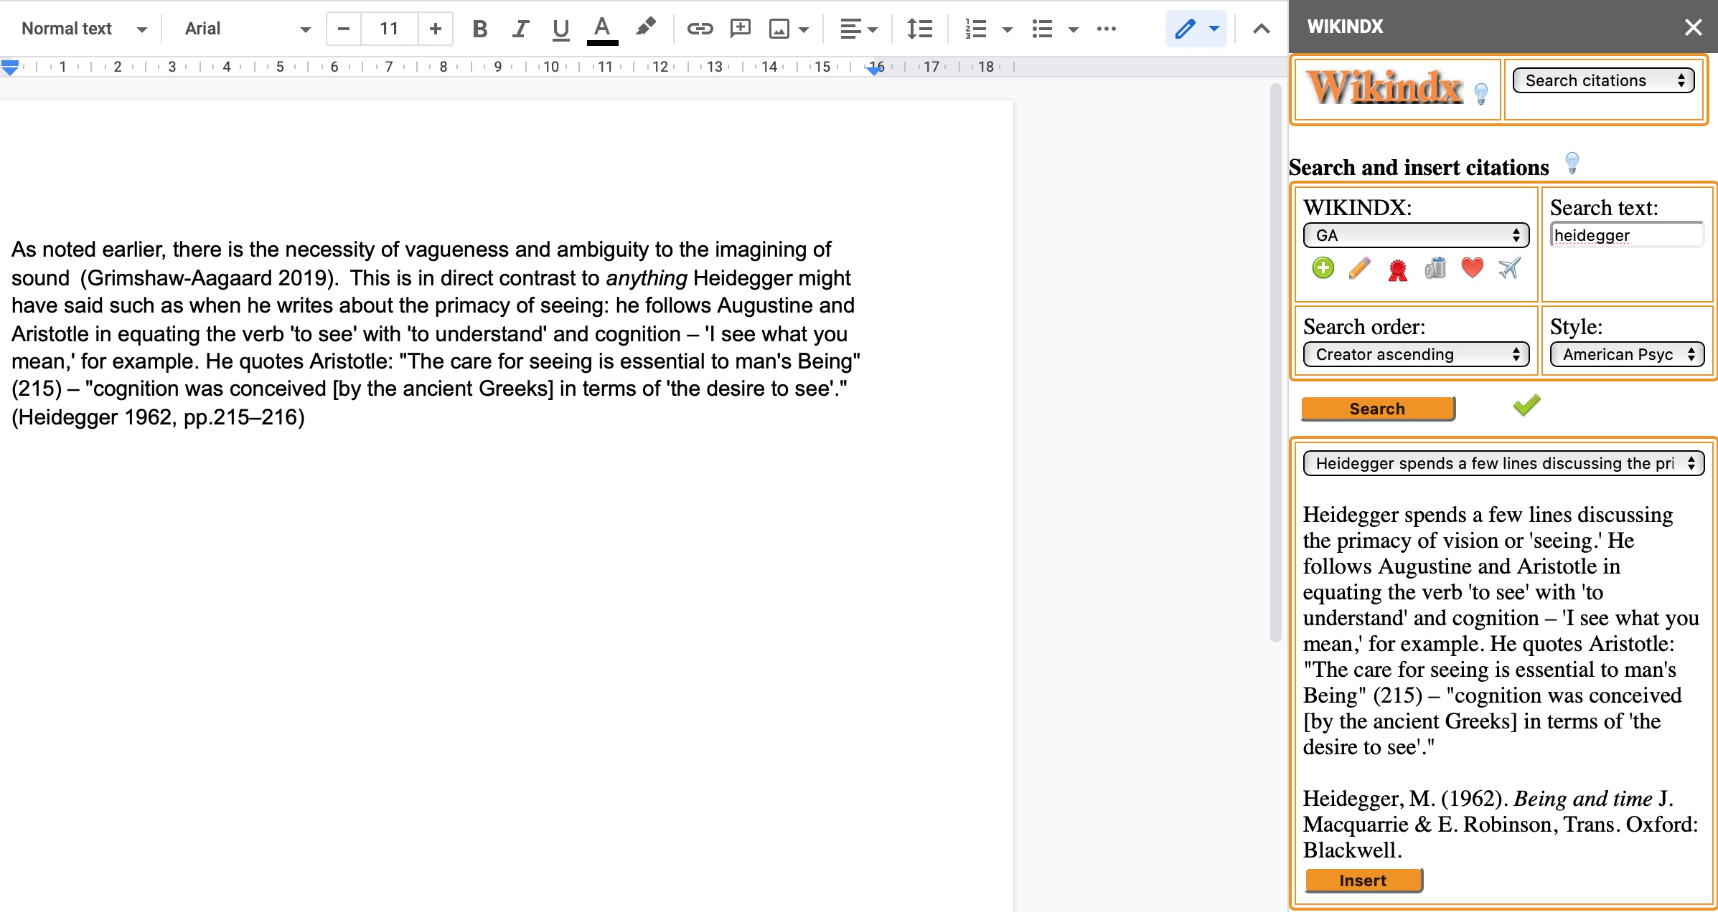
WIKINDX Google Docs Add-on
As a WIKINDX stores not only bibliographic references, but also metadata such as quotations and paraphrases, you can also insert these. Select Search citations in the top right select box.
Notes:
To search for and insert quotations and paraphrases, select Search citations in the top right select box.

Slide 11
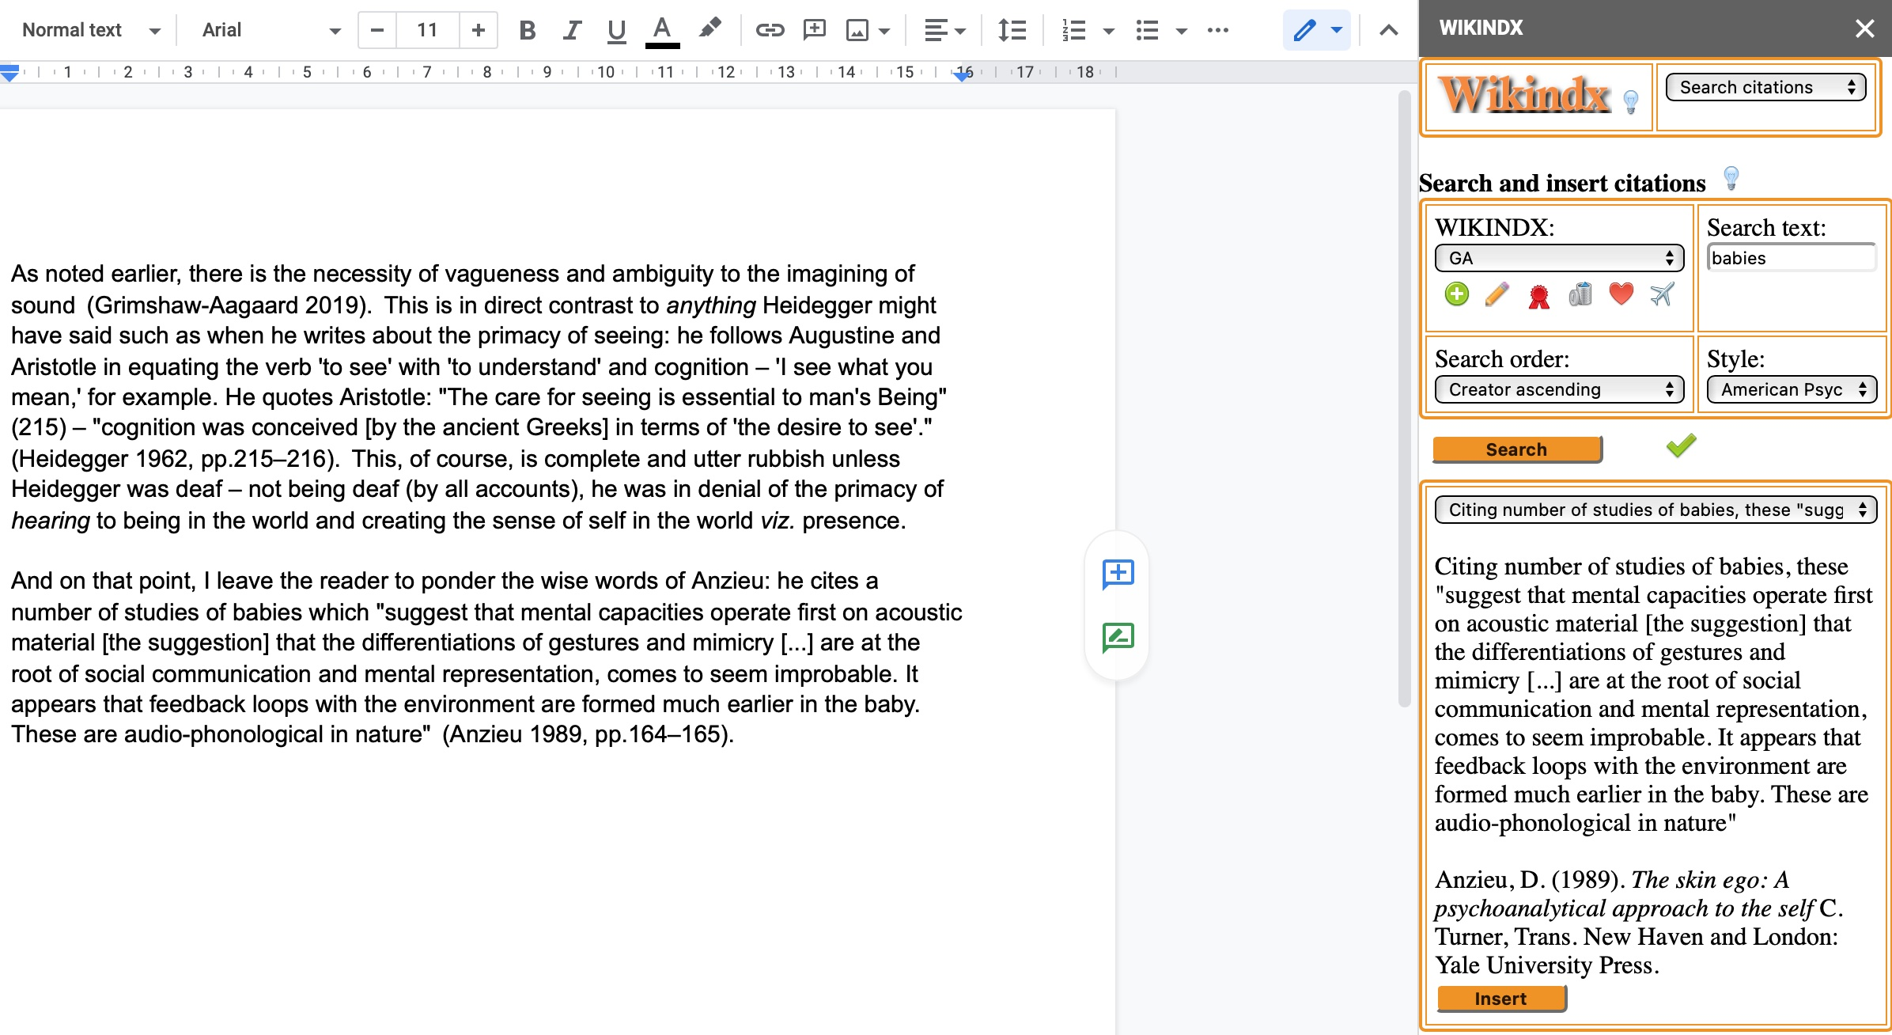
WIKINDX Google Docs Add-on
Another quotation . . .
Notes:
All the examples given here are from my personal WIKINDX. For your WIKINDX, the search terms you use will obviously be appropriate to that.

Slide 12
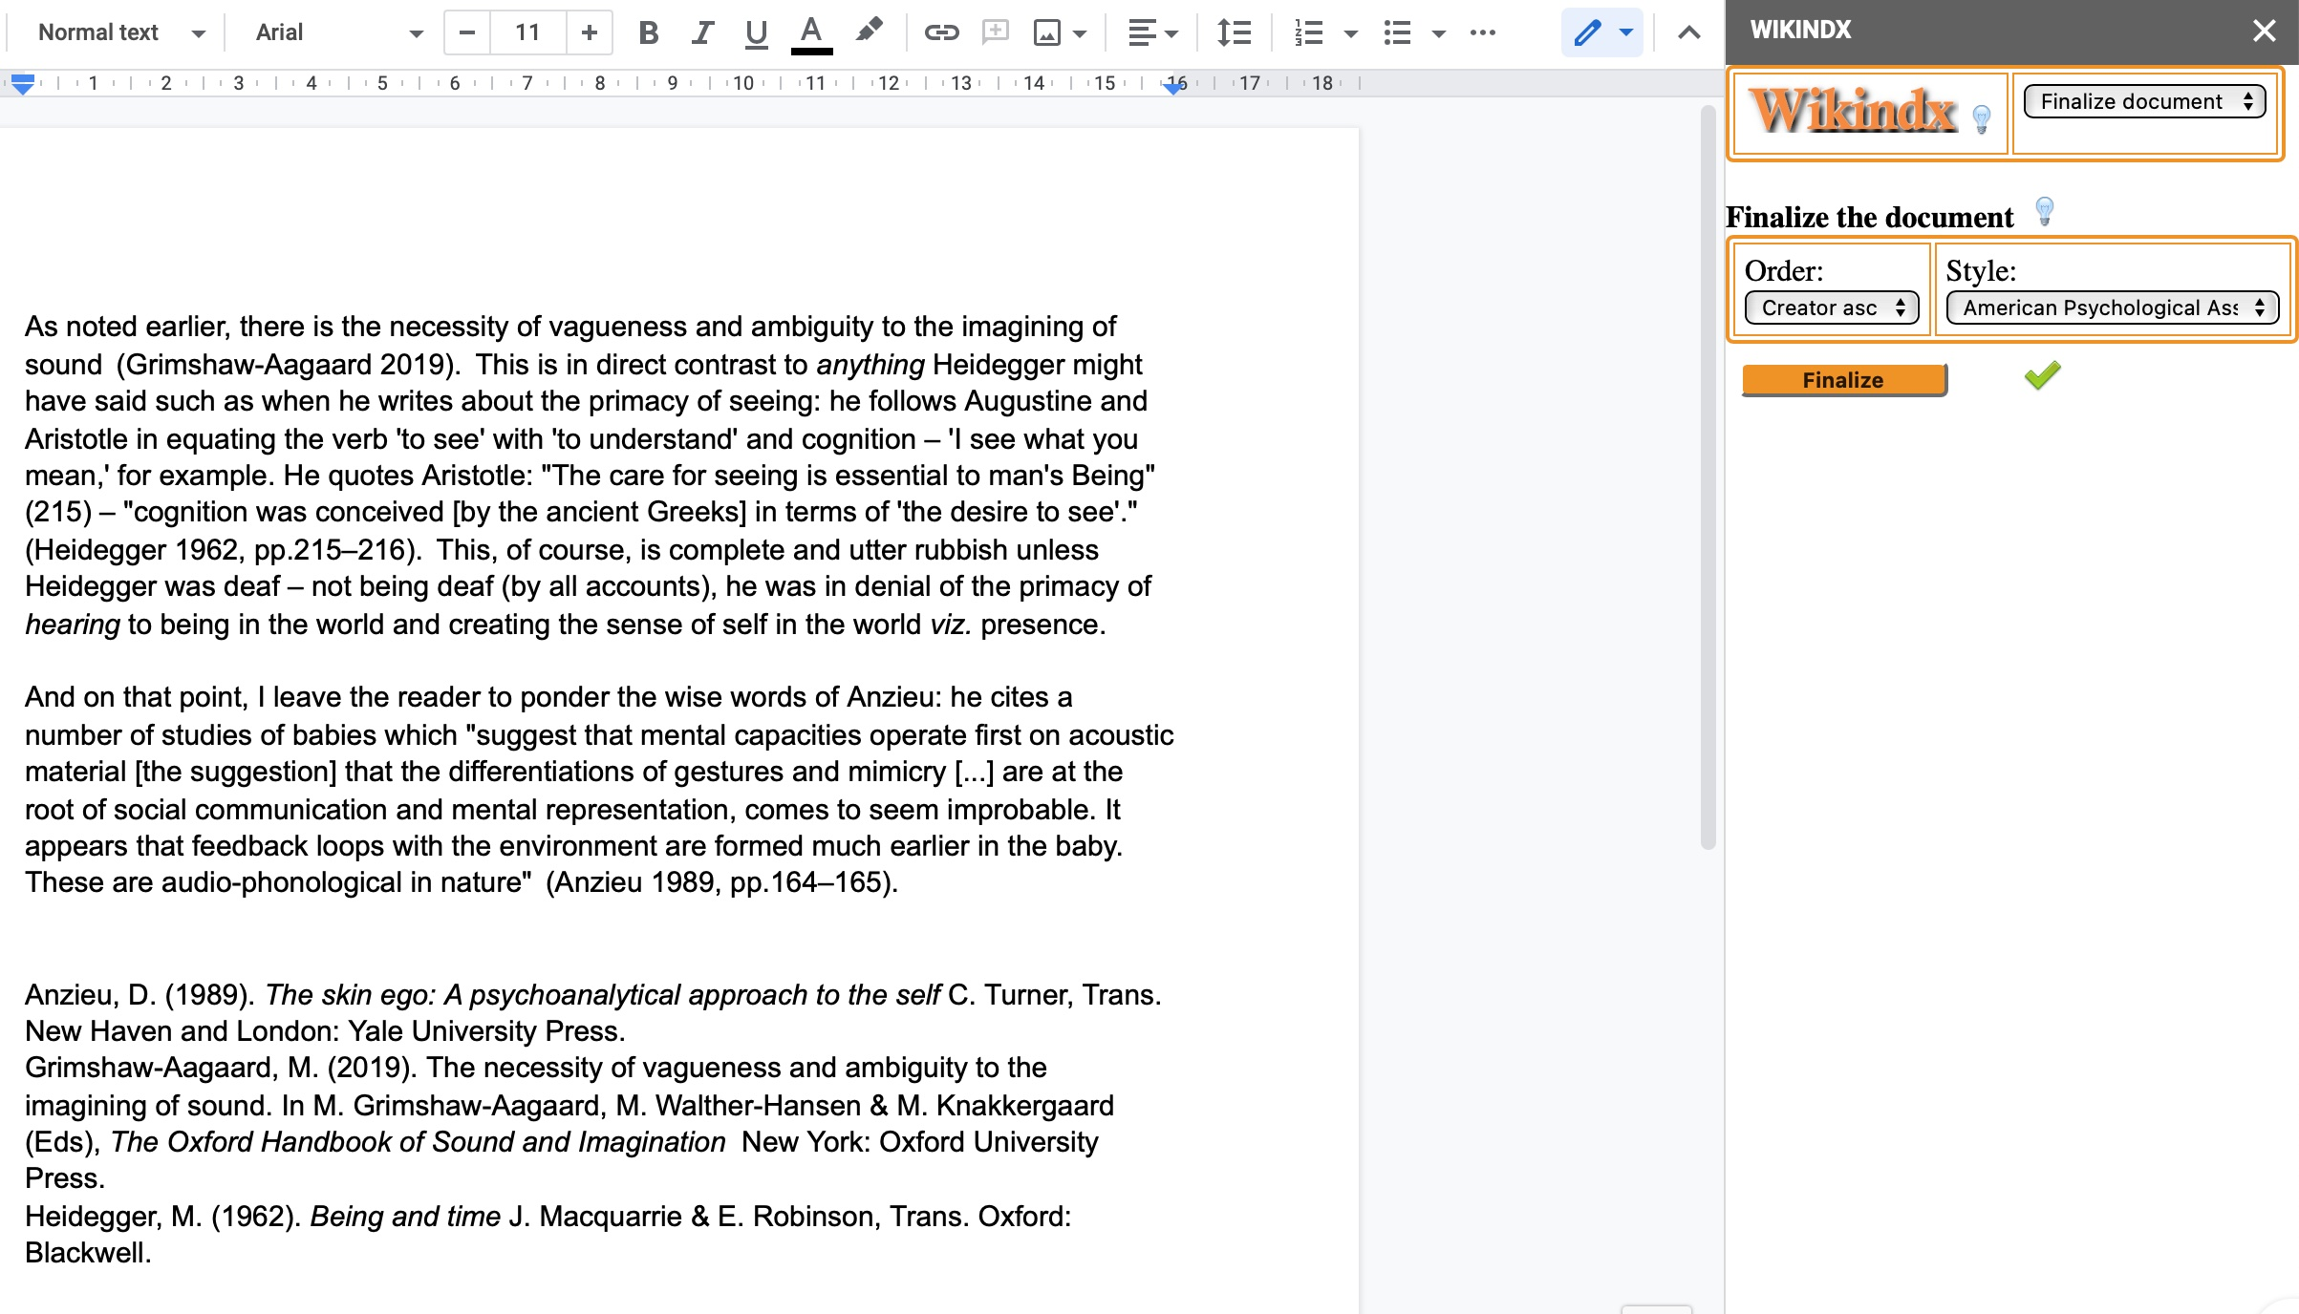
WIKINDX Google Docs Add-on
Once you have written your document and inserted all the references and citations you want, you can now ‘finalize’ the document.
Click on Finalize document in the top right select box
Select the bibliographic style and bibliography order
Click on Finalize
Notes:
Once you have completed the document, you can then finalize it.
This will format the inserted references to the chosen bibliographic style and append a bibliography ordered as you wish.
Here’s an example finalized to APA style.

Slide 13
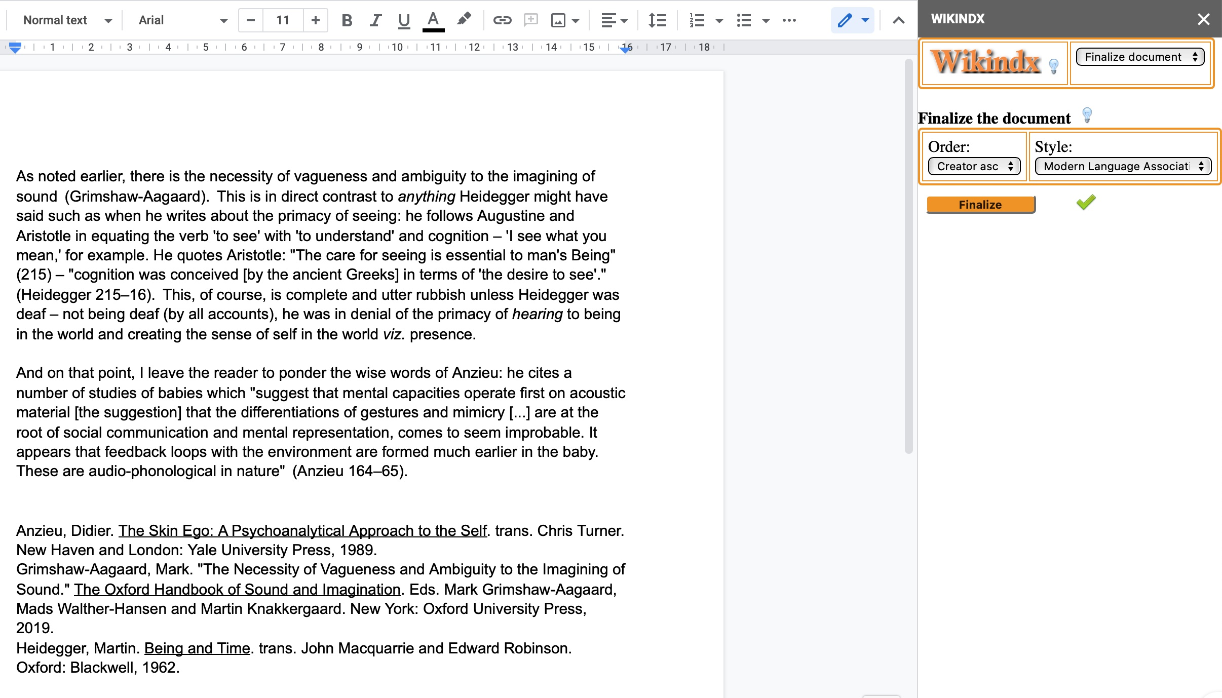
WIKINDX Google Docs Add-on
Note that a bibliography is appended when finalizing.
You can ‘finalize’ as often as you want, coming back to it after adding more metadata and references, and change the bibliographic style as you want. The previous example was APA, this one is MLA.
Notes:
You can finalize the document as often as you like, with different bibliographic styles and bibliography ordering.
Here’s the same document reformatted to MLA style.

Slide 14
WIKINDX Google Docs Add-on
Enjoy!
Mark Grimshaw-Aagaard
April 2021
Notes:
Thank you for listening. All that remains is to say: Enjoy!

