Slide 1
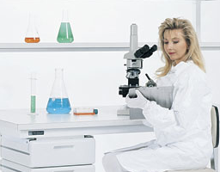
Concepts as Tools of Discovery
‘BACTERIA’
‘VIRUS’
Corinne Bloch
Department of Philosophy
Marquette University
corinne.bloch-mullins@marquette.edu

Slide 2
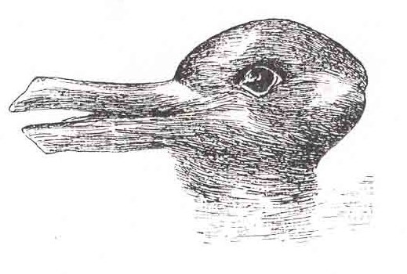
Roles of Scientific Concepts:
Integrators of empirical data:
Theories
Models
Induction
Production of empirical data:
Experimental design
Interpretation
Role mediated by theoretical baggage.
[Focus on concepts as vessels of representations, stores of information, defined at moment by the content that scientists attribute to them.]

Slide 3
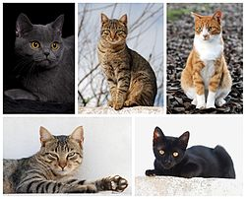
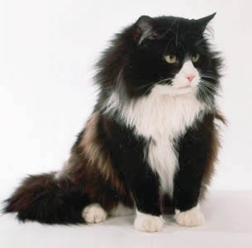

Concepts are Mental Categories:
I explore the idea that categorization itself – apart from scientists’ theoretical knowledge about the entities classified under a category – facilitates the detection of similarities (and differences) in the data.
[qualification: such a distinction is probably impossible in practice…]

Slide 4
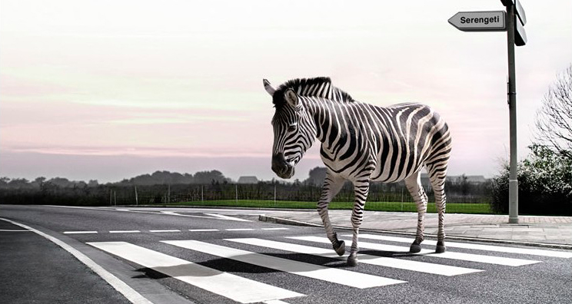
Respects of Similarity
Similarity must always be considered with respect to a particular set of properties. (Goodman, 1972)
Mom?
So… What determines the relevant respects of similarity?

Slide 5
Respects of Similarity
How are the relevant features chosen? How are they weighed?
Relevant respects of similarity are inferred from the context, or contrast classes.
(Goldstone et al., 1997; Medin et al., 1993; Tversky and Gati, 1978; Torgerson, 1965)

Slide 6
Respects of Similarity
Does categorization actually affect the ease with which some similarities and differences are detected?
Is this merely a task-specific change of weights of relevant properties?

Slide 7
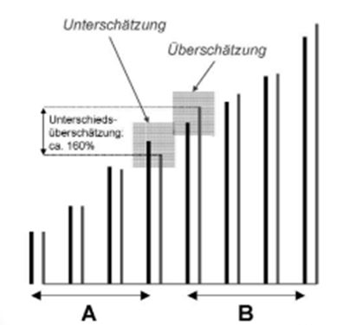
Categorical Perception :
Within a Dimension
Underestimation
Overestimation
(slide from Handschuch et al., based on Tajfel and Wilkes, 1963)

Slide 8
Categorical Perception :
Within a Dimension
Underestimation
Overestimation
(slide from Handschuch et al., based on Tajfel and Wilkes, 1963)

Slide 9
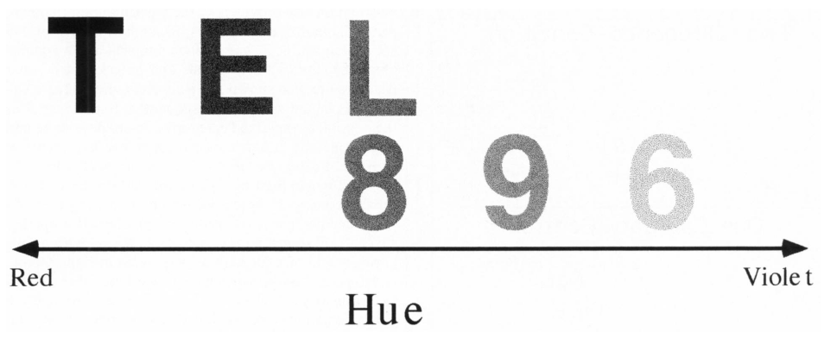
Categorical Perception :
Within a Dimension
(Goldstone, 1995)

Slide 10
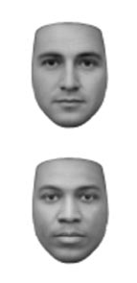
Categorical Perception :
Within a Dimension
(Levin and Banaji 2006)

Slide 11

Categorical Perception :
Between Dimensions
(Hockema, Blair and Goldstone 2005)

Slide 12
My focus here is on visual effects of categorical perception, but, importantly:
Similar phenomena are seen with non-perceptual features of a category:
Eiser 1971: degree of permissiveness toward drug use.
Krueger et al., 1989: evaluation of numerical stimuli.
Medin and Barsalou 1990
(of course, different mechanisms may be involved…)

Slide 13
Implications for Philosophy of Science?
‘BACTERIA’
‘VIRUS’

Slide 17
1884
Koch’s postulates
The Formation of the ‘Virus’ Concept
The Germ Theory:
Infectious diseases were caused by microorganisms.
Koch’s Postulates :
The specific microbe must be demonstrated in all cases of the disease
The microbe must be isolated and cultured in a pure state on an artificial medium
The pure culture must produce the disease when inoculated into healthy, susceptible animals.

Slide 18
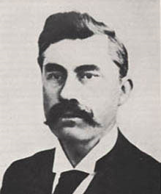
1884
Koch’s postulates
The Formation of the ‘Virus’ Concept
Martinus Beijerinck: sap from plants infected with TMD remained infectious after filtration; virus could not be isolated, observed or grown in culture.
A new, non-corpuscular, infectious agent:
contagium vivum fluidum.
1892
Ivanovski
Loeffler
& Frosch;
Beijerinck
1898

Slide 19
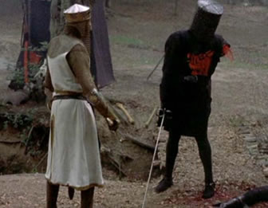
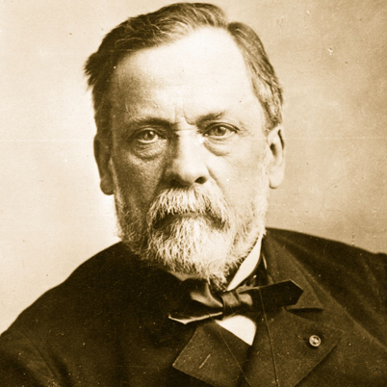
The Formation of the ‘Virus’ Concept
Beijerinck’s concept was not easily accepted.
In the following years, scientists working on various viruses were unable to isolate them, observe them, or grow them in culture. However, any assumed this was just a technical difficulty, not the result of an agent different in nature.
It’s only a flesh wound!
All infectious agents are bacteria!
(Pasteur, 1889)
From Monty Python and the Holy Grail (idea from Sandy Mitchell…)

Slide 20
1884
Koch’s postulates
The Formation of the ‘Virus’ Concept:
1892
Ivanovski: TMD
1932: Viruses are defined by “invisibility by ordinary microscopic methods, failure to be retained by filters impervious to well-known bacteria, and inability to propagate themselves in the absence of susceptible cells.” (Rivers, 1932)
Loeffler
& Frosch;
Beijerinck
1898
1957: Viruses are defined as “strictly intracellular and potentially pathogenic entities with an infectious phase, and (1) possessing only one type of nucleic acid, (2) multiplying in the form of their genetic material, (3) unable to grow and to undergo binary fission, (4) devoid of a Lipmann system.” (Lwoff, 1957)
1932
Rivers:
D1
1957
Lwoff:
D2

Slide 21
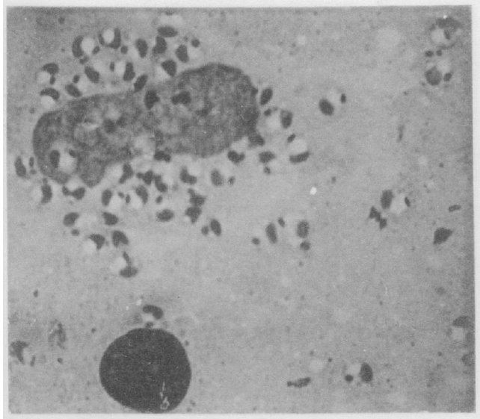
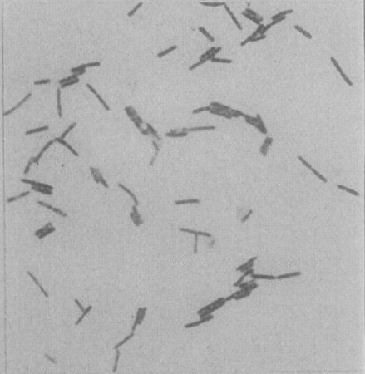
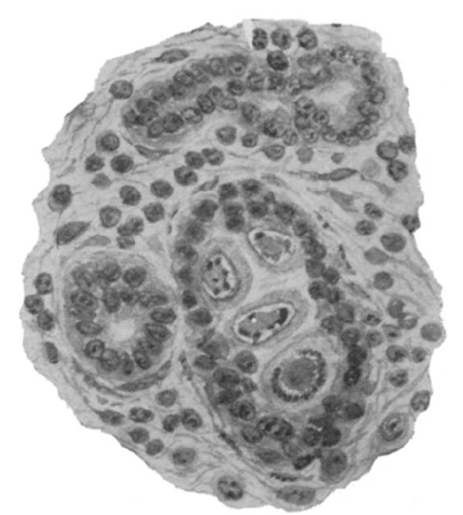
Histological Observations
Available categories for infectious agents before the virus concept: protozoa, fungi, bacteria and spirochetes
Protozoa
Bacteria
Jackson, 1920:
(from duct in the salivary gland in guinea pig)

Slide 22
Histological Observations
Protozoa
Bacteria
Jackson, 1920:
(from duct in the salivary gland in guinea pig)
Bollinger 1873;
Guarnieri 1892;
Williams and Lowden 1906;
Von Prowazec 1907;
Calkins 1910

Slide 23
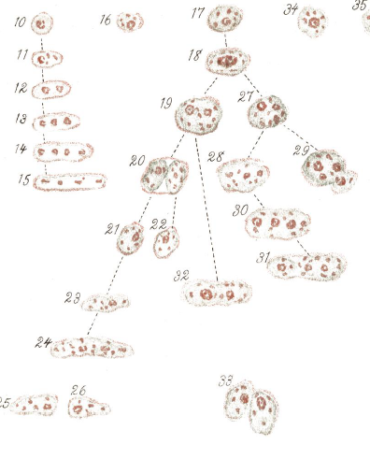
Histological Observations
Illustration of the “parasite” from Williams and Lowden (1906)

Slide 24
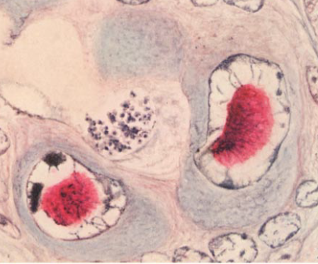
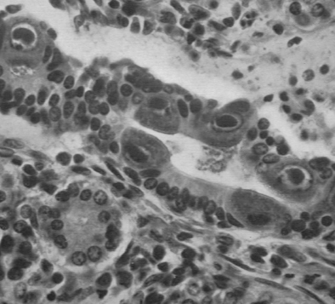
Histological Observations
Protozoa
Bacteria
Viruses – instances picked out according to the initial criteria: non-filterability, invisibility, inability to grow in lifeless media.
Jackson 1920
Cole & Kuttner 1926
Farber & Wolbach 1932

Slide 25
Histological Observations
Jackson 1920
Cole & Kuttner 1926
Farber & Wolbach 1932
After the acceptance of the new category, ‘virus’, the following general regularities in viral IB’s were discussed:
Easily stained by acid dyes;
A clear halo of non-stained area is visible around them;
Margination of the chromatin;
Differences in size and appearance in different species, while remaining constant for the same species.

Slide 26
Histological Observations
The same histological data was available before the formation of the virus concept, BUT:
Some authors did not discuss these features at all.
Others mentioned these features in individual diseases, but did not relate them to other reported diseases. In other words – these features were not viewed as regularities.

Slide 27
Additional Regularities
The same goes for non-perceptual characteristics:
Species Specificity
Examples of individual observations:
Sanarelli 1898
Rous 1911
Susceptibility of young, healthy cells
Examples of individual observations:
Beijerinck 1898
Rivers 1927

Slide 28
“OLD” DIVISION:
Infectious Diseases
Taken to be caused by a living (cellular, reproducing) agent.
Non-infectious Diseases
Caused by non-living entities
tobacco-mosaic disease
smallpox
diphtheria
pleuropneumonia
foot-and-mouth disease
anthrax
Avian cholera
rabies

Slide 29
Infectious Diseases
caused by virus
caused by a minute organism
tobacco-mosaic disease
smallpox
diphtheria
pleuropneumonia
foot-and-mouth disease
anthrax
Avian cholera
rabies

Slide 30
Concepts as Tools of Discovery
The roles of concepts in the detection of regularities
Concepts as TOOLS of discovery
Concepts as tools of DISCOVERY
‘BACTERIA’
‘VIRUS’

