Slide 1

Bayesian cognitive science,
inference to the best explanatory framework, and the value of specialization
(Joint work with Rogier de Langhe – UGhent)
Matteo Colombo
Tilburg Center for Logic, General Ethics, and Philosophy of Science
Cognitive Science of Science:
Kazimierz Naturalist Workshop
19 August 2014

Slide 2
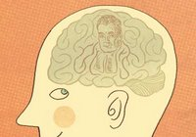
One widely-held assumption in current cog sci
If you are interested in explaining cognitive phenomena whose production involves uncertainty, then you should go Bayesian!

Slide 3
My Talk in a Q and two As
Q. Is this assumption justified?
A1: No, if an argument from uncertainty is used to support it.
A2: Yes, if an argument from specialization is used to support it.

Slide 4
Plan for the day
The argument from uncertainty.
A very quick tour through the zoo of approaches to uncertainty.
The argument from specialization.

Slide 5
The argument from uncertainty
What does it seek to establish?
BDT should be privileged as the framework for explaining many cognitive phenomena whose production requires cognitive systems to handle uncertainty.
Why?
Because BDT is the best framework for representing and dealing effectively with uncertainty.

Slide 6
Two steps
Cognitive systems must deal with uncertainty.
Many cognitive, perceptual and motor phenomena should be explained within the Bayesian framework.

Slide 7
Step 1
P.1 Cognitive systems interact adaptively with the world.
P.2 If a cognitive system interacts adaptively with the world, then it must deal with uncertainty.
C. Cognitive systems must deal with uncertainty.

Slide 8
What does ‘uncertainty’ mean here?
It means that a cognitive system facing some task lacks relevant information.
Two main sources of uncertainty
- Noise
- Underdetermination

Slide 9
Underdetermination
For any input to our cognitive system, there are multiple states in the world that can fit the input.
If the same sensory input can be fit equally well by many different states in the world,
Then processing the sensory input alone is not sufficient to determine which state in the world caused it.
Hence,
sensory inputs underdetermine their environmental causes.

Slide 10
Noise
Noise amounts to data that are not part of a signal.
Permeates every level of neural processing.
It can have detrimental consequences.
> It makes perception, action and judgement very much variable.

Slide 11
The two-step argument from uncertainty
Cognitive systems must deal with uncertainty.
Many cognitive, perceptual and motor phenomena should be explained within the Bayesian framework.

Slide 12
Step 2
Given feature F, which is essentially involved in the production of explananda P1,…, Pn,
and given candidate explanatory frameworks X1,…, Xn for explaining P1,…, Pn,
Infer the explanatory superiority with respect to P1,…, Pn of that Xi, which is best for treating F.
Hence, framework Xi should be chosen over alternatives for treating F.

Slide 13
F is the uncertainty that a cognitive system must handle when it produces cognitive phenomena P1,…, Pn.

Slide 14
F is essentially involved in the production of explananda P1,…, Pn,
because, as a matter of fact, unless the system deals with uncertainty, P1,…, Pn cannot be produced.

Slide 15
The explanatory framework Xi is the best for treating uncertainty, viz.:
It provides us with the best way to represent uncertainty and make inferences under uncertainty.
It is more parsimonious.
It is more unifying.
It is rigorous and quantitative.
It is more rational.

Slide 16
Leveraging all these features,
Cognitive scientists’ choice would rest justified to accept the Bayesian framework as the “most effective,” “congenial” or “natural” framework to study systems that must handle uncertainty.

Slide 17
By adopting BDT, we can best explain how the human cognitive system can make successful inferences under uncertainty so as to solve the problem of underdetermination and handle the effects of noise.
Basic Strategy:
Rely on prior probabilistic knowledge about expected inputs and update it in the light of incoming data.
> The system can:
- estimate the most probable cause of incoming data.
- give more weight to more reliable (less noisy) signals.

Slide 18
Summing up
* Cognitive systems need to deal with uncertainty.
* The Bayesian framework is the best to explain how cognitive systems deal with uncertainty.
* Cognitive scientists should go Bayesian.

Slide 19
Trafficking with Uncertainty.
A zoo of approaches
If some alternative, overlooked explanatory framework is currently available,
then it cannot be claimed that cognitive systems and the uncertainty-involving phenomena they produce are best explained within the Bayesian framework.
The argument from uncertainty alone does not justify cog scientists’ choice to work within the Bayesian framework.

Slide 20
There are several alternative approaches to represent and deal with uncertainty.
Dempster-Shafer theory (Dempster 1968)
Possibility theory (Dubois and Prade 2007)
Ranking theory (Spohn 2012)
Quantum probability theory (Pothos and Busemeyer 2013)
* The argument from uncertainty provides little support for cognitive scientists’ choice to work within the Bayesian framework.

Slide 21
An argument from specialization for Bayesian cognitive science
Not obvious that BDT enjoys special epistemic virtues.
Yet:
Currently, BDT is much more popular than alternatives.
> Some sociological factors may have led more and more cog scientists to approach research questions within the Bayesian framework, while neglecting some of the alternative frameworks.

Slide 22
As more and more cognitive scientists go Bayesian…
> Common language to frame problems.
> Division of cognitive labour takes place in the field.
> More sophisticated tools are developed.
> Successful coordination on a joint standard.

Slide 23
As more and more cognitive scientists go Bayesian…
Successful coordination on a joint standard means that scientists can spend less time reflecting on the foundations of the framework itself.
More time to actually use the framework to solve problems.
> Scientists have an incentive to play exploitation.

Slide 24
BUT
Less time spent on critical evaluation of the current framework and the formulation and exploration of novel frameworks with potentially superior intrinsic epistemic values entails:
- reduced ability to adapt to newly gathered knowledge,
- higher probability of lock-in to a suboptimal standard .
> Scientists have an incentive to play exploration.

Slide 25
The value of explanatory frameworks:
> The value of BDT does not lie only in its intrinsic virtues.
> Its value depends also on its power to facilitate social coordination and division of cognitive labour in science.

Slide 26
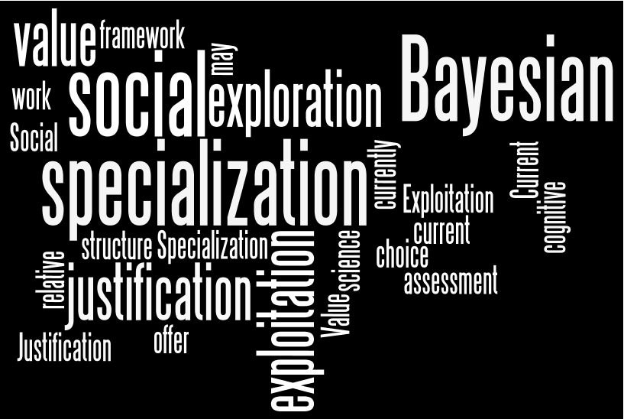
>> An assessment of the relative value of specialization within the social structure of current cognitive science may offer more justification for the choice to go Bayesian.

Slide 27
An AGM model of distribution of cognitive labour in science.
Two morals (cf. de Langhe 2014)
The monopoly of a single framework is preferable over pluralism in situations where the intrinsic value of different frameworks is comparable or unknown.

Slide 28
An AGM model of distribution of cognitive labour in science.
Two morals
2) A fixed exploration ratio of around 30% is superior to other fixed ratios,
but outperformed by a dynamic ratio by which exploration of new frameworks increases with the number of contributions to the monopolistic framework so that that framework is gradually depleted.

Slide 29
Conclusions
Is cog scientists’ choice to go Bayesian justified?
No.
The argument from uncertainty.
Under-considered alternatives.
Yes.
The exploration/exploitation dilemma.
The value of specialization.

Slide 30

m.colombo@uvt.nl
http://mteocolphi.wordpress.com/

Slide 31

Appendix (de Langhe 2014)
The utility of the next contribution to the framework j:
Tjt = total number of contributions to j at time t;
Cjt = current number of adopters of j at t;
s measures the benefits of specialization - “interconnectedness”;
The probability that an agent makes a contribution to a framework j at the next turn is directly proportional to the utility of j.

Slide 32
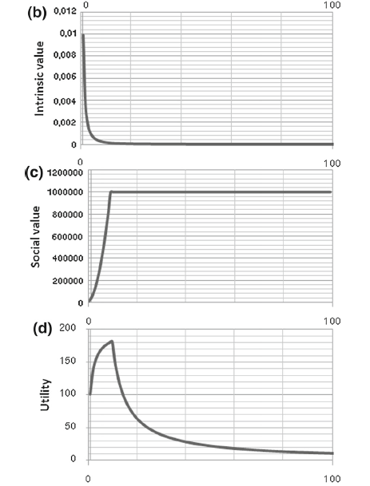

Slide 33
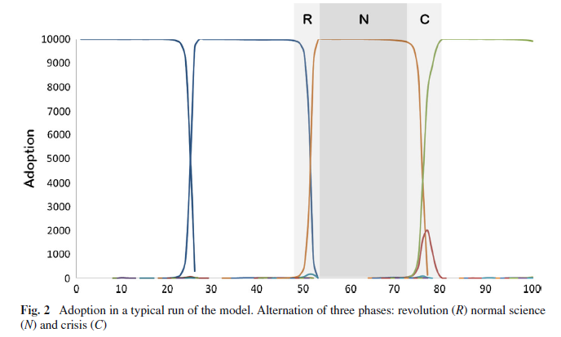
Three Kuhnian phases

Slide 34
